Slide 1
INTEGRATION OF AREAS
BUILDING & MECHANICAL ENGINEERING DRAWING
Module 1 Unit 1
Rawle Russell

Slide 2
Objectives
At the end of this session students will be able to:
Generally
determine the centroid of a plane figure by integration of areas.
Specifically:
construct two derived figures from a given figure;
find graphically the area of a plane figure;
apply simple calculations to find the centroid, 1st Moment of Area about XX, and 2nd Moment of Area about the centroid;

Slide 3
OBJECTIVES
For the purpose of this lesson, we will look specifically at specific objective 1:
Construct two derived figures from a given figure

Slide 4
APPLICATION OF TOPIC
This topic is useful when finding the centre of mass of a geometric object, these objects can be 2 & 3 – Dimensional.
The center of mass is a point at which all the mass of the object may be theoretically considered to be concentrated for design purposes.
In addition, it is used to properly balance a structure or retaining wall.

Slide 5
PREREQUISTE KNOWLEDGE
Ability to setup the CAD environment: Units, Limits, Layers, Leader line, Dimension Style, Point Size, Object Snap mode.
Ability to manipulate the draw toolbar.
Ability to manipulate the modify toolbar.
Knowledge of finding the area of basic shapes: Square, Rectangle, Circle, Segment, Sector, Trapezium.
Ability to find the centroid of plane figure.
Understand the Laws of Exponential.

Slide 6
OVERVIEW
To determine the centroid by integration of areas the following must be done:
Drawing the given figure;
Creating a 1st derived & 2nd derived shape;
Finding the areas of the original, 1st & 2nd derived shapes;
Applying three formulae –
Centroid
1st Moment of Area
2nd Moment of Area

Slide 7
Step 1: Construct the plane figure
Use the following measurements and construct the given figure.

Slide 8
Step 2:
Creating the 1st Derived Shape
Draw a horizontal axis at the base of the shape to represent the X-X Axis.
Note: it is very common to use the XX Axis to find the centroid of a plane figure when using the integration of area method.

Slide 9
Step 3: Creating the 1st Derived Shape
Divide the shape into a number of parts (equal or unequal).
The division lines will be drawn parallel to the X-X axis.
NOTE:
It is recommended that wherever the shape changes direction a division line should be drawn through that point. portion in the shape.

Slide 10
Step 3: Creating the 1st Derived Shape
Please note, this is for a greater level of accuracy when constructing the derived shapes and finding the areas of the three shapes.
Note well, the lower portion in the shape has a different spacing than the upper

Slide 11
Step 4: Creating the 1st Derived Shape
In this step we are going to create the 1st derived shape.
Choose a point on the base of the shape at (a).
Point ‘a’ could be anywhere along the base and is called the pole.
Note: The midpoint is commonly used.
Secondly, identify where the division lines intersect the shape (b, c, d, & e).
See the diagram on the next slide.

Slide 12
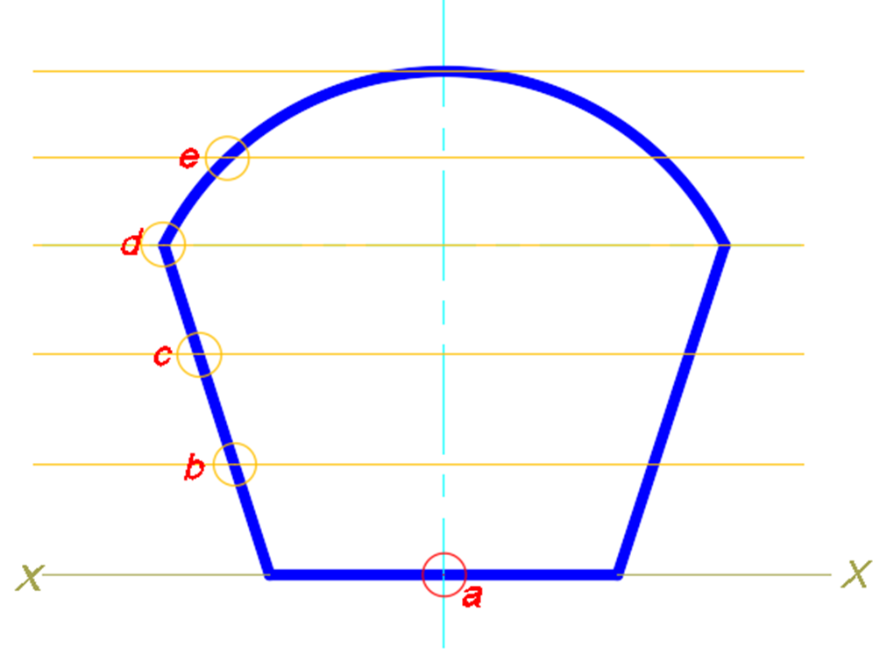

Slide 13
Step 5: Creating the 1st Derived Shape
This step requires a series of vertical and angled lines. The procedure is as follows:
A line is drawn from point ‘b’ vertically and perpendicular to the highest parallel.
Then another line is drawn from that point to the pole ‘a’.
The first point for the 1st derived figure is establish when the line drawn from the highest parallel to point ‘a’ intersects the first division line at ‘b’.

Slide 14
Step 6: Creating the 1st Derived Shape
This step follows the previous step, this time starting at point ‘c’ and going through the same procedure.
For instance:
A line is drawn from point ‘c’ vertically to the pole ‘a’, establish a point on the second division line.
Follow this same procedure for points ‘d’ and ‘e’.

Slide 15
Step 7: Creating the 1st Derived Shape
Follow the same procedure as Step 5 from points ‘d’ and ‘e’.

Slide 16
Step 8: Creating the 1st Derived Shape
Connect the points using the spline command to form half of the derived shape.

Slide 17
Step 9:
1st Derived Shape
Original Shape
1st Derived Shape
Mirror the curve to show the actual size of the 1st derived shape.

Slide 18
1st Derived Shape
This is what the 1st Derived Shape will look like.

Slide 19
Step 10: Creating the 2nd Derived Shape
To draw the 2nd derived shape you have to work with the 1st derived shape, therefore, copy the 1st derived shape with the same division lines as shown.

Slide 20
Step 11: Creating the 2nd Derived Shape
The same steps used to create the 1st derived shape will be used to draw the 2nd derived shape.
Note: The 1st derived shape will be used.
The previous slide asked us to copy the 1st derived shape with the division lines.
Number the division lines where they intersect the shape, such as, ‘f’, ‘g’, ‘h’ & ‘j’.

Slide 21
Step 12: Creating the 2nd Derived Shape
Follow the same procedures as of Step 5.
For example:
Draw a line from ‘f’ vertically upwards and perpendicular to the top parallel line, then down to the pole at ‘a’.
At the intersection of the corresponding division line is the first point (green) for the second derived shape.

Slide 22
Step 13: Creating the 2nd Derived Shape
Follow the same procedures for points ‘g’, ‘h’ & ‘j’ to obtain the other points for the 2nd derived curve.
Points ‘h’ & ‘j’ are obtained in the figure below.

Slide 23
Step 14: Creating the 2nd Derived Shape
.
Connect the points using the spline command to form half of the 2nd derived shape.

Slide 24
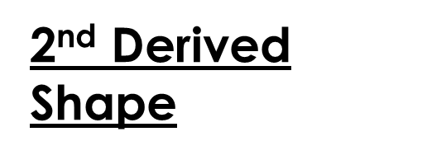
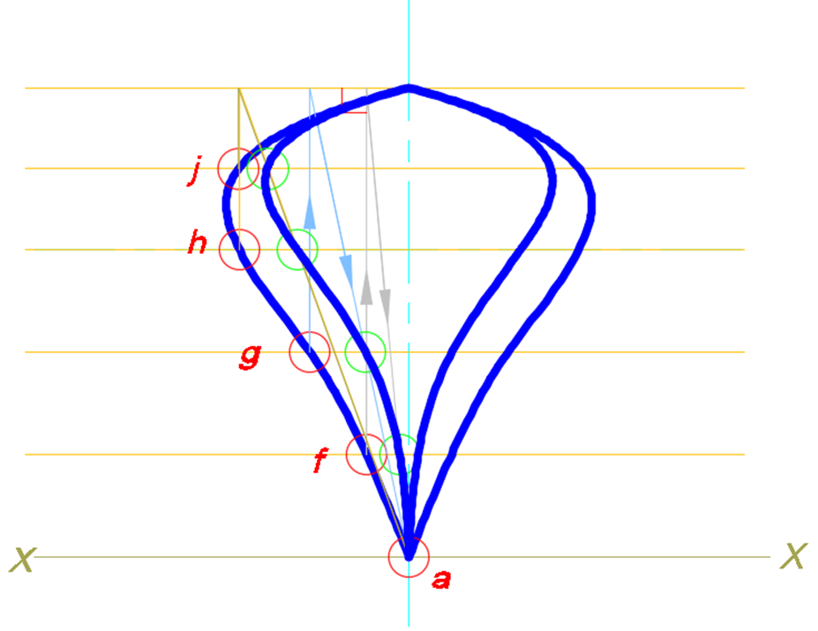
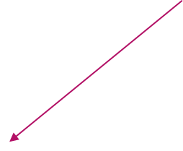
Mirror the curve to show the actual size of the 2nd derived shape

Slide 25
2nd Derived Shape
This is what the 2nd
Derived Shape will look like.

Slide 26
Original Shape
1st Derived Shape
2nd Derived Shape

Slide 27
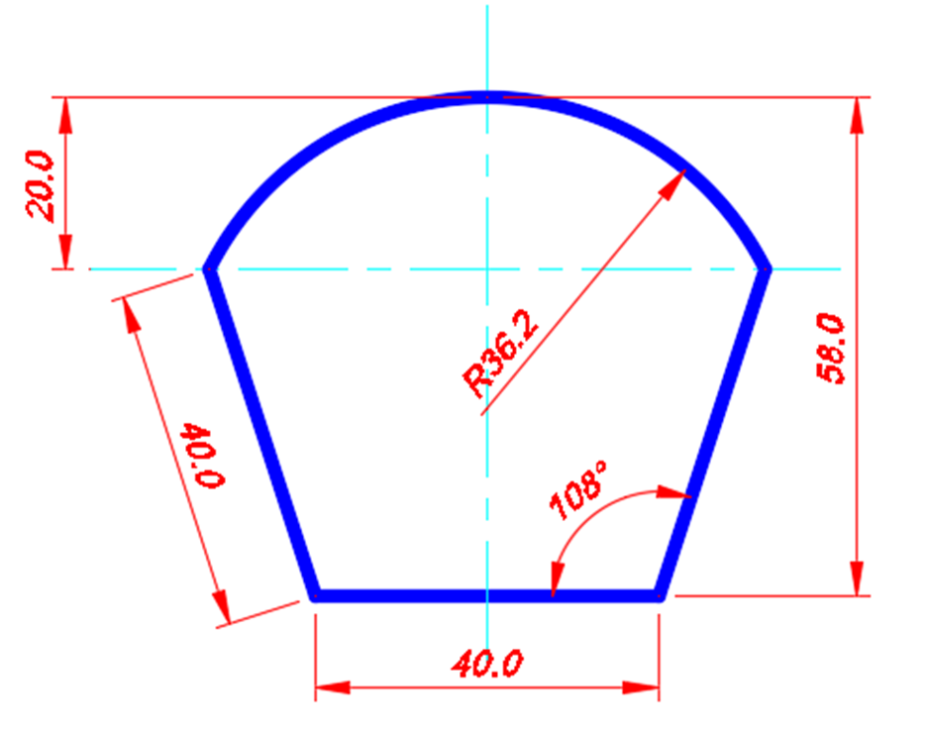
ASSIGNMENT
Reproduce the given figure using the dimensions given. You are required to Follow the instructions in the lesson to produce the:
1st derived figure
2nd derived figure

Slide 28
SOLUTION
Your solutions for the 1st derived and 2nd derived figures should look like those produced on Slides:
26 & 27
Did you get that??

