Slide 1
Characterization
Subject: VAPA Drama
Level: Form FOUR

Slide 2
Welcome to Theatre Arts Class!
As part of Theatre Arts class, you will definitely be acting and portraying various characters. This lesson will explore the process of building characters.
Firstly, think about an answer to the following:
Who is your favourite character from a movie?
What makes the character memorable?

Slide 3
Characterization
The act of changing voice, body language, movement, gesture etc when in role is called characterization. (BBC Bitesize Drama)
This process is designed to help actors build believable characters.
Let us hear more about this process. Click below:
Defining Characterization

Slide 4
How do you usually build your characters?
Research?
From experience?
Observation?
Be yourself?
With help from the Director?
Analyzing the script?
These are all excellent approaches. There is one strategy in particular that may make the process simpler in the future.
It was designed by a Russian Theatre Director Konstantin Stanislavski.
More about Stanislavski
Let us examine the steps now.

Slide 5
Question Guide for Brainstorming Use these when approaching Characterization.
Who Am I?
Where Am I?
When Is It?
What Do I Want?
Why Do I Want It?
How Will I Get It?
What Do I Need To Overcome?

Slide 6
WHO am I?
Who refers to the character that you are playing.
Always ask yourself WHO AM I?
Age?
Physical appearance?
Preferences?
Beliefs?
The answers to these questions will continue to grow as the play develops.

Slide 7
Where am I?
What time is it?
How does your character feel about where they are?
Do they behave differently in one place than the other?
When does this play take play and how does the character’s action change?
Examine the :
-time of day
-historical period
-day of the week (weekend activities differ)
-time of year (Carnival or Lent?)

Slide 8
What do I want?
Why do I want it?
What does your character want?
Your character must be working towards this objective throughout the play; this is where the drama unfolds as we see whether he/she will be successful or not.
Is there a convincing reason for why my character wants what he/she does?
Is this a reason that is feasible?
What are your character’s real motivations?

Slide 9
What must I overcome?
How will I get what I want?
How will I achieve my objective?
What am I willing to do? How do I keep working to achieve my objective?
What is standing in my way? Is it a person, society, a natural force?

Slide 10
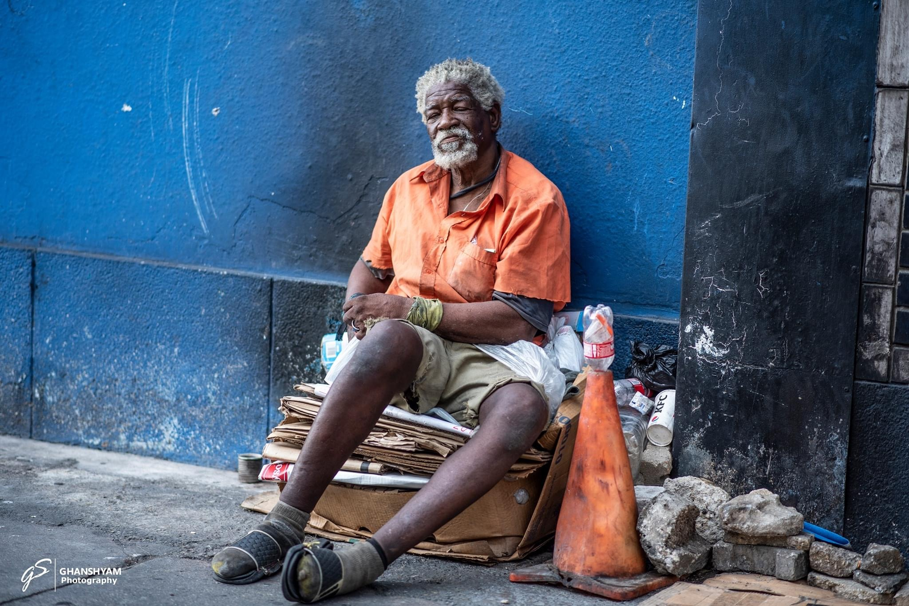
Assignment
Analyze the picture to the left.
Make some general notes in your Journal:
immediate thoughts and feelings when you saw the picture.
There is no right or wrong response.
Photo by Ghanshyam Photography

Slide 11
Now, answer the questions below in FIRST Person, as if you are the character in the picture.
Who Am I?
Where Am I?
When Is It?
What Do I Want?
Why Do I Want It?
How Will I Get It?
What Do I Need To Overcome?

Slide 12
These questions will now assist you with all of your practical examinations and with every character you may portray in the future.
Keep Working
END OF LESSON

