Slide 1
Marking out/Laying out
Click on this symbol below to advance the slide where ever shown.
Barataria North Secondary A Jaikeransingh

Slide 2
Laying or [Marking ] out is the process of drawing lines, circles, arcs , points and angles on a piece of metal in order to know where to cut, join and shape the metal.
Laying out helps to determine how accurate the job turns out to be.
Click anywhere to start

Slide 3
Common components of laying out include
Horizontal lines
Vertical lines
Centre lines
Circles
Arcs or Radii
Click anywhere to start
Tangential lines
Angles
Dot punch
Centre Punch

Slide 4
Lets review the common components of laying out include: Click to reveal the name of the component
Horizontal line
Vertical line
Centre lines
Circle
Arc or Radius
Click anywhere to start
Tangential lines
Angle
Dot punches
Centre Punch

Slide 5
The next three (3) slides are used to develop your skills in identifying the components of a marked out diagram.
Instructions: Try to identify the component labelled by given letter. To verify your answer click on the letter to reveal the name of the component . Try to follow the exercise alphabetically

Slide 6
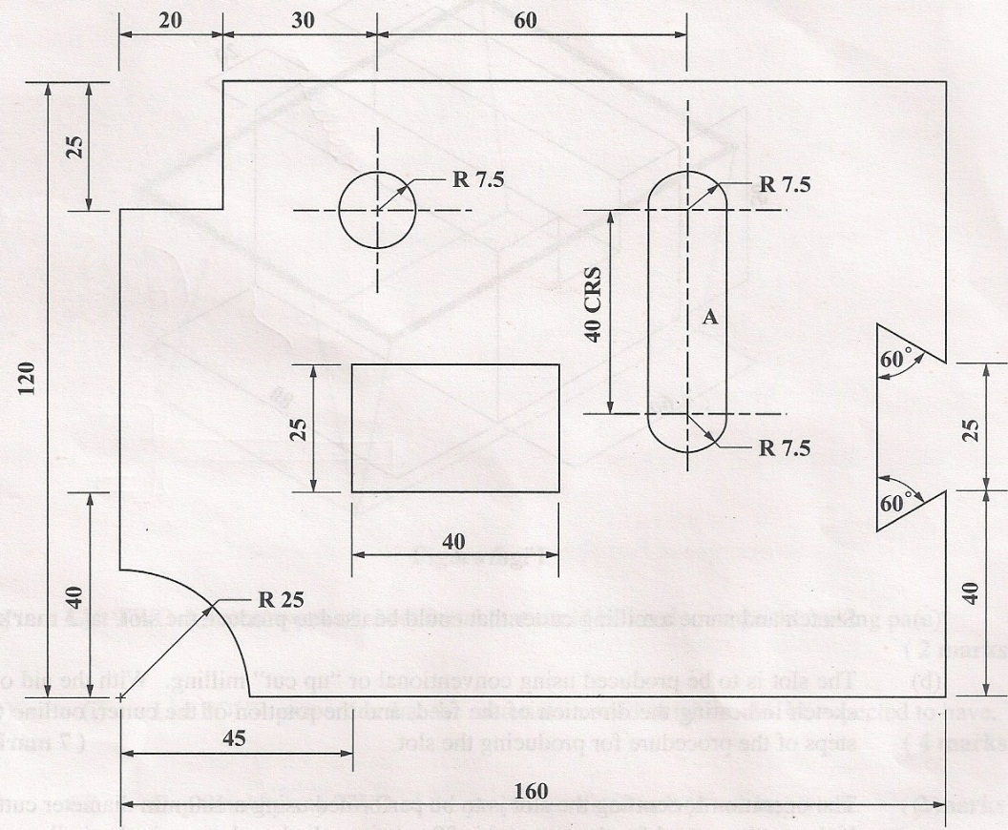
Identify the components of laying out labelled by the letters B, C, D, E, F , G and H
B
Horizontal line
C
Circle
D
Tangential Line
H
Vertical line
E
Centre Line
F
G
Angle
Arc

Slide 7
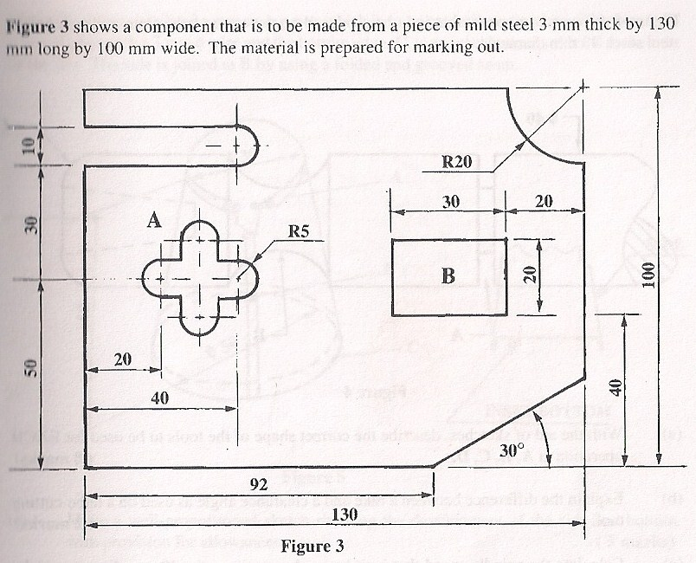
Identify the components of laying out labelled by the letters A, B, C, D and E.
A
Arc
B
Horizontal line
C
Vertical Line
D
Angle
E
Tangential Line

Slide 8
Identify the components of laying out labelled by the letters A, B, C, D, E and F.
A
Arc
B
Horizontal line
C
Vertical Line
D
Tangential Line
E
Angle
F
Circle

Slide 9
The next six (6) slides introduces you to answering actual past paper questions.
The steps are very similar , go at your own pace/speed and absorb the information
Note: exam questions DO NOT require you to draw the components, they are there just to assist in your understanding.

Slide 10
General Steps for Marking out workpieces
Draw Centre lines
Draw Horizontal lines
Draw Vertical lines
Draw Circles
Draw Arcs or Radii
Draw Tangential lines
Draw Angles
Dot punch all lines
Centre Punch centre lines

Slide 11
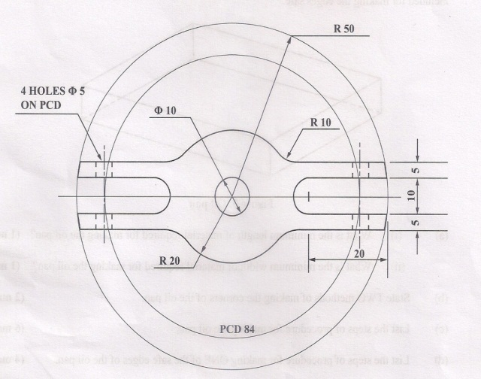
Draw Centre Lines
2014 laying out question
Draw Horizontal lines
Draw Circles R50, ∅10, R20
Draw Arcs
Dot punch all lines
Centre punch centre lines.

Slide 12
Draw Centre Lines: 50mm,35mm , 15 mm & 5mm
2013 Laying out
Draw Horizontal lines: 20mm
Draw Vertical lines: 15mm
Draw Circle: ∅10
Draw Arcs: R15, R5 & R10
Draw Tangential lines
Draw Angles: 60⁰
Dot punch all lines.
Centre punch centre lines.

Slide 13
Draw Centre Lines: 5, 15, 50 & 65 mm
2012 Laying out
Draw Horizontal line: 15mm
Draw Vertical lines: 45mm
Draw Circles: ∅20
Draw Arcs: R5 & 15
Draw Tangential lines
Draw Angles: 90⁰
Dot punch all lines.
Centre punch centre lines.

Slide 14
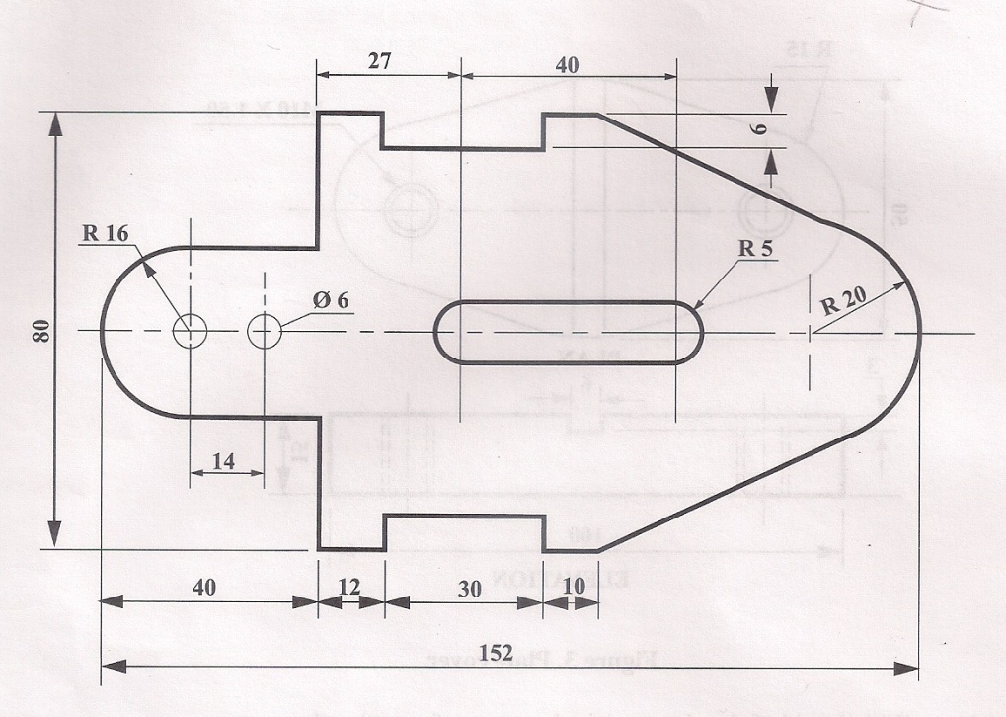
Draw Centre Lines: 16, 30 & 40 mm
2011 Laying out
Draw Horizontal lines: 6mm
Draw Vertical lines: 52 & 82 mm
Draw Circles :∅6
Draw Arcs R16,5 &20
Draw Tangential lines
Dot punch all lines.
Centre punch centre lines.

Slide 15
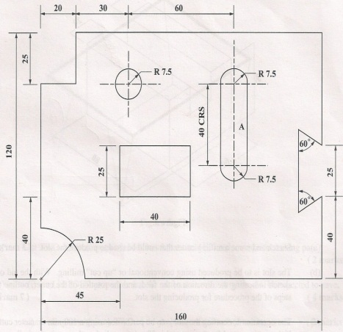
Draw Centre Lines: 25, 50,65 & 110mm
2010 Laying out
Draw Horizontal lines: 40mm
Draw Vertical lines:25 mm
Draw Circle R7.5
Draw Arcs R7.5 & R25
Draw Tangential lines
Draw Angles: 60⁰
Dot punch all lines.
Centre punch centre lines.

Slide 16
Lets try some parts of actual past paper questions.
All the following questions require responses that are very similar, even though they are worded differently.
Example. Outline the steps of procedure and List the steps of procedure require the same answer.
Note 1: Please remember that you do not have to drawn anything to answer this part of the question.
Note 2: Practice writing your answer as given in the examples, that is in step by step form.

Slide 17
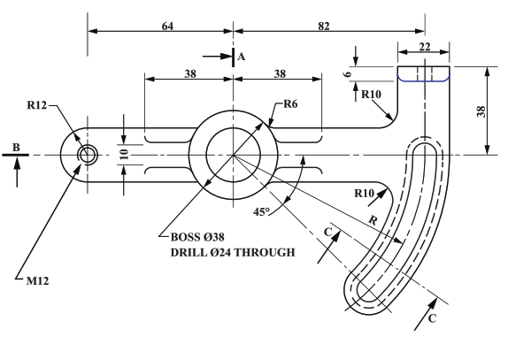
Mechanical Engineering Technology: Laying Out Question 2018
4. Figure 4 shows the plan view of a clutch bracket, which is to be produced by hand. The clutch bracket
Figure 4. Clutch Bracket
(a) Outline the steps of procedure for marking out the clutch bracket. (6 marks)

Slide 18
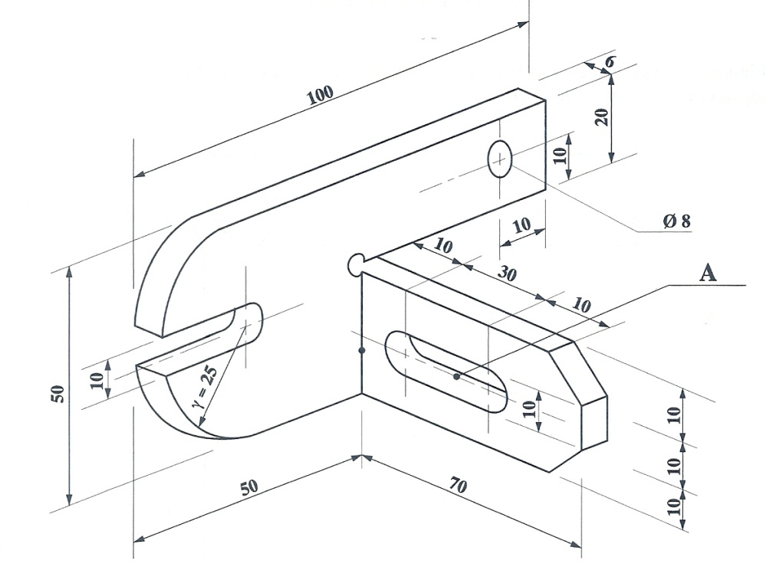
Mechanical Engineering Technology: Laying Out Question 2015
Figure 5 shows a bracket that is to be produced from a piece of mild steel plate 6mm x 50mm x 120mm.
Figure 5. Bracket
(a) (i) List the steps of procedure for marking the bracket. (6 marks)

Slide 19
Mechanical Engineering Technology: Laying Out Question 2008
3. The template shown in Figure 2 is to be produced from a piece of mild steel stock 3 mm thick by 103 mm long by 50 mm wide. The material is prepared and ready to be marked out.
(a) (i) List the steps of procedure for marking out the template.

Slide 20
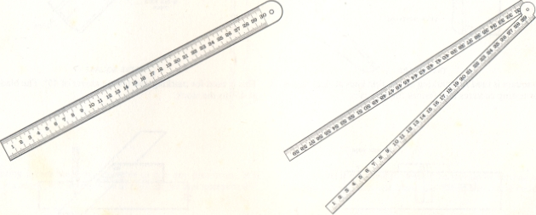
Marking out tools
Steel Rule:
for making small measurements up to 300 mm

Slide 21
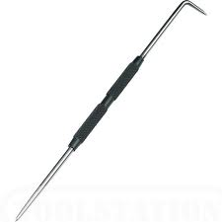
Marking out tools
Scriber
for drawing lines

Slide 22
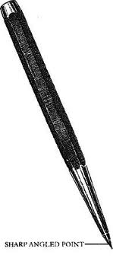
Marking out tools
Dot punch
for making layout lines, circles and arcs permanent and easier to see . [The angle is 60⁰ ]
Note: layout dye also makes the lines easier to see

Slide 23
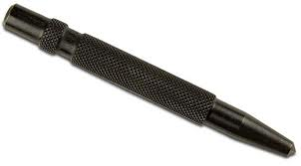
Marking out tools
Centre punch
Locating the centres of circles for drilling. [The grinding angle is 90⁰ ]

Slide 24
Marking out tools
Ball pein hammer
A striking tool, this is used to hit the dot and centre punch in marking out

Slide 25
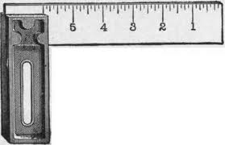
Marking out tools
Try square
For drawing perpendicular lines (90⁰)

Slide 26
Marking out tools
Combination square:
for drawing perpendicular lines and mitre angles (45⁰)

Slide 27
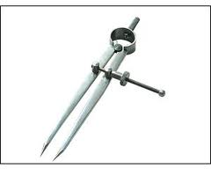
Marking out tools
Divider
for drawing circles and arcs

Slide 28
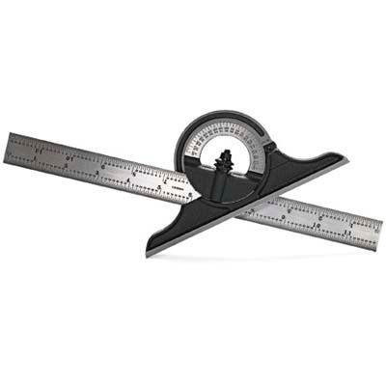
Marking out tools
Protractor
for drawing angles

Slide 29
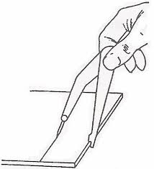
Marking out tools
Odd –leg Caliper
Drawing lines parallel to an edge.

Slide 30
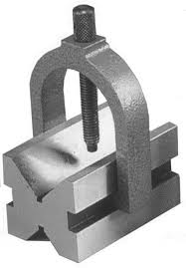
Marking out tools
Vee-block
for locating the centres of circular work

Slide 31
Identify the tools to be used for marking out the template.
Steel Rule
Scriber
Ball Pein Hammer
Dot Punch
Centre Punch
Divider
Protractor
Combination Square
Try Square
Odd Leg Caliper
Vee Block

Slide 32
SLOTS:
For metalwork a slot is an irregular shaped hole which most of the time is made up a number of regular shapes joined together such as circles, squares and rectangles. Some examples of slots are shown below

Slide 33
General procedure for cutting out slots
Step 1: Dot punch outside and centre punch inside the slot.
Step 2: Chain drill inside the slot.
Step 3: Chisel out the waste material.
Step 4: File to the line.

Slide 34
2014 laying out: Outline, in sequence, the steps of procedure for cutting out the 10 mm slots by chain drilling. (4 marks)
Step 1: Dot punch outside and centre punch inside the slot
Step 2: Chain drill inside the slot
Step 3: Chisel out the waste material
Step 4: File to the line

Slide 35
(c) Outline, in sequence, the steps of procedure to be used for cutting out and finishing the section marked Y. (4 marks)
Step 1: Dot punch outside and centre punch inside the slot
Step 2: Chain drill inside the slot
Step 3: Chisel out the waste material
Step 4: File to the line

Slide 36
The tools to be used for cutting out the slot.
Ball Pein Hammer
Dot punch
Centre Punch
Twist drill
Flat chisel
Flat and/or round file

Slide 37
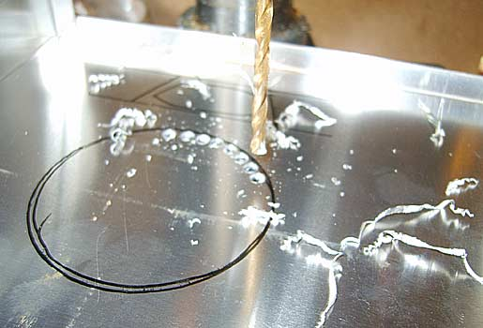
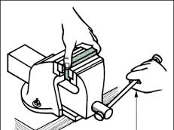
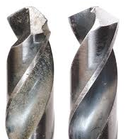
Precautions that should be observed when cutting out the slot to ensure it is done accurately.
Drill inside the line
Ensure tools are sharp
Secure job firmly
Cut away from the body
Use correct tools for the job
Observe point of chisel when cutting

Slide 38
Precautions that should be observed when using laying-out tools.
Do not place sharp tools in your pocket
Ensure tools are sharp
Do not drop tools on the floor
Pay attention to your work

Slide 39
Surface protection of workpieces is done in order to protect the workpiece from corrosion (rusting) and to improve its appearance.
Painting
Blueing
Polishing
Lacquering
Anodizing
Electroplating
Enameling

Slide 40
Review the notes on the previous slides Attempt the following three (3) questions. Write out your answers/responses on your writing paper. Click on the question part to check the solution. (attempt the question before checking the solution). Click on the blue rectangle with the triangle in it to return to the question.

Slide 41
Mechanical Engineering Technology: Laying Out Question 2018
4. Figure 4 shows the plan view of a clutch bracket, which is to be produced by hand. The clutch bracket
(a) Outline the steps of procedure for marking out the clutch bracket. (6 marks)
Figure 4. Clutch Bracket
(b) Name FOUR tools which can be used to completely mark out the clutch bracket.
(4 marks)
(c) Name FOUR tools which can be combined to produce slot C-C. (2 marks)
(d) Suggest FOUR safety precautions which should be followed when producing slot
C-C. (4 marks)
(e) Suggest TWO reasons for polishing the clutch bracket after it is made. (2 marks)
Total 18 marks

Slide 42
Mechanical Engineering Technology: Laying Out Question 2015
Figure 5 shows a bracket that is to be produced from a piece of mild steel plate 6mm x 50mm x 120mm.
Figure 5. Bracket
(i) List the steps of procedure for marking the bracket. (6 marks)
(ii) List FOUR tools that are used for the marking out exercise in (i) above.
(4 marks)
(b) List the steps of procedure required to produce the slot at “A”. (4 marks)
(c) Name FOUR tools used to produce the slot at “A”. (2 marks)
(d) State TWO ways that layout lines can be easily seen. (2 marks)
(e) State TWO safety precautions that should be observed while cutting out the slot at “A”. (2 marks)

Slide 43
Mechanical Engineering Technology: Laying Out Question 2008
3. The template shown in Figure 2 is to be produced from a piece of mild steel stock 3 mm thick by 103 mm long by 50 mm wide. The material is prepared and ready to be marked out.
(a) (i) List the steps of procedure for marking out the template.
(ii) Name the tools to be used in the process. (9 marks)
52
(b) (i) Outline, in sequence, the operations to be performed in cutting out the
piece marked X.
(ii) Name the tools used at (b) (i) above. (6 marks)
(c) (i) State TWO precautions that should be taken when marking out the template to ensure accuracy.
(ii) State TWO safety precautions that should be observed while cutting out the slot at X above. (4 marks)
(d) What is the size of the grinding angle of a centre punch? (1 mark)
Total 20 marks

Slide 44
Steps of procedure for marking out the Clutch Bracket
Draw Centre lines
Draw Horizontal lines
Draw Vertical lines at
Draw Circles
Draw Arcs
Draw Tangential lines
Draw Angles
Dot punch all lines
Centre punch centre lines
Click on the blue button below to return to the question

Slide 45
Name FOUR tools which can be used to completely mark out the clutch bracket
Any four below can be used in the answer
Steel rule
Odd leg caliper
Scriber
Try square
Divider
Protractor
Dot punch(60⁰ angle)
Ball pein hammer
Centre punch(90⁰ angle)

Slide 46
Name FOUR tools which can be combined to produce slot C-C
Any four below can be used in the answer
Dot punch
Centre punch
Ball pein hammer
Drill bit
Cold chisel [flat or round nose]
File [flat, half round, three-square]
File card
Bench vice.

Slide 47
(d) Suggest FOUR safety precautions which should be followed when producing slot C-C.
Wear safety glasses
Wear gloves
Secure work firmly
Ensure tools are in good condition

Slide 48
Suggest TWO reasons for polishing the clutch bracket after it is made.
To protect the work piece from corrosion (rusting)
To improve its appearance.

Slide 49
List the steps of procedure for marking the bracket.
Draw Centre lines
Draw Horizontal lines
Draw Vertical lines at
Draw Circles
Draw Arcs
Draw Tangential lines
Draw Angles
Dot punch all lines
Centre punch centre lines

Slide 50
(ii) List FOUR tools that are used for the marking out exercise in (i) above.
Any four below can be used in the answer
Steel rule
Odd leg caliper
Scriber
Try square
Divider
Protractor
Dot punch(60⁰ angle)
Ball pein hammer
Centre punch(90⁰ angle)

Slide 51
List the steps of procedure required to produce the slot at “A”.
Step 1: Dot punch and centre punch inside the slot.
Step 2: Chain drill inside the slot.
Step 3: Chisel out the waste material .
Step 4: File to the line.

Slide 52
Name FOUR tools used to produce the slot at “A”.
Any four below can be used in the answer
Dot punch
Centre punch
Ball pein hammer
Drill bit
Cold chisel [flat or round nose]
File [flat, half round, three-square]
File card
Bench vice.

Slide 53
State TWO ways that layout lines can be easily seen.
Dot punch the lines
Use layout dye

Slide 54
State TWO safety precautions that should be observed while cutting out the slot at “A”.
Wear safety glasses
Wear gloves
Secure work firmly
Ensure tools are in good condition

Slide 55
(a) (i) List the steps of procedure for marking out the template.
Draw Centre lines
Draw Horizontal lines
Draw Vertical lines at
Draw Circles
Draw Arcs
Draw Tangential lines
Draw Angles
Dot punch all lines
Centre punch centre lines

Slide 56
(ii) Name the tools to be used in the process.
Any six below can be used in the answer
Steel rule
Odd leg caliper
Scriber
Try square
Divider
Protractor
Dot punch(60⁰ angle)
Ball pein hammer
Centre punch(90⁰ angle)

Slide 57
(b) (i) Outline, in sequence, the operations to be performed in cutting out the piece marked X.
Step 1: Dot punch and centre punch inside the slot.
Step 2: Chain drill inside the slot.
Step 3: Chisel out the waste material .
Step 4: File to the line.

Slide 58
b (ii) Name the tools used at (b) (i) above.
Any four below can be used in the answer
Dot punch
Centre punch
Ball pein hammer
Drill bit
Cold chisel [flat or round nose]
File [flat, half round, three-square]
File card
Bench vice.

Slide 59
(c) (i) State TWO precautions that should be taken when marking out the template to ensure accuracy.
Ensure tools are sharp
Use proper layout dye
Remove all burrs
Use the correct tool for the job
Dot punch lines

Slide 60
C (ii) State TWO safety precautions that should be observed while cutting out the slot at X above.
Wear safety glasses
Wear gloves
Secure work firmly
Ensure tools are in good condition

Slide 61
(d) What is the size of the grinding angle of a centre punch?
90⁰

Slide 62
Remember
If YOU fail to prepare then YOU are preparing to fail
Benjamin Franklin
Revise your notes
Answer the past paper questions

