Slide 1
MARKETING FOR THE ARTS
MR. MICHAILEAN TAYLOR
PG. DIP.ED-DRAMA
MA ARTS ADMINISTRATION

Slide 2
OBJECTIVES
TO UNDERSTAND WHAT ARTS MARKETING IS
TO UNDERSTAND WHY MARKET RESEARCH IS IMPORTANT
TO KNOW HOW TO CONDUCT MARKET RESEARCH

Slide 3
Arts Marketing is…
Communicating an experience. Use the five W’s and an H:
Who you are
What you do
Where/When the experience will happen
How persons can be involved
Why people need to be involved.

Slide 4
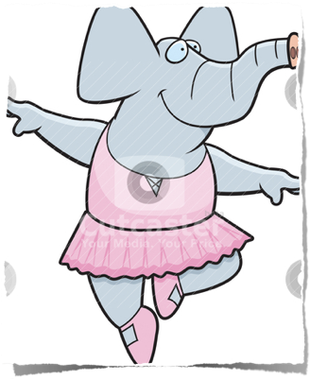
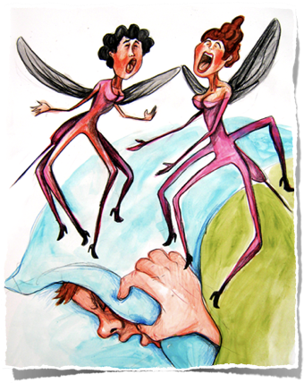
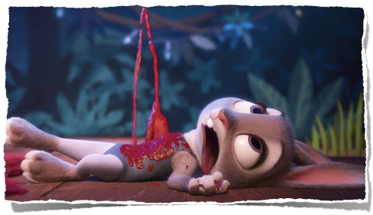
Click on the images below. Three students, using the Mantle of the Expert (Dorothy Heathcote), created three advertisements. Do they all subscribe to the 5 W’s and H? Rate them out of 10.
https://www.youtube.com/watch?v=2-xMXSro76M
https://www.youtube.com/watch?v=3pzuGXGuDIU
https://www.youtube.com/watch?v=eq92tRAQXh8

Slide 5
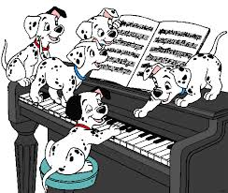
YOUR TURN!
“Piano classes for puppies”
Record yourself in 60 seconds or less advertising piano classes for puppies.
Ensure to have the 5 Ws and an H.
Upload to your social media with the hashtag #capeartsmarketing

Slide 6
The many definitions of Arts Marketing
While there is no single definition for Arts Marketing, those offered below share common themes:
“the process of planning and executing the conception, pricing, promotion, and distribution of ideas, goods and services to create exchanges that satisfy individual and organizational objective”
”marketing is the analysis, planning, implementation, and control of carefully formulated programs designed to bring bout voluntary exchanges of values with target markets for the purpose of achieving the organizational objectives.”
“the primary aim of arts marketing is to bring an appropriate number of people into an appropriate form of contact with the artist and in so doing to arrive at the best financial outcome that is compatible with the achievement of the aim”

Slide 7
Arts Marketing Definitions explained
COMMON THEMES
MANAGEMENT- A managed process involving analysis, planning, implementation and control.
EXCHANGE- Voluntary exchanges of things of value that are mutually beneficial. We ask audiences to exchange time and/or money for the experience of the arts.
MARKETS- Identifying, selecting and cultivating targeted audiences. It is NOT an attempt to entice the general public- specific groups are identified and research conducted to understand their attitudes about the arts and gain insight into their lifestyles.

Slide 8
Some real Arts Marketing Videos
NATIONAL THEATRE ARTS COMPANY OF TRINIDAD AND TOBAGO (NTAC) https://www.youtube.com/watch?v=2jL56Rd_WRA
COACHELLA MUSIC FESTIVAL https://www.youtube.com/watch?v=r_5gexg2B8U
QUESTION:
Who is the intended target market of these videos?

Slide 9
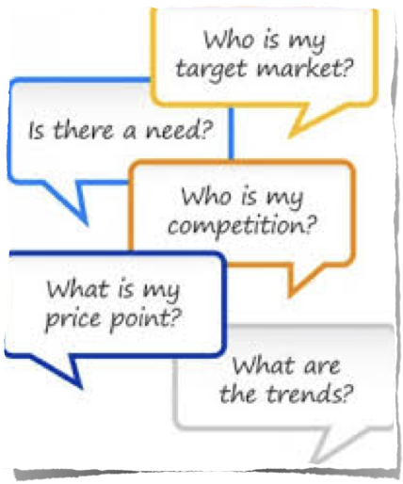
Market Research
Market Research is a process of finding out more information about existing or prospective markets to help you make better program and marketing decisions and to help minimise the risk of developing new programs and services.

Slide 10
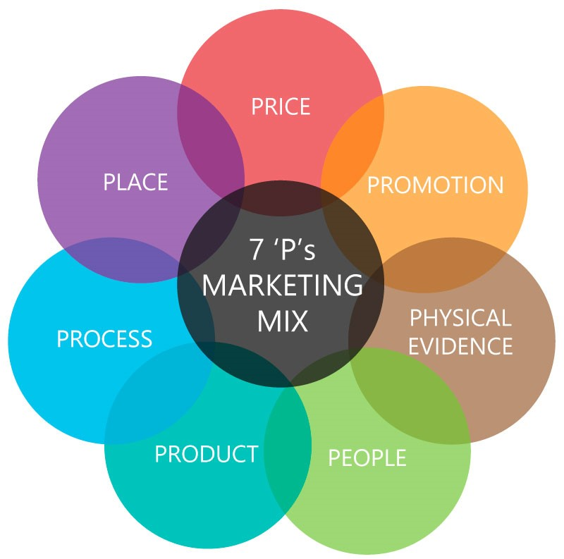
Market Research Information/Checklist
Do you know your intended audience’s….
…values and Beliefs?
…level of Arts Participation/ PHYSICAL EVIDENCE of participation?
…specific type of leisure Activity?
…media Habits (social media)?
…thoughts on completed/ongoing Programs and Events?
…willingness/ability to pay the ticket PRICE?
…interest on the PRODUCT and its quality?
…accessibility/opinion to the PLACE where your art is?
…knowledge on the current PROMOTION of the product?
Two other things to consider is the PEOPLE needed for your arts experience and the PROCESS by which you will integrate all aspects of your marketing.

Slide 11
COMPETITOR ANALYSIS
Helps to define your organisation’s own image and position in the market.
Observe what programs are offered at what prices.
Study other promotions for clues as to what audience segments are being targeted

Slide 12
GROUP EXERCISE
In your IA groups, come up with a potential person/company/institution that you can interview to solicit market information from. Come up with 6 questions that you can ask them that will specifically help your group’s creative intervention. Share your questions with your teacher.

