Slide 1
Internal Text Structure
Lesson 1: What is internal text structure?
Curriculum Planning and Development Division
2020

Slide 2
Internal Text Structure
Lesson 1: What is internal text structure?

Slide 3
Objectives
Identify the structures of informational text
Recognise transitional words that signal specific text structures
Analyse simple details and represent them in graphic organisers

Slide 4
Trying to understand some informational text can be challenging.

Slide 5
Paying attention to the internal text structure may help.

Slide 6
Internal text structure
Internal text structure

Slide 7
Internal text structure
Organisational structures or patterns within a text
=

Slide 8
Architects plan how to build houses.

Slide 9
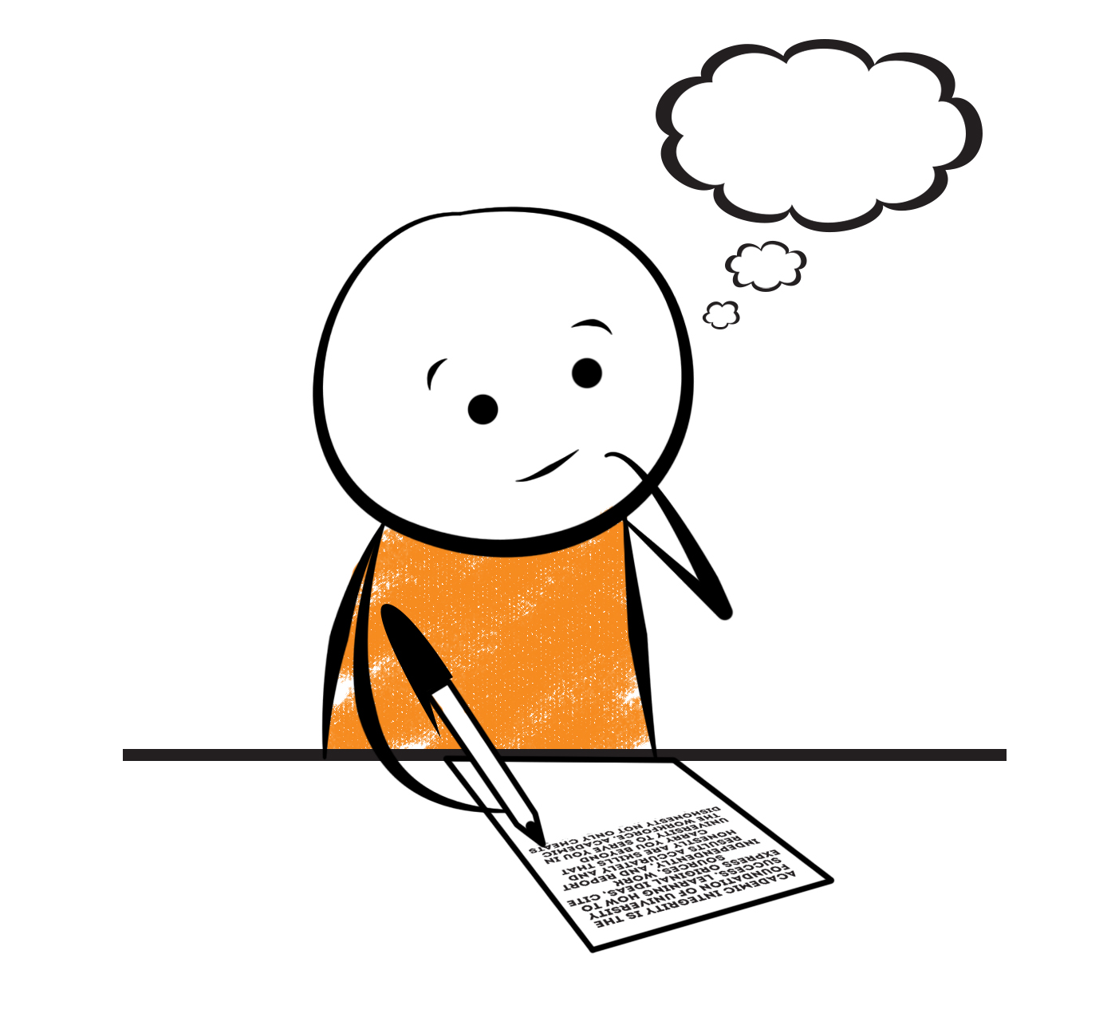
Writers plan what they want to write.
They use internal text structures to help them organise their writing.

Slide 10
4 Internal Structures for
Informational texts
Description
Sequence
Cause
&
Effect
Comparison
&
Contrast

Slide 11
Each text structure
Purpose
Associated graphic organiser
Signal transitional words

Slide 12
Internal Structure 1: Description
Purpose: to give information about the characteristics or features of a topic.

Slide 13
Text structure 1: Description
Detail
Detail
Topic
Detail
Detail

Slide 14
Text structure 1: Description
Size
Hummingbirds
Flying abilities
Migration patterns

Slide 15
Signal words (Description)
Look for transitional words like:
For example
For instance
Such as
Looks like
Also
Another
In addition
Look for adjectives and adverbs
Look for characteristics and details

Slide 16
Example
Hummingbirds are the smallest of all birds. Most species measure between 7.5 – 13 centimetres. A hummingbird’s wingspread is barely 10 centimetres. That is shorter than the length of some people’s fingers!
Some consider hummingbirds to be the best flyers of all birds because they can travel fast as well as far. A hummingbird is capable at anytime of flying straight up in the air, flying backwards and moving its wings so rapidly that it can remain in one spot in the air. Also, despite their tiny wingspread, hummingbirds travel annually between the United States and Central and South America.

Slide 17
Remember to:
Look for characteristics and details
Look for adjectives and adverbs
Look for signal transitional words like:
For example
For instance
Such as
Looks like
Also
Another
In addition

Slide 18
Hummingbirds are the smallest of all birds. Most species measure between 7.5 – 13 centimetres. A hummingbird’s wingspread is barely 10 centimetres. That is shorter than the length of some people’s fingers!
Some consider hummingbirds to be the best flyers of all birds because they can travel fast as well as far. A hummingbird is capable at anytime of flying straight up in the air, flying backwards and moving its wings so rapidly that it can remain in one spot in the air. Also, despite their tiny wingspread, hummingbirds travel annually between the United States and Central and South America.
Hummingbirds are the smallest of all birds. Most species measure between 7.5 – 13 centimetres. A hummingbird’s wingspread is barely 10 centimetres. That is shorter than the length of some people’s fingers!
Some consider hummingbirds to be the best flyers of all birds because they can travel fast as well as far. A hummingbird is capable at anytime of flying straight up in the air, flying backwards and moving its wings so rapidly that it can remain in one spot in the air. Also, despite their tiny wingspread, hummingbirds travel annually between the United States and Central and South America.
Hummingbirds are the smallest of all birds. Most species measure between 7.5 – 13 centimetres. A hummingbird’s wingspread is barely 10 centimetres. That is shorter than the length of some people’s fingers!
Some consider hummingbirds to be the best flyers of all birds because they can travel fast as well as far. A hummingbird is capable at anytime of flying straight up in the air, flying backwards and moving its wings so rapidly that it can remain in one spot in the air. Also, despite their tiny wingspread, hummingbirds travel annually between the United States and Central and South America.
Details/characteristics
Details/characteristics
Details/characteristics
Details/characteristics
Details/characteristics
Details/characteristics

Slide 19
Name two characteristics of a hummingbird.

Slide 20
Hummingbirds are the smallest of all birds. Most species measure between 7.5 – 13 centimetres. A hummingbird’s wingspread is barely 10 centimetres. That is shorter than the length of some people’s fingers!
Some consider hummingbirds to be the best flyers of all birds because they can travel fast as well as far. A hummingbird is capable at anytime of flying straight up in the air, flying backwards and moving its wings so rapidly that it can remain in one spot in the air. Also, despite their tiny wingspread, hummingbirds travel annually between the United States and Central and South America.

Slide 21
Name two characteristics of a hummingbird.
Any 2
They are very small.
They may measure between 7.5 and 13 centimetres.
They have the ability to fly at a great speed.
They have the ability to fly great distances.

Slide 22
Internal Structure
Internal structure is a way that writers organise their writing
Each text structure has its own purpose and signal words
Each structure can be organised into a graphic organiser
The description structure is used to show the characteristics of something
Stay tuned for Lesson 2

Slide 23
Internal Text Structure
Lesson 2: Internal text structure (Sequence)

Slide 24
Internal text structure
Organisational structures or patterns within a text
=

Slide 25
Each text structure
Purpose
Associated graphic organiser
Signal transitional words

Slide 26
Internal Structure 1: Description
Purpose: to give information about the characteristics or features of a topic.

Slide 27
Internal Structure 2: Sequence
Purpose:
To show steps in a process
To show the order of events

Slide 28
Text structure 2: Sequence
Step 1
Step 2
Step 3

Slide 29
Drafting
Revising
Editing
Publishing
Prewriting
The Writing Process

Slide 31
Signal words (Sequence)
Look for transitional words like:
First, Second…
Next
Then
Before
After
Finally
When

Slide 32
How many steps does the hummingbird take to extract nectar from a flower?
When a hummingbird locates a honeysuckle vine, it flies straight up and “stands still” in the air in front of the flower. It then directs its long bill into the blossom, which has a deep cup. Moving slowly, the bird flies forward until its bill penetrates the flower’s cup to the very bottom. After drinking the nectar it finds there, the hummingbird extracts its bill from the deep flower by flying backwards.
When a hummingbird locates a honeysuckle vine, it flies straight up and “stands still” in the air in front of the flower. It then directs its long bill into the blossom, which has a deep cup. Moving slowly, the bird flies forward until its bill penetrates the flower’s cup to the very bottom. After drinking the nectar it finds there, the hummingbird extracts its bill from the deep flower by flying backwards.
1
2
3
4
6
5

Slide 33
Hummingbird’s process for extracting nectar from a flower
Locates vine
Stand still in front of the flower
Places its bill in the blossom
Drinks nectar
Extracts bill by flying backwards

Slide 34
Find the sequence signal words in this paragraph
Firstly, the Vice Principal, Mrs. Joan Smith, welcomed everyone present and then the National Anthem was played. Next, all the children gathered at their respective tents and were ordered from First Year to Standard Five. They were then placed in the order of Scarlet Ibis, Egret, Keskidee and Hummingbird to start the March Past. When all the houses were lined up on the track, the March Past started with two senior students waving flags with their colours at the front of each group for the judges. Each house performed a different choreography and waited for the judges’ decision to be revealed. As the March Past concluded, the judges’ decision was submitted and the Hummingbird house was declared the winner.
Firstly, the Vice Principal, Mrs. Joan Smith, welcomed everyone present and then the National Anthem was played. Next, all the children gathered at their respective tents and were ordered from First Year to Standard Five. They were then placed in the order of Scarlet Ibis, Egret, Keskidee and Hummingbird to start the March Past. When all the houses were lined up on the track, the March Past started with two senior students waving flags with their colours at the front of each group for the judges. Each house performed a different choreography and waited for the judges’ decision to be revealed. As the March Past concluded, the judges’ decision was submitted and the Hummingbird house was declared the winner.

Slide 35
Internal Structure
The sequence text structure is used to:
Show steps in a process
To show the order of events
Stay tuned for Lesson 3

Slide 36
Internal Text Structure
Lesson 3: Comparison and Contrast

Slide 37
Internal Structure 1: Description
Purpose: to give information about the characteristics or features of a topic.

Slide 38
Internal Structure 2: Sequence
Purpose:
To show steps in a process
To show a timeline
To show the order of events

Slide 39
Internal Structure 3: Comparison and Contrast
Purpose:
To show how two topics are alike and different

Slide 40
Internal Structure 3: Comparison and Contrast
Thing 1
Thing 2
Similarities

Slide 41
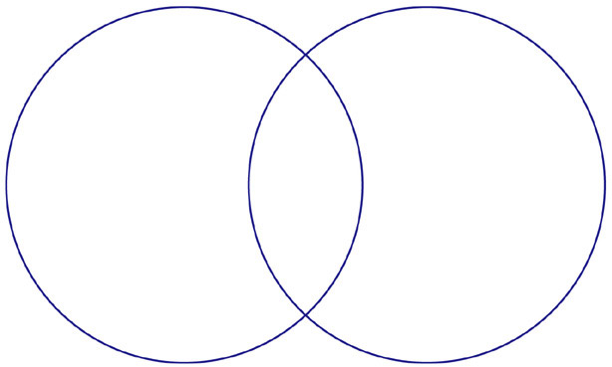
REPORT
STORY
Purpose: to inform
Purpose: to entertain
Content: 4 W’s + H
Content: Story elements: characters, setting, plot
Structure:
Introduction, Body, Conclusion
(Logical sequencing and organization of details)
Pay attention to:
Spelling
Grammar
Mechanics
Paragraphing
Structure:
Exposition, rising
action, climax, resolution (can
also start with a flashback)
Language:
Descriptive and figurative, appeal to senses
Use of transitions to ensure flow and
interest
Vocabulary that appeals to
the senses and emotions
Use of direct speech
Language:
Formal and factual
Use of transitions to ensure logical flow
Vocabulary that informs, use of indirect speech

Slide 42
Signal words (Comparison and Contrast)
Look for transitional words like:
However
On the other hand
But
Although
In contrast
Different
Alike
Same as
Similarly
Comparative adjectives

Slide 43
Example
Porpoises and dolphins are both large, sleek looking sea animals and they are related to the whale. Porpoises are smaller and measure up to about two metres in length and weigh no more than 100 kilograms. They have rounded snouts which are blunt.
Dolphins, on the other hand, are larger. They grow up to 3 metres long and can weigh about 270 kilograms. The very largest dolphins are called killer whales even though they are not whales.
Porpoises and dolphins can be found close to ocean coasts. However, some dolphins swim in fresh waters of large rivers and lakes in Asia and South America.

Slide 44
Signal words (Comparison and Contrast)
Look for transitional words like:
However
On the other hand
But
Similarly
Although
In contrast
Different
Alike
Same as
Comparative adjectives

Slide 45
Example
Porpoises and dolphins are both large, sleek looking sea animals and they are related to the whale. Porpoises are smaller and measure up to about two metres in length and weigh no more than 100 kilograms. They have rounded snouts which are blunt.
Dolphins, on the other hand, are larger. They grow up to 3 metres long and can weigh about 270 kilograms. The very largest dolphins are called killer whales even though they are not whales. The dolphin’s snout is pointed like a bird’s beak.
Porpoises and dolphins can be found close to ocean coasts. However, some dolphins swim in fresh waters of large rivers and lakes in Asia and South America.
Porpoises and dolphins are both large, sleek looking sea animals and they are related to the whale. Porpoises are smaller and measure up to about two metres in length and weigh no more than 100 kilograms. They have rounded snouts which are blunt.
Dolphins, on the other hand, are larger. They grow up to 3 metres long and can weigh about 270 kilograms. The very largest dolphins are called killer whales even though they are not whales. The dolphin’s snout is pointed like a bird’s beak.
Porpoises and dolphins can be found close to ocean coasts. However, some dolphins swim in fresh waters of large rivers and lakes in Asia and South America.
Porpoises and dolphins are both large, sleek looking sea animals and they are related to the whale. Porpoises are smaller and measure up to about two metres in length and weigh no more than 100 kilograms. They have rounded snouts which are blunt.
Dolphins, on the other hand, are larger. They grow up to 3 metres long and can weigh about 270 kilograms. The very largest dolphins are called killer whales even though they are not whales. The dolphin’s snout is pointed like a bird’s beak.
Porpoises and dolphins can be found close to ocean coasts. However, some dolphins swim in fresh waters of large rivers and lakes in Asia and South America.

Slide 46
Porpoises
Dolphins
Have round, blunt snouts
Have pointed snouts
Both
Large animals
Related to the whale
Can be found close to ocean coasts
Measure up to 2 metres in length and weigh no more than 110 kilogrammes.
Measure up to 3 metres in length and weigh no more than 270 kilogrammes.
Some dolphins swim in fresh waters

Slide 47
Answer these questions
Give one way in which porpoises and dolphins are similar.
2. State two differences between porpoises and dolphins.

Slide 48
Porpoises
Dolphins
Have round, blunt snouts
Have pointed snouts
Both
Large animals
Related to the whale
Can be found close to ocean coasts
Measure up to 2 metres in length and weigh no more than 110 kilogrammes.
Measure up to 3 metres in length and weigh no more than 270 kilogrammes.
Some dolphins swim in fresh waters

Slide 49
Try these
Give one way in which porpoises and dolphins are similar.
2. State two differences between porpoises and dolphins.
Any 1
They are both large animals.
They are both related to the whale.
They both can be found close to ocean coasts.
Any 2
Porpoises are smaller than dolphins.
Porpoises weigh less than dolphins.
Porpoises’ snouts are round and blunt, while dolphins’ snouts are sharp.

Slide 50
Complete the table below to show the differences between porpoises and dolphins.
Porpoises | Dolphins
Have round, blunt snouts
 | Measure up to 3 metres in length.
Weigh no more than 110 kilogrammes

Slide 51
Porpoises
Dolphins
Have round, blunt snouts
Have pointed snouts
Both
Large animals
Related to the whale
Can be found close to ocean coasts
Measure up to 2 metres in length and weigh no more than 110 kilogrammes.
Measure up to 3 metres in length and weigh no more than 270 kilogrammes.
Some dolphins swim in fresh waters

Slide 52
Complete the table below to show the differences between porpoises and dolphins.
Porpoises | Dolphins
Have round, blunt snouts | Have pointed snouts
Measure up to 2 metres in length. | Measure up to 3 metres in length.
Weigh no more than 110 kilogrammes. | Weigh no more than 270 kilogrammes.

Slide 53
Internal Structure
The comparison and contrast text structure is used to show similarities and differences between two things.
Stay tuned for Lesson 4

Slide 54
Internal Text Structure
Lesson 4: Cause and Effect

Slide 55
Internal Structure 1: Description
Purpose: to give information about the characteristics or features of a topic.

Slide 56
Internal Structure 2: Sequence
Purpose:
To show steps in a process
To show the order of events

Slide 57
Internal Structure 3: Comparison and Contrast
Purpose:
To show how two topics are alike and different

Slide 58
Internal Structure 4: Cause and Effect
Purpose: to present the reason something happened and the effect of/result of it happening.

Slide 59
Each text structure
Purpose
Associated graphic organiser
Signal transitional words

Slide 60
Internal Structure: Cause and Effect
Effect
Cause
Effect
Effect

Slide 61
Internal Structure: Cause and Effect
Cause
Effect
Cause
Cause

Slide 62
Signal words (Cause and Effect)
Look for transitional words like:
Reasons why
As a result
Therefore
Because
Consequently
Since
So that
For
Due to
This led to

Slide 63
Example
Despite all of the tiger’s strength, the future of the species is uncertain because tigers face a very high risk of extinction. It is estimated by the turn of the century, the number of tigers living in the wild had dwindled from 100 000 to just over 3 000. Humans are the major threat to tigers. This threat can be categorised in primarily two ways: hunting and destroying habitats.
Despite all of the tiger’s strength, the future of the species is uncertain because tigers face a very high risk of extinction. It is estimated by the turn of the century, the number of tigers living in the wild had dwindled from 100 000 to just over 3 000. Humans are the major threat to tigers. This threat can be categorised in primarily two ways: hunting and destroying habitats.
Despite all of the tiger’s strength, the future of the species is uncertain because tigers face a very high risk of extinction. It is estimated by the turn of the century, the number of tigers living in the wild had dwindled from 100 000 to just over 3 000. Humans are the major threat to tigers. This threat can be categorised in primarily two ways: hunting and destroying habitats.
Despite all of the tiger’s strength, the future of the species is uncertain because tigers face a very high risk of extinction. It is estimated by the turn of the century, the number of tigers living in the wild had dwindled from 100 000 to just over 3 000. Humans are the major threat to tigers. This threat can be categorised in primarily two ways: hunting and destroying habitats.
Effect
Effect
Effect
Cause
Cause
The passage is about the risk of tigers’ extinction and how humans are causing this extinction.

Slide 64
What are the effects of human activity on the tiger population?
Future uncertain
Human activity
High risk of extinction
Reduced population

Slide 65
Effect
Despite all of the tiger’s strength, the future of the species is uncertain because tigers face a very high risk of extinction. It is estimated by the turn of the century, the number of tigers living in the wild had dwindled from 100 000 to just over 3 000. Humans are the major threat to tigers. This threat can be categorised in primarily two ways: hunting and destroying habitats.
Effect
Cause
Cause
The passage is about the risk of tigers’ extinction and how humans are causing this extinction.

Slide 66
Give two possible reasons for tigers being almost extinct.
Hunting
Tigers almost extinct
Destroying habitats
Human activity

Slide 67
Internal Structure
The cause and effect text structure presents cause and effect relationships (how one thing affects another).

Slide 68
So what have we learned?

Slide 69
Internal text structure
Organisational patterns within a text
=

Slide 70
Architects plan how to build houses.

Slide 71
Writers plan what they want to write.
They use internal text structures to help them organise their writing.

Slide 72
Each text structure
Purpose
Associated graphic organiser
Signal transitional words

Slide 73
4 Internal Structures for
Informational texts
Description
Sequence
Cause
&
Effect
Comparison
&
Contrast

Slide 74
Trying to understand some informational text can be challenging.

Slide 75
Paying attention to the internal text structure may help.

