Slide 1
Non Conventional Farming systems:
Aquaponics
Hydroponics
Grow box
Trough culture
Urban and peri-urban farming

Slide 2
aquaponics
This is the combination of AQUACULTURE (raising fish) and HYDROPONICS (growing plants without soil)
The fish waste provides an organic food source for the plants and the plants provide a natural filter for the water the fish live in
The microbes present in the growing medium converts ammonia from the fish waste into NITRATES which is absorbed by the plants as a source of NITROGEN.

Slide 3
The aquaponics system

Slide 4
The aquaponics system

Slide 5
The system has two main parts; the aquaculture part and the hydroponics part
A pump moves the water from the fish tank to the hydroponics where a filter removes solids the plants cannot absorb
The water then provides nutrients to the plants and is retuned clean to the fish tank

Slide 6
Benefits of aquaponics
disadvantages
Reduction in use of water
No need for artificial fertilisers
More plants can be grown at the same time
Two sets of income earned from sale of crops and fish
Electrical energy is required
Cost of fish food
Start up cost may be high
Limited to growing certain types of crops

Slide 7
hydroponics
This is the growing of plants in a soilless medium, a water based environment or an inert medium e.g. gravel
Mineral solutions are used to feed the plants
There are different types of systems e.g. Ebb and flow (flood and drain), Drip system and NFT (Nutrient Film technique )

Slide 8
Examples of hydroponics systems
Ebb & flow ( flood and drain)
Drip system
Nutrient film technique (NFT)

Slide 9
Components of a hydroponic system
Growing chamber
Reservoir to hold the nutrient solution
Delivery system to get the water/nutrients from the pump in the reservoir to the plants
Submersible pump
Air pump and air stone to oxygenate the solution

Slide 10
Benefits/disadvantages of hydroponics
Benefits
disadvantages
The nutrient solution is perfectly balanced
It does not harm the environment
Ver little water is lost to evaporation
The growing medium is designed for good plant growth
Plants will grow faster, bigger and healthier
Less risks of pests and diseases
Initial set up is costly
It requires commitment and dedication
Artificial lighting may be needed depending on where the system is set up
The system is vulnerable to power outages

Slide 11
Grow box system
This is the use of an enclosed box like structure filled with a special mixed medium.
Soil is NOT USED
Fertilizers are added to the medium to provide the plants with nutrients
A wide variety of crops can be grown in the box
The size of the box varies depending on the available space
It allows plants to be grown in places that may be otherwise unsuitable for cultivation

Slide 13
Siting the box
Avoid shade
It should be fairly secured from pets/poultry
Land should be flat
Good drainage is necessary

Slide 14
Trough culture
This is the cultivation of crops on a small scale using containers or small structures that have space
Trough culture encourages reusing/recycling
A proper growing medium is used to suit the type of plant being grown
It allows plants to be grown in places that may be otherwise unsuitable for cultivation

Slide 15
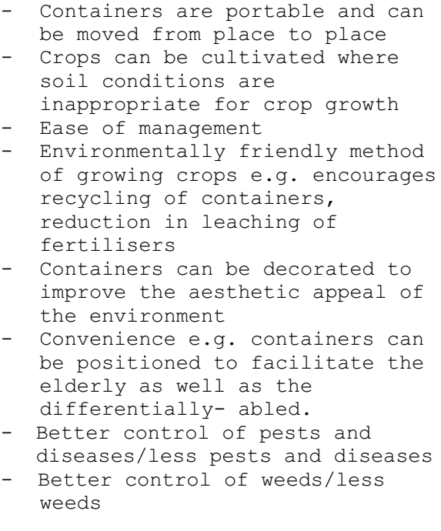
ADVANTAGES OF CONTAINER PLANTING

Slide 17
Urban & peri-urban farming (upa)
This is the practice of cultivating, processing and distributing food in/around towns/cities
Urban areas are city areas. Peri-urban areas are the areas surrounding the cities
Urban agriculture refers to small areas e.g. vacant lots, balconies, containers within the city for growing crops and raising small livestock
Peri-urban agriculture refers to farm units that are close to the town areas

Slide 19
Benefits of upa
It expands the economic base of the city
It presents an opportunity for women to be part of the formal economy of the city
It provides employment, income and access to food for urban populations

Slide 20
questions

Slide 21
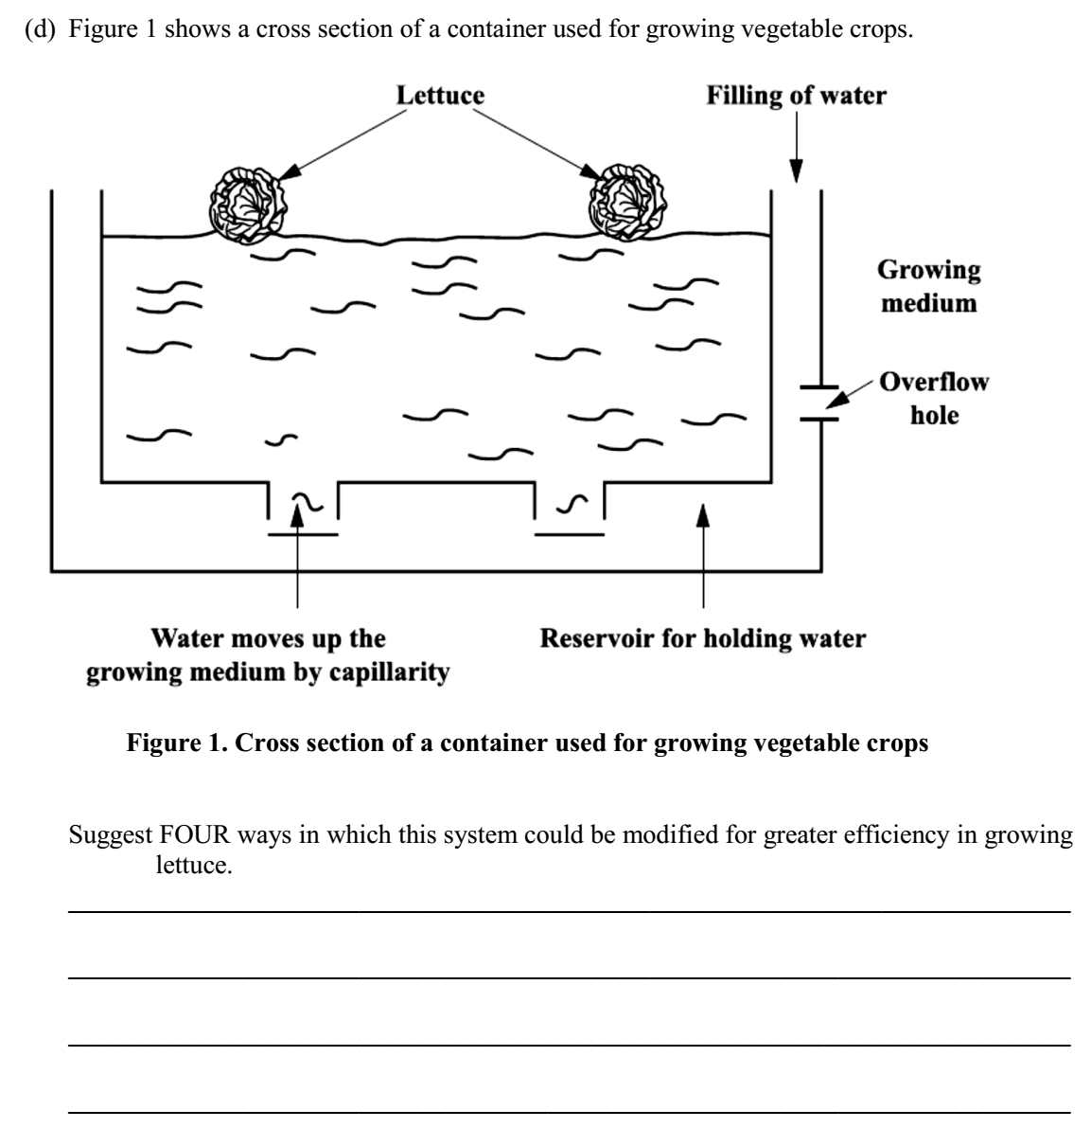

Slide 22
