Slide 1
3 Dimensional (3D) Drawing – Lesson 1
CSEC Technical Drawing

Slide 2
OBJECTIVES
Syllabus Reference:
SECTION 2B: GEOMETRICAL CONSTRUCTION: SOLID GEOMETRY
1. Pictorial drawings
(a) Types of pictorial drawings:
(i) isometric;
(ii) oblique;
(iii) perspective.

Slide 3
3D Drawing
Introductory lesson for Form 4
Review lesson for Form 5
Instructions:
Go through the material on the slides
Take the assessment quiz at the end
Review your answers on the Answer sheet

Slide 4
3D Drawing
Objectives:
At the end of this lesson you should be able to –
- Define 3Dimensional drawing
- state the characteristics of each type of 3D drawings
- differentiate among the different types of 3D drawings

Slide 5
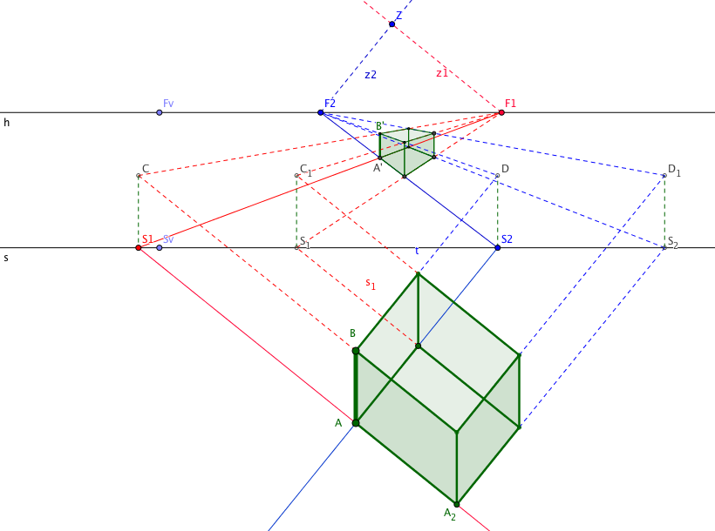
What is 3D Drawing
3D drawing or pictorial drawing is a drawing which looks like a picture image of the object.
It refers to any type of drawing which shows that an object has Volume or Space and this creates the illusion of Height, Width and Depth in an image, when it is viewed from a particular Angle.
This gives it a picture like image.

Slide 6
Why 3D Drawings??
A 3D drawing easily shows three dimensions of objects in space and their relationships with other objects.
This helps non-technical persons to visualize designs & the space, movement & access.
Our brains are better able to handle the visualization of an object over 2D or multi view drawings
It aids in picturing the finished product
And helps to detect problems with the design
3D models can be used to create 2D drawings directly
Using Cad the object can be turned virtually so that clients have a clear view of the finished product

Slide 7
Types of 3D Drawings
The three types of 3D drawings commonly used in Technical Drawing:
Isometric
Oblique
Perspective

Slide 8
Isometric Drawings
Characteristics:
Shows 3 sides
Has an axis like a “Y” whose angles equal 120°
Vertical lines remain vertical
Horizontal lines are drawn at 30° to the horizontal plane

Slide 9
Oblique Drawing
Characteristics:
Has an axis with two lines at 90 to each other while the 3rd is between 30° to 90°.
The angle of the receding line is generally 45°
The view with the most details is set out on the axis with the 90° lines so as to look like a front view of the object.
When the measurement is drawn to full size on the receding axis the drawing appears distorted.
There are two types of oblique drawings: Cavalier and Cabinet
Cavalier: full size measurements on the receding axis
Cabinet: Half of the measurement used to reduce distortion of the object.

Slide 10
Oblique Drawing - Types

Slide 11
Perspective
Perspective is an approximate representation of an image on a flat surface, such as paper, as seen by the eye.
All perspective drawings assume that there is a viewer who is a distance away from the object.
The objects appear much smaller that they actually are.
Perspective drawings have a horizon line which is implied, that is not actually the horizon, and is opposite to the viewer’s eyes.
Every perspective drawing has one or more vanishing points which allows the person drawing the object to draw parallel lines so that the object can be formed. The viewer cannot see beyond these points.

Slide 12
Perspective
Generally, 1 point or 2 point perspective drawing is used in Technical Drawing.
1 point perspective has one vanishing point
While 2 point has two on the opposite sides of each other.
2 point perspective drawings are usually done to depict buildings in relation to access; other buildings and to show the finished product.

Slide 13
Perspective drawings of buildings

Slide 14
Sources
Online Graphics:
Wikimedia commons
Linkedin slideshare

