Slide 1
Identification, Prevention, and Treatment of Dance Injuries
PART THREE

Slide 2
Healthy Eating for Dancers

Slide 3
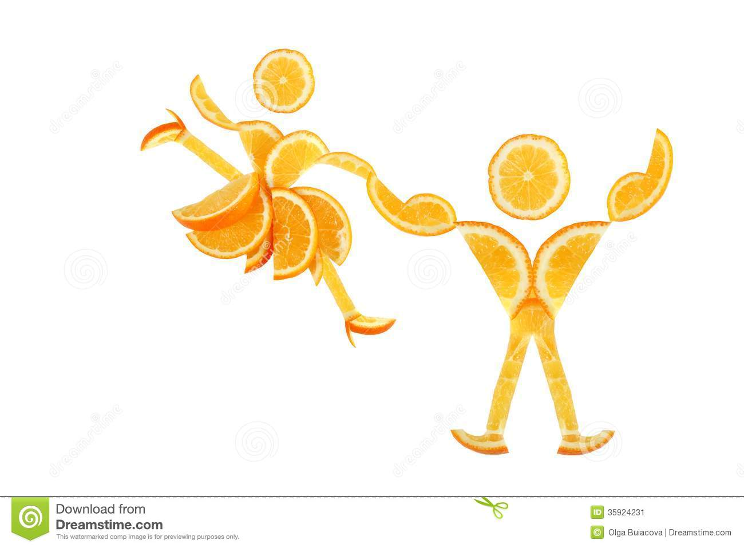
Healthy Eating for Dancers
Dancers expect a great deal from their bodies, so it is important to get proper nourishment (nutrition).
To perform at your best, you need energy, strong bones, flexible joints and muscles, and lungs that work efficiently.
Energy comes from the foods you eat. This energy is turned into fuel for the body.
A healthy diet is essential if you want your body to work effectively and efficiently.
.

Slide 4
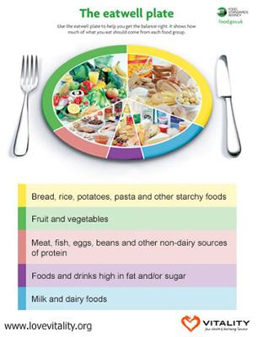
Healthy Diet for Dancers
The Eatwell Plate helps you to get the right balance. It shows how much you should consume from each food group.

Slide 5
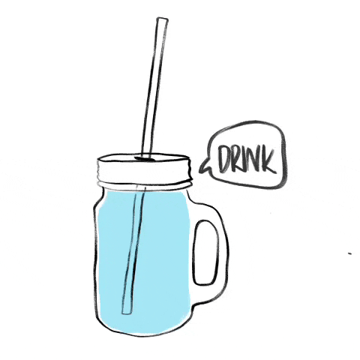

Slide 6
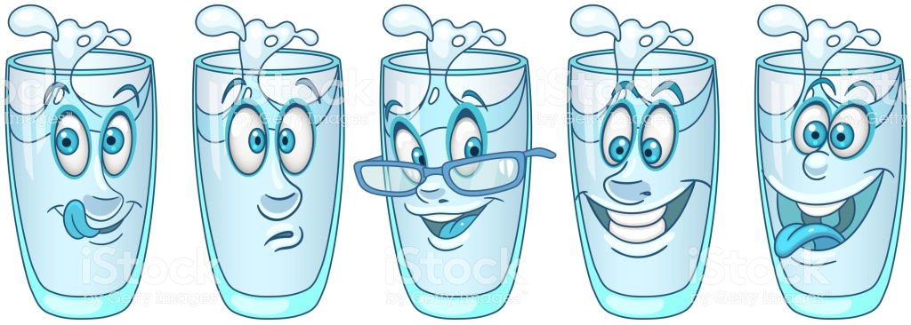
Hydration
When we work hard we sweat more, and during this process we lose water and vital body salts as well as heat.
We must replace the water and salts otherwise we get cramps and lactic acid builds up.
Regular sips of water during a dance session keep the body hydrated and the muscles working at optimum level.
Recommended daily allowance of fluids - 2 litres
Drink more when engaged in vigorous activity.

Slide 7
Activity
Prepare a Healthy meal plan for yourself.
You are preparing for a dance competition
Your rehearsal runs from 10 a.m. to 4 p.m.
The day is excessively hot
Your meal plan must include:
Breakfast
Lunch
Dinner
Snacks

Slide 8
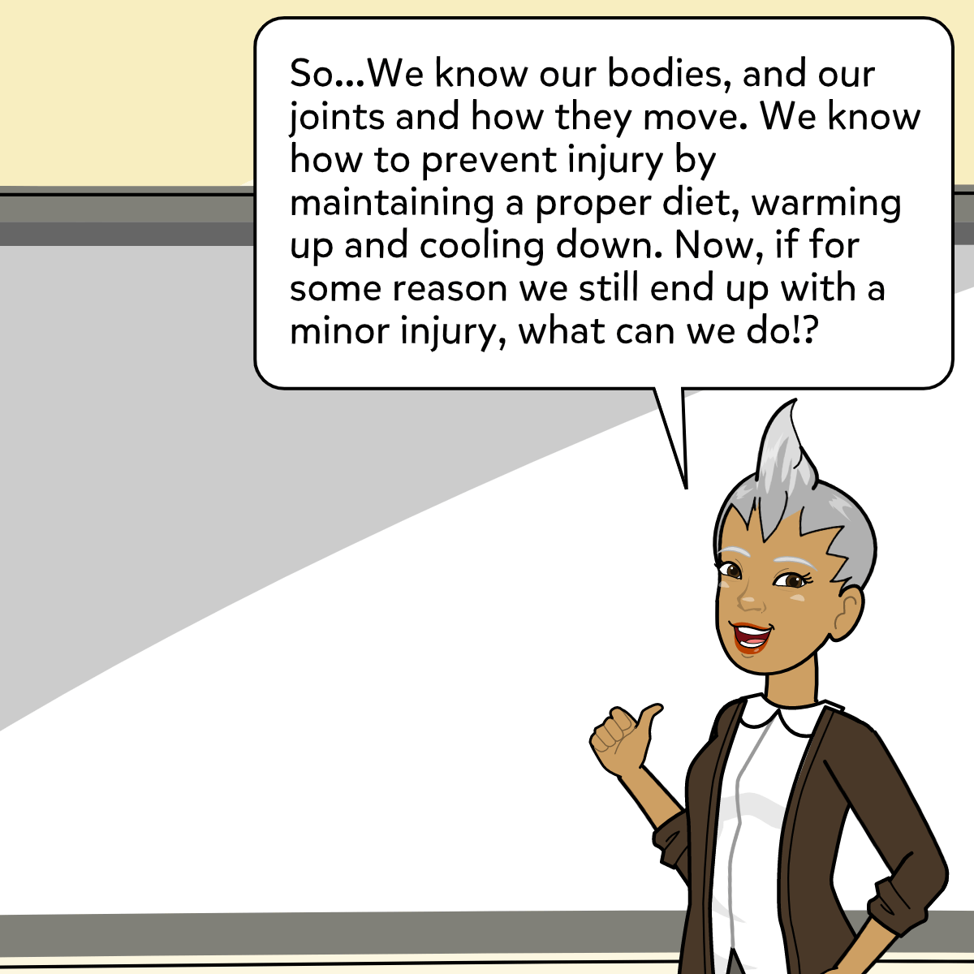

Slide 9
Treatment of Dance Injuries

Slide 11
Treatment of Injuries
It is possible that at some point a dancer might get injured.
If this happens, you need to know what to do.
If the injuries are limited to a sprain or strain, you should adopt the RICE method.

Slide 12
Treatment of Injuries
REST - stop the activity
ICE - apply ice for 10 minute intervals for the 1st 24 hours to reduce pain and swelling
COMPRESSION - apply a moderately firm bandage over the affected area and all around it to help control swelling
ELEVATION - raise the injured part above heart level to improve the drainage of fluid and reduce the blood flow to the area

Slide 14
Summary
Good eating habits can improve the recovery from strains, and even assist with lean muscle growth and soft tissue repair. Eating the right foods can increase energy, focus and concentration. Finding the proper balance of nutrients not only prevents fatigue and injury, but also supports a long healthy career in dance.

Slide 15
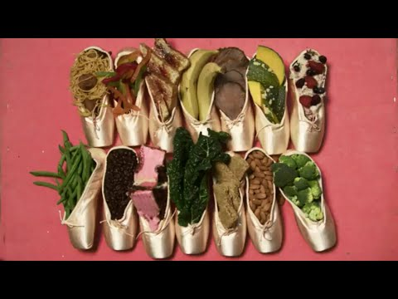
The following video summarises the Health and Lifestyle of a professional dancer.

Slide 17
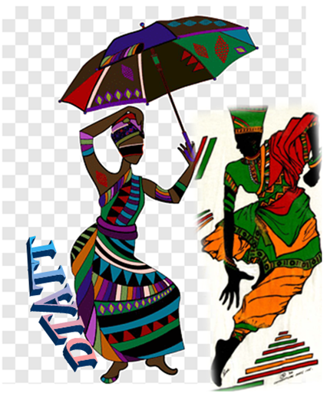
Compiled by
Roxanne De Souza- Diego Martin Central Secondary
Deon Baptiste- San Juan South Secondary
Julia Le Gendre-Stewart- Barrackpore East Secondary
Edited by:
Roxanne De Souza- Phillip
Dance Teachers’ Association of Trinidad and Tobago
(DTATT)

Slide 18
References
Ashley, Linda. Essential Guide to Dance. Third edition. (2008). Hackette UK Company
Clunie, Maggie. Dale, Liz et. AQA Dance GCSE. (2014). Oxford University Press
http://clipart-library.com/clipart/n723102.htm
https://gasparinutrition.com/blogs/fitness-facts/5-benefits-of-healthy-eating
https://giphy.com/gifs/sport-stay-hydrated-water-of-life-fSGJfM5HNbzz3NmCNo
https://giphy.com/gifs/spiritedaway-spirited-away-3oz8xTAJIQD6JWfTUc
https://www.livescience.com/44137-skeletal-system-surprising-facts.html
https://int.search.myway.com/search/AJimage.jhtml?&n=7849f3f6&p2=%5EY6%5Expv190%5ETTAB03%5ETT&pg=AJimage&pn=1&ptb=1CA02819-4072-4D3F-AD7F-7A4F55625703&qs=&si=XXXXXXXXXX&ss=sub&st=tab&trs=wtt&searchfor=fibrous+joint&tpr=jrel3&ots=1588700237748&imgs=1p&filter=on&imgDetail=true
https://int.search.myway.com/search/AJimage.jhtml?&n=7849f3f6&p2=%5EY6%5Expv190%5ETTAB03%5ETT&pg=AJimage&pn=1&ptb=1CA02819-4072-4D3F-AD7F-7A4F55625703&qs=&si=XXXXXXXXXX&ss=sub&st=tab&trs=wtt&searchfor=cartilaginous+joint&tpr=jrel3&ots=1588700477231&imgs=1p&filter=on&imgDetail=true

Slide 19
References Cont’d
https://int.search.myway.com/search/AJimage.jhtml?&n=7849f3f6&p2=%5EY6%5Expv190%5ETTAB03%5ETT&pg=AJimage&pn=1&ptb=1CA02819-4072-4D3F-AD7F-7A4F55625703&qs=&si=XXXXXXXXXX&ss=sub&st=tab&trs=wtt&searchfor=synovial+joint&tpr=jrel3&ots=1588700512480&imgs=1p&filter=on&imgDetail=true
https://www.istockphoto.com/vector/cartoon-glass-with-water-gm1190637194-337593324?irgwc=1&esource=AFF_IS_IR_SP_ClipArtLogo.com_340407_&asid=ClipArtLogo.com&cid=IS&utm_medium=affiliate_SP&utm_source=ClipArtLogo.com&utm_content=340407&clickid=1Xc16vzKaxyOTPGwUx0Mo3YVUkizOIWW%3A3zmww0
https://int.search.myway.com/search/AJimage.jhtml?&n=7849f3f6&p2=%5EY6%5Expv190%5ETTAB03%5ETT&ptb=1CA02819-4072-4D3F-AD7F-7A4F55625703&qs=&si=XXXXXXXXXX&ss=sub&st=tab&trs=wtt&tpr=sbt&enc=2&searchfor=XSlUlZGZJLr4_faMCxL2MwPuofbX_Rfd0UwW26j6KZrHKTCJvwPEicFuytEV5u04UQot3UNnCMNfMtvI38PCmQT2uDh7hnItKsbNNvX1jQR84BFTydKvxA4V_XRmAwdGHs9HyPD2IsHLe1TSzs30nKf_yPpBYDycQ-WiRQnJSdcwgwbRz1mP3liegjvHA5LlnS0xxyrWhACLInKkf7at9zlPpeLNcNxTXVde3JlAbgxzsoVgStgWjZp6uWLqG_swTEQMYLHCb4784BsKWH8jT7KRKjuTpats11MRqWV8_K09y4HsL6krixCnWLkVgiLJUrNrPTgRUyd7TpRUjXMsoQ&ts=1588727648947&imgs=1p&filter=on&imgDetail=true
https://www.balletdancersguide.com/ballet-dancers-loosing-weight.html
https://www.dreamstime.com/stock-image-healthy-eating-funny-little-pair-dancers-made-orange-slices-image35924231
https://www.dimensions.guide/element/ballet-male-dancers
https://twitter.com/spinalogy/status/759244714583396352
https://www.youtube.com/watch?v=779HgCRhEJQ
https://www.youtube.com/watch?v=PxCac1HzoJ8

