Slide 1
CSEC Electronic Document preparation and management
Section V – Business Document Preparation
Specific Objective 8 – Prepare Documents for Meetings
sessions one – four

Slide 2
Session 1 – meetings overview time – 45 minutes

Slide 3
What is a Meeting
A meeting is a formal or informal face to face channel of communication among people on a specific topic or issue. Documents used at a meeting include the following:
Notice of Meeting;
Agenda;
Combined Notice of Meeting with Agenda
Chairman’s Agenda
Minutes

Slide 4
Let's Explore Meeting Documents

Slide 5
Notice of Meeting
A notice of meeting is a document prepared by the secretary of an organization showing:
The name of the organisation
The type of meeting
The name of the body convening the meeting
The venue, date and time of the meeting
The purpose of the meeting
The signature of the Secretary

Slide 6
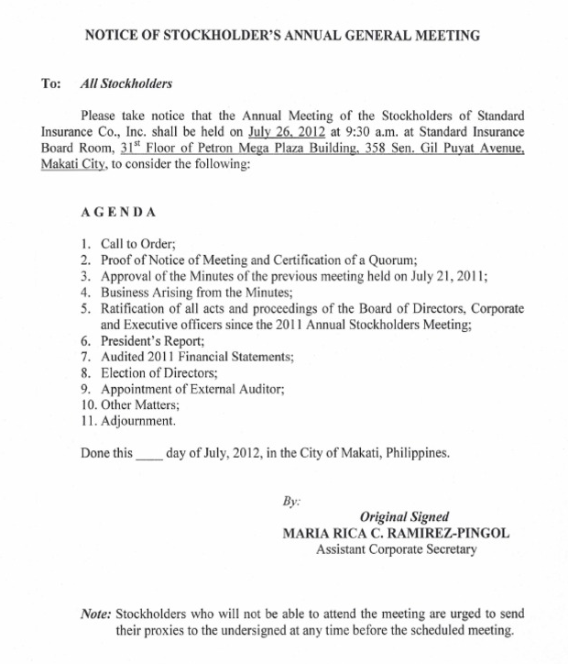
Purpose or type of meeting
The name of the organisation or body convening the meeting
venue, date and time of the meeting
Agenda- Items to be discussed at the meeting
signature of the Secretary
SAMPLE NOTICE OF MEETING WITH AGENDA

Slide 7
Key Points to remember
The notice is sent in advance of the meeting to enable members to:
make arrangements to attend the meeting
Query any matter; or
Suggest items to be included on the agenda.
The notice of the meeting may be combined with the agenda and prepared as one document.

Slide 8
General instructions for typing meeting documents
instructions
Follow the step by step instructions outlined
Look at the videos to review the process for each document
Use your EDPM recommended textbook to select meeting documents to type for additional practice
Send completed work to your teacher for correction
Upload the corrected work to your e-portfolio

Slide 9
Follow the instructions to Type a notice of meeting

Slide 10
Step 1 – open a new document
Select File – New, Blank Document

Slide 11
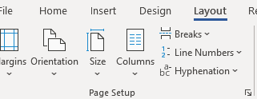
Step 2 – change page layout, orientation and margins
Select Layout
Change Paper Size, Orientation and Margins according to instructions

Slide 12
Step 3 – add your name and the name of the document in the header
Double Click the Mouse in the Header, Type your name to the left, tab twice and type the name of the document to the right.

Slide 13
Step 4 – type the document, format, spell check and save
Note: Formatting Utilized
Times New Roman 12pt
A5 Landscape, one inch margins
Main Heading – TNR, 16 pt and bold
Sub Heading – TNR 14 pt and underline
Change case
Underline and bold
Tabulation

Slide 14
Review how to Type a notice of meeting
Utilize the link to review how to type a notice of meeting
https://screencast-o-matic.com/watch/cY6iDtKBt5
Forward your completed document to your teacher for correction
Upload completed document to your E-Portfolio

Slide 15
Session 2 – notice of meeting and agenda time: 40 minutes

Slide 16
Notice of meeting and agenda
AN agenda is a list of items in the order in which they are to be discussed at a meeting.
The agenda is usually prepared by the secretary after consultation with the chairperson
The agenda is usually circulated before the meeting to allow members to study the items to be discussed.
The are two kinds of agendas, namely:
Ordinary (member’s) agenda
Chairman’s agenda

Slide 17
Creating meeting agendas

Slide 18
Step 1 – open a new document
Select File – New, Blank Document

Slide 19
Step 2 – change page layout, orientation and margins
Select Layout
Change Paper Size, Orientation and Margins according to instructions

Slide 20
Step 3 – add your name and the name of the document in the header
Double Click the Mouse in the Header, Type your name to the left, tab twice and type the name of the document to the right.

Slide 21
Step 4 – type the document, format, spell check and save
Note: Formatting Utilized
Times New Roman (TNR)12pt
Name of student and document in the header
A5, portrait display
Main Heading – TNR, 16 pt and bold
Numbering for agenda items and 1.5 line spacing between numbered items

Slide 22
Review how to Type a notice of meeting and agenda
Utilize the link to review how to type a notice of meeting and agenda
https://screencast-o-matic.com/watch/cY6ib2KB7y
Forward your completed document to your teacher for correction
Upload corrected document to your e-portfolio

Slide 23
Session 3 – chairman's agenda time: 40 minutes

Slide 24
Steps to type the chairman’s agenda

Slide 25
Step 1 – open a new document
Select File – New, Blank Document

Slide 26
Step 2 – change page layout, orientation and margins
Select Layout
Change Paper Size, Orientation and Margins according to instructions

Slide 27
Step 3 – add your name and the name of the document in the header
Double Click the Mouse in the Header, Type your name to the left, tab twice and type the name of the document to the right.

Slide 28
Step 4 – type the document, format, spell check and save
Note: Formatting Utilized
Times New Roman (TNR)12pt
Name of student and document in the header
A4 portrait display
Main Heading – TNR, 16 pt and bold
Sub heading – TNR 14 Pt and bold
Insertion of table for agenda items
Numbering for agenda items and 1.5 line spacing between numbered items

Slide 29
Review how to Type a chairman’s agenda
Utilize the link to review how to type a Chairman’s Agenda
https://screencast-o-matic.com/watch/cY6irfKkCh
Forward your completed document to your teacher for correction
Upload corrected document to your e-portfolio

Slide 30
Session four – minutes of meeting time – 45 minutes

Slide 31
Steps to type a Minutes of meeting

Slide 32
What is a minutes of meeting?
Minutes are records of the proceedings of meetings.
Follow the instructions to type minutes of meeting document.

Slide 33
Step 1 – open a new document
Select File – New, Blank Document

Slide 34
Step 2 – change page layout, orientation and margins
Select Layout
Change Paper Size, Orientation and Margins according to instructions

Slide 35
Step 3 – add your name and the name of the document in the header
Double Click the Mouse in the Header, Type your name to the left, tab twice and type the name of the document to the right.

Slide 36
Step 4 – type the document, format, spell check and save
Note: Formatting Utilized
Times New Roman (TNR)12pt
Name of student and document in the header
A4 portrait display
Main Heading – TNR, 16 pt and bold and center
Sub heading – TNR 14 Pt and bold and center
Insertion of table for attendance

Slide 37
Review how to Type a minutes of meeting
Utilize the link to review how to type a Chairman’s Agenda
https://screencast-o-matic.com/watch/cY6irzKkLX
Forward your completed document to your teacher for correction
Upload corrected document to your e-portfolio

Slide 38
activity
Instructions: complete the undermentioned activity and forward to your teacher for correction.
1. Outline at least three guidelines that should be followed when preparing each of the following documents:
Notice of a meeting
A combined notice and agenda
Prepare a combined notice and agenda for 5th AGM of victory heights beverage Company Limited, to be held at the hangout conference centre on 31 July, of this year at two o’clock in the afternoon. Include six agenda items.
What is the purpose of the chairman’s agenda
How does the chairman’s agenda differ from the general agenda

