Slide 1
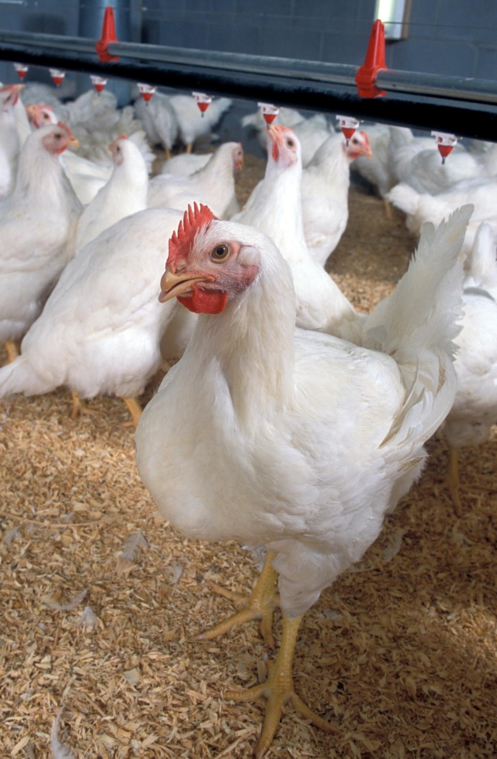
POULTRY PRODUCTION
BROILERS

Slide 3
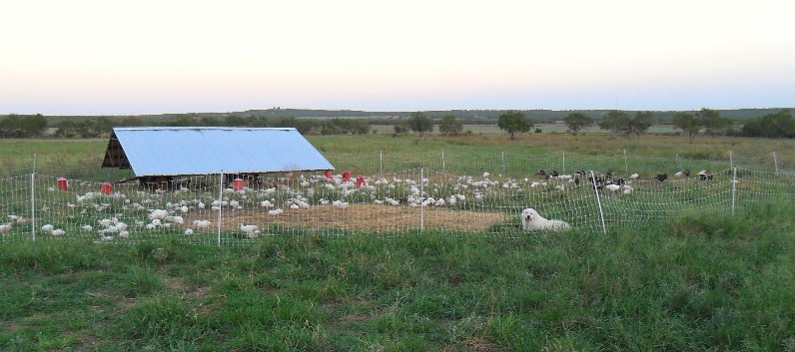
Management systems of poultry production
There are two systems of rearing chickens, they are:
Deep litter system
Battery cage system
Both systems are classified as INTENSIVE systems of management
An EXTENSIVE system of management allows the birds to be reared as FREE RANGE birds

Slide 4
Deep Litter System

Slide 5
Advantages & Disadvantages of the Deep Litter System
Advantage
Disadvantage
No need for a large amount of capital
The ammonia produced by decaying feces acts as a disinfectant
Litter needs to be turned regularly so it is labour intensive
Diseases are spread easily

Slide 6
Battery Cage System

Slide 7
Advantages & Disadvantages of the Battery Cage System
Advantage
Disadvantage
Labour is saved
Accurate records are kept
Initial capital is high for construction of buildings and pens

Slide 8
BROODING of CHICKS

Slide 10
There are two types of brooding:
Natural Brooding – hen
Artificial Brooding – Here the chicks are housed in a specially prepared area where they are protected, kept warm and provided with warmth, feed and water. Before using the brooder the following preparations must be made:
The entire pen should be cleaned and disinfected 2 to 3 days before the chicks arrive.
The brooding area is separated form the rest of the pen
The outer walls are covered with feed bags to keep out cold draughts of air
Litter (bagasse, wood shavings, straw) is placed on the floor 5 to 7 cm thick
Lighting and heating is set up over the brooding area to keep the chicks warm
Newspaper sheets are spread over the litter for the first few days of brooding
Mini waterers and feeders are placed in the brooding area.

Slide 11
Chick feeders and waterers

Slide 12
Factors to consider when rearing broilers
Location of housing
Size of housing & spacing requirements for chickens (broilers – 30cm²)
Construction of the house;- materials needed, heating, lighting and source of water
Equipment required;- feeders, waterers, cleaning equipment etc
Feed;- type and quantity needed
Immunisation
Record keeping

Slide 13
Housing
If available, buildings should be on the highest ground
All buildings should face the same direction
The buildings should have an east to west orientation
A distance of 40 ft should be kept between buildings
The floor should be concrete for easy cleaning and sanitation
The buildings are enclosed by a wall about 30 cm high then wire mesh is placed up to a height of 9ft
The walls are covered with feed bags
The roof should be from corrugated iron
The width of the building should be no more than 30ft

Slide 15
Feeding
Name of Ration | Age of Bird | Protein content
Starter | 0 – 4 weeks old | 24 – 26%
Grower | 3 – 6 weeks old | 18 – 20%
Finisher | 6 – 10 weeks old | 16 – 18%
The term “RATION” refers to the type, quality and quantity of food that is fed to a particular group of animals. There are three types of rations:
Maintenance ration – this satisfies the energy and protein needs of the animal, maintains metabolic processes and body repairs without any gain or loss in body weight.
Production ration – this is the extra food that is added to the maintenance ration for productive purposes such as meat, milk, eggs.
Balanced ration – consists of all essential nutrients needed to satisfy both maintenance and production requirements of the animal.

Slide 16
Feed Conversion Ratio (FCR)
This is the number of units of feed that the animal requires to produce one unit of increase in body weight. It is expressed as a ratio e.g. 3.0 : 1. this means that it takes 3 kg of feed to produce a 1 kg increase in body weight. Different livestock classes have different FCR’s
FCR can be calculated using the following formula:
1000 broilers consumed 3500 kg feed in 45 days of rearing
Total weight of birds is 1750 kg from 1000 birds
FCR = 3500/1750 = 2.0

Slide 17
FCR’s of some common farm animals
LIVESTOCK | NORMAL F.C.R.
Broilers | 3 : 1
Layers | 5 : 1
Pigs | 3 : 1 to 4 : 1
Sheep | 5 : 1
Goat | 5 : 1
Cattle | 5 : 1
Rabbit | 3.5 : 1

Slide 18
The Importance of FCR
Since feed is a major expense, an understanding of FCR can:
Selection of classes and breeds which have a low FCR for production
Identification of particular animals which are efficient feed converters
Raising early maturing animals resulting in a control on expenditure in feed
Knowing when to market mature animals before the FCR increases.

Slide 19
VACCINATION
AGE of BIRD | VACCINE | ADMINISTERED BY
1 day old | Marek’s disease New Castle Disease Bronchitis | Individual hypodermic Drinking water Drinking water
10 days old | New Castle Disease | Drinking water

Slide 20
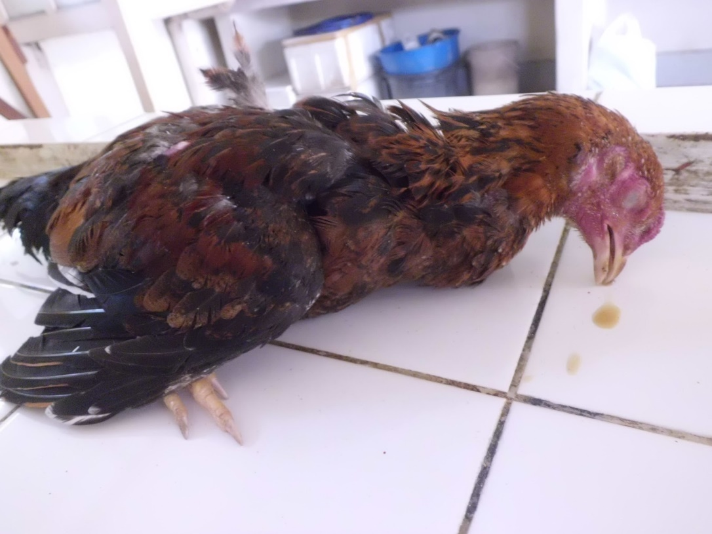
PESTS & DISEASES OF POULTRY
NEWCASTLE DISEASE:
CAUSE – a virus
SYMPTOMS – loss of appetite, droopiness, nasal discharge, twitching of head and neck, coughing, diarrhea, sneezing sound in the breathing, mucus from eyes or nose, paralysis in late stage
PREVENTION – good sanitation, avoid overcrowding, vaccination, dead birds should be buried or burnt
TREATMENT - none

Slide 21
FOWLPOX
CAUSE – a virus
SYMPTOMS - blotches or warts on the comb, beaks and other parts. The blotches later become black scabs
PREVENTION – birds are vaccinated as chicks. Infected birds are isolated, carcasses should be burnt or buried
TREATMENT - none

Slide 22
MAREK’S DISEASE
CAUSE – a virus
SYMPTOMS – twisting of the head and neck, droopy wings, loss of weight, grey color of the iris, paralysis followed by death
PREVENTION – vaccination, observe strict hygiene, isolate infected birds and bury or burn carcasses
TREATMENT - none

Slide 23
COCCIDIOSIS
CAUSE – a protozoan
SYMPTOMS – droopiness, slight diarrhea with bloody streaks in the faeces, the vent becomes swollen and bloody.
PREVENTION – good hygiene, remove sick birds, remove wet litter
TREATMENT – use Sulphur drugs and magnesium sulphate in the drinking water, a coccidiostat can be used.

Slide 24
Avian influenza

Slide 25
SLAUGHTERING

