Slide 1
ENGLISH LANGUAGE ARTS ACTIVITY
HOMONYMS
STANDARD FOUR

Slide 2
Curriculum Topic: Vocabulary
Teaching Point: Homonyms are words that
have identical pronunciation,
same spelling,
different meanings.
Example: present (a gift) & present (attendance)

Slide 3
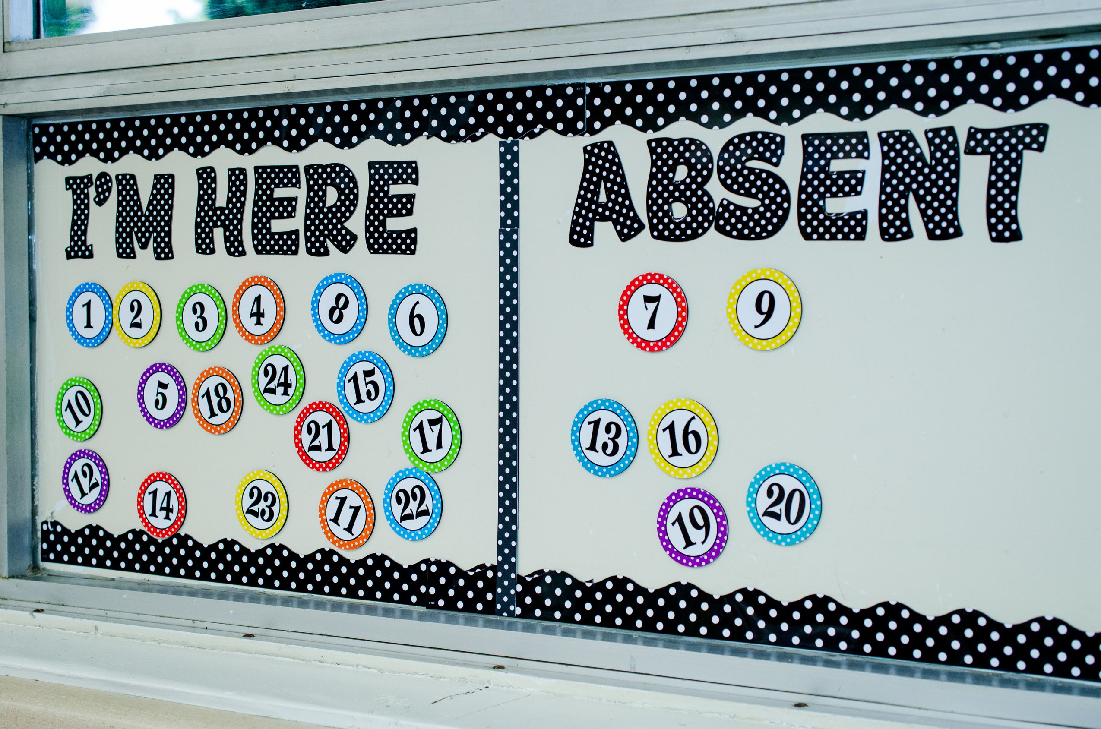
Activity 1
There are 8 sentences, with 8 pairs of homonyms, on the following slides.
Fill in the blank spaces with the appropriate icon from the
box. Click on the icon and drag it to the space.
Example:
He got a for always being . (present)
He got a present for always being present.

Slide 4
The homonyms for Activity 1 are:
bank | space | address | sign
crane | content | letters | deck

Slide 5
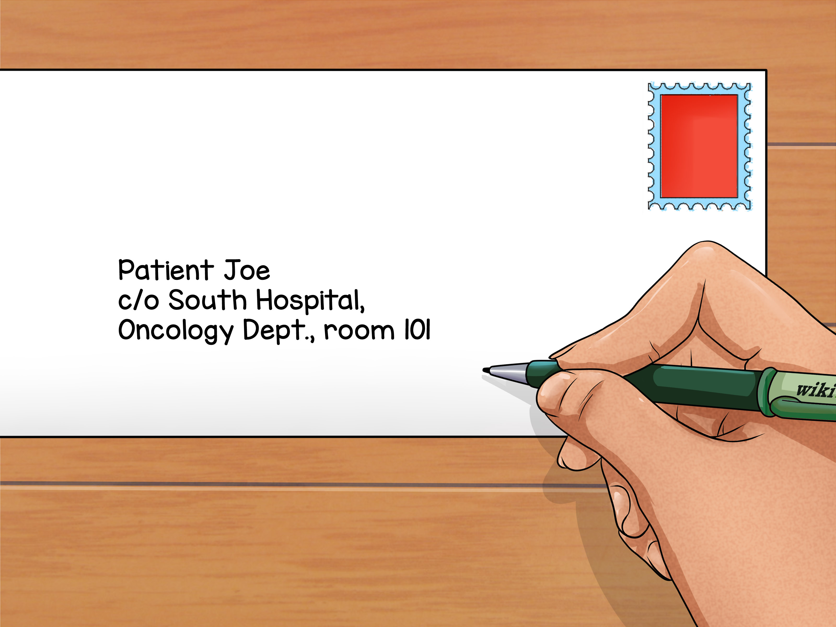
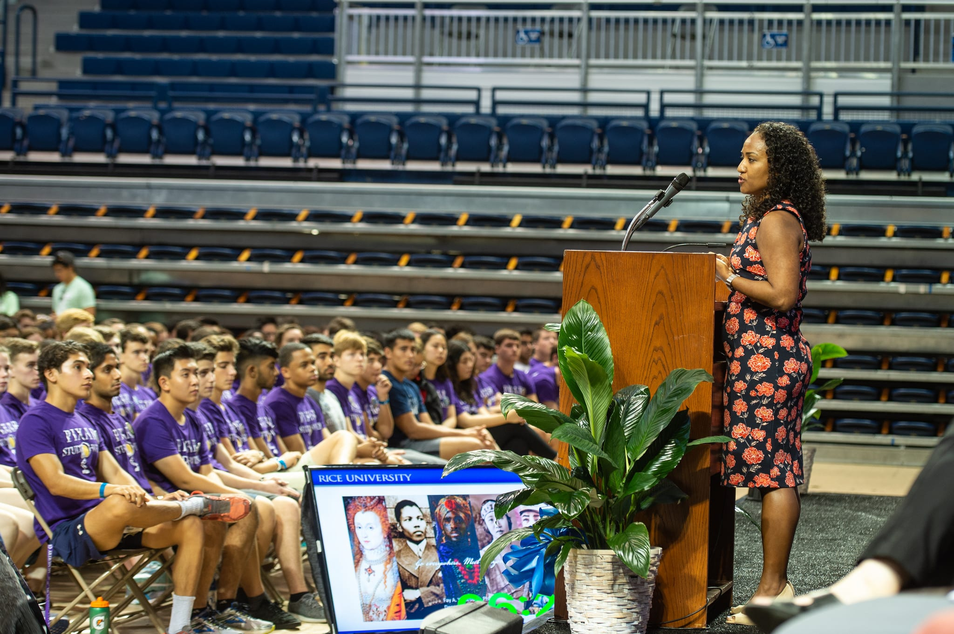
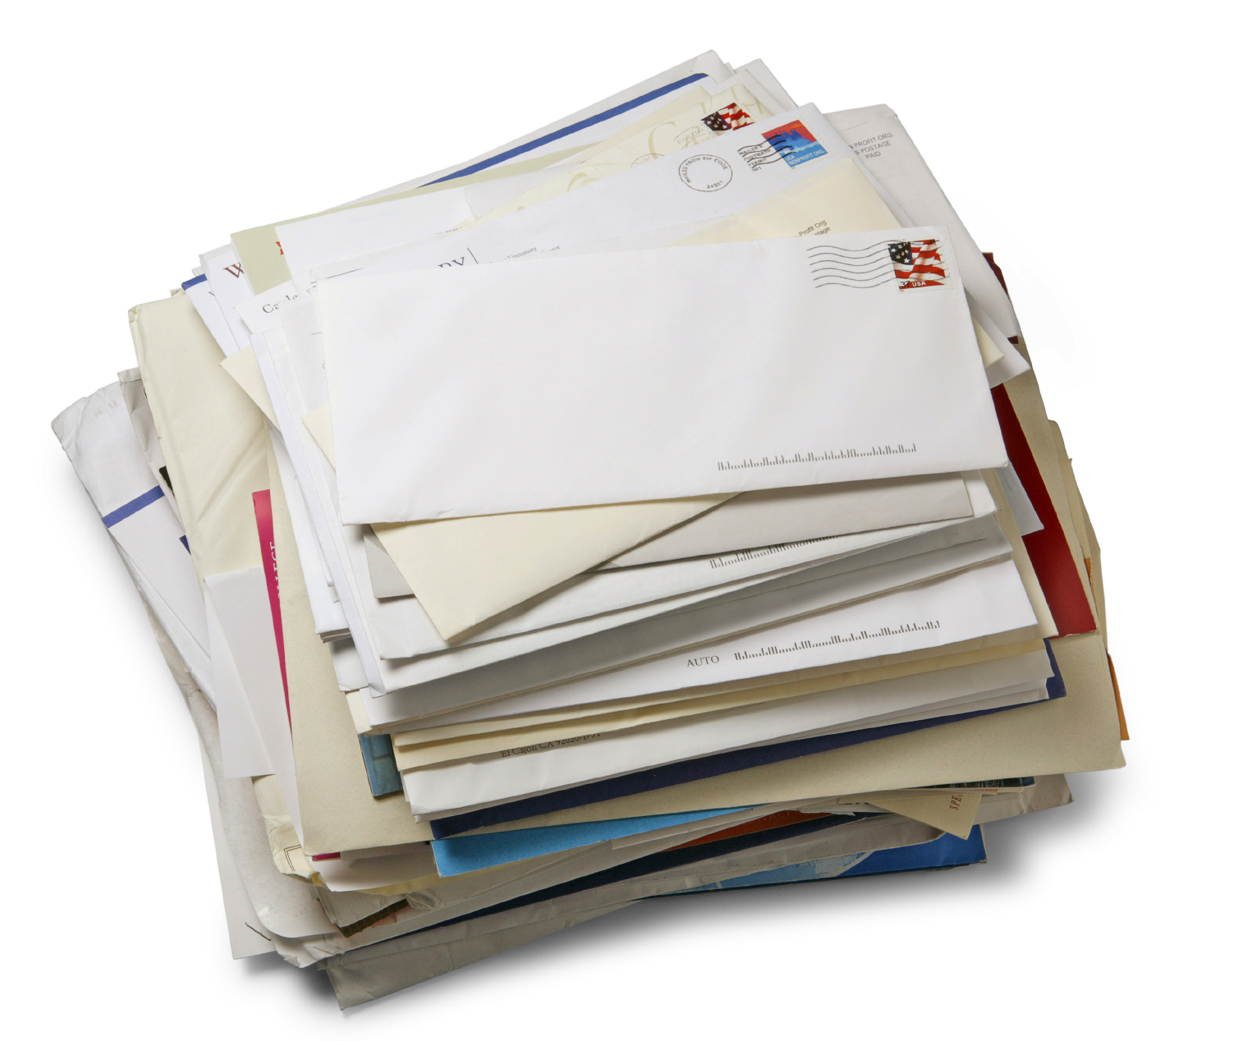
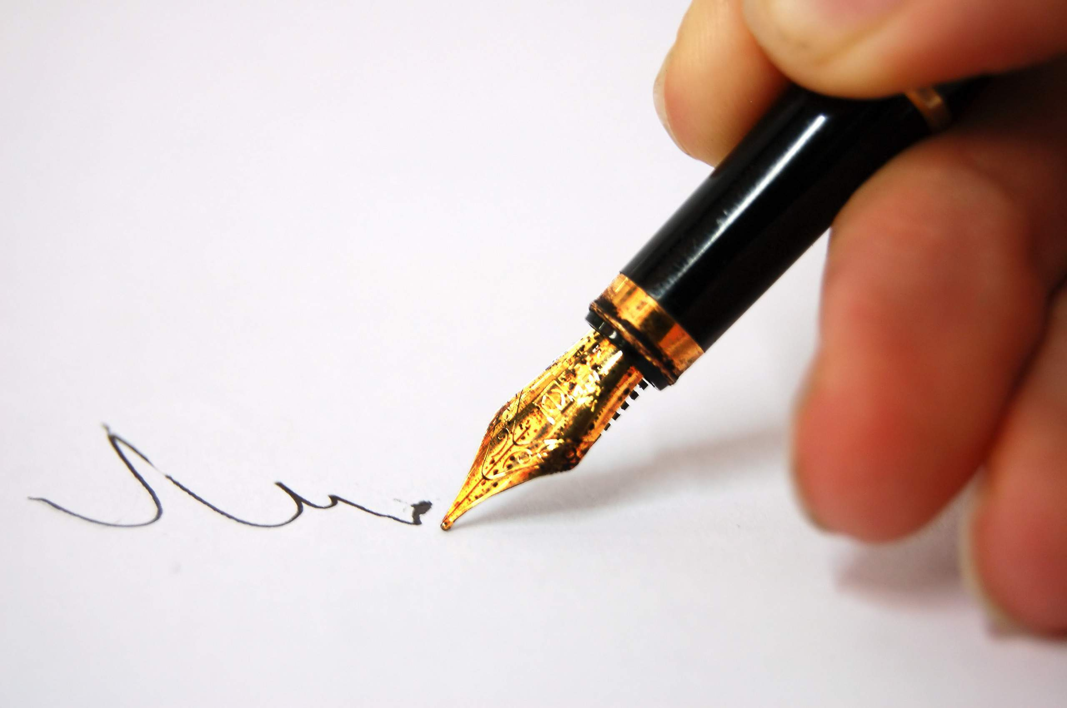
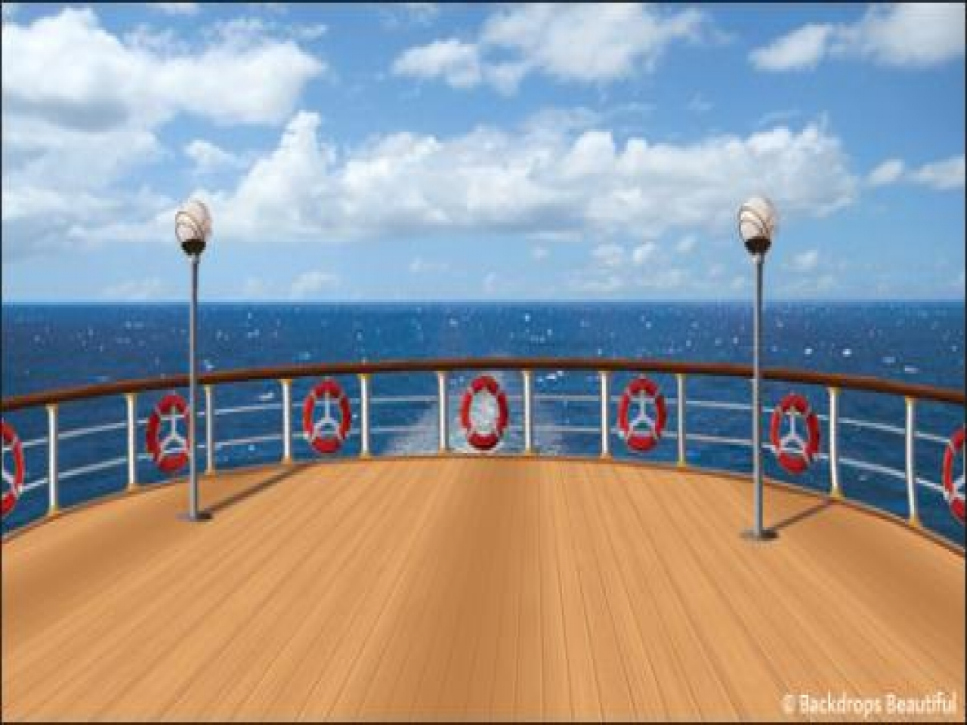
1. She wrote the wrong ------------------- so she was late to ----------- the students.
2. Sam had to ------------ the new football ----------- before putting it on the wall.

Slide 6
A ----------- of cards was found on the ship’s ------------- .
4. Form your ------------ properly when you are writing the
------------- to give to the mailman.

Slide 7
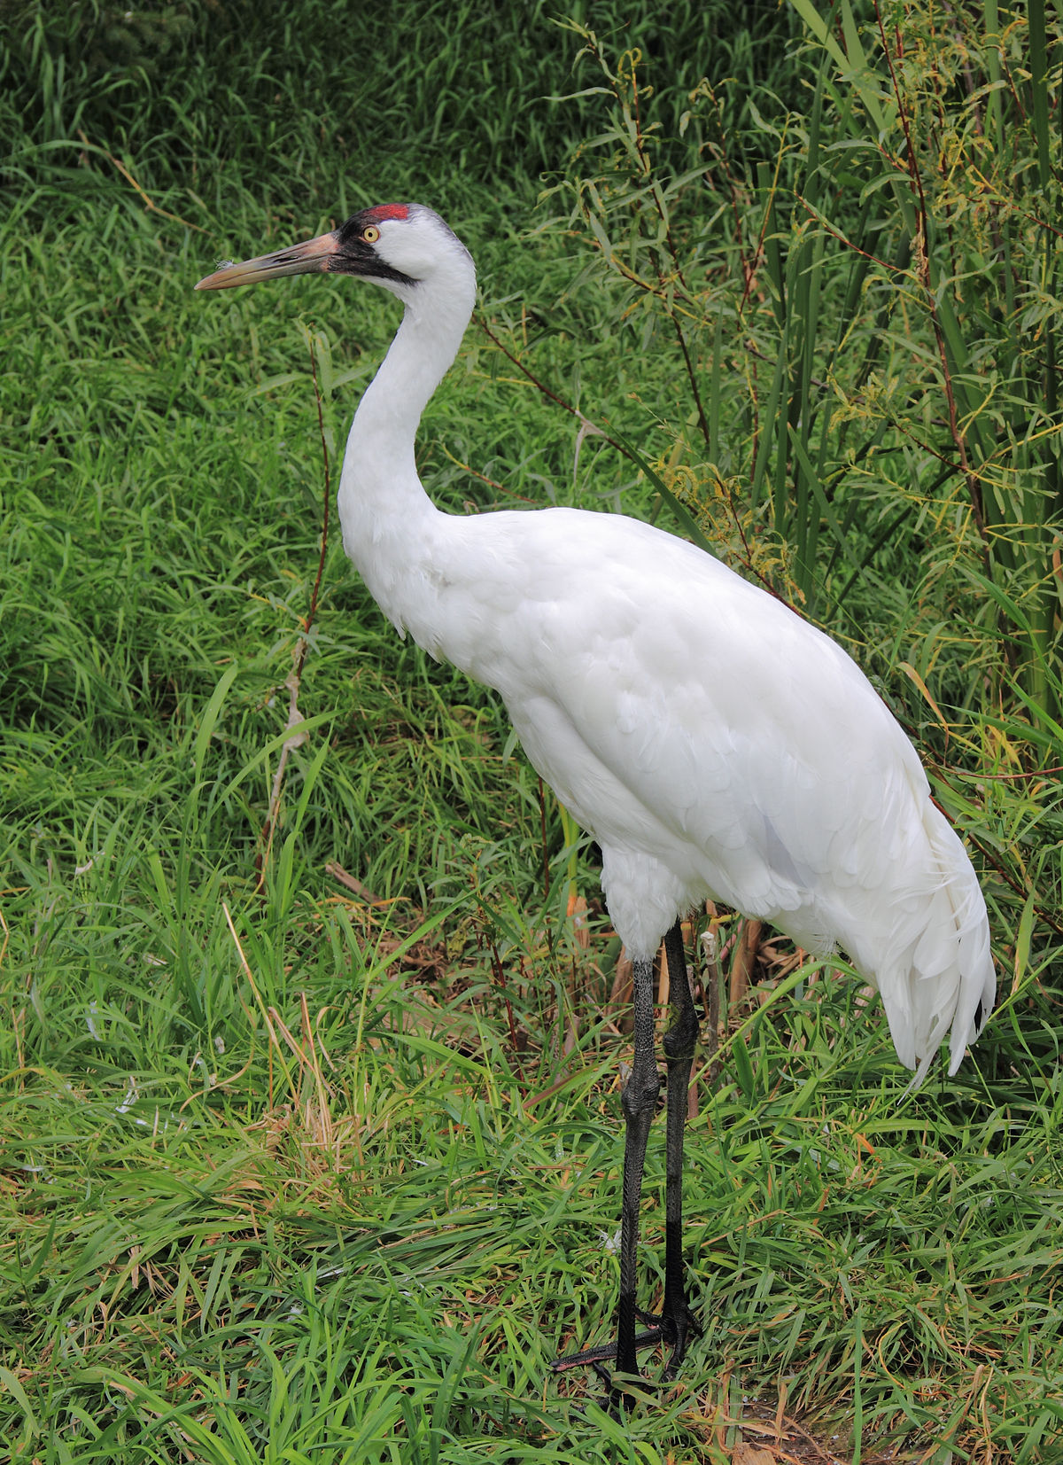
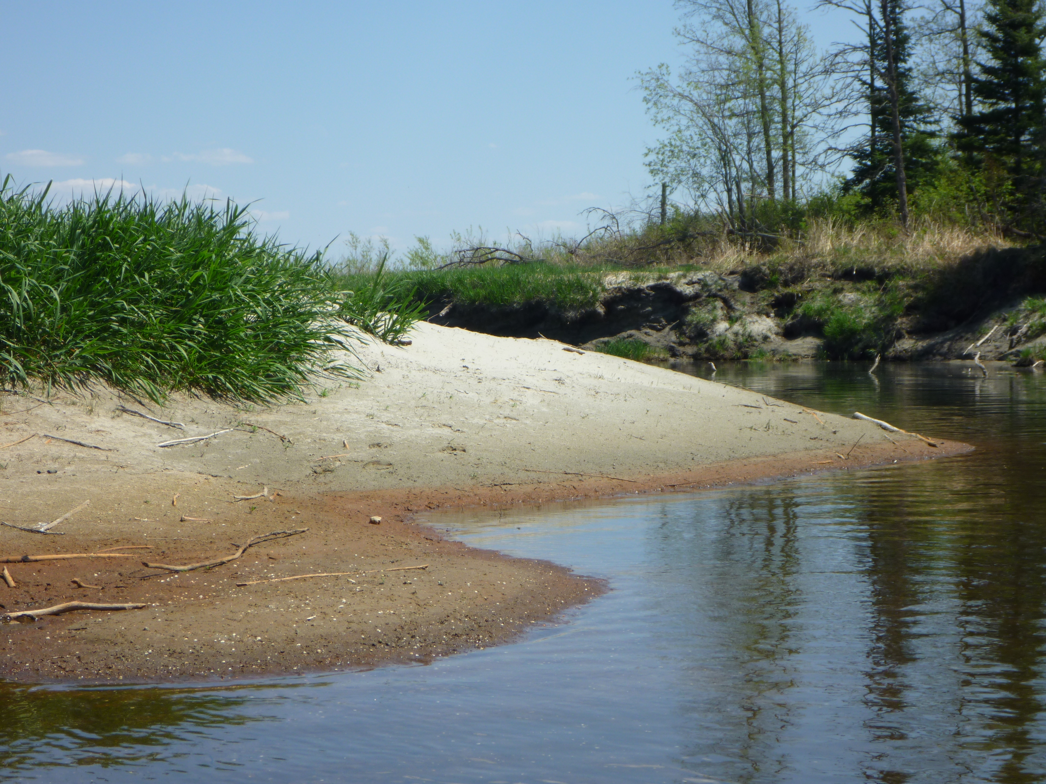
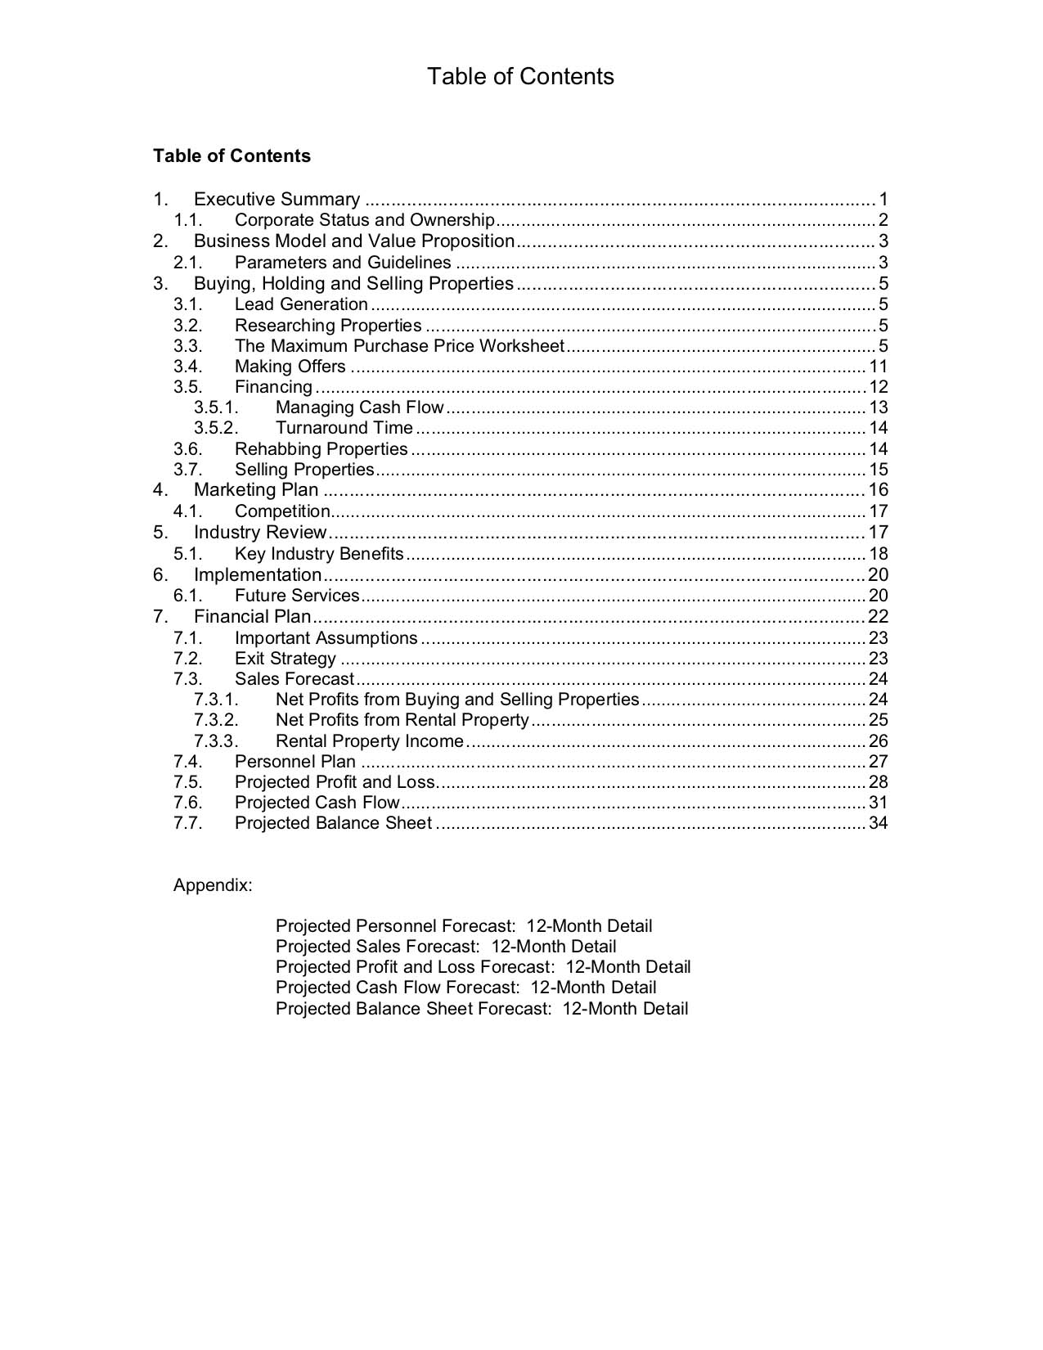
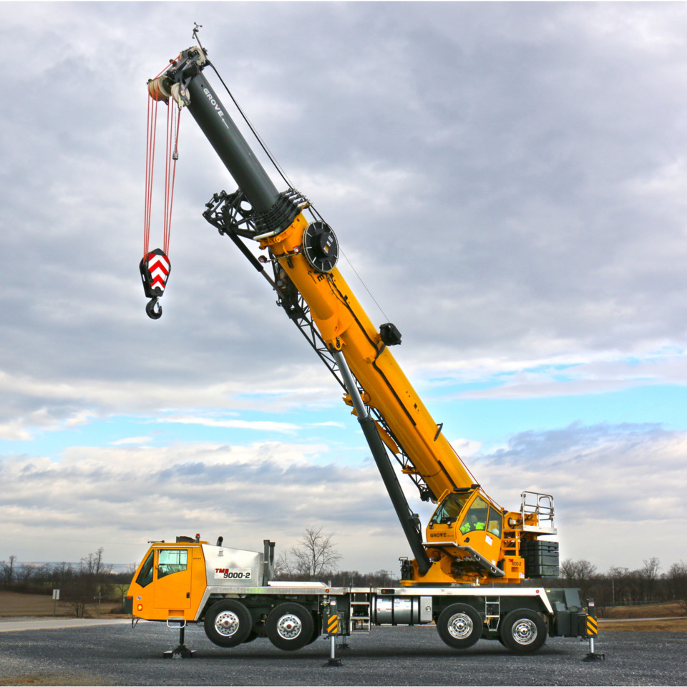
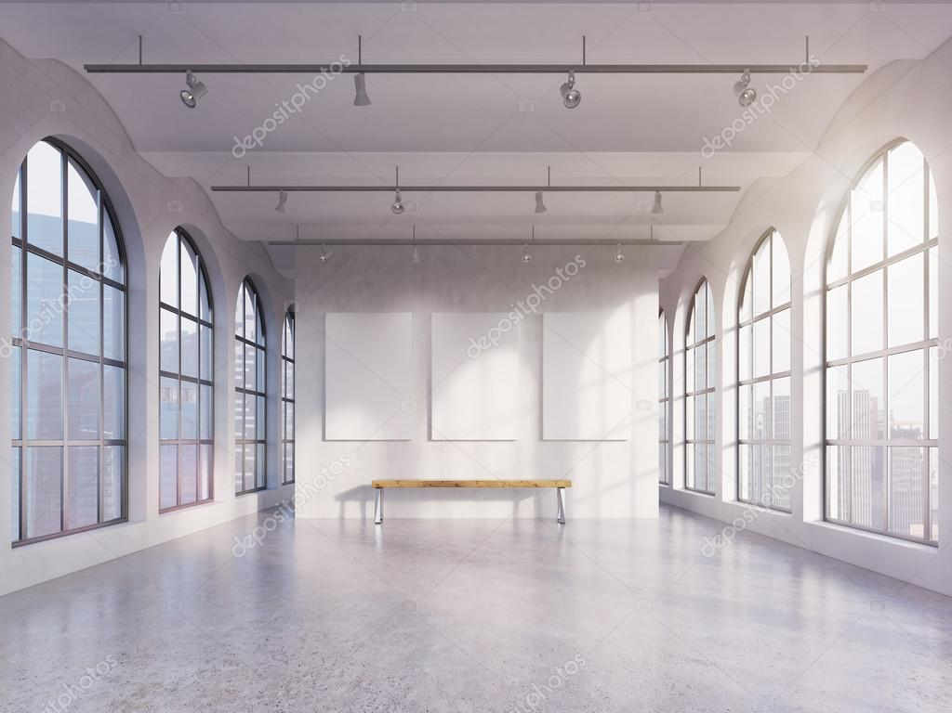
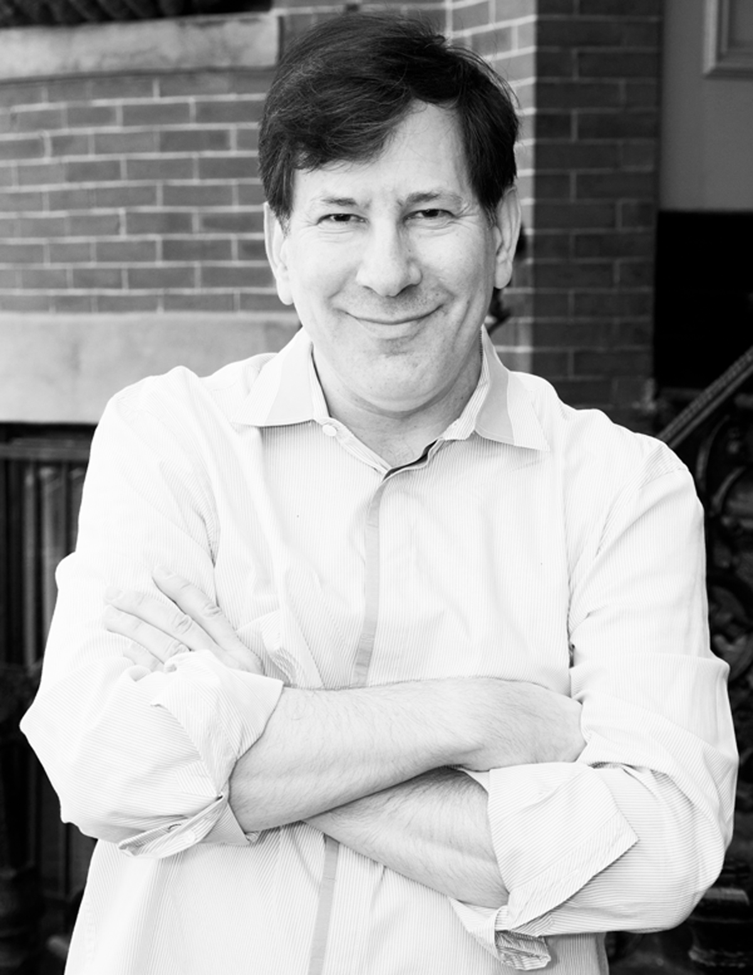
5. A ----------- had to be removed before the men could use the ------.
6. Lee was ----------- when he saw the movie’s ------------ was for children.

Slide 8
7. On the river ------------ was where he found the gold coins,
which he took to the ----------- .

Slide 9
Activity 2
Use the three homonyms below to create 3 sentences.
Example: Before we could enter the park, we had to park the car.
The three homonyms are, bat, wave and circular. Use your dictionary. Write your sentences.
1. ---------------------------------------------------------------------------------------------------- .
2. ---------------------------------------------------------------------------------------------------- .
3. ---------------------------------------------------------------------------------------------------- .

Slide 10
Activity 3
Draw images to represent any three homonyms from Activity 2.

Slide 11
THE ANSWERS Activity 1
She wrote the wrong so she was late to the students.
2. Sam had to the new football before putting it on the wall.

Slide 12
THE ANSWERS Activity 1
3. A ---------- of cards was found on the ship’s .
4. Form your properly when you are writing the to give to the mailman .

Slide 13
THE ANSWERS Activity 1
5. A had to be removed before the men could use the
.
6. Lee was when he saw the book’s was for children.

Slide 14
THE ANSWERS Activity 1
7. On the river was where he found gold coins,
which he took to the .

Slide 15
ANSWERS Activity 1
She wrote the wrong address so she was late to address the students.
Sam had to sign the new football sign before putting it on the wall.
A deck of cards was found on the ship’s deck.
Form your letters properly, when you are writing the letters to give to the mailman.

Slide 16
ANSWERS Activity 1
5. A crane had to be removed before the men could use the crane.
6. Lee was content when he saw the book’s content was for children.
7. On the river bank was where he found gold coins, which he took to the bank.

Slide 17
Answer Activities 2 and 3
Activity 2
Sentences in which the homophone pairs are used correctly
Activity 3
Any appropriate representation is acceptable

