Slide 1
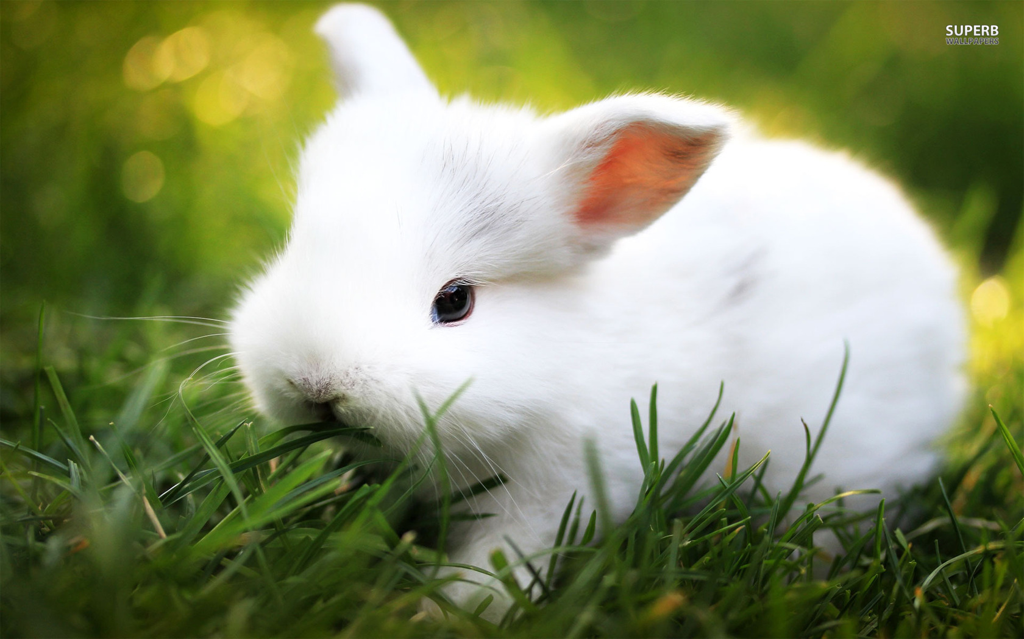
RABBIT REARING

Slide 2
Breeds of Rabbit
Rabbits are classified according to their uses:
Meat breeds
These rabbits are specially reared for meat. They should be well fleshed and should attain maturity at an early age of eight to ten weeks. The Flemish Giant, Belgian Hare and New Zealand White are all good meat breeds.

Slide 3
FLEMISH GIANT
NEW ZEALAND WHITE

Slide 4
Fur rabbits
The fur rabbits are reared for their pelts. All breeds of rabbits could give pelts, but better quality pelts are obtained from the Chinchilla and Sable breeds. Their hairs are fine, silky and glossy and are of two definite lengths with short under-coat hairs and longer guard hairs.

Slide 5
CHINCHILLA
SABLE

Slide 6
Wool Rabbits
Wool is the hair that is fine and wavy, an example of a wool type is the Angora

Slide 7
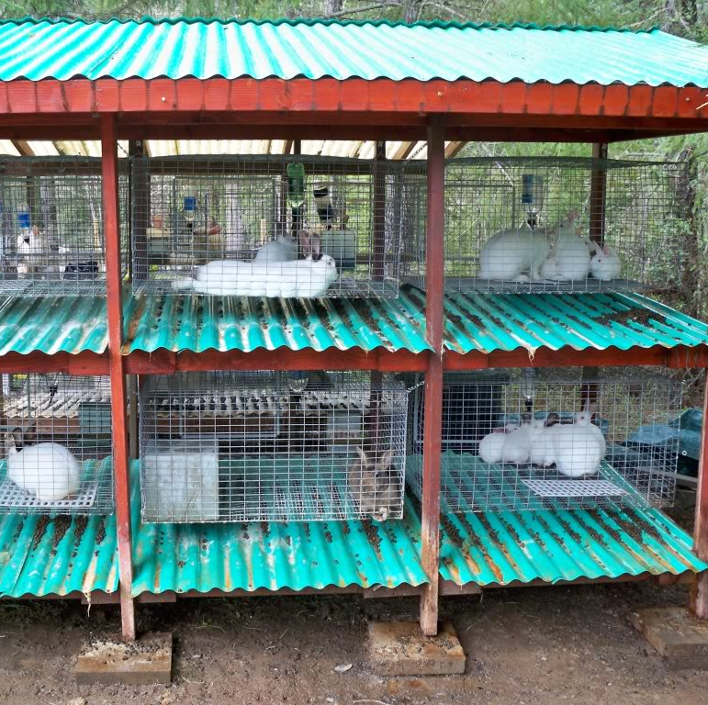
Housing of Rabbits
Rabbits are reared in hutches. A number of hutches are kept in a rabbitry or rabbit house. The best place to locate a rabbitry is on a flat well-drained area with shady trees around. Trees are especially helpful during hot weather conditions.
The floor should be solid and easy to clean.
Nest boxes should be provided for pregnant does

Slide 8
RABBIT DIGESTIVE SYSTEM
The rabbit is a herbivore but NOT a ruminant, it does not chew its cud and depends on bacterial digestion of cellulose.
Bacteria to digest cellulose is found in the caecum
Since the caecum is located after the stomach, the digested cellulose must first be passed out as soft droppings and reingested for absorption. This is called coprophagycoprophagy

Slide 9
RABBIT DIGESTIVE SYSTEM

Slide 10
Feeding
Rabbits, like other farm animals need food for healthy growth and development. A good ration consist of green feeds and concentrates, as well as household scraps. Since rabbits are nocturnal, they feed more at night
Green feeds
Green feeds are rich in proteins, vitamins and minerals. Only succulent material should be fed to the animals. It is so because the rabbit has a simple stomach and cannot deal with fibrous matter.
Green feeds consist of rabbit meat, patchoi, watergrass, cauliflower leaves, lettuce, sweet- potato slips, hibiscus leaves and various types of vines. Rabbits also delight in carrots, radish and sweet-potato tubers. Green feeds should be wilted before feeding to prevent diarrhoea
Commercial feeds
Commercial feeds for rabbits are not readily obtained in local markets. However, chicks starter rations or broiler starter rations are good substitutes. Rations are needed to supplement green feeds and just enough should be given so that the animal can eat it in twenty minutes. Pregnant mother does with litters should be given additional rations. Baby rabbits should consume about 56 g to 70 g of feed daily by weaning time that is, when they are seven to eight weeks old.
Household scraps
Rabbits accept fresh kitchen scraps such as crusts and fresh milk. Meat and greasy foods should be avoided.
Water
A supply of fresh pure water must be maintained regularly in the hutch. Rabbits drink a lot of water and it is especially important that a doe with a litter has steady supply.

Slide 11
Reproduction and Mating
Small breeds reach sexual maturity in 5 – 6 months old
Large breeds are bred at 8 – 10 months old
The gestation period is 31 days
Rabbits are mated by taking the doe to the buck.
After mating, ovulation occurs and the doe conceives
Bucks begin service at 9 – 12 months old
One buck is kept for ten to twelve does

Slide 12
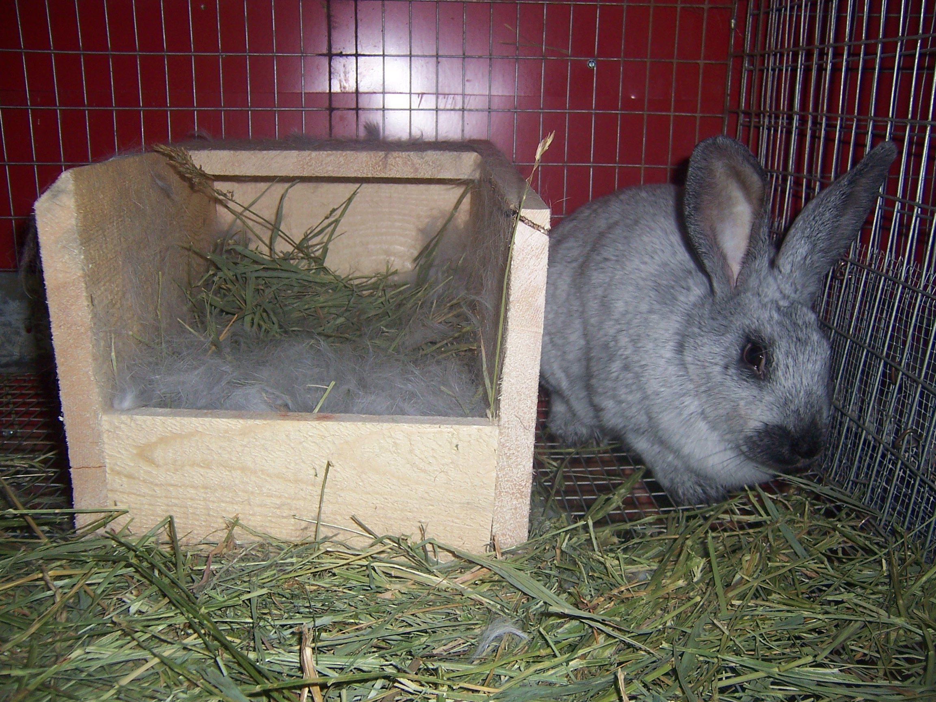
Kindling & Weaning
Kindling occurs 31 days after conception
One or two days before kindling, a nest box with straw is placed in the hutch. The doe will pull out her own fur to line the box.
The doe should not be disturbed at this time
Kittens are born naked and blind, avoid touching the rabbits with your bare hands since the mother may reject them
Weaning occurs approximately 8 weeks after kindling i.e. the kittens are separated from their mother in a gradual process.

Slide 13
How to correctly hold and handle a rabbit

Slide 14
Diseases
Snuffles
Symptoms – a runny nose, coughing and sneezing, rubbing of nose and eyes with forepaws
Treatment – treat with Sulphur drugs and antibiotics. Keep the rabbit in a dry draught free area. Ensure proper sanitation

Slide 15
Diseases
Coccidiosis
Symptoms – the rabbit looks droopy and loses appetite, dull eyes, diarrhea with bloody streaks in its faeces, abdomen swells up with gas and water
Treatment – ensure proper sanitation. A coccidiostat is used in the feed

Slide 16
Diseases
Mange
Symptoms – head shaking, itching and scratching, thick crusts of mites inside the ear, loss of fur, sores in the ears
Treatment – Mineral oil can be massaged into the ear, clean infected areas with antiseptic solution, apply lime/Sulphur ointment, adopt strict sanitation, clean and disinfect the rabbitry.

Slide 17
Past Papers

Slide 20
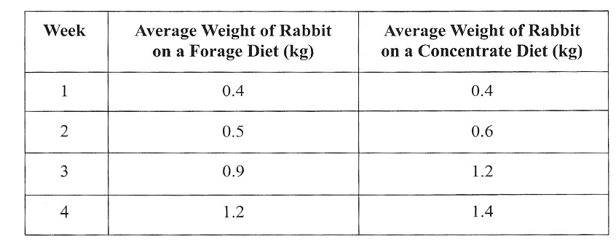

Slide 21
