Slide 1
CROPPING SYSTEMS
Farming is any deliberate attempt to produce crops and livestock. A cropping system is a way of growing crops
Notes:
Grasslands
(Basic)
Note: This template is optimized for PowerPoint 2010 and uses a video background. If used in PowerPoint 2007, video elements will play, but all content will be covered by video background when in slideshow. If used in PowerPoint 2003, video will not play, but the poster frame of the videos will remain in place as a static image.
The video:
Plays automatically after each slide transition.
Is 30 seconds long.
Seamlessly loops for infinite playback.
To add slides or change layout, do the following:
To add a new slide, on the Home tab, in the Slides group, click the arrow under New Slide, then click under Motion Background Theme select the desired layout.
To change the layout of an existing slide, on the Home tab, in the Slides group, click Layout, then select the desired layout.
This template uses the “Pushpin” Theme Font. To access or change the Theme Font, do the following:
On the View tab in the Master Views group, select Slide Master.
In the Slide Master view, select slide 1 (the Master Slide for Master Layouts that use the video background).
On the Slide Master tab, in the Edit Theme group, click Fonts, and then select new theme fonts.
Using animated elements:
Any animated element will begin after the slide transition and the background video has started.

Slide 2
THE NEED for AN EFFICIENT SYSTEM of FARMING
People need food to live. Land space is limited and population is growing.
With time, standards of living rise. The demand for luxuries increases. Production by farmers has to increase so as to increase income.
In some countries, there are no or little natural deposits. To get money to pay for goods and services, farmers must increase productivity.
Farming generates employment.
An efficient system of farming makes economic use of resources.

Slide 3
THE PLANTATION SYSTEM

Slide 4
Some major features of the plantation system:
The system involves a large acreage cultivated with one main crop.
There are several employees, many technically trained.
It is highly mechanised.
.

Slide 5
A PINEAPPLE PLANTATION

Slide 6
MONOCROPPING

Slide 7
Some major features of mono-cropping:
This system involves the growing of one type of annual crop, harvesting it and planting another on the same piece of land.
Mono-cropping is very risky. Farmers are exposed to the danger of poor harvest due to pest and diseases or climatic conditions.

Slide 8
MONOCULTURE

Slide 9
Some major features of monoculture:
This system involves the growing of the same crop on the same piece of land year round.
The same nutrients are used up, leading to soil exhaustion.
It exposes the farmer to risk such as inadequate income from a low price or a drop in price of the particular crop grown; a crop failure means a complete loss for the farm and farmer.
It encourages specialisation.

Slide 10
MIXED FARMING

Slide 11
Some major features of mixed farming:
The system involves the rearing of livestock and planting of crops.
Land is used more efficiently and reduces the risk of failure.
Excess from the garden is fed to the animals.
Excreta and litter (manure) from the pens are used in the garden.
Disadvantages:
A higher level of management is required.
A labour force needs to be trained.
There is need to find markets for different produce.
Animals can damage crops if they are not properly enclosed or tethered.

Slide 13
INTEGRATED FARMING

Slide 14
Integrated farming is the practice of growing crops and raising livestock simultaneously. Integrated farming is diversification at its best
Examples of integrated farming include; using pigs to clear fields of rocks and roots prior to planting a crop. Poultry is used to clean up rotten fruit and weeds found in orchards and vineyards at the end of the season as well as add fertilizer to the soil. Cattle grazing on cover crops grown in between other crops keep the land fertilized as well as manicured.

Slide 16
SUBSISTENCE FARMING

Slide 17
Some features of subsistence farming:
Earnings are supplemented from other jobs.
It assists with family food requirements.
Some Major Features Of Shifting Cultivation:
The land is cleared (usually by burning) and planted.
The farmer relies on natural fertility.
Simple tools are used.
The land is abandoned to grow into secondary forest and the farmer moves on to another area.

Slide 19
MIXED CROPPING

Slide 20
Some major features of mixed cropping:
This system involves the cultivation of more than one type of crop on a piece of land at the same time, e.g., corn and yam.
It makes efficient use of soil resources.
Mechanisation may not be possible.

Slide 21
CROP ROTATION

Slide 22
This is a system whereby the ground is kept under cultivation in such way that the crops follow in a definite order or cycle.
Some crops use a fair quantity of nutrients, .e.g., yams, maize, and cassava; while some use less, .e.g., tomatoes, pumpkin.
Other adds nutrients, .e.g., legumes, and grasses.
Crops have different root lengths- shallow rooted and deep rooted.
These variables are made use of in a crop rotation system.

Slide 23
Benefits of Crop Rotation
Crop rotation improves soil fertility.
It controls pests and diseases.
It controls weeds.
Labour is occupied throughout the year.
Income is maintained throughout the year.

Slide 24
INTERPLANTING & INTERCROPPING

Slide 25
INTERCROPPING
INTERPLANTING
Interplanting is the growing of a major crop in between planting of another major crop, e.g., cassava and corn.
Intercropping is the planting of quick growing and quick maturing crops between slow growing and slow maturing crops, e.g., melon and yam

Slide 26
INTERPLANTING
INTERCROPPING

Slide 27
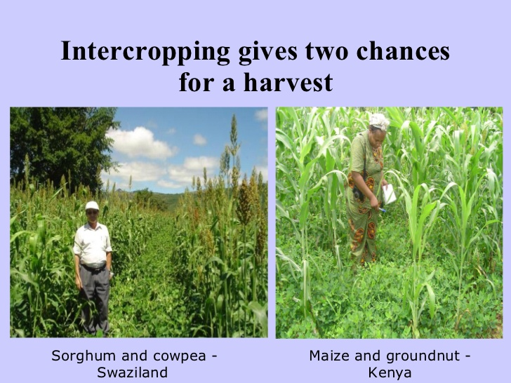

Slide 28
PHASED CROPPING

Slide 29
This is a system of continuous cropping and harvesting. A plot of land is divided into 4 sections. The planting dates are sequenced so that there is continuous cropping and harvesting of produce. This allows the farmer to maintain a regular supply of produce without causing a glut on the market.

Slide 30
STRIP CROPPING & CONTOUR CROPPING

Slide 31
Both of these systems are used on sloping land.
Strip cropping refers to planting crops in strips of varying widths. It is normally used as a soil conservation measure.
Contour cropping
. Is another soil conservation measure. The land is ploughed along the contours and then the crops are planted

Slide 32
COVER CROPPING

Slide 33
This involves planting a crop that grows rapidly and provides cover on bare soil. It is usually planted after the main crop has been harvested and can be ploughed into the soil as green manure before replanting

