Slide 1
Identification, Prevention, and Treatment of Dance Injuries
PART ONE

Slide 3
Dance involves the use of the entire body which requires a combination of flexibility, force and joint movement. Dancers are most prone to injuries due to the overuse of joints and muscles. The main areas of the dancer’s body which experience overuse are:
Ankle
Foot
Leg
Lower back
However, injuries can occur throughout the entire body, especially where joints are located (elbows, knees, shoulders) etc.

Slide 4
Let us recap ‘JOINTS’

Slide 5
A joint is where two bones meet.
What is a Joint?
The function of a joint is to allow movement to take place between two bones. It is the presence of the joints which allows the skeleton as a whole to be flexible.

Slide 6
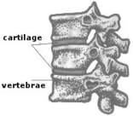
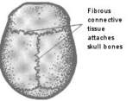
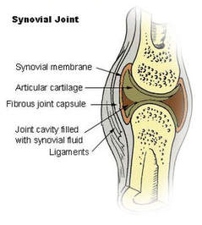
There are THREE types of Joints
CARTILAGINOUS FIBROUS SYNOVIAL
Little movement but gives great strength
Little or no movement
The most movable joint. These are the ones of greatest concern to a dancer.

Slide 7
Synovial Joints
The joint is lubricated by synovial fluid and is surrounded by a layer of tissue called synovial membrane.
Cartilage covers the bone, reducing friction and allowing smooth movement.
These allow or restrict movement according to their structure.

Slide 8
Synovial Joints Cont’d
There are six types of synovial joints: ball and socket, ellipsoid (condyloid), gliding, hinge, pivot and saddle.
Synovial joints allow a range of movement: flexion, extension, abduction, adduction, rotation, circumduction.

Slide 9
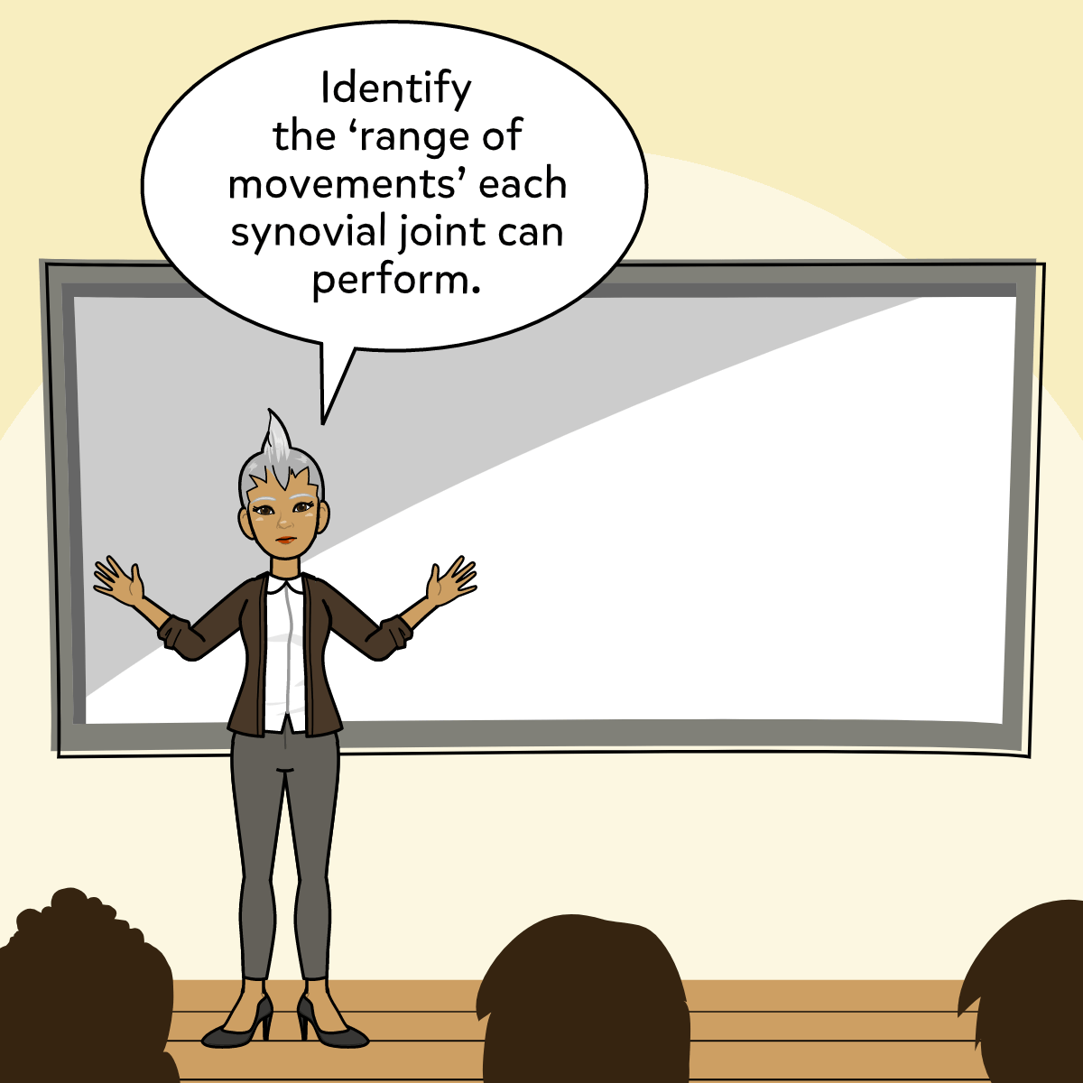
Activity
Complete the chart on the board with all relevant information. More columns are required
Joint | Joint Type | Movement Range
Knee | Hinge | Flexion,-------,----
Wrist | ----, ----

Slide 10
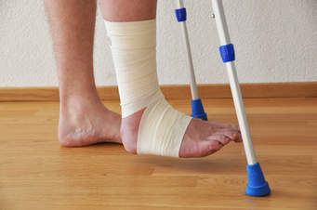
Common Dance Injuries and Location

Slide 11
BODY LOCATION | INJURY
Foot and ankle | Achilles tendonitis, Trigger toe Ankle impingement, Sprains, Strains
Knee | Patellofemoral pain syndrome
Hip | Snapping hip syndrome, Hip impingement, Labral tears, Hip flexor tendonitis, Hip bursitis Sacroiliac joint dysfunction

Slide 12
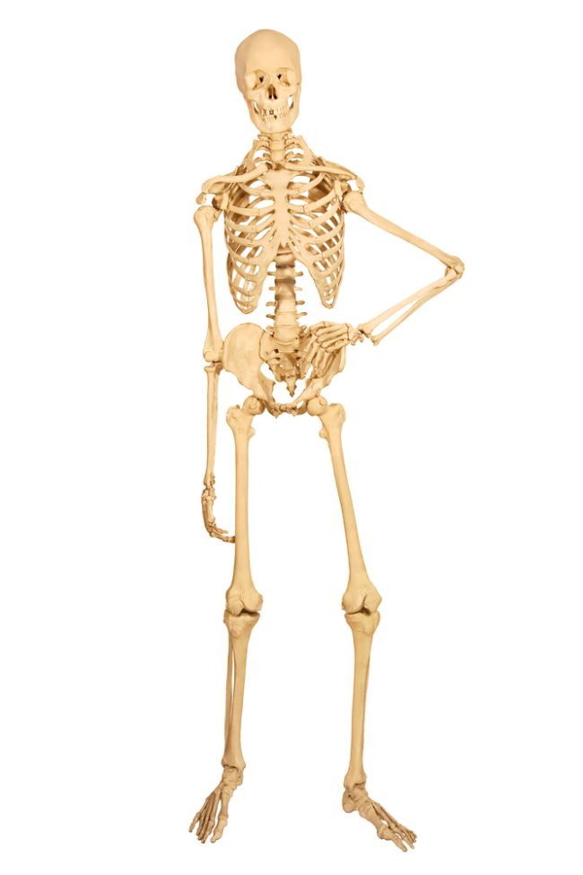
Activity
Research the injuries mentioned in the previous slide.
Look at the skeleton and see if you can identify exactly where the injuries would be located.

Slide 13
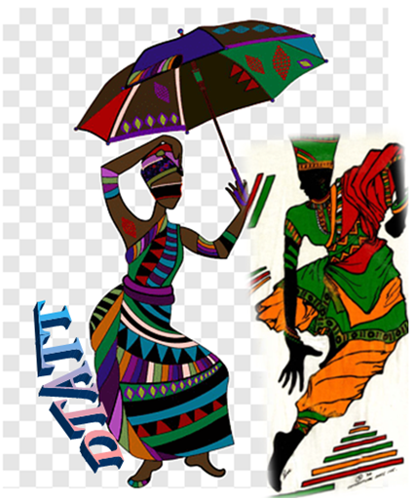
Compiled by
Roxanne De Souza- Diego Martin Central Secondary
Deon Baptiste- San Juan South Secondary
Julia Le Gendre-Stewart- Barrackpore East Secondary
Edited by:
Roxanne De Souza- Phillip
Dance Teachers’ Association of Trinidad and Tobago
(DTATT)

Slide 14
References
Ashley, Linda. Essential Guide to Dance. Third edition. (2008). Hackette UK Company
Clunie, Maggie. Dale, Liz et. AQA Dance GCSE. (2014). Oxford University Press
http://clipart-library.com/clipart/n723102.htm
https://gasparinutrition.com/blogs/fitness-facts/5-benefits-of-healthy-eating
https://giphy.com/gifs/sport-stay-hydrated-water-of-life-fSGJfM5HNbzz3NmCNo
https://giphy.com/gifs/spiritedaway-spirited-away-3oz8xTAJIQD6JWfTUc
https://www.livescience.com/44137-skeletal-system-surprising-facts.html
https://int.search.myway.com/search/AJimage.jhtml?&n=7849f3f6&p2=%5EY6%5Expv190%5ETTAB03%5ETT&pg=AJimage&pn=1&ptb=1CA02819-4072-4D3F-AD7F-7A4F55625703&qs=&si=XXXXXXXXXX&ss=sub&st=tab&trs=wtt&searchfor=fibrous+joint&tpr=jrel3&ots=1588700237748&imgs=1p&filter=on&imgDetail=true
https://int.search.myway.com/search/AJimage.jhtml?&n=7849f3f6&p2=%5EY6%5Expv190%5ETTAB03%5ETT&pg=AJimage&pn=1&ptb=1CA02819-4072-4D3F-AD7F-7A4F55625703&qs=&si=XXXXXXXXXX&ss=sub&st=tab&trs=wtt&searchfor=cartilaginous+joint&tpr=jrel3&ots=1588700477231&imgs=1p&filter=on&imgDetail=true

Slide 15
References Cont’d
https://int.search.myway.com/search/AJimage.jhtml?&n=7849f3f6&p2=%5EY6%5Expv190%5ETTAB03%5ETT&pg=AJimage&pn=1&ptb=1CA02819-4072-4D3F-AD7F-7A4F55625703&qs=&si=XXXXXXXXXX&ss=sub&st=tab&trs=wtt&searchfor=synovial+joint&tpr=jrel3&ots=1588700512480&imgs=1p&filter=on&imgDetail=true
https://www.istockphoto.com/vector/cartoon-glass-with-water-gm1190637194-337593324?irgwc=1&esource=AFF_IS_IR_SP_ClipArtLogo.com_340407_&asid=ClipArtLogo.com&cid=IS&utm_medium=affiliate_SP&utm_source=ClipArtLogo.com&utm_content=340407&clickid=1Xc16vzKaxyOTPGwUx0Mo3YVUkizOIWW%3A3zmww0
https://int.search.myway.com/search/AJimage.jhtml?&n=7849f3f6&p2=%5EY6%5Expv190%5ETTAB03%5ETT&ptb=1CA02819-4072-4D3F-AD7F-7A4F55625703&qs=&si=XXXXXXXXXX&ss=sub&st=tab&trs=wtt&tpr=sbt&enc=2&searchfor=XSlUlZGZJLr4_faMCxL2MwPuofbX_Rfd0UwW26j6KZrHKTCJvwPEicFuytEV5u04UQot3UNnCMNfMtvI38PCmQT2uDh7hnItKsbNNvX1jQR84BFTydKvxA4V_XRmAwdGHs9HyPD2IsHLe1TSzs30nKf_yPpBYDycQ-WiRQnJSdcwgwbRz1mP3liegjvHA5LlnS0xxyrWhACLInKkf7at9zlPpeLNcNxTXVde3JlAbgxzsoVgStgWjZp6uWLqG_swTEQMYLHCb4784BsKWH8jT7KRKjuTpats11MRqWV8_K09y4HsL6krixCnWLkVgiLJUrNrPTgRUyd7TpRUjXMsoQ&ts=1588727648947&imgs=1p&filter=on&imgDetail=true
https://www.balletdancersguide.com/ballet-dancers-loosing-weight.html
https://www.dreamstime.com/stock-image-healthy-eating-funny-little-pair-dancers-made-orange-slices-image35924231
https://www.dimensions.guide/element/ballet-male-dancers
https://twitter.com/spinalogy/status/759244714583396352
https://www.youtube.com/watch?v=779HgCRhEJQ
https://www.youtube.com/watch?v=PxCac1HzoJ8

Slide 16
Answer Key/Joint Movement Chart
JOINT | JOINT TYPE | MOVEMENT RANGE
Shoulder | Ball and Socket | Adduction, Abduction, Flexion, Extension, Rotation, Circumduction.
Hip | Ball and Socket | Adduction, Abduction, Flexion, Extension, Rotation, Circumduction.
Wrist | Gliding | Adduction, Abduction, Flexion, Extension
Elbow | Hinge | Flexion, Extension, Some rotation when not bearing weight
Knee | Hinge | Flexion, Extension, Some rotation when not bearing weight
Ankle | Gliding | Adduction, Abduction, Flexion, Extension
Go
to next Slide

Slide 17
Answer Key/Joint Movement Chart
JOINT | JOINT TYPE | MOVEMENT RANGE
Thumb | Saddle | Adduction, Abduction,Flexion, Extension
Neck/head | Pivot | Rotation
Finger | Ellipsoid/Condyloid | Adduction, Abduction,Flexion, Extension

Slide 18
Compiled by
Roxanne De Souza- Diego Martin Central Secondary
Deon Baptiste- San Juan South Secondary
Julia Le Gendre-Stewart- Barrackpore East Secondary
Edited by:
Roxanne De Souza- Phillip
Dance Teachers’ Association of Trinidad and Tobago
(DTATT)

Slide 19
References
Ashley, Linda. Essential Guide to Dance. Third edition. (2008). Hackette UK Company
Clunie, Maggie. Dale, Liz et. AQA Dance GCSE. (2014). Oxford University Press
http://clipart-library.com/clipart/n723102.htm
https://gasparinutrition.com/blogs/fitness-facts/5-benefits-of-healthy-eating
https://giphy.com/gifs/sport-stay-hydrated-water-of-life-fSGJfM5HNbzz3NmCNo
https://giphy.com/gifs/spiritedaway-spirited-away-3oz8xTAJIQD6JWfTUc
https://www.livescience.com/44137-skeletal-system-surprising-facts.html
https://int.search.myway.com/search/AJimage.jhtml?&n=7849f3f6&p2=%5EY6%5Expv190%5ETTAB03%5ETT&pg=AJimage&pn=1&ptb=1CA02819-4072-4D3F-AD7F-7A4F55625703&qs=&si=XXXXXXXXXX&ss=sub&st=tab&trs=wtt&searchfor=fibrous+joint&tpr=jrel3&ots=1588700237748&imgs=1p&filter=on&imgDetail=true
https://int.search.myway.com/search/AJimage.jhtml?&n=7849f3f6&p2=%5EY6%5Expv190%5ETTAB03%5ETT&pg=AJimage&pn=1&ptb=1CA02819-4072-4D3F-AD7F-7A4F55625703&qs=&si=XXXXXXXXXX&ss=sub&st=tab&trs=wtt&searchfor=cartilaginous+joint&tpr=jrel3&ots=1588700477231&imgs=1p&filter=on&imgDetail=true

Slide 20
References Cont’d
https://int.search.myway.com/search/AJimage.jhtml?&n=7849f3f6&p2=%5EY6%5Expv190%5ETTAB03%5ETT&pg=AJimage&pn=1&ptb=1CA02819-4072-4D3F-AD7F-7A4F55625703&qs=&si=XXXXXXXXXX&ss=sub&st=tab&trs=wtt&searchfor=synovial+joint&tpr=jrel3&ots=1588700512480&imgs=1p&filter=on&imgDetail=true
https://www.istockphoto.com/vector/cartoon-glass-with-water-gm1190637194-337593324?irgwc=1&esource=AFF_IS_IR_SP_ClipArtLogo.com_340407_&asid=ClipArtLogo.com&cid=IS&utm_medium=affiliate_SP&utm_source=ClipArtLogo.com&utm_content=340407&clickid=1Xc16vzKaxyOTPGwUx0Mo3YVUkizOIWW%3A3zmww0
https://int.search.myway.com/search/AJimage.jhtml?&n=7849f3f6&p2=%5EY6%5Expv190%5ETTAB03%5ETT&ptb=1CA02819-4072-4D3F-AD7F-7A4F55625703&qs=&si=XXXXXXXXXX&ss=sub&st=tab&trs=wtt&tpr=sbt&enc=2&searchfor=XSlUlZGZJLr4_faMCxL2MwPuofbX_Rfd0UwW26j6KZrHKTCJvwPEicFuytEV5u04UQot3UNnCMNfMtvI38PCmQT2uDh7hnItKsbNNvX1jQR84BFTydKvxA4V_XRmAwdGHs9HyPD2IsHLe1TSzs30nKf_yPpBYDycQ-WiRQnJSdcwgwbRz1mP3liegjvHA5LlnS0xxyrWhACLInKkf7at9zlPpeLNcNxTXVde3JlAbgxzsoVgStgWjZp6uWLqG_swTEQMYLHCb4784BsKWH8jT7KRKjuTpats11MRqWV8_K09y4HsL6krixCnWLkVgiLJUrNrPTgRUyd7TpRUjXMsoQ&ts=1588727648947&imgs=1p&filter=on&imgDetail=true
https://www.balletdancersguide.com/ballet-dancers-loosing-weight.html
https://www.dreamstime.com/stock-image-healthy-eating-funny-little-pair-dancers-made-orange-slices-image35924231
https://www.dimensions.guide/element/ballet-male-dancers
https://twitter.com/spinalogy/status/759244714583396352
https://www.youtube.com/watch?v=779HgCRhEJQ
https://www.youtube.com/watch?v=PxCac1HzoJ8

Slide 21
Activity Answer Key

