Slide 1
FARM eCONOMICS
The Laws of Demand & Supply
Equiibrium Price

Slide 2
Look at the video on the law of demand
As you watch, make your notes

Slide 3
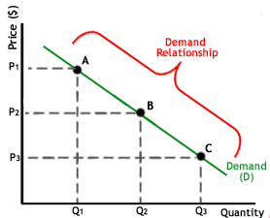
The law of demand states that the higher the price, the lower the quantity demanded. This is represented in the graph below

Slide 4
Changes in demand
Results in a new demand curve.
Lower demand causes the curve to shift to the left
Higher demand causes the curve to shift to the right

Slide 5
FACTORS AFFECTING CHANGE IN DEMAND
Change in taste and preference
Change in income
Change in technology to replace old products with new ones
Change in population
Future trade expectations
Taxes and duties
Advertising

Slide 6
Look at the video on the law of supply
As you watch, make your notes

Slide 7
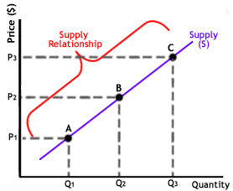
The law of supply says that as the price of an item goes up, suppliers will attempt to maximize their profits by increasing the quantity offered for sale. This is represented by the graph below

Slide 8
Changes in supply
Results in a new supply curve
A decrease in supply causes the curve to shift to the left
An increase in supply causes the curve to shift to the right

Slide 9
FACTORS AFFECTING CHANGE IN SUPPLY
The producer consumes more of his own product
Change in cost of production
Change in technique of production
Changes in the weather
Taxation
Future expectations

Slide 10
Look at the video on equilibrium price
As you watch, make your notes

Slide 11
EQUILIBRIUM PRICE –
The state in which market supply and demand balance each other and, as a result, prices become stable. Generally, when there is too much supply for goods or services, the price goes down, which results in higher demand. The balancing effect of supply and demand results in a state of equilibrium.
The equilibrium price is where the supply of goods matches the quantity demanded.

Slide 12
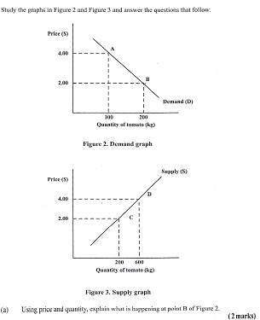
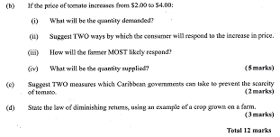
Review questions

Slide 13
