Slide 1
Improvisation (Improv) Prepared by Kerwyn Curt Allan Turnbull
EMPOWERING THE SELF DIRECTED LEARNER

Slide 2
WHO IS A SELF DIRECTED LEARNER?
YOU ARE!

Slide 4
Objectives (This is a revision lesson for you because you were already exposed to the basics of improv in forms three and term 1 & 2 in form four.)
1. Define the term improvisation (Cognitive)
2. Apply drama skills for prepared or impromptu improvisations (the tools). (Cognitive)
3. Create and present simple improvisation scenes for short plays. (Cognitive, Psychomotor, Affective)
4. Demonstrate an appreciation for creating and using improvisation to build plays. (Affective)

Slide 5
DEFINITION
1. Improvisation is devising (creating) on the spot. 2. Improvisation is the spontaneous use of movement and speech to create a character (person or animal) or object in a particular situation. Adapted from (© Ministry of Education Published in 2014 by the Curriculum Development Division Ministry of Education Rudranath Capildeo Learning Resource Centre Mc Bean, Couva Republic of Trinidad and Tobago)

Slide 6
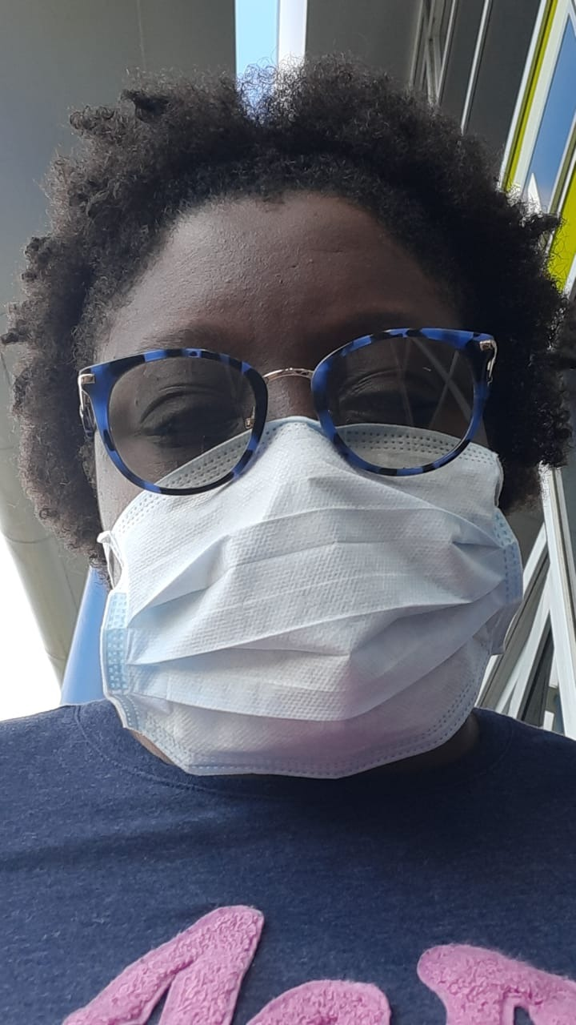
Using items to make improv
Different objects, proverbs (sayings) and situations can be used as stimuli for improvisation.
Objects | Proverbs/ Sayings | Situations
A bunch of keys A bottle of hand sanitizer A mask | Yuh never miss de water till de well runs dry. De longest rope has an end. How yuh make yuh bed so yuh lie. https://www.youtube.com/watch?v=DUmt21TqHw4&list=RDJkDenyslF84&index=20 | The fight At the cricket match You see someone wearing a mask in public

Slide 7
Rules of Improv
By Christopher Farlow
https://www.youtube.com/watch?v=StESLTnGyHM

Slide 8
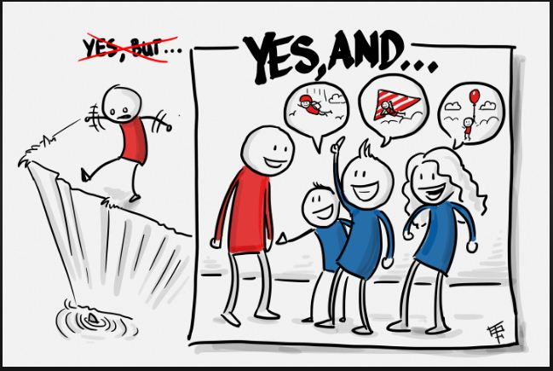
Building improv…
In this picture the word BUT causes the story to come to an abrupt end. The alternative is to use “AND” to progress the improv. Using “YES AND” helps to build the plot for the improv, taking it to its high point and successfully to it’s ending, where everyone is happy.
Illustrator unknown

Slide 9
Improv in Action
Start with a warm up.
Tell the body that work for creating an improv is about to happen.
Brainstorm ideas for the improv.
In this activity participants are creating lines for the improv idea. In each instance, that idea can be used to create the improv or add to the improv.

Slide 10
Improv in Action continued.
What to do and what not to do when building improv?
This is an excellent way to build dialogue for your improvisation scene:
Who, What Where, When, Why and sometimes How?
In the above video, the student automatically adds to the improv using the accent used by the teacher.
In every instance the student jumped in and ran with what was happening.
When you plan your improv, try this, to see where it leads you and your group.

Slide 11
Improv in Action continued.
Pay attention to the use of the body and voice. The student in the video uses the mind.
She thinks and uses the information from the teacher’s dialogue to build the improv.
Q &A based on the first activity in the video
Who are the characters in the scene?
Two elderly women.
What were they engaged in?
Pre lunch conversation.
Where were they?
In an old folks home.
When?
Before lunch.
Why?
Because she is seeing her friend moving around for the fist time after surgery.
How did they get there?
Because they know it is lunch time
What did they use to move the improv forward?
By one character using the line “Would you help me get to the lunch line?”

Slide 12
Activities
Using a stimuli from each section on slide 6 (objects, proverbs/saying and situation), brainstorm and jot ideas for an improv scene.
Using 3-5 members of your family, create ONE improv scene (3-5 mins long) from the brainstormed ideas. Video/audio record your improvised scene.
Create a group chat with 3-5 of your classmates. Discuss with the aim of creating an improv piece based on ONE OTHER stimuli from slide 6.
Journal the process and reflect on the experience.

Slide 13
Assessment
In your own words define the term improvisation. (2 mks)
What are three ways to build improv? (6 mks)
Create a list of three objects, three local sayings, three situations which you can use to build improv scenes. (9 mks)
(i) Using the picture of the mask from slide 6, in point form state your process for creating an improvisation scene using the picture. (6 mks)
(ii) Create a simple dialogue for the above improvisation scene. (7 mks)
5. Write an e-mail to your class teacher informing him or her of the advantages associated with using improv in theatre. (10 mks)

Slide 14
References
Farlow, C. (2015). Rules of Improv. Retrieved from: https://www.youtube.com/watch?v=StESLTnGyHMn
IsDePanInM
(2011). Mighty Bomber – Proverbs. Retrieved from: https://www.youtube.com/watch?v=DUmt21TqHw4&list=RDJkDenyslF84&index=20
Study.com (n.,d). What is Self-directed learning. Retrieved from: https://study.com/academy/lesson/self-direct-learning-definition-strategies.html
Vora, T. (n.d). 3L’s of Self-Directd learning. Retrieved from https://www.google.com/search?q=self+directed+learning&rlz=1C1CHBF_enTT883TT886&sxsrf=ALeKk02x1tJI6dkz0r2iBcMfb7KlEdHayg:1585502358852&tbm=isch&source=iu&ictx=1&fir=_8fmahQt1mja6M%253A%252CFMoXHvqhSBSwYM%252C_&vet=1&usg=AI4_-kSf3Aj3kG-9EGFrgQkhhwcBGQtl1g&sa=X&ved=2ahUKEwiC3Y7HmMDoAhWxTd8KHZKhAzMQ9QEwAXoECAYQAw#imgrc=Aw1MzH7m1OnkzM
Flynn, R. (2014). Introducing Improvisation in the Classroom. Retrieved from: ttps://vimeo.com/84647481

Slide 15
Thank You.
Be wise….improvise!

