Slide 1
Subject Area: Logistics and Supply Chain Operations Level: CAPE Curriculum Topic: Logistics and Supply Chain Operations
Unit 1 Module 2 Objective 3
Key Teaching Points: (1) Explain the concept of supply chain operations

Slide 2
Definition
Supply chain operations are any systems involved in moving goods and services from the supplier to the consumer.

Slide 3
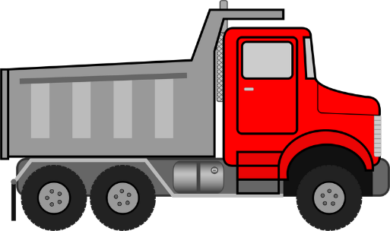
Activity 1
Label the supply chain operation below using the terms: consumer, producer, supplier, wholesaler, retailer
Wholesaler
Supplier
Producer
Consumer
Retailer

Slide 4
Intermediaries
Manufacturer – One who produces goods for resale or use.
Wholesaler – A person or business that buys from the manufacturer in large quantities and so gets cheaper prices. The bulk is then broken up into smaller quantities and sold to the retailer or consumer. The retailer is able to get desired quantities and the consumer gets cheaper prices from the wholesaler than buying from retailer. The manufacturer does not need to source warehouses of his own as the wholesaler provides storage facilities.
Retailer – Sells goods to consumers. Quantities are normally small and goods are for consumption and not resale.

Slide 5
Intermediaries
Transport Operator (marine, air, road, rail) – person or business responsible for all vehicles or means of transport operating from supplier to consumer to ensure goods reach their final destination. Responsibility includes the fleet of transport, documentation, drivers, loaders etc.

Slide 6
Intermediaries
Suppliers – These persons or businesses provide raw materials to be used in production.
Warehouse operators – Persons who control the functions of the warehouse so that all systems flow smoothly.

Slide 7
Media Centre
Click on the following link to see how the supply chain operations function effectively for Starbucks, a leading international brand.
https://www.bing.com/videos/search?q=the+supply+chain+operation&&view=detail&mid=1DF37A8751D3E36B62E61DF37A8751D3E36B62E6&&FORM=VRDGAR&ru=%2Fvideos%2Fsearch%3Fq%3Dthe%2Bsupply%2Bchain%2Boperation%26FORM%3DHDRSC4

Slide 8
Activity 2
Make a list of all intermediaries in the supply chain process.
Manufacturer, wholesaler, retailer, transport operator, warehouse operator, supplier
2. Clearly identify the functions of each intermediary.
Slides 4-6

