Slide 1
ISOMETRIC DRAWING – Lesson 2
CPDD, MoE 2020

Slide 2
OBJECTIVES
Specific Objective:
2B: 2 Producing pictorial drawings
(a) Isometric Drawing
At the end of this lesson, you should be able to produce isometric drawings given:
- regular shaped objects
- irregular shaped objects
- objects with inclined surfaces;

Slide 3
ISOMETRIC DRAWING
Go back to Isometric Drawing Lesson 1 to review the basics principles of sketching in isometric
The principles of isometric sketching and isometric drawing are the same and apply to all aspects of your Technical Drawing examination

Slide 4
ISOMETRIC DRAWING
In the traditional drawing method, we use the following instruments to produce isometric drawing:
T Square
30°/60$°$ combination set square
Pencils
Scale rule

Slide 5
ISOMETRIC DRAWING: Traditional Method
See the link for a demonstration of drawing components in Isometric using the traditional drawing method.
Skip the Ad and view Tutorial 1
https://youtu.be/KAx390oVKuo

Slide 6
ISOMETRIC DRAWING using AutoCAD
Our focus is using AutoCAD software to produce drawings in Technical Drawing

Slide 7
ISOMETRIC DRAWING using AutoCAD
To produce Isometric drawings using AutoCAD requires the knowledge of the AutoCAD commands:
AutoCAD has a command called ISOPLANE which allows you to easily draw at a 30 degree angle as is required for isometric drawing.
One can interface with the three 'isoplanes' (top, right, left) by using this command or by pressing the F5 key.
Newer versions of AutoCAD have an Isoplane icon on the status bar which can be used

Slide 8
ISOMETRIC DRAWING using AutoCAD

Slide 9
ISOMETRIC DRAWING using AutoCAD
See the link below for a demonstration of how to draw components in Isometric using AutoCAD.
Skip the Ad and view the tutorial
https://thesourcecad.com/how-to-make-isometric-drawing-in-autocad-2/

Slide 10
ISOMETRIC DRAWING using AutoCAD
NOTE:
Despite using the AutoCAD software which simplifies the drawing process, you are still required to understand the process for constructing isometric drawings or producing isometric sketches.

Slide 11
THINGS TO NOTE
Always start by drawing the isometric axes or
An isometric block with the overall dimensions of the object.
The Isometric axes form a Y with angles of 120°
The receding axes are at 30° to the horizontal.
All measurements are the true measurements of the component
Decide on which receding axis the details of the object should be shown

Slide 12
PRACTICE ACTIVITY
Review the tutorials for both methods of drawing components in Isometric projection.
If you have a computer/laptop with AutoCAD reproduce the isometric components given on the next slide. OR
If you do not have a computer/laptop with AutoCAD produce isometric sketches of the components given on the following slide.
Spend no more than 90 minutes on this activity.

Slide 13
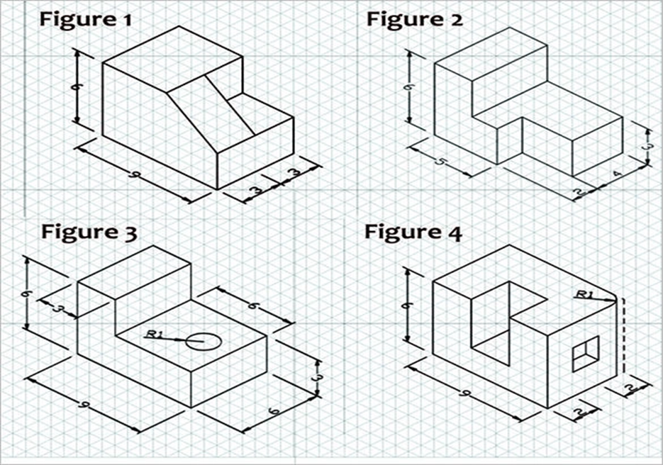
PRACTICE WORK SHEET #1
Each isometric square on the paper is equal to 1cm.
The numbers on the dimension lines represent the number of squares.

Slide 14
PRACTICE WORK SHEET #2
Each isometric square on the paper is equal to 1cm.
Try to attempt 4 problems per 90minutes sessions

Slide 15
SOLUTIONS
Did your drawings look the blocks in the work sheet?
If they did great job!!
If not, go back and look at the tutorial videos and figure out where you went wrong.

Slide 16
REFERENCES
ONLINE:
Wikimedia commons
Technologystudent.com
https://youtu.be/KAx390oVKuo
https://youtu.be/KAx390oVKuo

