Slide 1
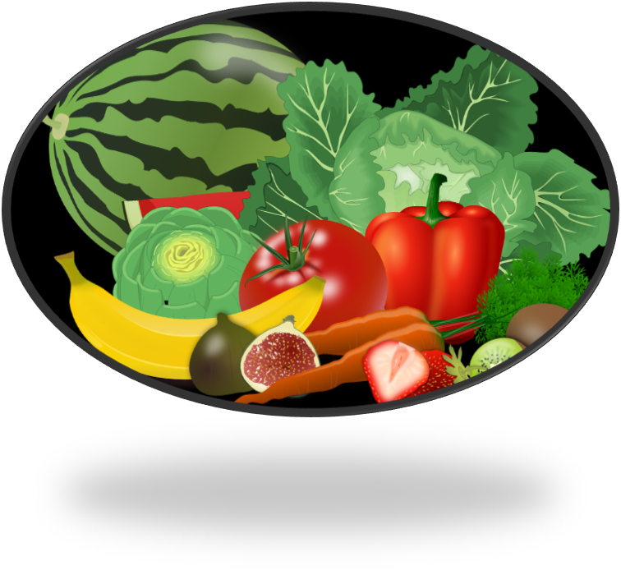
VITAMINS
Curriculum Planning & Development Division, Ministry of Education
WATER SOLUBLE VITAMINS

Slide 2
CONTENT
OBJECTIVES
1. WATER SOLUBLE VITAMINS
4. VITAMIN B12 (COBALAMIN)
7. DEFICIENCY DISEASES
2. VITAMIN B1 (THIAMIN)
5. FOLATE ACID
8. SUMMARY
3. VITAMIN B2 (RIBOFLAVIN)
6. VITAMIN C (ASCORBIC ACID)
9. ASSIGNMENTS

Slide 3
OBJECTIVES
At the end of this lesson, students should be able to:
List the water-soluble vitamins.
State the functions of each water soluble vitamin.
Name the sources of each water soluble vitamin.
Discuss the diseases associated with water soluble vitamins.

Slide 4
WATER SOLUBLE VITAMINS
Water soluble vitamins are vitamins that can dissolve in water. The water soluble vitamins, we will be focusing on are:
B1 (Thiamin)
B2 (Riboflavin)
B12(Cobalamin)
Folic Acid
C (Ascorbic Acid)

Slide 5
VITAMIN B1 (THIAMIN)

Slide 6
FUNCTIONS OF VITAMIN B1
Needed for:
metabolic reactions that release energy from carbohydrates
the normal growth of children.
the function and maintenance of nerves

Slide 7
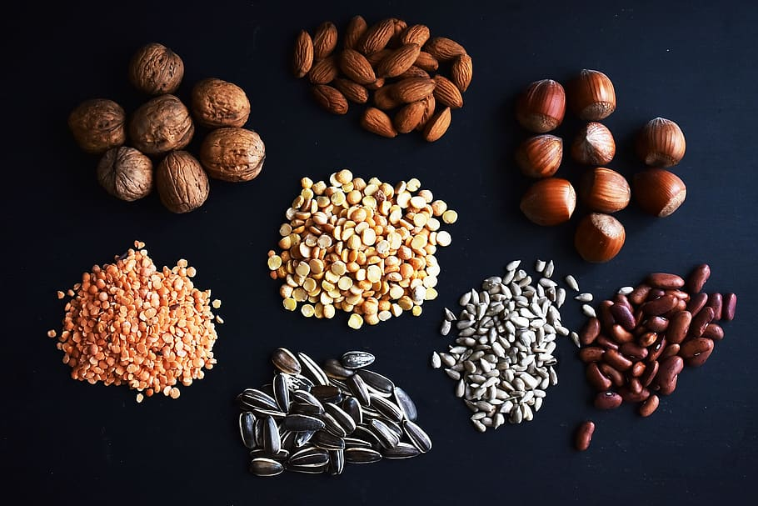
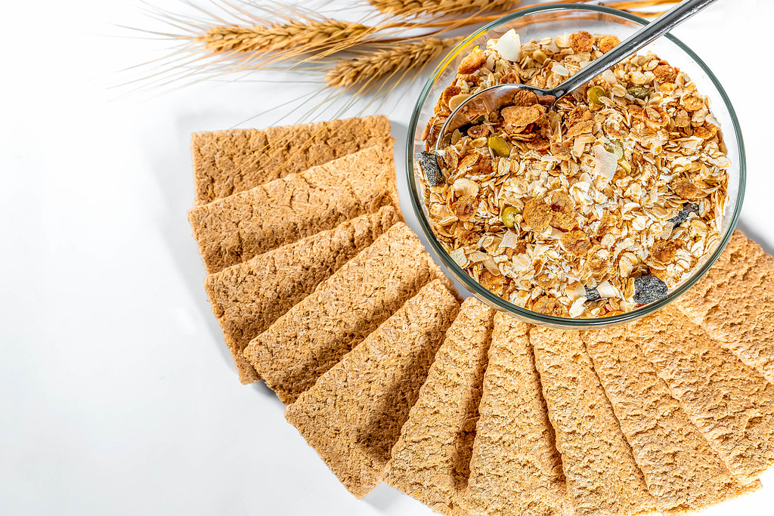
SOURCES OF VITAMIN B1
Lean Meat
Legumes
Nuts
Whole grain Cereal

Slide 8
VITAMIN B2 (RIBOFLAVIN)

Slide 9
FUNCTIONS OF VITAMIN B2
Needed:
For normal growth.
For the release of energy from food, especially for amino acids and fats by oxidation.
To Help maintain good vision, healthy hair, skin , and nails.
For red blood cell formation and respiration.
To regulate human growth and reproduction.

Slide 10
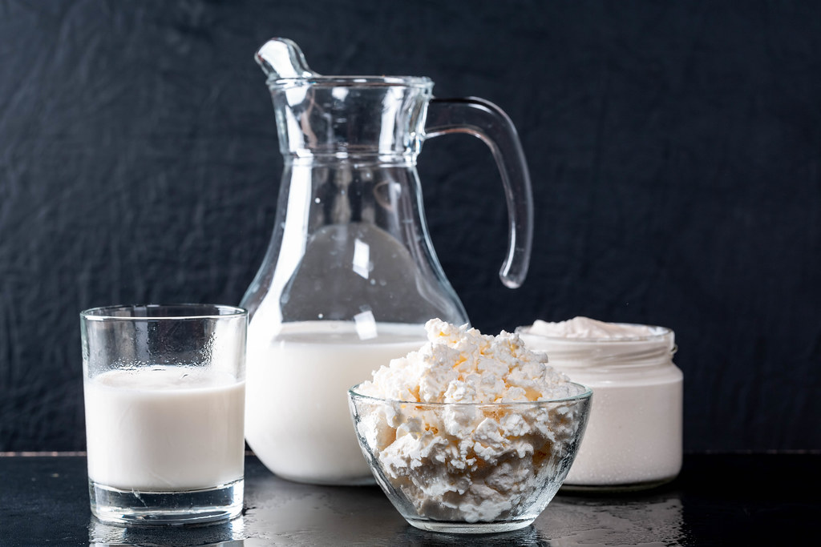
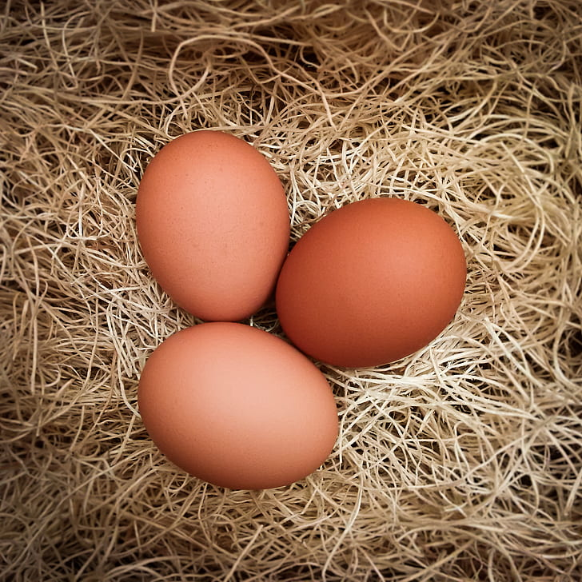
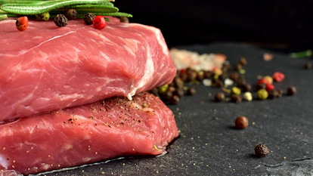
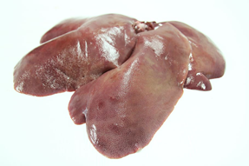
SOURCES OF VITAMIN B2
Dairy products
Eggs
Meat
Whole grain cereal
Green leafy vegetables
Liver, kidney and heart

Slide 11
VITAMIN B12 (COBALAMIN)

Slide 12
FUNCTIONS OF B12
Is critical for metabolism of amino acids and other enzyme systems in the body.
Works with folate to make red blood cells.
Important for normal nerve function.
Helps to build protein tissues.

Slide 13
SOURCES OF VITAMIN B12
Animal Products
Fortified Products

Slide 14
FOLIC ACID

Slide 15
FUNCTIONS OF FOLIC ACID
Important for normal growth.
Important for formation of red blood cells.
Required for the release of energy from food, especially amino-acids
Important for the production of the nucleic acids RNA and DNA.

Slide 16
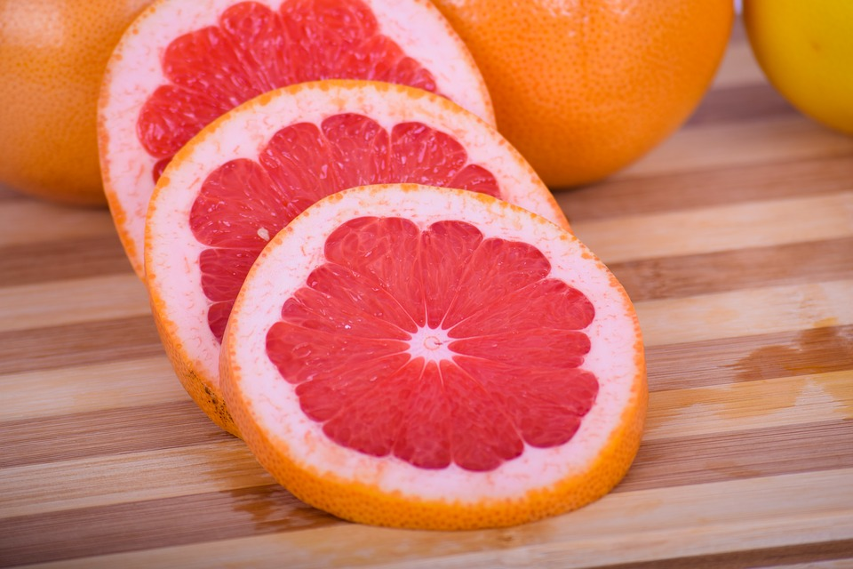
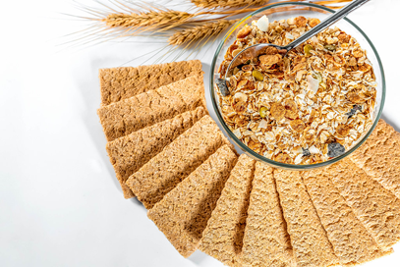
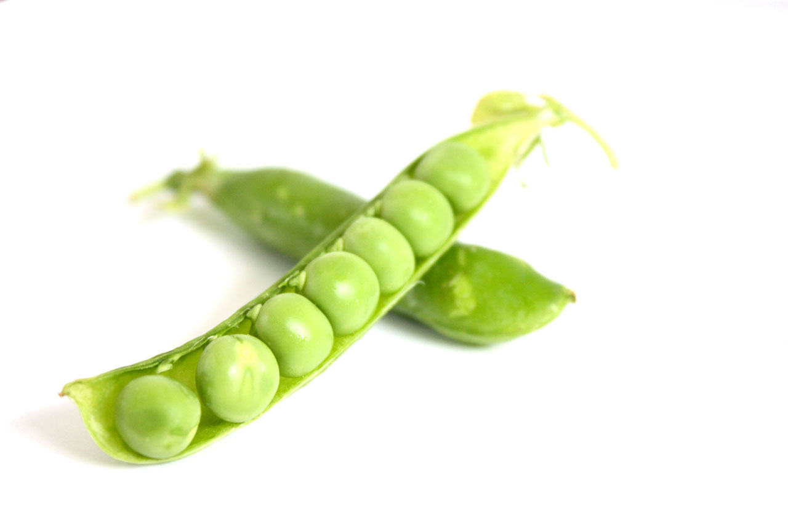
SOURCES OF FOLIC ACID
Green leafy vegetables
Dairy products
Green beans
Peas
Oranges
Grapefruits
Cereals

Slide 17
VITAMIN C (ASCORBIC ACID)

Slide 18
FUNCTIONS OF VITAMIN C
Needed to make connective tissue which binds the body cells together.
Helps absorb the mineral iron
Helps build strong bones and teeth
Required for the production of blood and blood vessels
Needed for the building and maintenance of the skin and linings of the digestive system
Helps vitamin E in its role as an antioxidant to prevent heart disease
Needed to make collagen.

Slide 19
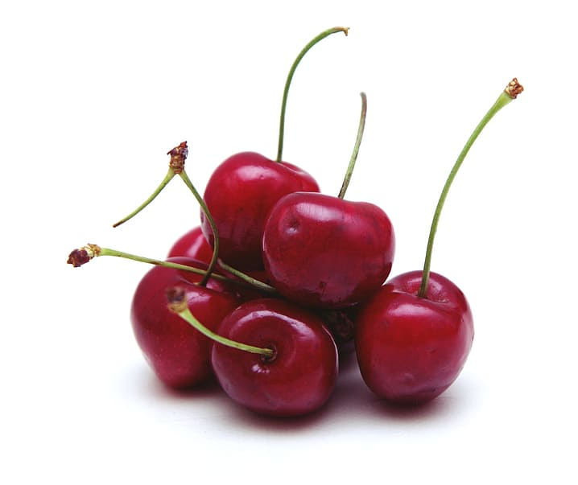
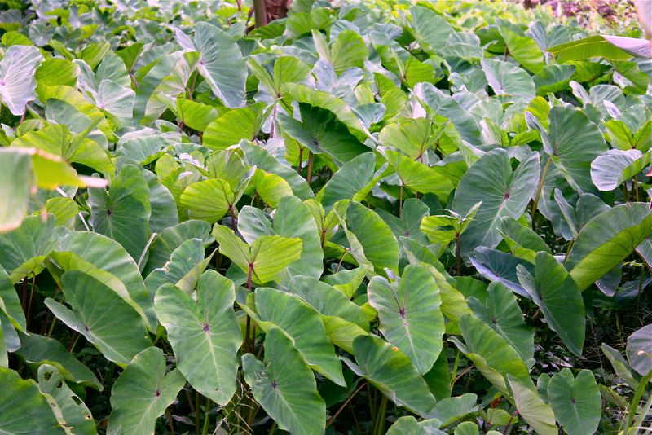
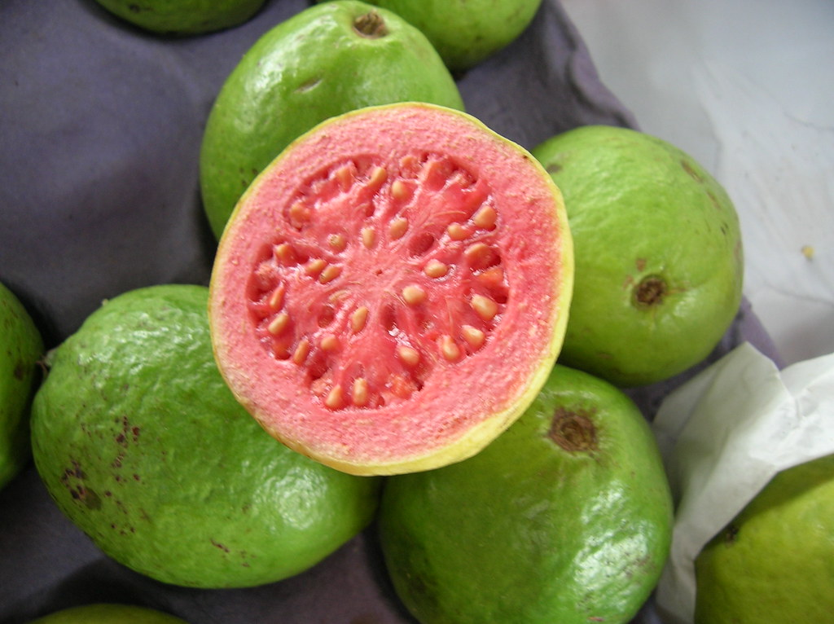
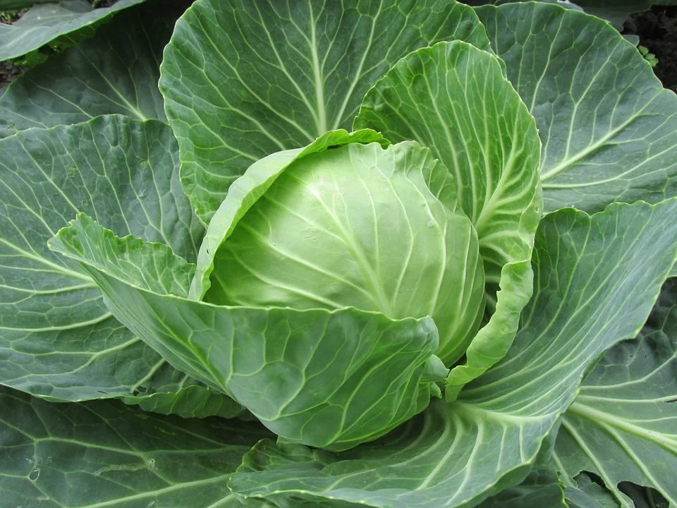
SOURCES OF VITAMIN C
West Indian Cherries
Callaloo
Guava
Citrus Fruits
Cabbage
Spinach

Slide 20
DEFICIENCY DISEASES

Slide 21
BERI BERI
VITAMIN B1 (THIAMIN)
SIGNS AND SYMPTOMS
A lack of vitamin B1 maybe due to alcoholism, not consuming the correct food, digestive disorders and pregnancy (loss of appetite, vomiting).
Severe deficiency leads to Beri Beri
Loses weight
Exhausted
Weak muscles
Swelling due to fluid in the tissues.

Slide 22
SCURVY
VITAMIN C
(ASCORBIC ACID)
SIGNS AND SYMPTOMS
Severe lack of vitamin C can lead to scurvy which can result in the following symptoms.
Poor development of connective tissue
Bleeding gums and loose teeth
Weak blood vessels
Cuts fail to heal
Weak scar tissue that is easily broken
Anaemia because iron isn’t absorbed properly

Slide 23
RETARDED GROWTH IN CHILDREN
VITAMINS
SIGNS AND SYMPTOMS
Retarded growth in children can develop due to a lack of the B vitamins (B1 and B2)and vitamin A (fat-soluble vitamin).
Poor growth in terms of height and weight gain expected for a particular age.

Slide 24
SUMMARY
The water soluble vitamins are B1, B2, B12, FOLIC ACID, C.
They are all essential for the proper functioning of our bodies
They can be found in vegetables, fruits and animal products.
Diseases can develop from a lack of these essential vitamins such as Beri Beri, Scurvy and Retarded Growth in children.

Slide 25
COMPLETE THE WORKSHEETS ATTACHED

Slide 26
REFERENCES
TEXTBOOK-
Anita Tull and Antonia Coward, (2009), Caribbean Food and Nutrition for C.S.E.C. Oxford.

Slide 27
REFERENCES
IMAGE SOURCES-
https://freesvg.org/fruit-and-vegetables-vector-image
https://publicdomainvectors.org/en/free-clipart/Smiling-water-droplet-vector-clip-art/16319.html
https://www.wallpaperflare.com/beef-meat-bbq-steak-lunch-dinner-spices-salt-pear-pepper-wallpaper-gpfgz
https://www.wallpaperflare.com/legumes-nuts-health-hazelnuts-lens-beans-sunflower-sunflower-seeds-wallpaper-eqlef
https://www.flickr.com/photos/30478819@N08/45439050672
https://www.flickr.com/photos/30478819@N08/45680168564
https://www.pickpik.com/brown-chicken-eggs-easter-egg-eggs-eggshell-102380
https://www.pikrepo.com/fkjzx/green-leafy-vegetable-on-white-background

Slide 28
REFERENCES
IMAGE SOURCES-
https://www.wallpaperflare.com/liver-pig-pigs-cook-fresh-food-meat-thailand-food-delicious-wallpaper-gmuir
https://pxhere.com/en/photo/1179945
https://pixabay.com/photos/grapefruit-grapefruit-red-citrus-3434196/
https://www.publicdomainpictures.net/en/view-image.php?image=8111&picture=peas
https://www.wallpaperflare.com/seven-cherries-fruit-sweet-cherries-food-garden-summer-wallpaper-wnwsf
https://www.flickr.com/photos/cumidanciki/6090880830
https://pixabay.com/photos/white-cabbage-cabbage-cabbage-leaves-2705228/
https://www.flickr.com/photos/viclic/270435530
https://pixnio.com/media/citrus-exotic-fruit-cocktail-fruit-juice-grapefruit

Slide 29
Acknowledgement
Lesson compiled by:
Ms. Venita Ramcharan Rio Claro East Secondary School

