Slide 1
Comprehension: Analysing Poetry
Curriculum Planning and Development Division
2020

Slide 2
Comprehension: Analysing poetry
Lesson 1: Answering literal questions.

Slide 3
Boring, wordy, difficult to understand
Fun, great way to express feelings and emotions, can even be used to tell a story
Notes:
NOTE: To change images on this slide, select a picture and delete it. Then click the Insert Picture icon in the placeholder to insert your own image.

Slide 4
Remember:
Questions on the Poem contribute a total of 20 marks to the English Language Arts Paper
Questions based on the poem would be at three different levels (Literal, Inferential and Evaluation/Appreciation)
Vocabulary is also examined in context
For more information visit: https://www.moe.gov.tt/

Slide 5
Materials used in this presentation can be found in the SEA ELA Specimen Papers 1 & 2 and the English Language Arts Specimen Items for the Secondary Entrance Assessment.
All materials can be found on the Ministry of Education website
https://www.moe.gov.tt/
Also, visit the School Learning Management System at https://learn.moe.gov.tt/

Slide 6
Literal Questions
ask students to recall information explicitly stated in the poem
can be answered directly and explicitly from the poem

Slide 7
Inferential Questions
the answers are in the poem or text, but are not explicitly stated
connections need to be made in order to determine the answer
you can work out the answers by considering the hints and clues in the poem in light of your own knowledge and experience

Slide 8
Evaluation Questions
you must think about the poem and write answers based on your assessment of the poem
your answers must be linked to the poem and based on its details
Appreciation Questions
allows you to provide an answer based on your emotional response and connection with the poem (what you appreciate or do not appreciate about how the poet crafted the poem)

Slide 9
In today’s lesson we will look at:
Retrieving information that is stated explicitly- Literal

Slide 10
Let’s read a poem.

Slide 11
Clouds
As I lay upon my back looking at the sky,
Watching soft white clouds passing by.
Some large, some quite small,
Many different shapes and sizes I recall.
As I lay there and watched the clouds take shape,
From my imagination a million images did escape.
I could see anything that was in my mind's eye,
In those fluffy white clouds as they went floating by.
5

Slide 12
Clouds
For hours on end, no two images were ever the same,
As the clouds on their journey came.
As if on film, this movie played,
While quietly on my back I stayed.
Music came to the movie
That played in the sky,
By all the different birds, their songs
A soothing lullaby,
So beautifully orchestrated
And done for me,
That movie was created
For me to see.
10
15
20

Slide 13
Literal questions (answers are clearly stated in the poem).
Examples:
What was the poet doing?
What did the poet see when he looked up?
State two words used by the poet to describe the clouds.
Name one animal mentioned in the poem.

Slide 14
Let’s check.
Look for verbs.
Question: What was the poet doing?
Question: What was the poet doing?
Where can I find the answer?
As I lay upon my back looking at the sky,
Watching soft white clouds passing by.
(Stanza 1, lines 1-2)
As I lay upon my back looking at the sky,
Watching soft white clouds passing by.
(Stanza 1, lines 1-2)
Answer: The poet was lying on his back, looking at the clouds.

Slide 15
Let’s check.
Question: What did the poet see when he looked up?
Question: What did the poet see when he looked up?
Check for the word “see” or a synonym.
Where can I find the answer?
As I lay upon my back looking at the sky,
Watching soft white clouds passing by.
(Stanza 1, lines 1-2)
As I lay upon my back looking at the sky,
Watching soft white clouds passing by.
(Stanza 1, lines 1-2)
Answer: He saw clouds passing by.

Slide 16
Let’s check.
Question: State two words used by the poet to describe the clouds.
Question: State two words used by the poet to describe the clouds.
You only need two words!
Check for adjectives.
Where can I find the answer?
Let’s go back to the poem.

Slide 17
Look for the words, “cloud” or “clouds” or words that refer to clouds.
Look for words that describe the clouds.
Clouds
As I lay upon my back looking at the sky,
Watching soft white clouds passing by.
Some large, some quite small,
Many different shapes and sizes I recall.
As I lay there and watched the clouds take shape,
From my imagination a million images did escape.
I could see anything that was in my mind's eye,
In those fluffy white clouds as they went floating by.
As I lay upon my back looking at the sky,
Watching soft white clouds passing by.
Some large, some quite small,
Many different shapes and sizes I recall.
As I lay there and watched the clouds take shape,
From my imagination a million images did escape.
I could see anything that was in my mind's eye,
In those fluffy white clouds as they went floating by.
As I lay upon my back looking at the sky,
Watching soft white clouds passing by.
Some large, some quite small,
Many different shapes and sizes I recall.
As I lay there and watched the clouds take shape,
From my imagination a million images did escape.
I could see anything that was in my mind's eye,
In those fluffy white clouds as they went floating by.
5

Slide 18
Clouds
For hours on end, no two images were ever the same,
As the clouds on their journey came.
As if on film, this movie played,
While quietly on my back I stayed.
Music came to the movie
That played in the sky,
By all the different birds, their songs
A soothing lullaby,
So beautifully orchestrated
And done for me,
That movie was created
For me to see.
For hours on end, no two images were ever the same,
As the clouds on their journey came.
As if on film, this movie played,
While quietly on my back I stayed.
Music came to the movie
That played in the sky,
By all the different birds, their songs
A soothing lullaby,
So beautifully orchestrated
And done for me,
That movie was created
For me to see.
The word “cloud” is used. However, no more adjectives are used to describe them in these stanzas.
10
15
20

Slide 19
Let’s check.
Question: State two words used by the poet to describe the clouds.
Answer: Any 2 from: soft, white, fluffy, small, large
(From stanzas one and two)

Slide 20
The answers to literal questions can be found right there in the text.
Answer only what the question is asking.
Look for key words in the question to signal where in the passage you can start searching for the answer.
Stay tuned for Lesson 2!

Slide 21
Comprehension: Analysing poetry
Lesson 2: Identifying figures of speech

Slide 22
In today’s lesson we will look at:
Identifying figures of speech in literary texts (simile, metaphor, personification)- Literal

Slide 23
Figure of speech
A word or phrase that diverges from its normal meaning.
Is not based on the literal meaning of the words.
Often provide emphasis, freshness of expression, or clarity.
Include metaphors, similes, or personification.

Slide 24
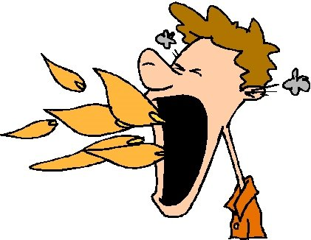
Identifying figures of speech in literary texts: simile - Literal
Simile: a comparison made, using “as” or “like”
Example: The mango chow was hot like fire.
Example: The mango chow was hot like fire.

Slide 25
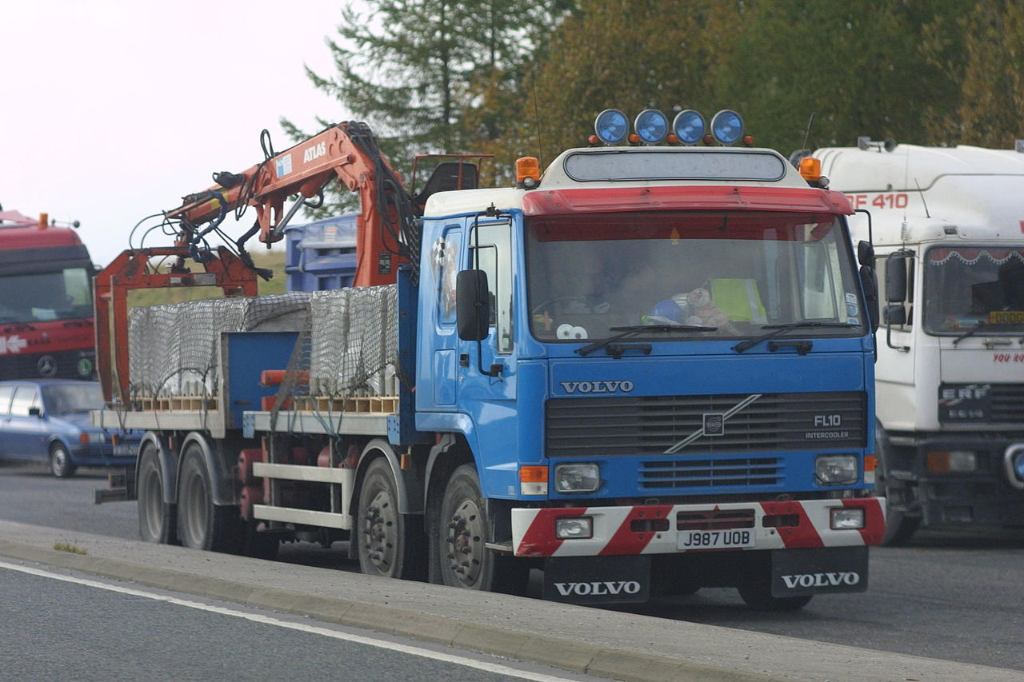
Identifying figures of speech in literary texts: simile [Literal]
Simile: a comparison made, using “as” or “like”
Example: My bag is as heavy as a truckload of bricks.
Example: My bag is as heavy as a truckload of bricks.
This Photo by Unknown Author is licensed under CC BY-NC-ND
This Photo by Unknown Author is licensed under CC BY-NC

Slide 26
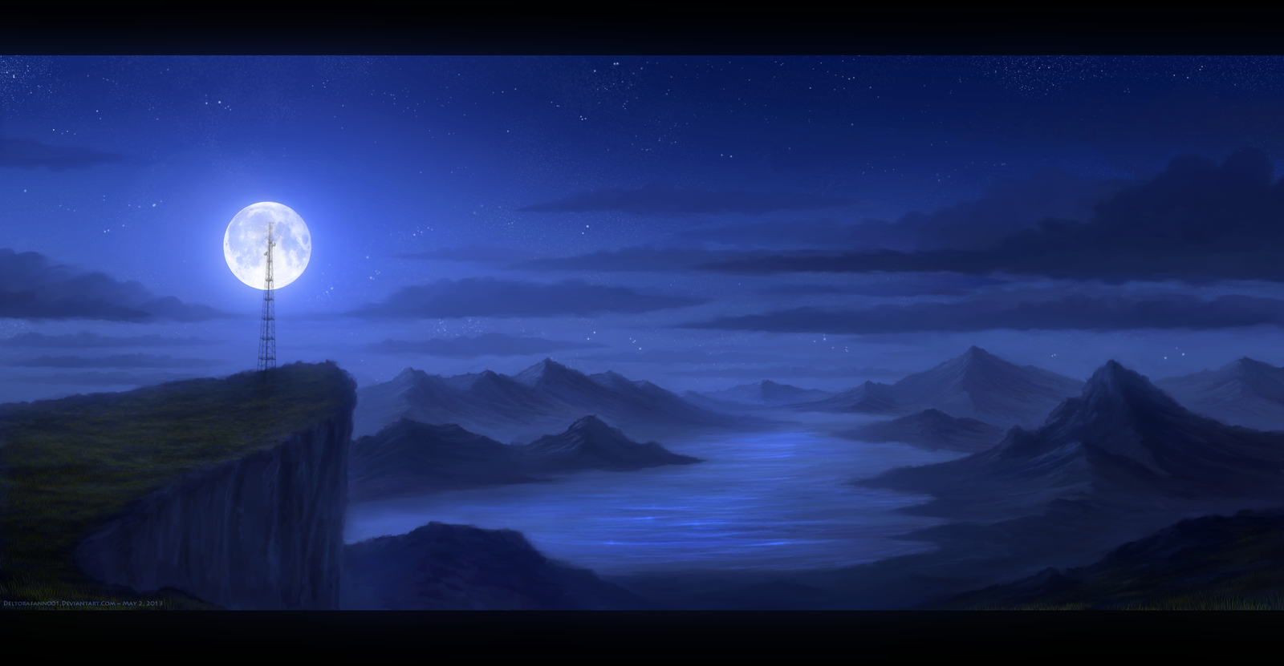
Identifying figures of speech in literary texts: metaphor [Literal]
Metaphor: a comparison made without using ‘as’ or ‘like’
Example: The curtain of night quickly fell upon us.
Example: The curtain of night quickly fell upon us.
It got very dark, very quickly.

Slide 27
Identifying figures of speech in literary texts: metaphor [Literal]
Metaphor: a comparison made without using ‘as’ or ‘like’
Example: Rodney had to slither through the crowd to get to his destination.
Example: Rodney had to slither through the crowd to get to his destination..
In order to get through the crowd, Rodney had to make the slithering movements of a snake.
This Photo by Unknown Author is licensed under CC BY

Slide 28
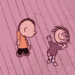
Identifying figures of speech in literary texts: metaphor [Literal]
Personification: inanimate objects are given human qualities.
Example The coconut trees danced in the wind.
Example The coconut trees danced in the wind.
The wind blowing through the coconut trees gave them the appearance of dancing.

Slide 29
Identifying figures of speech in literary texts: personification [Literal]
Personification: inanimate objects are given human qualities.
Example: The sun peeped playfully through the clouds.
Example: The sun peeped playfully through the clouds.
Although dark clouds were present, one could still see the sun.

Slide 30
Lets check:
For hours on end, no two images were ever the same,
As the clouds on their journey came.
As if on film, this movie played,
While quietly on my back I stayed.
For hours on end, no two images were ever the same,
As the clouds on their journey came.
As if on film, this movie played,
While quietly on my back I stayed.
Identify one simile used in stanza three (3) of the poem.
For hours on end, no two images were ever the same,
As the clouds on their journey came.
As if on film, this movie played,
While quietly on my back I stayed.
Where can I find the answer?
Which line contains the simile?

Slide 31
Lets check:
For hours on end, no two images were ever the same,
As the clouds on their journey came.
As if on film, this movie played,
While quietly on my back I stayed.
Identify one metaphor used in stanza three (3) of the poem.
For hours on end, no two images were ever the same,
As the clouds on their journey came.
As if on film, this movie played,
While quietly on my back I stayed.
Where can I find the answer?
The moving clouds are being compared to a movie.
Which line contains the metaphor?

Slide 32
Practice exercise
State whether each of the following is a simile, metaphor or personification.
I was as calm as a wave-less ocean.
The kitchen is the heart of the home.
He roars like a lion when he is cheering his favourite team.
The storm took the house in its teeth and shook it.
Daniel, the human lightning-bolt, won the race.
The green vines wound their arms around the rusty gate.
Simile
Metaphor
Simile
Personification
Metaphor
Personification

Slide 33
Simile- a comparison made using ‘as’ or ‘like’
Metaphor- a comparison made without using ‘as’ or ‘like’
Personification- inanimate objects are given human qualities.
Stay tuned for Lesson 3!

Slide 34
Comprehension: Analysing poetry.
Lesson 3: Identifying words that appeal to the senses and using context clues

Slide 35
In today’s lesson we will look at:
Identifying words/language used to appeal to the senses- [Literal]
Identifying words/language used to create specific moods [Inferential]
Using context-clues (word structure clues, definition clues) and background knowledge to determine the meaning of words or phrases [Inferential]

Slide 37
Identify words/language used to appeal to the senses
Humans have five senses which include the ability to see, hear, touch, taste and smell.
Poets use specific words/language to appeal to our senses, so allowing us to enjoy the poem.

Slide 38
What is the main sense being appealed to in this stanza?
As I lay upon my back looking at the sky,
Watching soft white clouds passing by.
Some large, some quite small,
Many different shapes and sizes I recall.
As I lay upon my back looking at the sky,
Watching soft white clouds passing by.
Some large, some quite small,
Many different shapes and sizes I recall.
sight

Slide 39
What is the main sense being appealed to in this stanza?
Music came to the movie
That played in the sky,
By all the different birds, their songs
A soothing lullaby,
Music came to the movie
That played in the sky,
By all the different birds, their songs
A soothing lullaby,
hearing

Slide 40
Can you find any other words/language and images in the poem that appeal to your senses?

Slide 41
Clouds
As I lay upon my back looking at the sky,
Watching soft white clouds passing by.
Some large, some quite small,
Many different shapes and sizes I recall.
As I lay there and watched the clouds take shape,
From my imagination a million images did escape.
I could see anything that was in my mind's eye,
In those fluffy white clouds as they went floating by.
For hours on end, no two images were ever the same,
As the clouds on their journey came.
As if on film, this movie played,
While quietly on my back I stayed.
Music came to the movie
That played in the sky,
By all the different birds, their songs
A soothing lullaby,
So beautifully orchestrated
And done for me,
That movie was created
For me to see.
10
5
15
20

Slide 42
Poems often use images that appeal to the reader’s senses.
Look for words that signal appeal to the different senses.

Slide 43
Using context-clues and background knowledge to determine the meaning of words or phrases [Inferential]
Context clues are hints found within a sentence, line, paragraph or passage which help a reader to understand new or unfamiliar words.
Context clues are very helpful for learning new words and promote better understanding of what is being read.

Slide 44
According to the poem, what is the meaning of the word 'orchestrated' in the last stanza?
Music came to the movie
That played in the sky,
By all the different birds, their songs
A soothing lullaby,
So beautifully orchestrated​
And done for me,​
That movie was created​
For me to see.

Slide 45
Hint 1:
A group of performers on various musical instruments.
In order to play together, they must be very organised.

Slide 46
Hint 2: Examine the other verbs around “orchestrated” in the last stanza.
So beautifully orchestrated​
And done for me,​
That movie was created​
For me to see.
The meaning of “orchestrated” in the context of this poem is “planned, organised, created”.

Slide 47
Use context clues to discover the meanings of words used in the context of the poem to answer vocabulary questions.
Stay tuned for Lesson 4!

Slide 48
Comprehension: Analysing poetry.
Lesson 4: Exploring Mood

Slide 49
In today’s lesson we will look at:
Identifying words/language used to create specific moods [Inferential]
Making connections between literature and real-life situations [Inferential]

Slide 51
Identifying words/language used to create specific moods
Mood is the feeling created by the poet for the reader.
Mood is different from the tone, which is the feeling displayed by the poet toward the subject of the poem.

Slide 52
Some words that can describe mood
Happy, excited, optimistic
Angry, irate, frustrated
Sad, gloomy, pessimistic

Slide 53
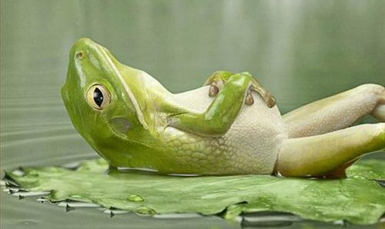
Some words that can describe mood
Relaxed, blissful, tranquil, serene
Fearful, scared, frightened

Slide 54
How can we identify mood in a poem?
Look for words that will appeal to your emotions.
Look for words that appeal to your senses.
Examine the setting of the poem.
How do all of these combined make you feel?

Slide 55
Let’s examine an excerpt from the poem, ‘The Crocodile’s Toothache’ by Shel Silverstein
The Crocodile Went to the dentist And sat down in the chair, And the dentist said, "Now tell me, Sir,
Why does it hurt and where?" And the Crocodile said, "I'll tell you the truth, I have a terrible ache in my tooth," And he opened his jaws so wide, so wide, That the dentist, he climbed right inside, And the dentist laughed, "Oh isn't this fun?" As he pulled the teeth out, one by one. And the Crocodile cried, "You're hurting me so!
Please put down your pliers and let me go."

Slide 56
What is the crocodile’s mood?
And the Crocodile said, "I'll tell you the truth, I have a terrible ache in my tooth,"
And the Crocodile said, "I'll tell you the truth, I have a terrible ache in my tooth,"
And the Crocodile cried, "You're hurting me so!
Please put down your pliers and let me go."
And the Crocodile cried, "You're hurting me so!
Please put down your pliers and let me go."
Most of the highlighted words are associated with negative feelings. The word “Please” suggests the idea of pleading and desperation.
Mood: Depressed, desperate

Slide 57
What is the dentist’s mood?
And the dentist laughed, "Oh isn't this fun?" As he pulled the teeth out, one by one.
And the dentist laughed, "Oh isn't this fun?" As he pulled the teeth out, one by one.
Mood: Happy, excited, exhilarated
Let’s examine another excerpt from a poem.

Slide 58
Let’s look at an excerpt from the poem, ‘A Sudden Storm’ by Pius Oleghe.
The wind howls, The trees sway,
The loose top sheets clatter and clang,
The open windows shut with a bang,
And the sky makes night of day.
The wind howls, The trees sway,
The loose top sheets clatter and clang,
The open windows shut with a bang,
And the sky makes night of day.
Setting: a neighbourhood that is about to experience a storm.
What mood is the poet trying to create?
Let’s look at the key words.
Mood: eerie, scary

Slide 59
Let’s go back to “The Clouds”
Identify the mood in stanza one of the poem.
As I lay upon my back looking at the sky,
Watching soft white clouds passing by.
Some large, some quite small,
Many different shapes and sizes I recall.
Hint: How would you feel if you were doing this?
Answer: Calm, Peaceful, Relaxed.

Slide 60
Now try this one:
Identify the mood in stanza two (2) of the poem.
Answer: Excited
Optimistic, hopeful
As I lay there and watched the clouds take shape,
From my imagination a million images did escape.
I could see anything that was in my mind's eye,
In those fluffy white clouds as they went floating by.

Slide 61
REMEMBER! - Mood and tone can very easily be confused!
Tone | Mood
It refers to how the author feels towards the subject, or towards something. The author’s tone is implied by the words he uses. | It refers to the feeling of the atmosphere the author is describing. It is what you feel when you read his writings e.g. One can read a sentence and feel sad, happy or angry.
Notes:
Use the poetry pieces to explore mood and tone. We need one sentence to explore this*

Slide 62
Mood in poetry refers to how a particular work makes you feel.
To find the mood in a poem, examine key words that are designed to make the reader feel a particular way.
The setting of the poem may also give you a hint about the mood.
Stay tuned for Lesson 5!

Slide 63
Comprehension: Analysing poetry
Lesson 5: Making connections between Literature and Real Life

Slide 64
In today’s lesson we will look at:
Making connections between literature and real-life situations
Judging the nature of characters with supporting evidence

Slide 66
Making connections between literature and real-life situations-Inferential
This is when you connect the words and ideas you read to your experience. It helps you to understand what you’re reading. You put yourself in the place of the writer based on what you know and have experienced.
Let’s consider these questions.
Where do you think the poet was when he saw the clouds? Give a reason for your answer.
Why is the word “movie” a suitable description for the action of the clouds?

Slide 67
Let’s check those answers
Where do you think the poet was when he saw the clouds? Give a reason for your answer.
Connection- To be able to answer this, you would need to consider that in order to see clouds, the sky must be visible and it must be a place where you would find birds. Therefore the answer needs to be a place where you can see the clouds and find birds .
Answer: in the yard, in a playground, in a field, in the porch, near a window. (any place where you can lie look at the clouds and hear birds.
Reason- he could see the clouds and hear the birds sing.

Slide 68
2. Why is the word “movie” a suitable description for the action of the clouds?
Connection- the characters and scenes in a movie change.
It is suitable because the scenes and characters in a movie change, just as the clouds are changing size and shape as they are passing by.

Slide 70
Judging the nature of characters with supporting evidence-[Evaluation/Appreciation]
Draw conclusions about characters based on what you’ve read. It is based on your values and beliefs.
Let’s consider :
Do you think the poet was lazy? Give a reason to support your answer.
Yes. He did nothing for hours besides lie and look at the clouds passing.
Or
No. He used his imagination for hours to create movies from passing clouds.
Remember there is no right or wrong answer but your answer must be justified.

Slide 71
In this series, we looked at
Retrieving information that is stated explicitly
Identifying figures of speech in literary texts (simile, metaphor, personification)
Identifying words/language used to appeal to the senses
Identifying words/language used to create specific moods

Slide 72
Using context-clues (word structure clues, definition clues) and background knowledge to determine the meaning of words or phrases
Making connections between literature and real-life situations
Judging the nature of characters with supporting evidence to add text

Slide 73
Let’s revisit the poem 'Clouds' and answer some questions
As I lay upon my back looking at the sky,
Watching soft white clouds passing by.
Some large, some quite small,
Many different shapes and sizes I recall.
As I lay there and watched the clouds take shape,
From my imagination a million images did escape.
I could see anything that was in my mind's eye,
In those fluffy white clouds as they went floating by.
For hours on end, no two images were ever the same,
As the clouds on their journey came.
As if on film, this movie played,
While quietly on my back I stayed.
Music came to the movie
That played in the sky,
By all the different birds, their songs
A soothing lullaby,
So beautifully orchestrated
And done for me,
That movie was created
For me to see.
10
5
15
20

Slide 74
Literal
What is described as “a soothing lullaby” in stanza 4?
Answer:
The songs of the birds flying in the sky.

Slide 75
Literal
Identify one metaphor in the poem.
Answer:
One metaphor in the poem is, 'As if on film, this movie played,'

Slide 76
Literal
What sense is appealed to in the line “so beautifully orchestrated”, (stanza 5)?
Answer:
The sense that is appealed to is the sense of hearing.

Slide 77
Inferential
Why do you think “no two images were ever the same” (line 9)? Explain your answer.
Answer:
The images were never the same because the clouds constantly passed by in different sizes and shapes.

Slide 78
Inferential
Identify the mood in stanza 2 and give one example to support your answer.
Answer:
The mood in stanza 2 can be described as excited, optimistic and hopeful.
One example which supports this mood is found in the line, "From my imagination a million images did escape."

Slide 79
Inferential
Give a synonym for “my mind’s eye” in stanza 2.
Answer:
A synonym for "my mind's eye" is the word "imagination".

Slide 80
Inferential
What in the poem is referred to as “a movie”? Explain your answer.
Answer:
The clouds passing by in the sky are referred to as "a movie".
This is because the clouds are continuously passing by in different sizes and shapes. It feels like a movie being played to the person watching the clouds.

Slide 81
Evaluation and Appreciation
Why is the word “movie” a suitable description for the action of the clouds?
Answer:
A movie plays a story over time. Similarly, the person watching the clouds pass by, "for hours on end", feels like a movie is being played.

Slide 82
Evaluation and Appreciation
Answer:
Two ways in which the language of the poem affects me are:
1. I feel peaceful, relaxed and contented.
2. I feel happy and hopeful like I can do anything.
State two ways in which the language of the poem affects you (the reader).

Slide 83
Evaluation and Appreciation
Answer:
This poem makes me realise that I love to look at clouds. They are fascinating with many different shapes that remind me of objects and things I know.
How does this poem make you feel about clouds? Give a reason for your answer.

Slide 85
Thank you,
that’s all for today!
Visit:
www.moe.gov.tt
for more resources

