Slide 1
PLANT PROCESSES
PHOTOSYNTHESIS, TRANSPIRATION, RESPIRATION, PHOTOPERIODISM

Slide 2
PHOTOSYNTHESIS
Photosynthesis is a chemical process through which plants produce glucose and oxygen from carbon dioxide using light as the source.
Glucose, an energy unit, helps trees and plants to survive and grow. Since most living creatures on earth, directly or indirectly, depend on these green trees, the process of photosynthesis is considered as a very important one.

Slide 4
The Photosynthesis Equation
Carbon dioxide + water --------- -> glucose + oxygen
In chemical language, this is written as,
6H₂O + 6CO₂ ----------> C₆H₁₂O₆+ 6O₂
The above chemical equation is read as, Six molecules of carbon dioxide plus six molecules of water, produce one molecule of sugar and six molecules of oxygen.

Slide 5
Importance of Photosynthesis
The process of photosynthesis benefits us in the following ways:
1. Photosynthesis converts inorganic raw materials into food, that provides our ecosystem with energy.
2. Green plants provide organic food to all the animals and humans.
3. Rare fossil fuels like coal, petroleum and natural gas are formed through the degradation of the past plant and animal parts, which were originally formed by photosynthesis.
4. Plant products like timber, rubber, herbs, medicines resin and oils are derived from photosynthesis.
5. Photosynthesis helps in providing oxygen in the atmosphere required by all living organisms.
6. Photosynthesis decreases the concentration of carbon dioxide and other harmful industrial wastes that lead to respiration problems in living beings.

Slide 8
RESPIRATION
In respiration, plants (and animals) convert the sugars (photosynthates) back into energy for growth and other life processes (metabolic processes). The chemical equation for respiration shows that the photosynthates are combined with oxygen releasing energy, carbon dioxide, and water.

Slide 9
CHEMICAL EQUATION FOR RESPIRATION
Notice that the equation for respiration is the opposite of that for photosynthesis.

Slide 10
Chemically speaking, the process is similar to the oxidation that occurs as wood is burned, producing heat. When compounds combine with oxygen, the process is often referred to as “burning”, for example, athlete’s “burn” energy (sugars) as they exercise. Athletes take up oxygen through their lungs. Plants take up oxygen through the stomata in their leaves and through their roots.
Again, respiration is the burning of photosynthates for energy to grow and to do the internal “work” of living. It is very important to understand that both plants and animals (including microorganisms) need oxygen for respiration. This is why overly wet or saturated soils are detrimental to root growth and function, as well as the decomposition processes carried out by microorganisms in the soil.

Slide 12
Comparison of photosynthesis and respiration
Photosynthesis | Respiration
Produces sugars from light energy Stores energy Occurs only in cells with chloroplasts Releases oxygen Uses water Uses carbon dioxide Requires light | Burns sugars for energy Releases energy Occurs in most cells Uses oxygen Produces water Produces carbon dioxide Occurs in dark and light

Slide 13
TRANSPIRATION
What is transpiration?
Transpiration is the process by which moisture is carried through plants from roots to small pores on the underside of leaves, where it changes to vapor and is released to the atmosphere. Transpiration is essentially evaporation of water from plant leaves or evapotranspiration

Slide 15
What Is The Purpose Of Transpiration?
Transpiration serves three essential roles:
Movement of water and nutrients – Moves minerals up from the root (in the xylem) and sugars (products of photosynthesis) throughout the plant (in the phloem).
Cooling – 80% of the cooling effect of a shade tree is from the evaporative cooling effects of transpiration. This benefits both plants and humans.
Turgor pressure – Water maintains the turgor pressure in cells much like air inflates a balloon, giving the non-woody plant parts form. Turgidity is important so the plant can remain stiff and upright and gain a competitive advantage when it comes to light. Turgidity is important for the functioning of the guard cells, which surround the stomata and regulate water loss and carbon dioxide uptake. Turgidity is also the force that pushes roots through the soil.

Slide 16
Atmospheric factors affecting transpiration
The amount of water that plants transpire varies greatly geographically and over time. There are a number of factors that determine transpiration rates:
Temperature:Transpiration rates go up as the temperature goes up, especially during the growing season, when the air is warmer due to stronger sunlight and warmer air masses.
Relative humidity: As the relative humidity of the air surrounding the plant rises the transpiration rate falls. It is easier for water to evaporate into dryer air than into more saturated air.
Wind and air movement: Increased movement of the air around a plant will result in a higher transpiration rate. This is somewhat related to the relative humidity of the air, in that as water transpires from a leaf, the water saturates the air surrounding the leaf. If there is no wind, the air around the leaf may not move very much, raising the humidity of the air around the leaf. Wind will move the air around, with the result that the more saturated air close to the leaf is replaced by drier air.
Soil-moisture availability: When moisture is lacking, plants can begin to senesce (premature ageing, which can result in leaf loss) and transpire less water.
Type of plant: Plants transpire water at different rates. Some plants which grow in arid regions, such as cacti and succulents, conserve precious water by transpiring less water than other plants.

Slide 21
PHOTOPERIODISM
Photoperiodism is a biological response to a change in the proportions of light and dark in a 24-hour daily cycle. Plants use it to measure the seasons and to coordinate seasonal events such as flowering.

Slide 22
Photoperiodism was first studied in relation to flowering. Plants can be described in relation to their photoperiod responses as short-day, long-day, day-neutral, and intermediate-day plants.

Slide 23
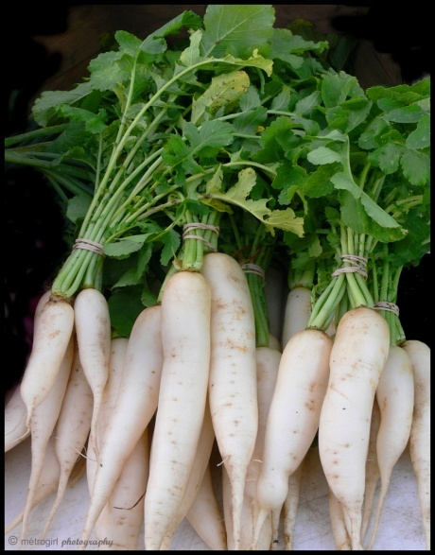
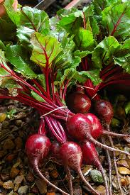
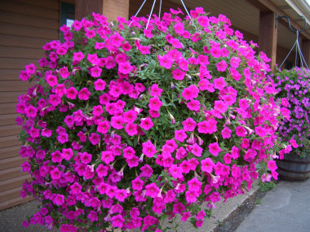
LONG DAY PLANTS:
Produce vegetative growth when the day length is short
Produce flowers when the day length is long
Examples: radish, beetroot, petunia

Slide 24
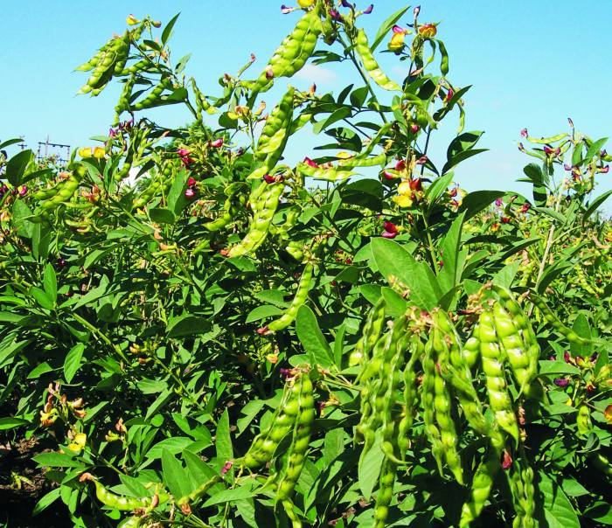
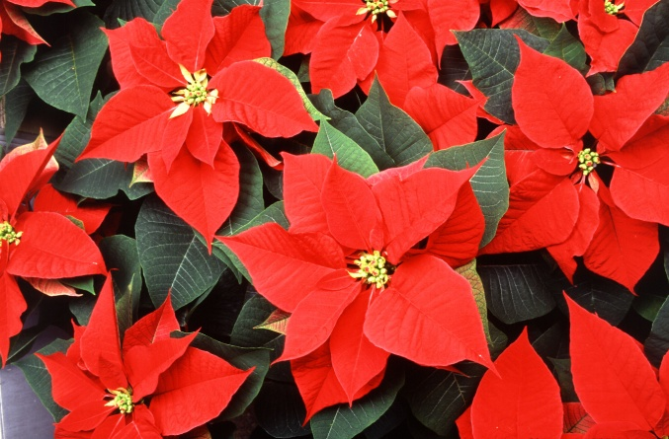
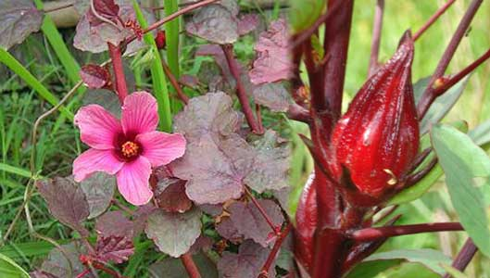
SHORT DAY PLANTS
Produce vegetative growth when the day is long.
Produce flowers when the day length is short
Examples: Pigeon Pea, Poinsettia, Sorrell

Slide 25
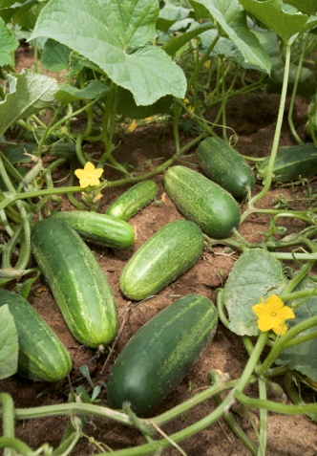
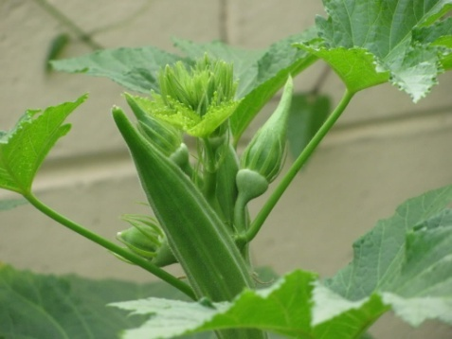
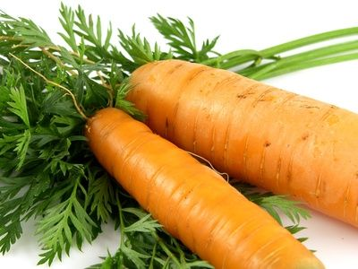
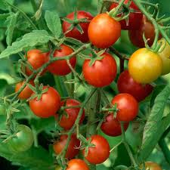
DAY NEUTRAL PLANTS
Insensitive to day length
Grow vegetatively to maturity and produce flowers all year round
Examples: Ochro, Cucumber, Carrot, Tomato

