Slide 1
Subject Area: Logistics and Supply Chain Operations Level: CAPE Curriculum Topic: Intermodal and multimodal transportation
Unit 1 Module 1 Objectives 7 & 8
Key Teaching Points: (1) Differentiate between intermodal and multimodal transportation
(2) Discuss the impact of intermodal and multimodal transportation in logistics

Slide 2
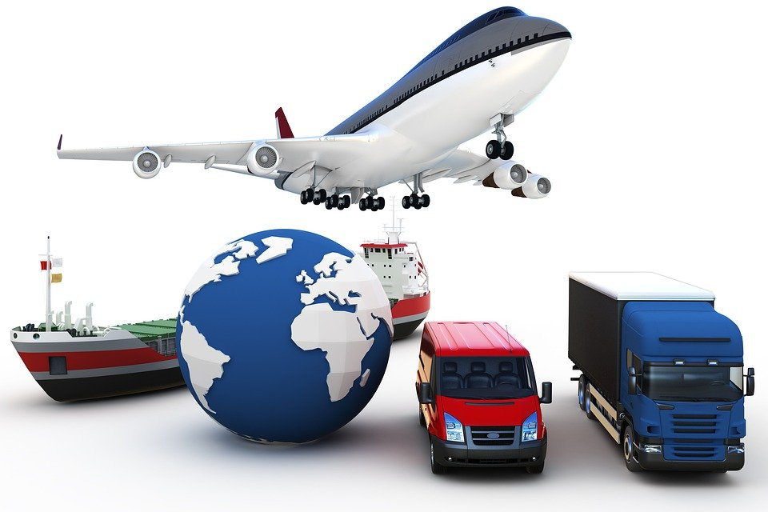

Slide 3
Intermodal vs Multimodal
Intermodal | Multimodal
Cargo is moved from origin to destination by several transport providers, each contracted separately. Different businesses are responsible for shipping along each route. | Cargo is moved from origin to destination by several transport providers, contracted under one contract. The same business is responsible for shipping along each route.

Slide 4
Advantages/Disadvantages of each
Intermodal | Multimodal
1. The cheapest or most desired carriers can be chosen for each route. 2. Specialised services can be sought for each route 3. Tracking of goods is difficult due to number of carriers. 4. As different carriers are used, cost may be higher in total. | With one transport carrier, tracking of goods is easier Costs may be lower as only one carrier is contracted. Dependence on one carrier can lead to efficiency for the manufacturer but can result in delays in the event of problems on the part of the shipping company.

Slide 5
Modes of transportation
Click on the link below to view a short video on modes of transportation.
https://www.bing.com/videos/search?q=modes+of+transportation+for+goods+and+passengers&&view=detail&mid=FBA3287499010D1E69F8FBA3287499010D1E69F8&&FORM=VRDGAR

Slide 6
Forms of transport
Intermodality
Air transport
Land transport
Marine transport

Slide 7
Modes of transportation
Air
Moving passengers and cargo from one destination to another through the air. For example, planes, helicopter, hot air balloons, rockets, blimps. Can transport small and large quantities. Is fairly expensive, fast and efficiency is affected by natural elements (hurricanes, snowstorms) and terrorism (bomb threats, hijackers).
Land - Rail
Moving passengers and cargo via several wagons and or cars grouped together to operate with wheels running on rails along a track. Can transport very large quantities at affordable rates. Can be high speed or low speed.

Slide 8
Modes of transportation
Land - Road
Moving passengers and cargo over land routes from one location to another. Cost is dependent on fuel prices. Different quantities can be transported as vehicles range from bicycles to cars to trucks to large containers. Cargo and passengers can only be moved to destinations accessible to land transport. Traffic and congestion can limit efficiency.
Marine
Moving passengers and cargo through waterways like rivers, seas, lakes using ships, barges, boats etc. This is cheaper that air transport and can facilitate large quantities.

Slide 9
Modes of transportation
Land/Marine - Pipeline
A system of pipes used to transport mainly liquids and gases over long distances. Has been used to transport petroleum, natural gas, granular coal, sewage, beer etc. There is continuous flow through the pipeline which is unaffected by weather conditions, traffic etc. Only certain products can be transported via this method. The product goes directly to the user and pipelines can be installed over land or water.
Intermodality
Moving passengers and cargo through the use of at least two forms of transport to their final destination. All means of transportation must be able to move the same quantities.

Slide 10
Activity 1
1. Identify three main types of transportation.
2. Discuss the differences between intermodal and multimodal transportation.
3. Explain how multimodal and intermodal transportation has impacted logistics.

Slide 11
Answer Key
Air, Land and Sea
Intermodal – different contracted transporters
Multimodal – one contracted transporter using different means
(Slide 4)
3. The most appropriate, cost effective or efficient means of transportation can be accessed at different points in the journey and several different means can be used within one journey. Passengers and cargo reach the destination faster and at a cheaper cost to consumers.

