Slide 1
Launch
Launch
REPORT WRITING
Curriculum Planning and Development Division
2020

Slide 2
INTRODUCTION
SEA

Slide 3
We will be looking at:
What is a report?
The parts of a report.
Using transition words in a report.
One example of a report.

Slide 4
What is a Report?
A factual piece written, for a clear purpose, to a particular audience
Information is presented in a clearly structured format
Information is easy to locate and follow

Slide 5
Structure of a Report
Introduction
ONE PARAGRAPH: Summary of 4 W's (What happened, involving whom, where and when)
Body
Conclusion
ONE paragraph: brief discussion of what happened at the end
TWO to THREE PARAGRAPHS: Details of what happened in chronological order
Use factual information
Use formal tone
Use appropriate transitional words and phrases

Slide 6
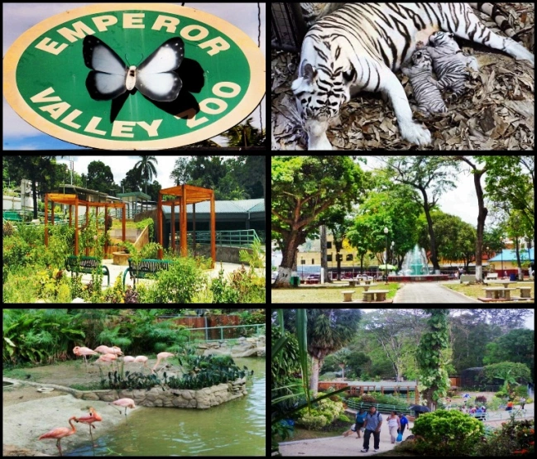
Have you ever been to the Emperor Valley Zoo?

Slide 7
Large image slide
Write a report about a field trip to the Emperor Valley Zoo.
You may include details about:
The date, time of the visit
What you saw during the visit
How the trip ended

Slide 9
Friday
7th
February
2020
Five
Central Primary
School
the Emperor Valley Zoo,
Zoo Road, Port of Spain
Mr. Marvin Lee
8:30 a.m.
2:30 pm

Slide 10
Body of the Report

Slide 11
Video slide
After a journey of about forty-five minutes, we arrived at the zoo. Upon arrival, we were instructed by Mr. Lee to proceed single file from the bus and purchase tickets at the entrance. Each student purchased a ticket at a cost of fifteen dollars, after which we entered the zoo.
Upon entry, we visited the reptile enclosure. There we saw iguanas, snakes and other lizards. Next, we proceeded to the aquarium where we saw different species of fish and aquatic animals. After this display, we visited the giraffe enclosure. There, we were able to see the giraffes up close and feed them using a cup provided by one of the zoo keepers, Ms. Sharon Rose.

Slide 12
After a journey of about forty-five minutes, we arrived at the zoo. Upon arrival, we were instructed by Mr. Lee to proceed single file from the bus and purchase tickets at the entrance. Each student purchased a ticket at a cost of fifteen dollars, after which we entered the zoo. Upon entry, we visited the reptile enclosure. There we saw iguanas, snakes and other lizards. Next, we proceeded to the aquarium where we saw different species of fish and aquatic animals. After this display, we visited the giraffe enclosure. There, we were able to see the giraffes up close and feed them using a cup provided by one of the zoo keepers, Ms. Sharon Rose.
Do not forget your transitional words and phrases!

Slide 13
Video slide
Following this, we visited the enclosures with the monkeys, lions and tigers. The monkeys were eating fruits and the lions were asleep. Finally, we visited the displays with the birds. There we saw various species of birds: parrots, Scarlet Ibis, Cocrico, macaws and the grey African parrot. At this point, we were met by another zoo keeper, Mr. Roger Ali, who explained briefly the zoo’s project to reintroduce the pink flamingo and the gold and blue macaws to the wild in Trinidad and Tobago.

Slide 14
Conclusion

Slide 15
Video slide
Our tour of the zoo concluded at approximately 1:00 p.m. After this, we ate our lunches near the cafeteria area. We boarded the bus at around 1:30 p.m. and following a head count by Mr. Lee, we returned to school. The return journey took about an hour. Upon arrival at the school compound, we were dismissed for the day.

Slide 16
Summary
A report is a factual piece (contains no opinions or emotions)
It has three main parts:
Introduction (including date, time, place, persons involved)
Body (discussion of events in logical order)
Conclusion (brief discussion of how it all ended)

Slide 17
Thank You
Launch
Launch

