Slide 1
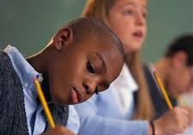
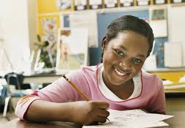
Distinguishing Reports from Stories: Author’s purpose
Curriculum Planning and Development Division
2020

Slide 2
Objectives
Explore the idea of author’s purpose
Differentiate between stories and reports

Slide 3
Why do writers write?

Slide 4
Author’s Purpose (PIE)
Persuade
Inform
Entertain
To convince someone
To teach or share information
To provide amusement or enjoyment

Slide 5
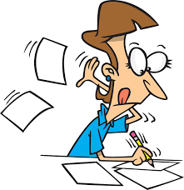
English Language Arts Writing in the SEA
Writing to inform
(Reports)
Writing to entertain
(Stories)

Slide 6
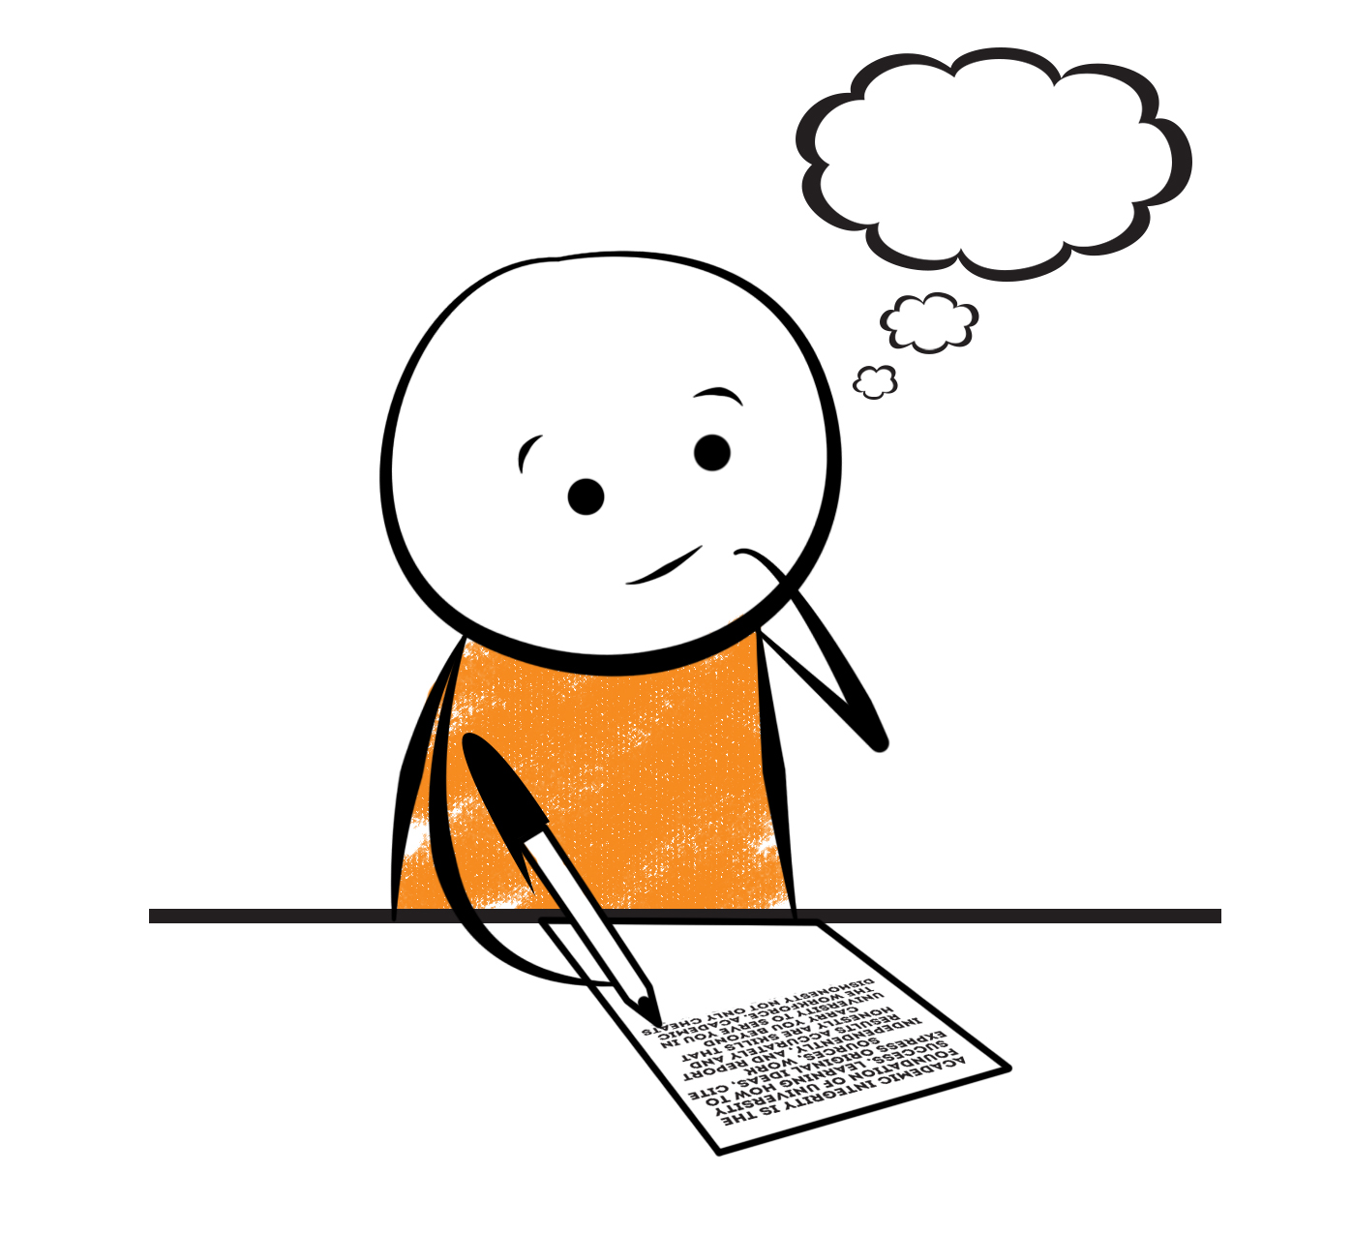
Construction workers use tools to build different structures.
Writers use tools to create different types of writing.

Slide 7
Writer’s tools
Parts of speech
Figures of speech
Punctuation
Specific sentence structures
Factual Language

Slide 8
Let’s read the next few selections.
What is each writer’s purpose?
2. How were you able to determine the
purpose?

Slide 9
What is a Beach?
A beach is made of very small loose rock (sand) that gathers at the shore of a body of water. Beaches are created by waves or currents. The sand comes from erosion of rocks both far away from and near the water. Coral reefs are a major source of sand.
Source: http://water.epa.gov/learn/kids/beachkids/what-beaches.cfm

Slide 10
Shark Attack
The midday sun shined its heated rays on to the turquoise waters of the beach, causing them to sparkle like diamonds. The beach was packed with people of all shapes and sizes. Little children screamed with glee as they scampered like crazy ants under the watchful eyes of their parents. The green palm trees danced to the distant music of Kes’ latest hit. Meanwhile, the wicked, hot sand singed the feet of the brave souls who dared to walk without slippers.
Suddenly, this perfect scene was shattered by a scream that came from north of the lifeguard’s booth, “Shark! Shark!”

Slide 11
A beach is made of very small loose rock (sand) that gathers at the shore of a body of water. Beaches are created by waves or currents. The sand comes from erosion of rocks both far away from and near the water. Coral reefs are a major source of sand.
Fact
The midday sun shined its heated rays on to the turquoise waters of the beach, causing them to sparkle like diamonds. The beach was packed with people of all shapes and sizes. Little children screamed with glee as they scampered like crazy ants under the watchful eyes of their parents. The green palm trees danced to the distant music of Kes’ latest hit, while the wicked, hot sand singed the feet of the brave souls who dared to walk without slippers.
Suddenly, this perfect scene was shattered by a scream that came from the north of the lifeguard’s booth, “Shark! Shark!”
The midday sun shined its heated rays on to the turquoise waters of the beach, causing them to sparkle like diamonds. The beach was packed with people of all shapes and sizes. Little children screamed with glee as they scampered like crazy ants under the watchful eyes of their parents. The green palm trees danced to the distant music of Kes’ latest hit, while the wicked, hot sand singed the feet of the brave souls who dared to walk without slippers.
Suddenly, this perfect scene was shattered by a scream that came from the north of the lifeguard’s booth, “Shark! Shark!”
The midday sun shined its heated rays on to the turquoise waters of the beach, causing them to sparkle like diamonds. The beach was packed with people of all shapes and sizes. Little children screamed with glee as they scampered like crazy ants under the watchful eyes of their parents. The green palm trees danced to the distant music of Kes’ latest hit, while the wicked, hot sand singed the feet of the brave souls who dared to walk without slippers.
Suddenly, this perfect scene was shattered by a scream that came from the north of the lifeguard’s booth, “Shark! Shark!”
Simile
Fact
Simile
Fact
Personification
Fact
Personification
Shorter
Inform
Entertain

Slide 12
Punctuation helps us to understand how to read the piece.
The Big Picture!
Form
Report, Story
Grammar helps us to structure the ideas clearly.
Purpose
Inform
Entertain
Language
Formal, Informal, Figurative, Factual.

Slide 13
Next step: Characteristics of stories and reports.
Stay tuned.

Slide 14
Distinguishing Reports from Stories Lesson 2: Characteristics of Stories and Reports

Slide 15
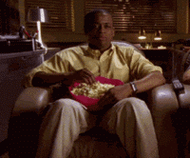
English Language Arts Writing in the SEA
Writing to inform
(Reports)
Writing to entertain
(Stories)

Slide 16
Punctuation helps us to understand how to read the piece.
The Big Picture!
Form
Report, Story
Grammar helps us to structure the ideas clearly.
Purpose
Inform
Entertain
Language
Formal, Informal, Figurative, Factual.

Slide 17
Writer’s tools
Parts of speech
Figures of speech
Punctuation
Specific sentence structures
Factual Language

Slide 18
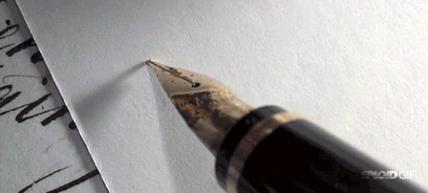
English Language Arts Writing in the SEA
Report
Story
Writing to inform
Writing to entertain

Slide 19
REPORT WRITING
NARRATIVE WRITING
Purpose: to inform
Purpose: to entertain
Content: 4 W’s
Content: Story elements: characters, setting, plot
Structure:
Introduction, Body, Conclusion
(Logical sequencing and organization of details)
Pay attention to:
Spelling
Grammar
Mechanics
Paragraphing
Structure:
Exposition, rising
action, climax, resolution (can
also start with a flashback)
Language:
Formal and factual
Use of transitions to ensure logical flow
Vocabulary that informs
Use of indirect speech
Language:
Descriptive and figurative, appeal to senses
Use of transitions to ensure flow and
interest
Vocabulary that appeals to
the senses and emotions
Use of direct speech

Slide 20
Introducing:
Calvin Hobbes
Calvin’s mom
Susie

Slide 21
Incident at the Bus Stop Version 1

Slide 22
On Monday 23rd March 2020, at approximately 7:45 a.m., an incident occurred at the bus stop at Farley Street, Port of Spain. The persons involved were Calvin Hobbes and his mother, Darlene Hobbes.
At 7:30 am, Mrs. Hobbes was accompanying Calvin to the bus stop. During that time, Calvin repeatedly expressed his lack of desire to go to school that day. While making these statements, Calvin held a blanket and threw household items into the street.
After approximately five minutes, Mrs. Hobbes asked Calvin to stand still or he would be sorry. Calvin ceased all movement and remained standing with his mother at the bus stop until the school bus arrived at 7:45 am.
When Calvin saw the bus pulling up to the bus stop, he ran in the opposite direction. Mrs. Hobbes followed Calvin, caught him and ensured that he entered the bus and took a seat. As the bus was pulling away from the curb, Calvin could be heard repeatedly asking his mother to take him home. However, Mrs. Hobbes did not respond to his requests.
Calvin remained seated in the bus until it arrived at Riverdale Primary school at 8:30 a.m. without any further incident.

Slide 23
On Monday 23rd March 2020, at approximately 7:45 a.m., an incident occurred at the bus stop at Farley Street, Port of Spain. The persons involved were Calvin Hobbes and his mother, Darlene Hobbes.
At 7:30 am, Mrs. Hobbes was accompanying Calvin to the bus stop. During that time, Calvin repeatedly expressed his lack of desire to go to school that day. While making these statements, Calvin held a blanket and threw household items into the street.
After approximately five minutes, Mrs. Hobbes asked Calvin to stand still or he would be sorry. Calvin ceased all movement and remained standing with his mother at the bus stop until the school bus arrived at 7:45 am.
When Calvin saw the bus pulling up to the bus stop, he ran in the opposite direction. Mrs. Hobbes followed Calvin, caught him and ensured that he entered the bus and took a seat. As the bus was pulling away from the curb, Calvin could be heard repeatedly asking his mother to take him home. However, Mrs. Hobbes did not respond to his requests.
Calvin remained seated in the bus until it arrived at Riverdale Primary school at 8:30 a.m. without any further incident.
On Monday 23rd March 2020, at approximately 7:45 a.m., an incident occurred at the bus stop at Farley Street, Port of Spain. The persons involved were Calvin Hobbes and his mother, Darlene Hobbes.
At 7:30 am, Mrs. Hobbes was accompanying Calvin to the bus stop. During that time, Calvin repeatedly expressed his lack of desire to go to school that day. While making these statements, Calvin held a blanket and threw household items into the street.
After approximately five minutes, Mrs. Hobbes asked Calvin to stand still or he would be sorry. Calvin ceased all movement and remained standing with his mother at the bus stop until the school bus arrived at 7:45 am.
When Calvin saw the bus pulling up to the bus stop, he ran in the opposite direction. Mrs. Hobbes followed Calvin, caught him and ensured that he entered the bus and took a seat. As the bus was pulling away from the curb, Calvin could be heard repeatedly asking his mother to take him home. However, Mrs. Hobbes did not respond to his requests.
Calvin remained seated in the bus until it arrived at Riverdale Primary school at 8:30 a.m. without any further incident.
Introduction
Factual details
Factual details
Body
Factual details
Conclusion
Factual details

Slide 24
Incident at the Bus Stop Version 2

Slide 25
“What a gorgeous day!” Susie declared as she strolled towards the bus stop. The gentle, morning wind lightly tossed her pixie-cut hair as she glanced at her watch. It was 7:30 am. She had just enough time to read a chapter of her novel. Soon, she was lost in her hero’s adventures.
Suddenly, ear-piercing screams shattered the early morning tranquillity. “I don’t want to go to school! You can’t make me! Arrrrrrrrrgh! Help!” Susie’s eyes widened like two saucers and waited for the epic battle to begin.
Soon, two figures came into view. Mrs Hobbes, wearing her fuzzy, red bathrobe and brown, bedroom slippers was trying to grasp her tiny, wriggling son, Calvin. Calvin’s blond hair pointed in all directions. He was gripping his blanket and screaming louder than ten fire engine sirens.

Slide 26
“Calvin, you know you have to go to school!” Mrs Hobbes’ voice was strained from all her exertion. Then, as if gathering superhuman powers, she held Calvin’s shoulders and growled, “You stand right here, or you will be sorry!”
Coming to his senses, Calvin finally stood still. Susie’s eyes moved from scowling mother to pouting son. How long would this peace last? The familiar revving of the big, yellow school bus answered her question.
“Yes!” Mrs Hobbes joyfully declared.
“No!” Calvin screamed as he jumped like a deranged kangaroo and scampered into the opposite direction. Susie’s saucer eyes became full moons as Mrs Hobbes sprinted after her escaping son. Her heart skipped a beat at this spectacle. This was better than her novel!

Slide 27
With superhuman speed, Mrs Hobbes galloped after Calvin, caught him and marched him towards the open bus door. “Have a good day at school, Son,” she said sweetly, as she shoved him into the bus and breathed a sigh of relief.
Susie silently followed Calvin as he resumed his morning tantrum. She shook her head. You would have sworn that he was being sent into a den of lions and not to the same school he had been attending for five years. When they settled into their seats, Susie turned to her grumpy neighbour and said, “Did you know that nobody on our street sets an alarm clock in the morning?”
“Oh hush,” Calvin grumbled. Susie shrugged and stared out the window. As the bus slowly pulled away from the curb, she wondered what acts of torture he was plotting for Ms. Wormwood today.

Slide 28
How were they similar? How were they different?

Slide 29
Version 1
Version 2
Purpose: To inform
Purpose: to entertain
Content: 4 W’s
Content: Characters, setting, plot
Structure:
Introduction, Body, Conclusion
(Logical sequencing and organization of details)
Both were accounts of what happened at a bus stop.
Both had paragraphs.
Structure:
Exposition, rising
action, climax, resolution
Language:
Descriptive and figurative, appeal to senses
Use of transitions to ensure flow and
interest
Vocabulary that appeals to
the senses and emotions
Use of direct speech
Language:
Formal and factual
Use of transitions to ensure logical flow
Vocabulary that informs, use of indirect speech

Slide 30
Introduction: the report
Exposition: the story
Direct speech
Setting
Date
On Monday 23rd March 2020, at approximately 7:45 a.m., an incident occurred at the bus stop at Farley Street, Port of Spain. The persons involved were Calvin Hobbes and his mother, Darlene Hobbes.
“What a gorgeous day!” Susie declared as she strolled towards the bus stop. The gentle, morning wind lightly tossed her pixie-cut hair as she glanced at her watch. It was 7:30 am. She had just enough time to read a chapter of her novel. Soon, she was lost in her hero’s adventures.
“What a gorgeous day!” Susie declared as she strolled towards the bus stop. The gentle, morning wind lightly tossed her pixie-cut hair as she glanced at her watch. It was 7:30 am. She had just enough time to read a chapter of her novel. Soon, she was lost in her hero’s adventures.
Time
What happened
Setting
Location
Description of character
Persons involved
Character’s actions.

Slide 31
Suddenly, ear-piercing screams shattered the early morning tranquillity. “I don’t want to go to school! You can’t make me! Arrrrrrrrrgh! Help!” Susie’s eyes widened like two saucers and waited for the epic battle to begin.
Soon, two figures came into view. Mrs Hobbes, wearing her fuzzy, red bathrobe and brown, bedroom slippers was trying to grasp her tiny, wriggling son, Calvin. Calvin’s blond hair pointed in all directions. He was gripping his blanket and screaming louder than ten fire engine sirens.
At 7:30 am, Mrs. Hobbes was accompanying Calvin to the bus stop. During that time, Calvin repeatedly expressed his lack of desire to go to school that day. While making these statements, Calvin held a blanket and threw household items into the street.
Suddenly, ear-piercing screams shattered the early morning tranquillity. “I don’t want to go to school! You can’t make me! Arrrrrrrrrgh! Help!” Susie’s eyes widened like two saucers and waited for the epic battle to begin.
Soon, two figures came into view. Mrs Hobbes, wearing her fuzzy, red bathrobe and brown, bedroom slippers was trying to grasp her tiny, wriggling son, Calvin. Calvin’s blond hair pointed in all directions. He was gripping his blanket and screaming louder than ten fire engine sirens.

Slide 32
After approximately five minutes, Mrs. Hobbes asked Calvin to stand still or he would be sorry. Calvin ceased all movement and remained standing with his mother at the bus stop until the school bus arrived at 7:45 am.
“Calvin, you know you have to go to school!” Mrs Hobbes’ voice was strained from all her exertion. Then, as if gathering superhuman powers, she held Calvin’s shoulders and growled, “You stand right here, or you will be sorry!”
Coming to his senses, Calvin finally stood still. Susie’s eyes moved from scowling mother to pouting son. How long would this peace last? The familiar revving of the big, yellow school bus answered her question.
“Yes!” Mrs Hobbes joyfully declared.

Slide 33
When Calvin saw the bus pulling up to the bus stop, he ran in the opposite direction. Mrs. Hobbes followed Calvin, caught him and ensured that he entered the bus and took a seat. As the bus was pulling away from the curb, Calvin could be heard repeatedly asking his mother to take him home. However, Mrs. Hobbes did not respond to his requests.
“No!” Calvin screamed as he jumped like a deranged kangaroo and scampered into the opposite direction. Susie’s saucer eyes became full moons as Mrs Hobbes sprinted after her escaping son. Her heart skipped a beat at this spectacle. This was better than her novel! With superhuman speed, Mrs Hobbes galloped after Calvin, caught him and marched him towards the open bus door. “Have a good day at school, Son,” she said sweetly, as she shoved him into the bus and breathed a sigh of relief.

Slide 34
Susie silently followed Calvin as he resumed his morning tantrum. She shook her head. You would have sworn that he was being sent into a den of lions and not to the same school he had been attending for five years. When they settled into their seats, Susie turned to her grumpy neighbour and said, “Did you know that nobody on our street sets an alarm clock in the morning?”
“Oh hush,” Calvin grumbled. Susie shrugged and stared out the window. As the bus slowly pulled away from the curb, she wondered what acts of torture he was plotting for Ms. Wormwood today.
Calvin remained seated in the bus until it arrived at Riverdale Primary school at 8:30 a.m. without any further incident.

Slide 35
Three differences between a report and a story
Different purposes
Different content
Different language

Slide 36
Distinguishing Reports from Stories (Example 1)

Slide 37
SEA Writing
Report
Story

Slide 38
What happens if they get mixed up?
Report
Story

Slide 39
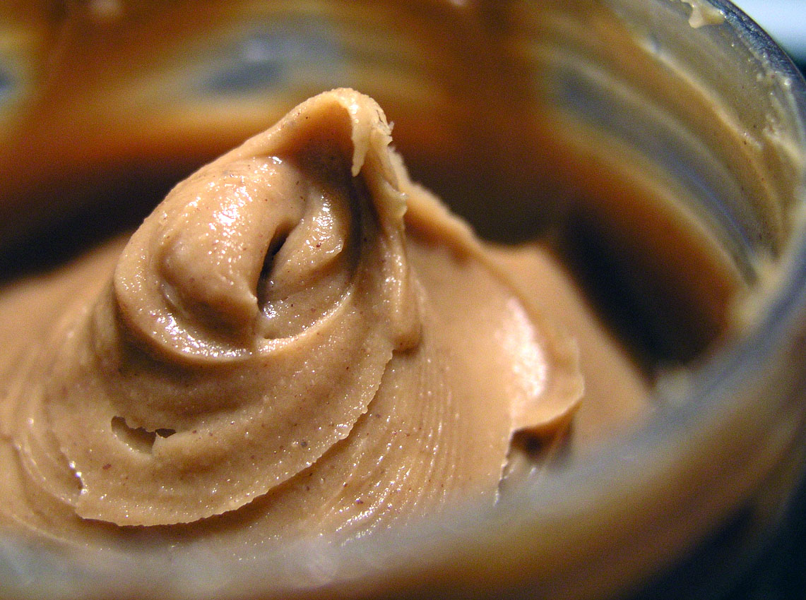
Would you eat this mixture?
+

Slide 40
Let’s not confuse reports and stories

Slide 41
Read the following “report” on a visit to the zoo.
One lovely day, I woke up and dressed for school. I was going on a field trip to the zoo. I ran outside fast as I could while telling Mummy and Daddy goodbye.
When I reached to school, my friends told me to get ready the bus was coming. I said okay. I went to the shop and bought water, juice and food. Soon the bus arrived, and everybody entered the bus and sat.
When we reached the zoo, I ran to see the lion, but the teacher told us not to touch. I ask my friend if he wanted to see the lions. We ran and saw a big one and a small one. Afterwards, we saw monkeys eating bananas and playing. Afterwards, we saw beautiful green and blue fishes.
Finally, it was time to return to school. When I got home, I told my mother and father about it.

Slide 42
One lovely day, I woke up and dressed for school. I was going on a field trip to the zoo. I ran outside fast as I could while telling Mummy and Daddy goodbye.
When I reached to school, my friends told me get ready the bus was coming. I said okay. I went to the shop and bought water, juice and food. Soon the bus arrived, and everybody entered the bus and sat.
When we reached the zoo, I ran to see the lion, but the teacher told us not to touch. I asked my friend if he wanted to see the lions. We ran and saw a big one and a small one. Afterwards, we saw monkeys eating bananas and playing. Then, we saw beautiful green and blue fishes.
Finally, it was time to return to school. When I got home, I told my mother and father about it.
One lovely day, I woke up and dressed for school. I was going on a field trip to the zoo. I ran outside fast as I could while telling Mummy and Daddy goodbye.
When I reached to school, my friends told me get ready the bus was coming. I said okay. I went to the shop and bought water, juice and food. Soon the bus arrived, and everybody entered the bus and sat.
When we reached the zoo, I ran to see the lion, but the teacher told us not to touch. I asked my friend if he wanted to see the lions. We ran and saw a big one and a small one. Afterwards, we saw monkeys eating bananas and playing. Then, we saw beautiful green and blue fishes.
Finally, it was time to return to school. When I got home, I told my mother and father about it.
Fairly good use of transitional words
Missing details?
Some details are present.

Slide 43
Unnecessary details?
One lovely day, I woke up and dressed for school. I was going on a field trip to the zoo. I ran outside fast as I could while telling Mummy and Daddy goodbye.
When I reached to school my friends told me get ready the bus was coming. I said okay. I went to the shop and bought water, juice and food. Soon the bus arrived, and everybody entered the bus and sat.
When we reached the zoo, I ran to see the lions, but the teacher told us not to touch. I ask my friend if he wanted to see the lions. We ran and saw a big one and a small one. Afterwards, we saw monkeys eating bananas and playing. Afterwards, we saw beautiful green and blue fishes.
Finally, it was time to return to school. When I got home, I told my mother and father about it.
One lovely day, I woke up and dressed for school. I was going on a field trip to the zoo. I ran outside fast as I could while telling Mummy and Daddy goodbye.
When I reached to school my friends told me get ready the bus was coming. I said okay. I went to the shop and bought water, juice and food. Soon the bus arrived, and everybody entered the bus and sat.
When we reached the zoo, I ran to see the lions, but the teacher told us not to touch. I ask my friend if he wanted to see the lions. We ran and saw a big one and a small one. Afterwards, we saw monkeys eating bananas and playing. Afterwards, we saw beautiful green and blue fishes.
Finally, it was time to return to school. When I got home, I told my mother and father about it.
One lovely day, I woke up and dressed for school. I was going on a field trip to the zoo. I ran outside fast as I could while telling Mummy and Daddy goodbye.
When I reached to school my friends told me get ready the bus was coming. I said okay. I went to the shop and bought water, juice and food. Soon the bus arrived, and everybody entered the bus and sat.
When we reached the zoo, I ran to see the lions, but the teacher told us not to touch. I ask my friend if he wanted to see the lions. We ran and saw a big one and a small one. Afterwards, we saw monkeys eating bananas and playing. Afterwards, we saw beautiful green and blue fishes.
Finally, it was time to return to school. When I got home, I told my mother and father about it.
One lovely day, I woke up and dressed for school. I was going on a field trip to the zoo. I ran outside fast as I could while telling Mummy and Daddy goodbye.
When I reached to school my friends told me get ready the bus was coming. I said okay. I went to the shop and bought water, juice and food. Soon the bus arrived, and everybody entered the bus and sat.
When we reached the zoo, I ran to see the lions, but the teacher told us not to touch. I ask my friend if he wanted to see the lions. We ran and saw a big one and a small one. Afterwards, we saw monkeys eating bananas and playing. Afterwards, we saw beautiful green and blue fishes.
Finally, it was time to return to school. When I got home, I told my mother and father about it.

Slide 44
Missing details?
What was the report about?
Where did the visit take place?
When did the field trip take place?
Who went on the field trip?
What was seen during the field trip? (in order)
How did the field trip end?
A visit to the zoo
Name of the zoo not given
No date given, no time given
Class wasn’t given, name of accompanying teacher was not given
Lions, monkeys and fish
Unclear

Slide 45
Examine the introduction. What can we keep?
One lovely day, I woke up and dressed for school. I was going on a field trip to the zoo. I ran outside fast as I could while telling Mummy and Daddy goodbye.
One lovely day, I woke up and dressed for school. I was going on a field trip to the zoo. I ran outside fast as I could while telling Mummy and Daddy goodbye.
Date?
Who went on the field trip?
What
Name of zoo? Address?

Slide 46
Introduction
ONE PARAGRAPH: Summary of 4 W’s
What happened
Involving whom (the people involved)
Where (location)
When (date and time)

Slide 48
Friday
7th
February
2020
Five
Central Primary
School
the Emperor Valley Zoo,
Zoo Road, Port of Spain
Mr. Marvin Lee
8:30 a.m.
2:30 pm

Slide 49
Do not mix!
Report
Story

Slide 50
Body of Report
Discussion of different stalls visited at the zoo in logical order.
Conclusion of Report
How the trip ended (time they left the zoo, time they returned to school.)

Slide 51
Remember the Structure of a Report
Introduction
ONE PARAGRAPH: Summary of 4 W's (What happened, involving whom, where and when)
Body
Conclusion
ONE paragraph: brief discussion of what happened at the end
TWO to THREE PARAGRAPHS: Details of what happened in chronological order
Use factual information
Use formal tone
Use appropriate transitional words and phrases

Slide 52
Let’s examine another example.
Stay tuned…

Slide 53
Distinguishing Reports from Stories (Example 2)

Slide 54
SEA Writing
Report
Story

Slide 55
What happens if they get mixed up?
Report
Story

Slide 56
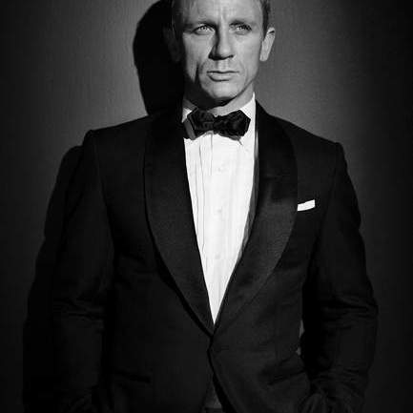
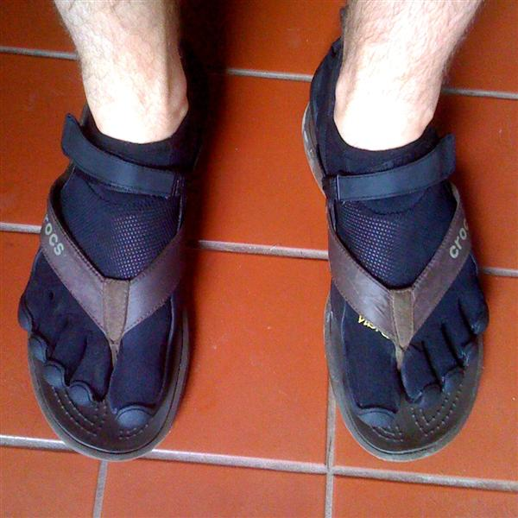
Would you wear these together?
This Photo by Unknown Author is licensed under CC BY-NC

Slide 57
Let’s not confuse stories and reports

Slide 58
Read the following “story”.
On Monday 23rd March, I was returning home from school when I was distracted by my neighbour’s dog. I was not paying attention and was not in a proper position to move. A car was coming towards me and I felt someone pick me up and throw me on the pavement.
I got up and in pain looked at the person who saved me. It was my Uncle Paul. He was angry and worried at the same time. “How did this happen?” he asked. I was scared to tell him the truth because I thought I was going to be in trouble.
Eventually, I told the truth and he forgave me. I decided that I would always pay more attention when walking on the street.

Slide 59
Story checklist
I have described the time and place so that my reader can clearly picture them.
I developed characters through:
Physical descriptions
Action
Dialogue
My story has an:
Exposition
Rising action
Climax
Falling Action
Resolution

Slide 60
On Monday 23rd March, I was returning home from school when I was distracted by my neighbour’s dog. I was not paying attention and was not in a proper position to move. A car was coming towards me and I felt someone pick me up and throw me on the pavement.
I got up and in pain looked at the person who saved me. It was my Uncle Paul. He was angry and worried at the same time. “How did this happen?” he asked. I was scared to tell him the truth because I thought I was going to be in trouble.
Eventually I told the truth and he forgave me. I decided that I would always pay more attention when walking on the street.
Not for stories!
Exposition
Rising action
Falling action
Falling action
Resolution

Slide 61
Story checklist
I have described the time and place so that my reader can clearly picture them.
I developed characters through:
Physical description
Action
Dialogue
My story has an:
Exposition
Rising action
Climax
Falling Action
Resolution
I have used descriptive and figurative language to appeal to my reader’s senses.
No description was given of the dog or Uncle Paul.
A few more details were needed to get the reader to visualise what happened.
A bit more dialogue may have helped the reader to get insight into the narrator’s feelings.
Avoid starting a story like a report.
Is very rushed: no description of emotions, no reactions to the dramatic events.
No intense emotions, heightened physical reactions shown.
No adjectives or figures of speech present in this story.

Slide 62
This story can be fixed!

Slide 63
Don’t rush your story…

Slide 64
Take your reader on a journey..
Take the time to:
Describe the setting
Develop your character
Express emotions
Use dialogue
Exposition
Resolution

Slide 65
Let’s fix the exposition
On Monday 23rd March, I was returning home from school when I was distracted by my neighbour’s dog.
What was the weather like?
What was going on around you?
How were you feeling?
How did the dog get your attention?
What kind of dog was it? What did it look like?
Hot weather
Busy street. Honking cars.
Tired from a long day of school.
Squeezed through the fence and ran towards you.
White Husky with deep blue eyes.

Slide 66
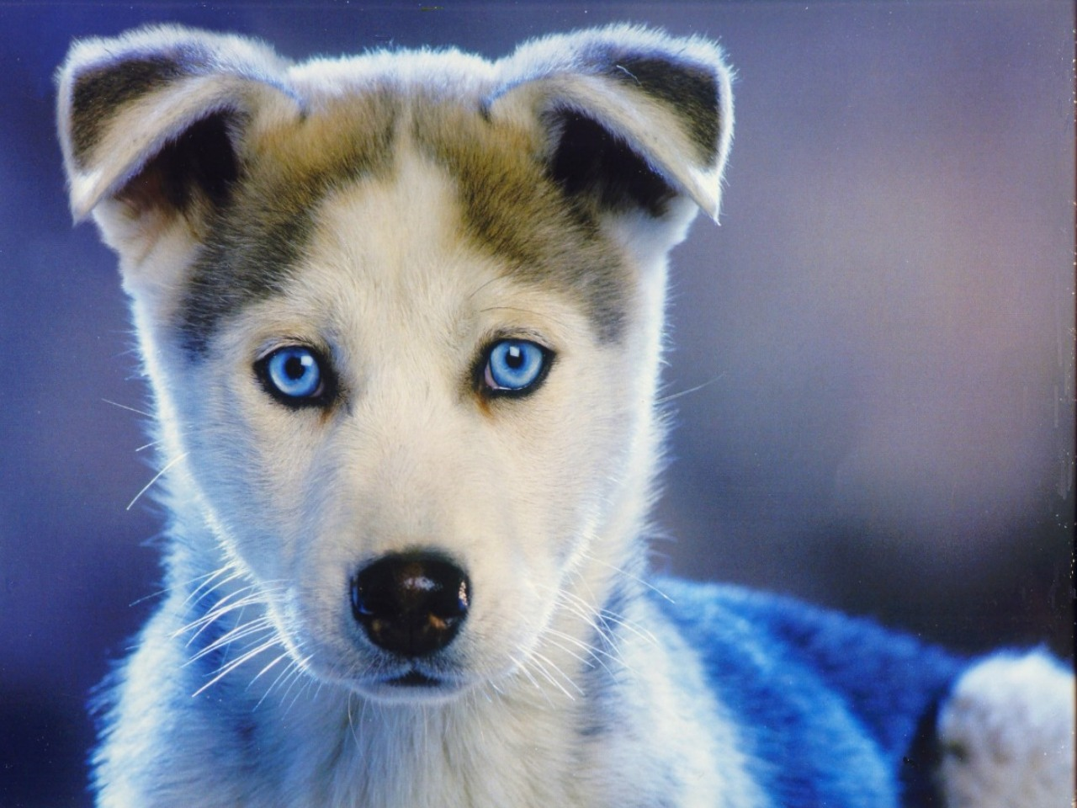

Slide 67
On Monday 23rd March, I was returning home from school when I was distracted by my neighbour’s dog.
Exposition 1. Too bland. Too short.
My scuffed sneakers scraped the uneven pavement as I stumbled tiredly home from school. The wicked sun drained my energy with every step. Through my weariness I could vaguely hear the honking horns on the busy street. I didn’t pay much attention to this because it was normal at this time of day. I continued to daydream about my soft bed waiting at home when I heard a yelp behind me. I jumped, turned around and smiled. It was my neighbour’s dog, Blue. Blue was everyone’s favourite dog. He was a gorgeous, white Husky with the most piercing blue eyes I had ever seen. Blue had two speeds: top speed and dead asleep. Today was a top speed kind of day.
My scuffed sneakers scraped the uneven pavement as I stumbled tiredly home from school. The wicked sun drained my energy with every step. Through my weariness I could vaguely hear the honking horns on the busy street. I didn’t pay much attention to this because it was normal at this time of day. I continued to daydream about my soft bed waiting at home when I heard a yelp behind me. I jumped, turned around and smiled. It was my neighbour’s dog, Blue. Blue was everyone’s favourite dog. He was a gorgeous, white Husky with the most piercing blue eyes I had ever seen. Blue had two speeds: top speed and dead asleep. Today was a top speed kind of day.
Adjectives can make a difference!
Exposition 2: introduced the setting (hot afternoon on a busy street); introduced characters (tired student and excited white husky with blue eyes).

Slide 68
Let’s fix the rising action and climax.
I was not paying attention and was not in a proper position to move. A car was coming towards me
How was he distracted?
How did he become aware that a car was approaching?
How did he feel/How did he react?
Busy petting Blue.
Heard a blaring horn.
Turned around to see headlights. Heartbeat accelerated. Eyes widened. Saw life flash before hime. Opened mouth to scream.

Slide 69
I was not paying attention and was not in a proper position to move. A car was coming towards me…
I bent to pet Blue, and his pink tongue wiggled crazily. Soon we were jostling like two wrestlers in the street, not caring about our surroundings. All my tiredness had fled. Blue had that effect on me.
Suddenly, a blaring horn interrupted our game. We jumped. What in the world was that? I turned around to see two headlights approaching me. Although it was daylight, the headlights looked like laser beams in the distance. All thoughts of play escaped as I tried to move, but fear glued me like cement to the spot. My life flashed before me. Since I had only been on earth for eleven years, it didn’t flash for long. I squeezed my eyes shut as the headlights got bigger and bigger…
I bent to pet Blue, and his pink tongue wiggled crazily. Soon we were jostling like two wrestlers in the street, not caring about our surroundings. All my tiredness had fled. Blue had that effect on me.
Suddenly, a blaring horn interrupted our game. We jumped. What in the world was that? I turned around to see two headlights approaching me. Although it was daylight, the headlights looked like laser beams in the distance. All thoughts of play escaped as I tried to move, but fear glued me like cement to the spot. My life flashed before me. Since I had only been on earth for eleven years, it didn’t flash for long. I squeezed my eyes shut as the headlights got bigger and bigger…
Emotions
Physical reactions
Physical reactions and emotions
Physical reactions

Slide 71
Let’s not confuse reports and stories

Slide 72
Let’s not confuse stories and reports

Slide 73
REPORT WRITING
NARRATIVE WRITING
Purpose: to inform
Purpose: to entertain
Content: 4 W’s + H
Content: Story elements: characters, setting, plot
Structure:
Introduction, Body, Conclusion
(Logical sequencing and organization of details)
Pay attention to:
Spelling
Grammar
Mechanics
Paragraphing
Structure:
Exposition, rising
action, climax, resolution (can
also start with a flashback)
Language:
Formal and factual
Use of transitions to ensure logical flow
Vocabulary that informs
Use of indirect speech
Language:
Descriptive and figurative, appeal to senses
Use of transitions to ensure flow and
interest
Vocabulary that appeals to
the senses and emotions
Use of direct speech

Slide 74
Remember for reports:
Focus on logical structure and sequencing
Include facts only
Maintain formal language
Omit opinions and emotions

Slide 75
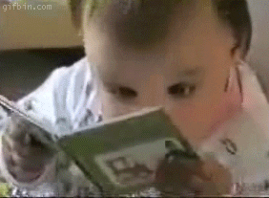
Remember for stories:
Focus on appealing to your reader’s senses
Take the time to describe your setting
Take the time to develop your characters
Use descriptive language
Use figures of speech

Slide 76
Happy Writing!

