Slide 1
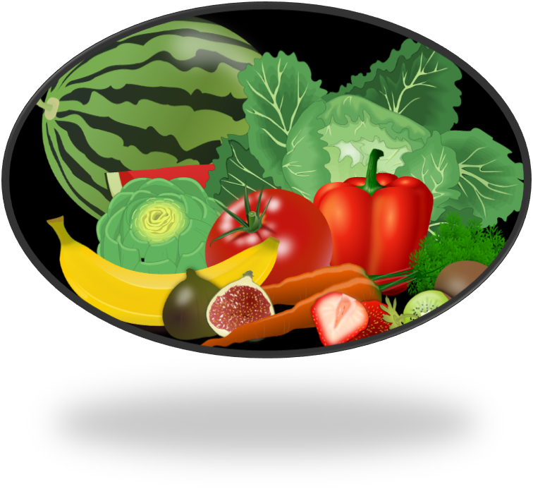
MINERALS PART 2
Curriculum Planning & Development Division, Ministry of Education

Slide 2
CONTENT
OBJECTIVES
1. IMPORTANCE OF CALCIUM AND IRON
2. FOODS THAT IMPACT THE ABSORPTION OF CALCIUM AND IRON
3. DEFICIENCY DISEASES
4. SUMMARY
5. ASSIGNMENT
6. REFERENCE

Slide 3
OBJECTIVES
AT THE END OF THIS LESSON,STUDENTS SHOULD BE ABLE TO :
Discuss the importance of calcium and iron to special groups.
Identify foods that inhibit and promote the absorption of calcium and iron.
Discuss the deficiency diseases associated with certain minerals.

Slide 4
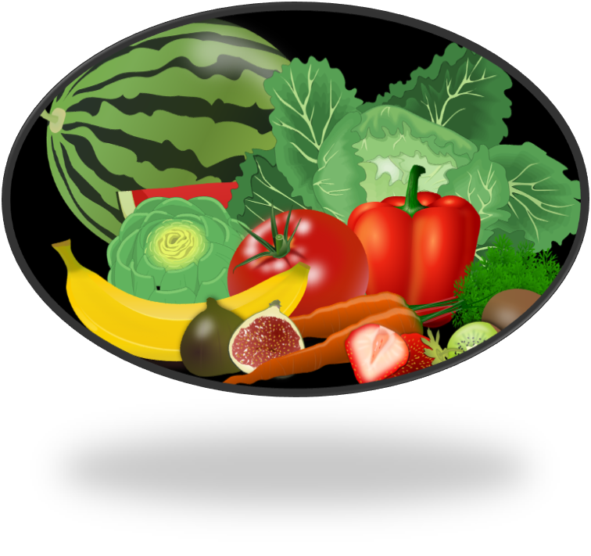
IMPORTANCE OF CALCIUM AND IRON TO SPECIAL GROUPS

Slide 5
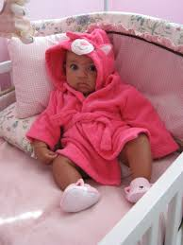
BABIES
CALCIUM
When new bones are made it replaces the old bones. For example, in young children the skeletal structure is replaced in two (2) years.
IRON
Babies are born with a supply of iron to last them four months, after which they need to be given foods that contain iron.

Slide 6
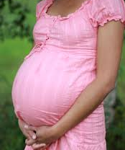
PREGNANT AND LACTATING WOMEN
CALCIUM
The foetus needs a lot of calcium as the skeleton develops. If the mother’s diet doesn’t have enough, calcium from the mothers bones will be used.
IRON
The need for iron is greater during pregnancy, since iron is needed to develop the baby’s blood supply.

Slide 7
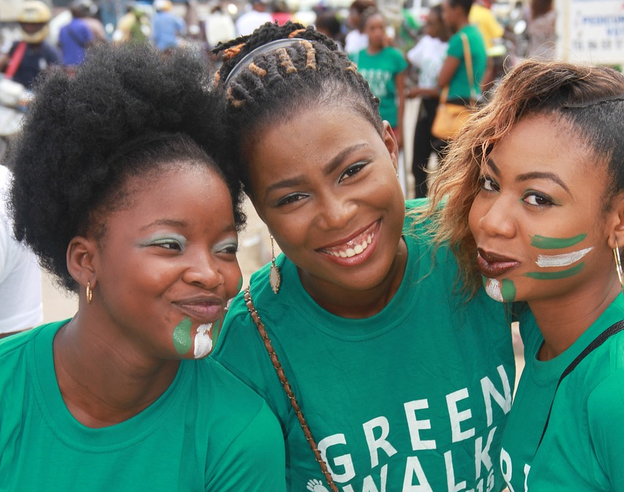
YOUNG GIRLS AND WOMEN
CALCIUM
Calcium is needed to build strong bones from childhood to adulthood. Around the age of 30 our bones begin to lose calcium and it isn’t replaced. This speeds up in women at menopause. The continual loss of bone can lead to osteoporosis.
IRON
The regular loss of blood through the menstrual cycle means that iron is lost. Iron needs to be replaced, especially after the birth of a baby.

Slide 8
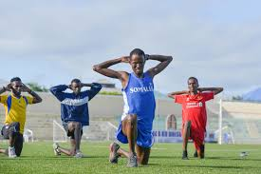
ATHLETES
CALCIUM
They need strong bones and joints, to endure the stress placed on them. Calcium is needed to ensure that they are kept strong.
IRON
Athletes require energy that must be obtained from reactions within their bodies. Having a good supply of iron, ensures the flow of oxygen to cells to produce energy.

Slide 9
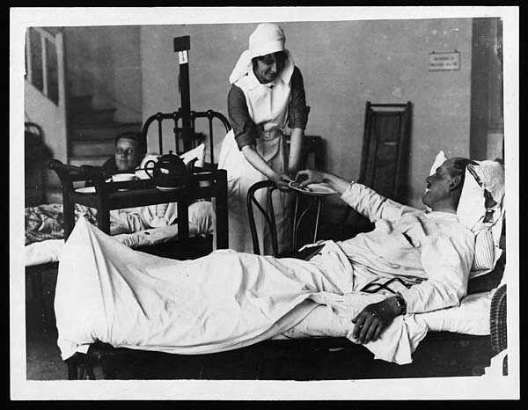
CONVALESCENTS
CALCIUM
Calcium along with phosphorous and vitamin D would assist in the healing of broken bones.
IRON
During injuries or surgeries, blood is lost, therefore the iron and blood needs to be replaced.

Slide 10
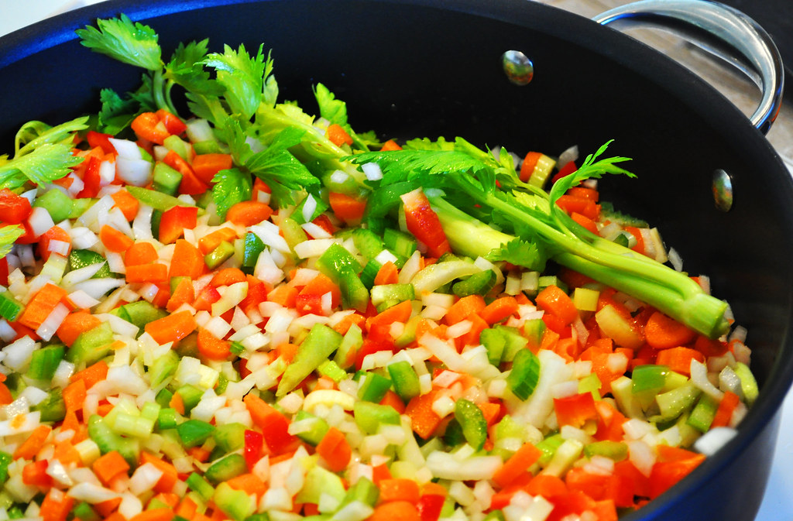
STRICT VEGETARIANSA
CALCIUM
Vegetarians can obtain their calcium from non-animal sources like, molasses, legumes and patchoi. Many cereals and other foods have calcium added to it.
IRON
Iron in its ferrous form (heme iron) is easily absorbed, unlike iron in its ferric form(non-heme). Vegetarians therefore, need to have vitamin C in their diet so that ferric iron found in plants can be turned into its ferrous form.

Slide 11
THE IMPACT OF FOOD ON THE ABSORPTION OF CALCIUM AND IRON

Slide 12
CALCIUM
INCREASE
Vitamin D is responsible for the absorption of phosphorous and calcium. Together they work to form stronger bones and teeth. Therefore, foods that contain vitamin D would increase the absorption of calcium like, liver, oily fish and dairy products.
DECREASE
A diet without vitamin D can inhibit the absorption of calcium. Calcium in plant sources are also prevented from being used by the body because our bodies cant digest cellulose. Calcium may also be found in whole grain cereals, but when combined with phytic acid it is made unavailable to the body.

Slide 13
IRON
INCREASE
Iron is easily absorbed in its ferrous form (heme iron) as oppose to its ferric form (non-heme iron). Animals are a great source of ferrous iron. Vitamin C rich foods enhances the absorption of iron especially from plant foods as it changes the ferric iron to ferrous iron.
DECREASE
Grains, leafy vegetables, and soy have phytic acid that can prevent the absorption of iron. Oxalate from spinach, calcium and phosphorous from milk, and tannin acid from tea, coffee, nuts, fruit and vegetables can have the same effect.

Slide 14
DEFICIENCY DISEASES RELATED TO MINERALS

Slide 15
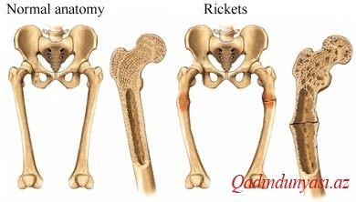
RICKETS
RICKETS | SIGNS AND SYMPTOMS
Rickets is a deficiency disease which results from a lack of vitamin D, phosphorous and calcium. The bones in the leg are not strong enough to withstand the weight of the body so it begins to bend. When this occurs in adults it is called osteomalacia | Pain in the bones of the lower body. Skeletal deformities Bone easily fractures Muscle cramps

Slide 16
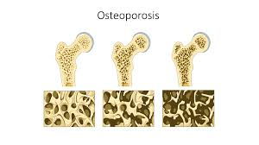
OSTEOPOROSIS
OSTEOPROSIS | SIGNS AND SYMPTOMS
Osteoporosis is a bone disease, where the body makes too little bone or there is bone loss. Low calcium intake affects the development of osteoporosis. | Loss of height Easily broken bones Pain especially in the back Osteoporosis means porous bones

Slide 17
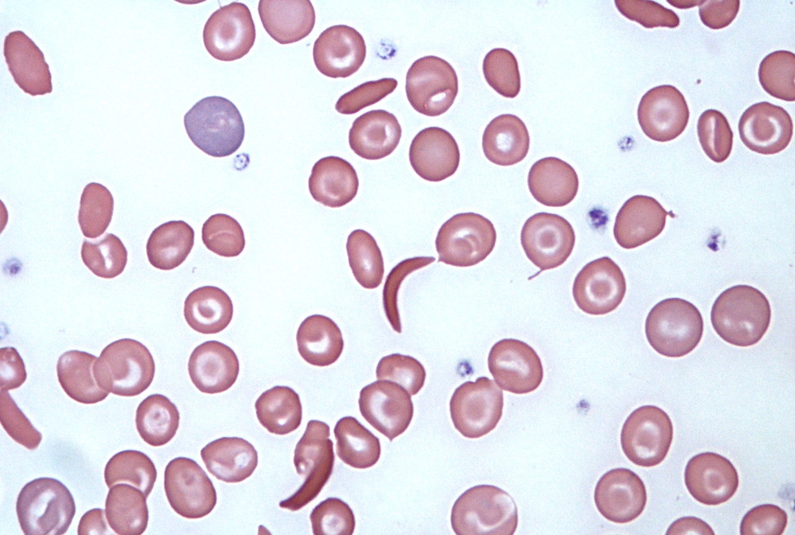
ANAEMIA
ANAEMIA | SIGNS AND SYMPTOMS
Anaemia is a condition where the amount of red blood cells or the amount of haemoglobin in the cells are low. Haemoglobin enables the blood to carry oxygen, which is used in reactions to produce energy. Anaemia can result from a lack of iron. | Fatigue Weakness Pale complexion Shortness of breath

Slide 18
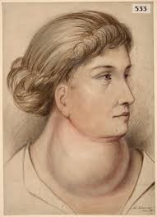
GOITRE
GOITRE | SIGNS AND SYMPTOMS
Goitre is an enlarged thyroid gland, which can be seen by the swelling of the neck. The production of thyroxine in the thyroid gland is reduced, which is responsible for metabolism slowing down. This is related to a lack of iodine in the diet. | Swelling in the neck. Difficulty breathing Difficulty swallowing Hoarseness Coughing Tightness in the throat

Slide 19
SUMMARY
Calcium and iron is needed by special groups of people for various reasons.
The absorption of iron and calcium can be affected by other foods that we eat.
A lack of certain minerals in our diet can cause deficiency diseases.

Slide 20
COMPLETE THE WORKSHEETS ATTACHED

Slide 21
REFERENCE
TEXTBOOK :
Anita Tull and Antonia Coward. (2009). Caribbean Food and Nutrition for C.S.E.C. Oxford.

Slide 22
REFERENCE
IMAGES:
https://freesvg.org/fruit-and-vegetables-vector-image
https://pxhere.com/en/photo/272661
https://commons.wikimedia.org/wiki/File:Gravid_-_pregnant_woman.jpg
https://www.needpix.com/photo/700486/young-girls-smile-nigerians-cotonou-green-walk
https://commons.wikimedia.org/wiki/File:2016_23_Athletes-10_(28454263401).jpg
https://www.flickr.com/photos/nlscotland/4699883972
https://www.flickr.com/photos/goodncrazy/3882450270
https://commons.wikimedia.org/wiki/File:Raxit.jpg
https://commons.wikimedia.org/wiki/File:Osteoporosis_--_Smart-Servier.jpg
https://www.flickr.com/photos/sicklecellanaemia/16428744572
https://commons.wikimedia.org/wiki/File:Large_goitre_in_a_woman_Wellcome_L0061670.jpg

Slide 23
Acknowledgement
Lesson compiled by:
Ms. Venita Ramcharran, Rio Claro East Secondary
Lesson reviewed by:
Ms. Malarie Horseford, Princes’ Town East Secondary

