Slide 1
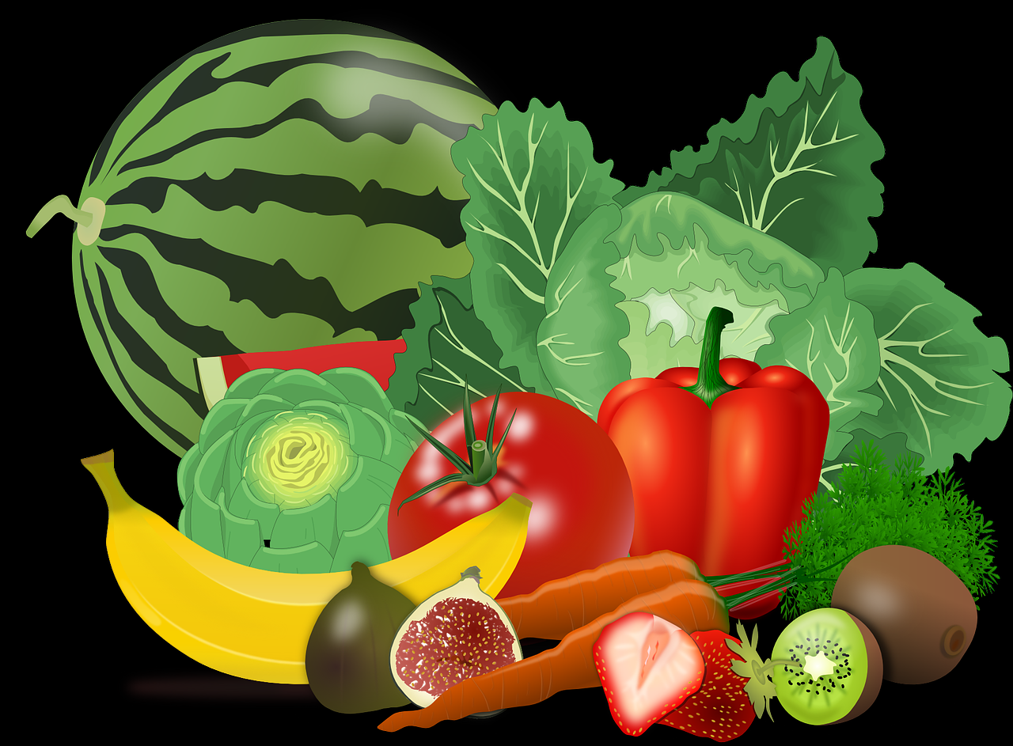
MINERALS
PART 1

Slide 2
CONTENT
OBJECTIVES
1.CLASSIFICATION OF MINERALS
2. CALCIUM
3. PHOSPHOROUS
4. SODIUM
5. IRON
6. IODINE
7. FLUORIDE
8. SUMMARY
9. REFERENCES

Slide 3
OBJECTIVES
AT THE END OF THIS LESSON,STUDENTS SHOULD BE ABLE TO :
Classify the minerals (calcium, iron, phosphorous, sodium, iodine and fluoride)based on the amount needed.
State the functions of each mineral.
List the sources of each mineral.

Slide 4
WHAT ARE MINERALS?
Minerals are chemical compounds that are formed naturally. They can be found in large deposits around the world, and they can be found in small amounts in the food that we eat. Of course, for this lesson, we are talking about the minerals found in our food.

Slide 5
CLASSES OF MINERALS
There are two classes of minerals found in food. These are grouped based on the amounts that our bodies need. We need large amounts(macro) and small amounts (micro).
Macro Amounts | Micro Amounts
Calcium Phosphorous Sodium | Iodine Iron Fluorine

Slide 6
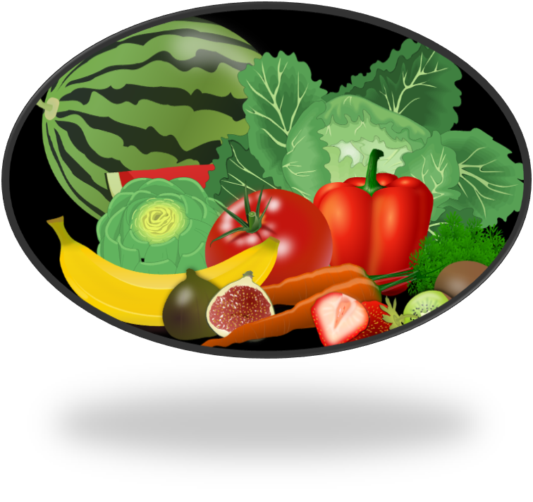
FUNCTIONS AND SOURCES OF MINERALS

Slide 7
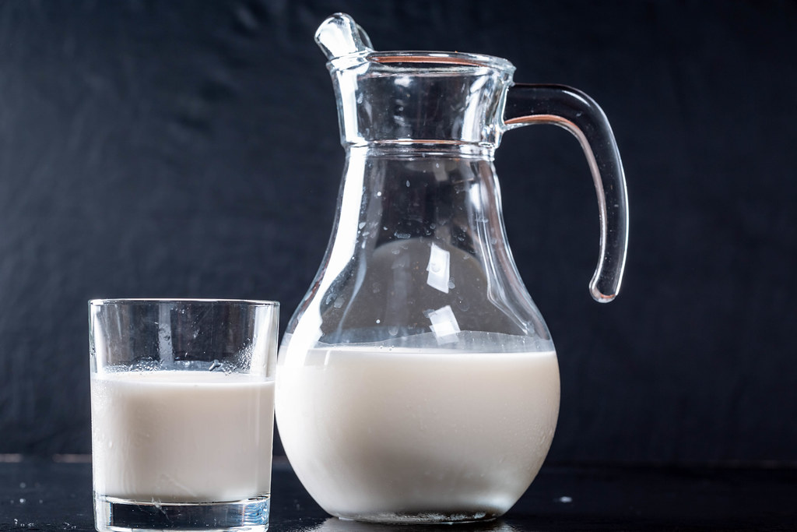
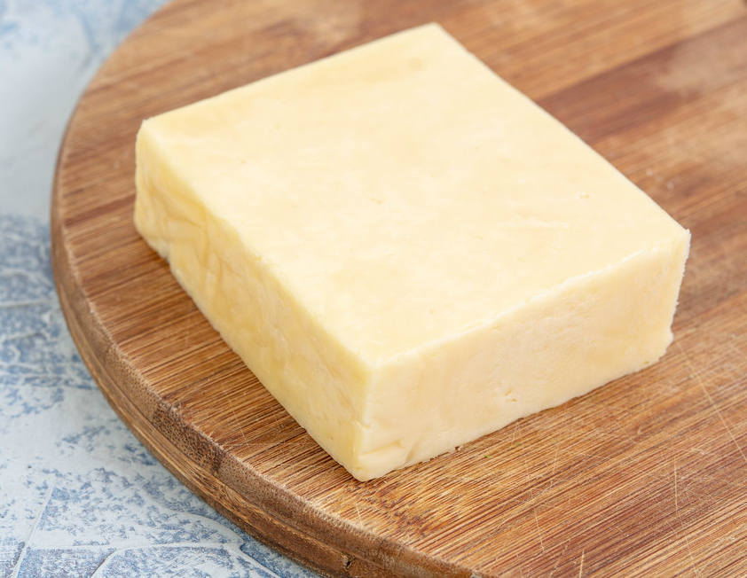
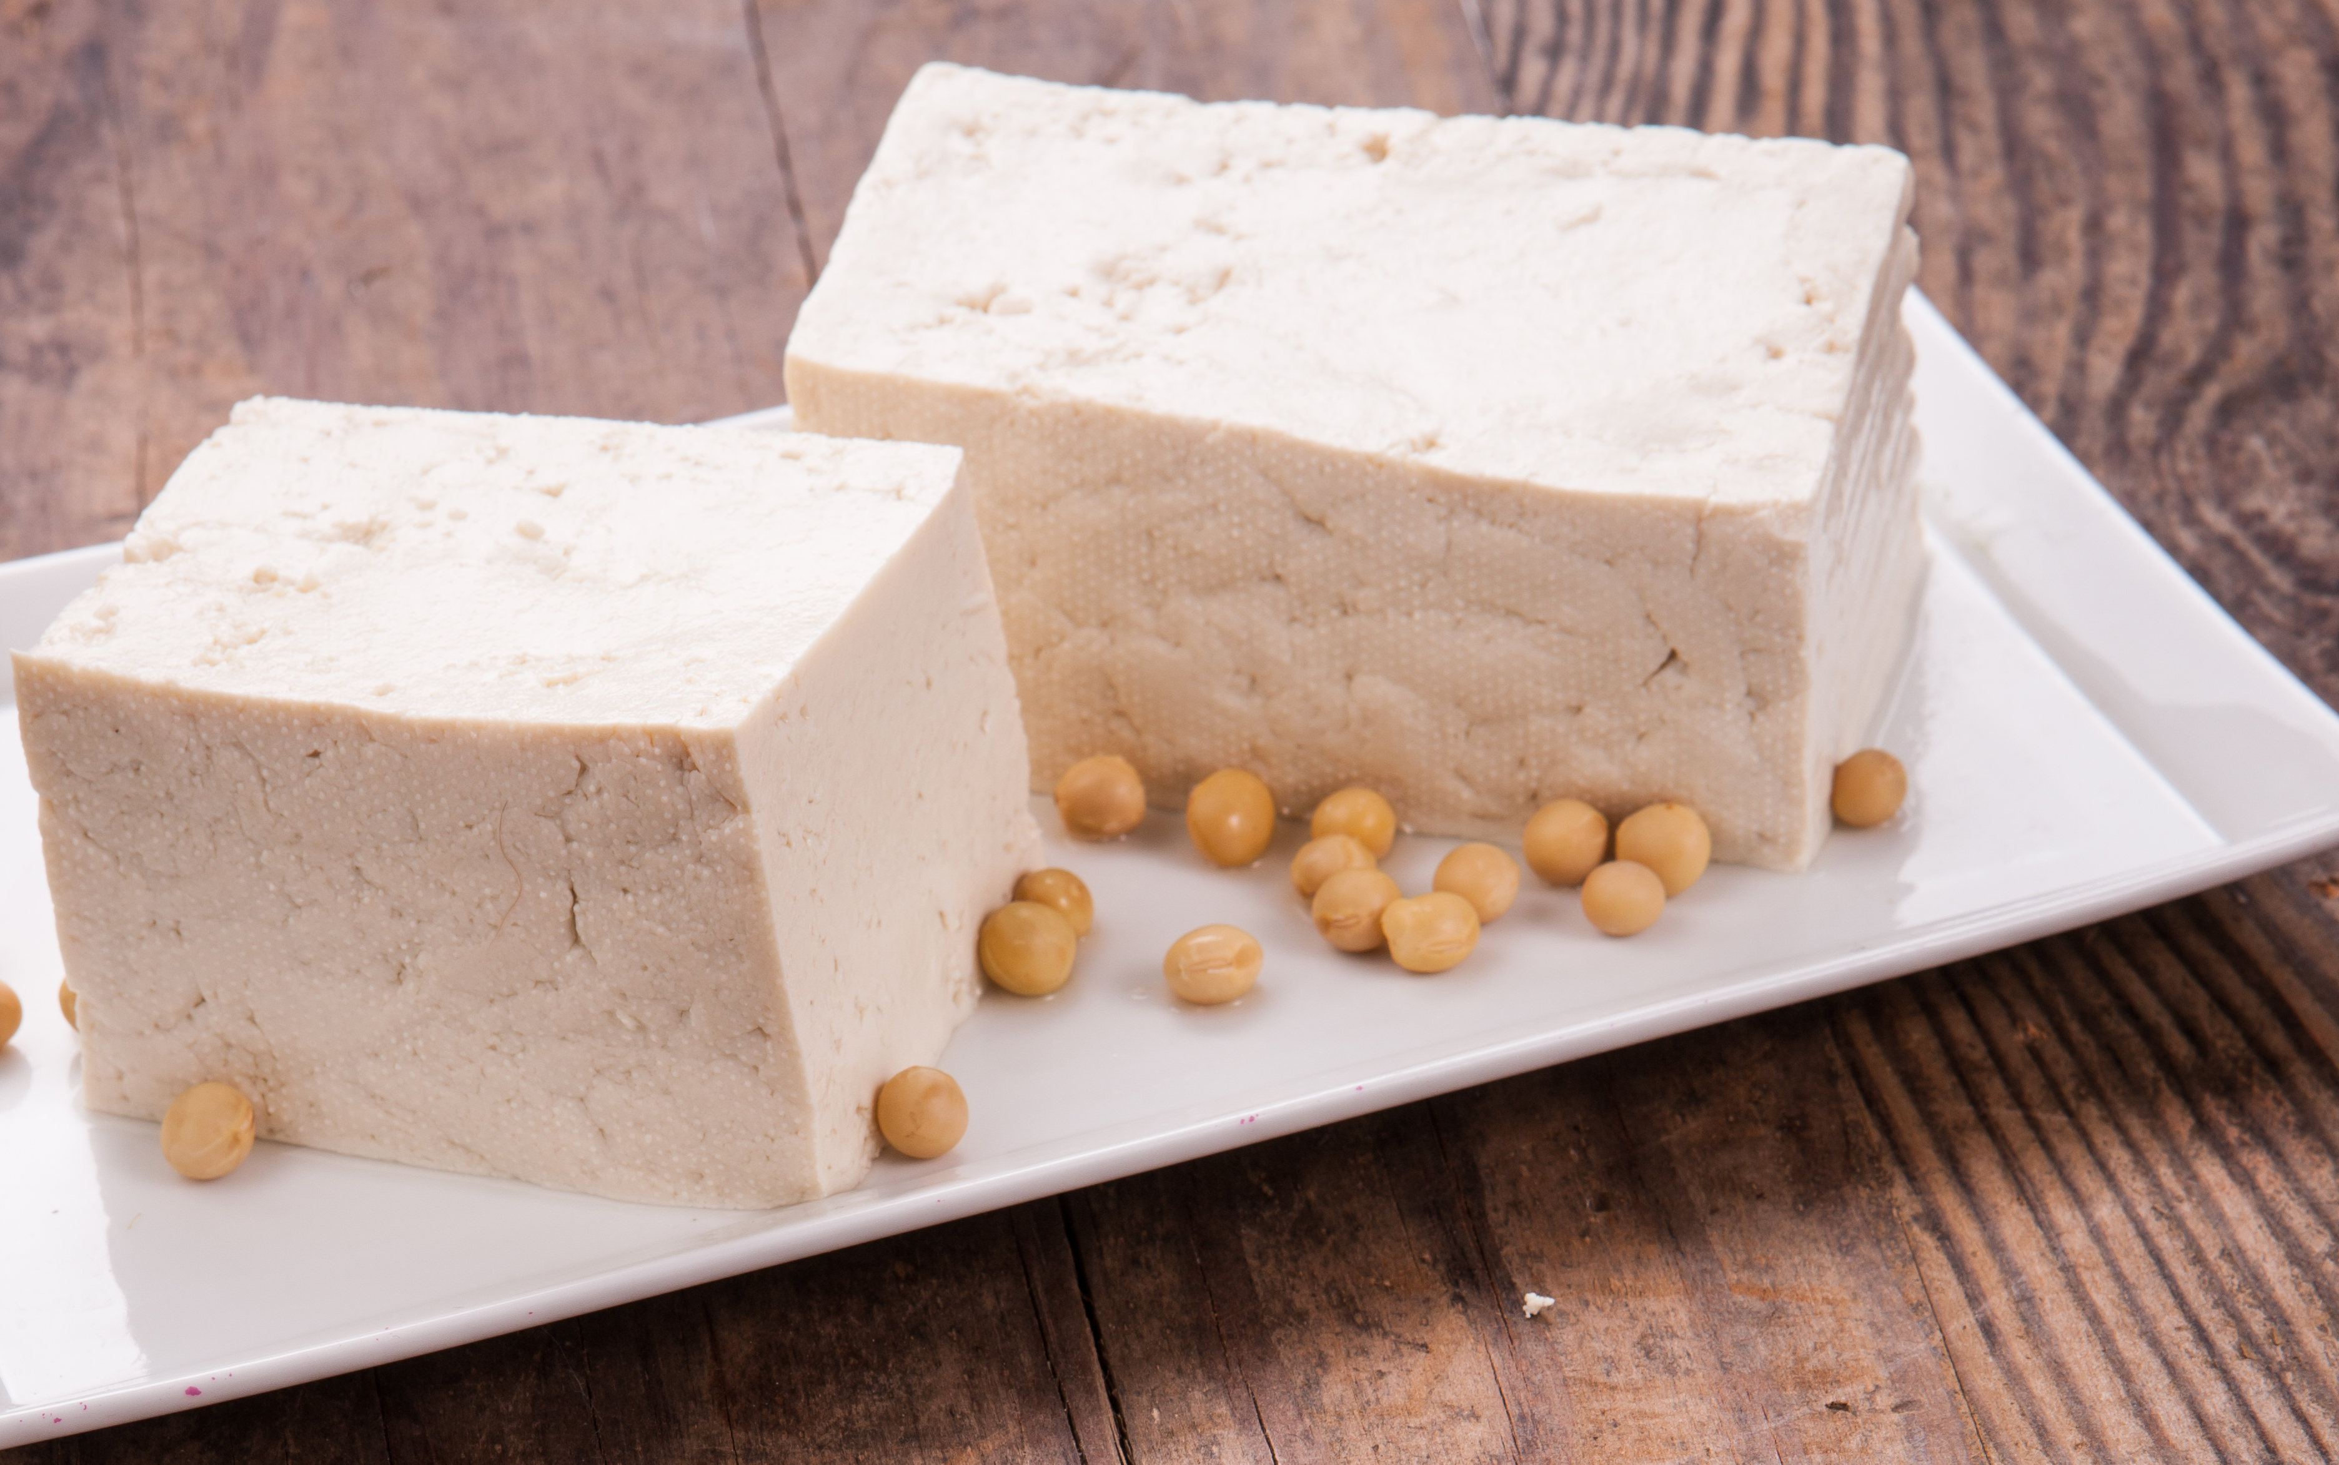
CALCIUM
FUNCTIONS | SOURCES
Calcium along with phosphorous and Vitamin D, forms calcium phosphate, which hardens bones and teeth. Needed to clot blood after an injury. Required for the proper functioning of muscles and nerves. Needed for the secretion of hormones and to activate some enzymes. Helps maintain normal blood pressure. | Milk Cheese Tofu

Slide 8
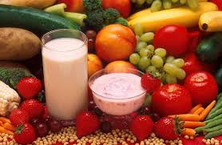
PHOSPHOROUS
FUNCTIONS | SOURCES
Works with calcium, therefore has similar functions. Needed for the production of energy in the body. It maintains the correct acid-base balance of body fluids. Lipids (fats) that have phosphorous as part of their structure, helps transports other lipids in the blood. | All plant and animal cells have phosphorous which is present as phosphate. Rich sources include dairy products, meats, cereals, and spinach.

Slide 9
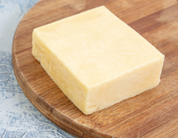
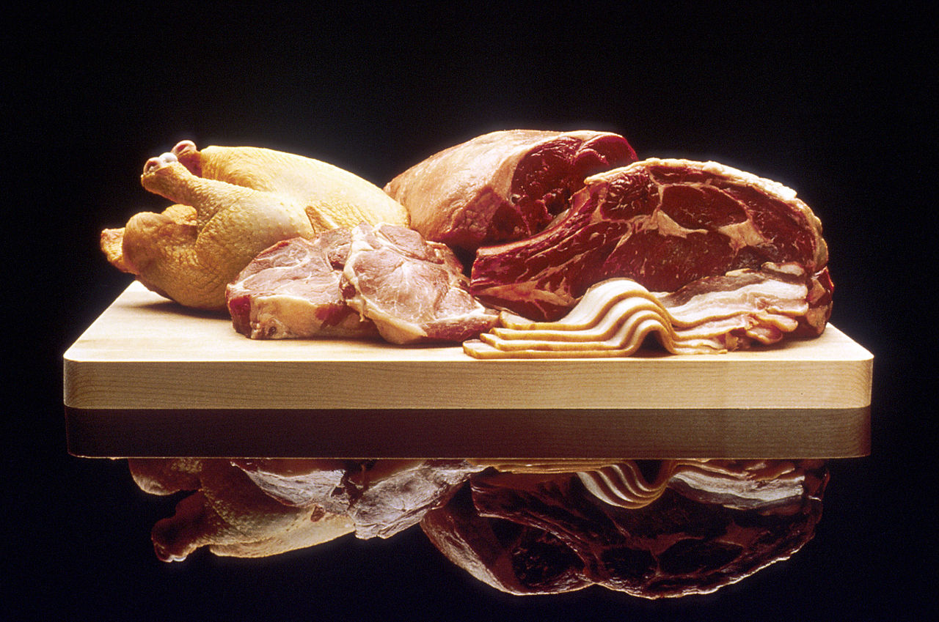
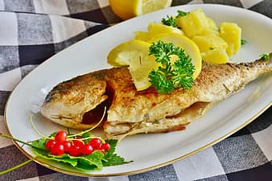
SODIUM
FUNCTIONS | SOURCES
Maintains the right acid-base balance in body fluids. Maintains water balance in the body. Helps in nerve impulse transmission. Needed to produce hydrochloric acid in the gastric juice of the stomach. | Cheese Meats Fish

Slide 10
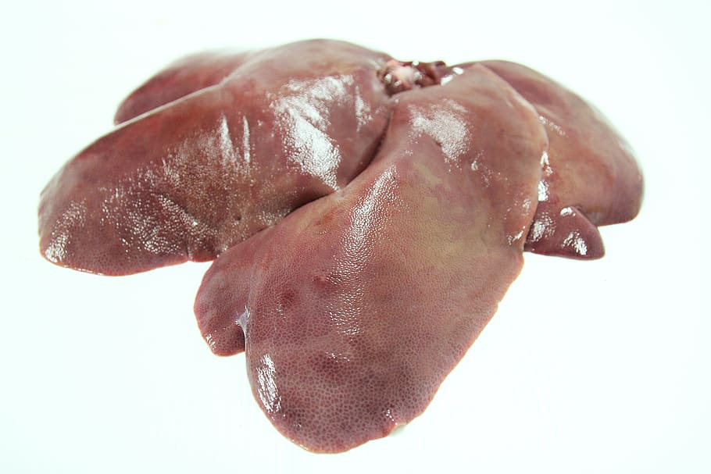
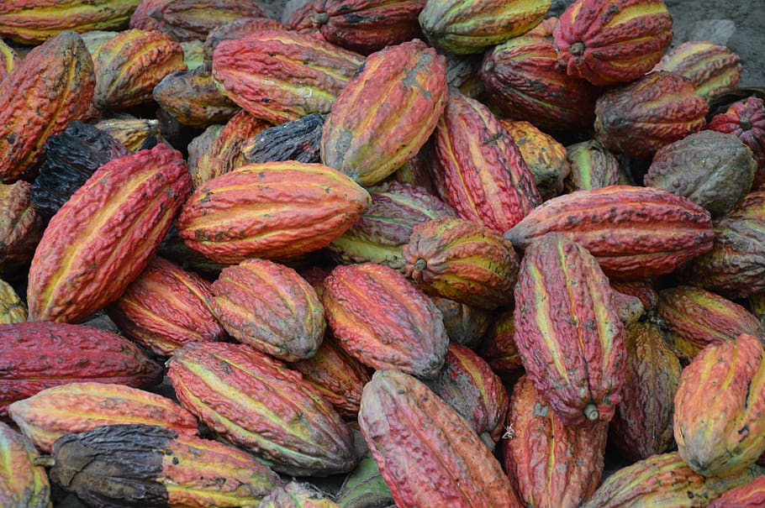
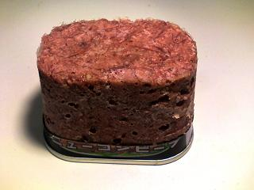
IRON
FUNCTIONS | SOURCES
Forms part of haemoglobin which is found in red blood cells. Haemoglobin is needed to transport oxygen around the body to every cell It forms part of myoglobin(a muscle protein). Needed for reactions that make energy | Liver and Kidney Cocoa Corned Beef

Slide 11
IRON Cont’d
There are two kinds of naturally occurring iron in foods that are absorbed and handled by our body differently.
Heme iron (ferrous) is found only in meat, poultry, seafood, and fish, so heme iron is the type of iron that comes from animal proteins in our diet. Heme iron is easily absorbed in our bodies.
Non-heme iron (ferric acid form) is found in plant-based foods like grains, beans, vegetables, fruits, nuts, and seeds. Non-heme iron is also found in animal products such as eggs or milk/dairy. Non-heme iron is usually less readily absorbed than heme iron

Slide 12
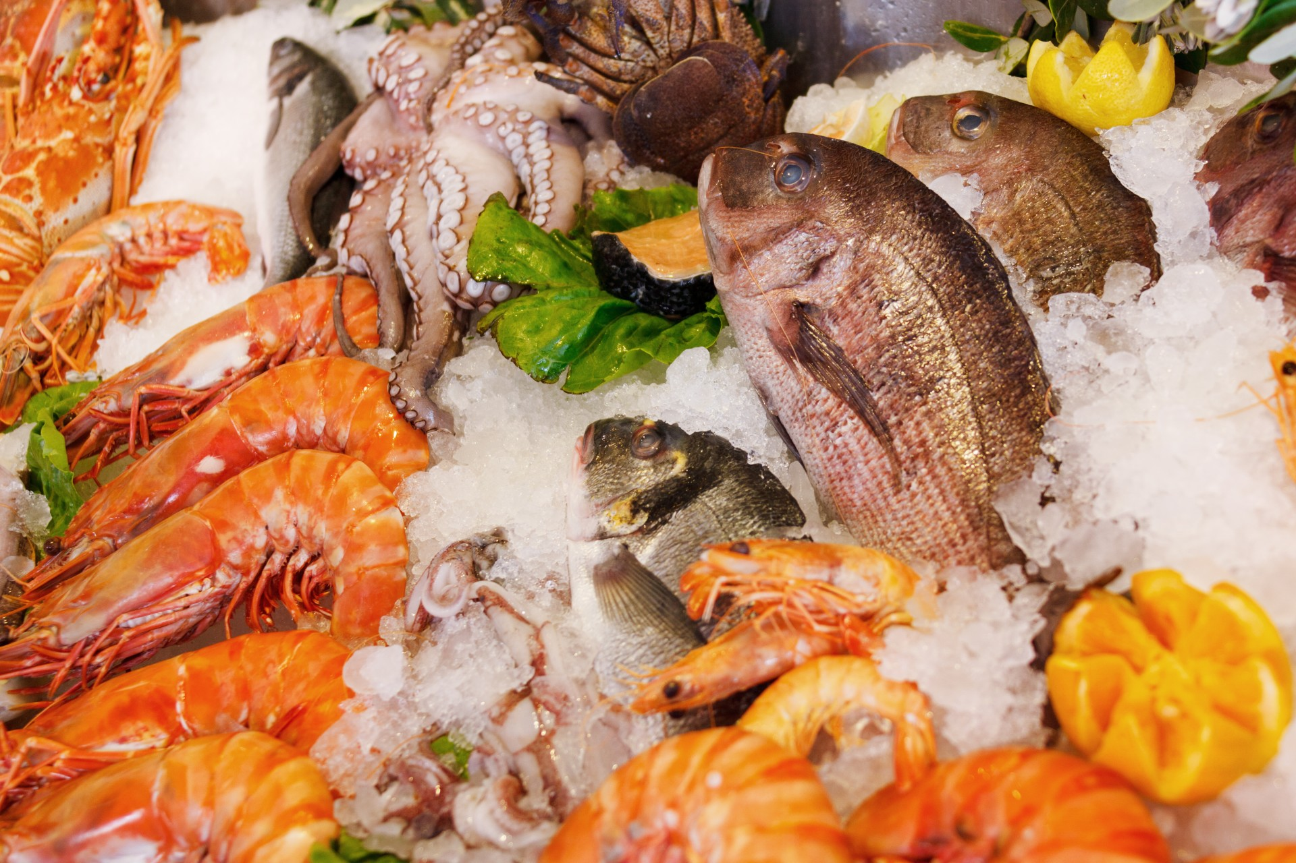
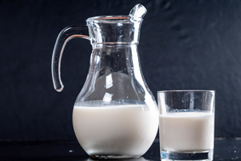
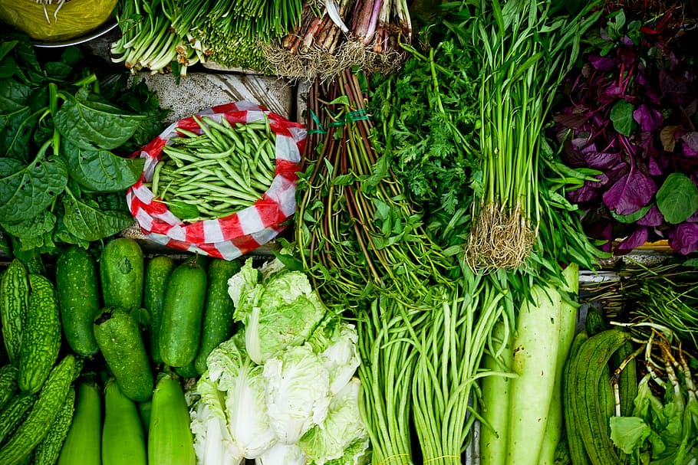
IODINE
FUNCTIONS | SOURCES
Needed to make the hormone thyroxine -Thyroxine along with other hormones helps control metabolism in the body. | Seafood Milk Green vegetables

Slide 13
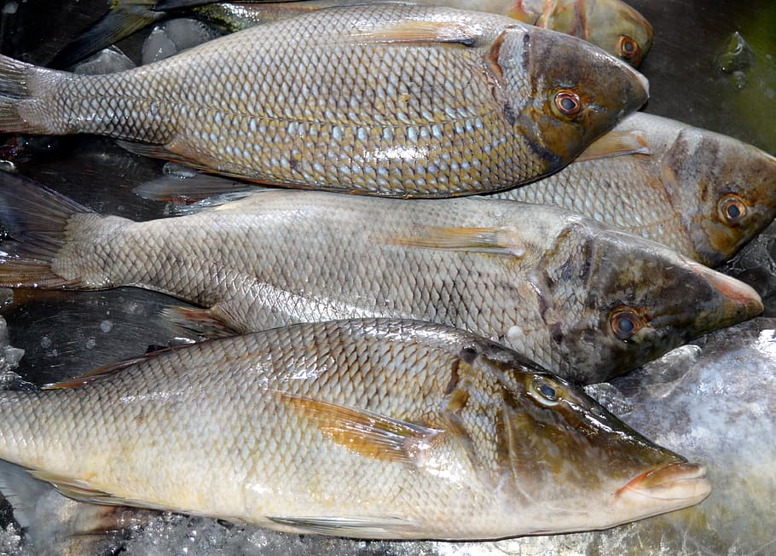
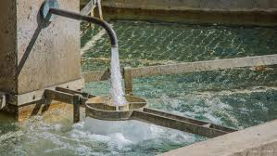
FLUORIDE
FUNCTIONS | SOURCES
Strengthening teeth to prevent decay. It combines with the enamel layer of the teeth to resist the effects of acid, produced by bacteria. | Tea Sea water fish In some water supplies

Slide 14
SUMMARY
Our bodies need minerals found in food to function properly.
Minerals such as calcium, phosphorous and sodium are needed in larger amounts and iodine, iron and fluorine are needed in smaller amounts.
All these minerals have specific functions and have various food sources.
Iron has 2 forms. Heme iron is readily absorbed in our bodies unlike non heme iron.

Slide 15
COMPLETE THE WORKSHEETS ATTACHED

Slide 16
REFERENCE
Lesson by: Venita Racharan (Rio Claro East Sec.)
TEXTBOOK:
Anita Tull and Antonia Coward, (2009), Caribbean Food and Nutrition for C.S.E.C. Oxford.

Slide 17
REFERENCE
IMAGES:
https://freesvg.org/fruit-and-vegetables-vector-image
https://www.pxfuel.com/en/free-photo-xpwbr
https://en.wikipedia.org/wiki/Food
https://www.flickr.com/photos/30478819@N08/44586577260
https://www.flickr.com/photos/30478819@N08/48394232096
https://www.needpix.com/photo/1455142/fish-bone-skeleton-holdinghand
https://www.wikiwand.com/en/Tofu
https://ecomercioagrario.com/en/the-eu-brought-the-consumption-of-fruits-and-vegetables-and-dairy-products-to-more-than-30-million-children-during-the-school-year-2016-17/
https://commons.wikimedia.org/wiki/File:FoodMeat.jpg

Slide 18
REFERENCE
IMAGES:
https://commons.wikimedia.org/wiki/File:FoodMeat.jpg
https://www.pikist.com/free-photo-vhviu
https://commons.wikimedia.org/wiki/File:Dry_yeast.jpg
https://www.publicdomainpictures.net/en/view-image.php?image=44295&picture=fresh-seafood-on-ice
https://www.wallpaperflare.com/assorted-vegetables-assorted-green-vegetables-on-ground-vegtable-wallpaper-zttau
https://www.publicdomainpictures.net/en/view-image.php?image=226319&picture=iodized-salt-crystals
https://pixabay.com/photos/tea-in-the-cup-turkish-tea-cup-hot-3640923/
https://www.pxfuel.com/en/free-photo-qjbah
https://pxhere.com/en/photo/1076353

