Slide 1
Factors affecting Soil Fertility
Erosion

Slide 2
What is soil erosion?
“The removal of soil from its original place to another place by the action of the external factors of wind and rain”
The major external factors that we encounter in our region that bring about soil erosion are wind and water

Slide 5
Natural or Geological erosion –
Occurs in an undisturbed natural environment as a result of :
running water on steep slopes
Running water on sloping areas with loose friable soil
Landlsides
Strong winds blowing over loose soil in dry, semi-arid or arid areas
Sea waves pounding the land in coastal areas

Slide 6
Accelerated Erosion –
Occurs as a result of the activities of people who disturb the natural environment creating conditions that speed up erosion. Such activities include:
Burning the vegetation e.g. Slash and Burn agriculture
Overgrazing of pastures
Deforestation
Mining and quarrying
Over weeding or brush cutting too closely
Not using a ground cover e.g. cover crop or mulch
Unsuitable cultural or conservation practices on hilly areas

Slide 7
CAUSES of SOIL EROSION
The major causes of erosion in the Caribbean are water and wind
There are five types of water erosion that we will examine in this section they are:
raindrop or splash erosion,
sheet erosion,
rill erosion,
gully erosion
coastal erosion.
Let us take some time and look at each type.

Slide 8
Raindrop or splash erosion –
The intensity or force of the rain is strong so that, you will find that as it hits the ground it can beat the soil apart and even cause it to be splashed away. The action of the rain causes soil particles to become loose. These loose particles are now able to float or be washed away in rain water from their point of origin. Soil that is naturally loose such as sandy soils would be easily affected by splash erosion.

Slide 9
Sheet erosion –
When sheet erosion occurs you would find that soil is removed by water in a sheet like manner across flat land or a gentle slope

Slide 10
Rill erosion –
A rill is a shallow narrow channel that is formed in the soil by the movement of water that runs off the surface of the soil found on slopes. It is usually seen where sheet erosion may have occurred. As the water runs off it carries with it, particles of soil and eventually begins to carve small, narrow channels into the soil surface..

Slide 11
Gully erosion –
Rill erosion eventually leads to gully erosion as the channels begin to widen and deepen. As the water moves through these gullies it takes with it valuable soil needed for crop cultivation also it reduces the amount of land space where crops could be established

Slide 12
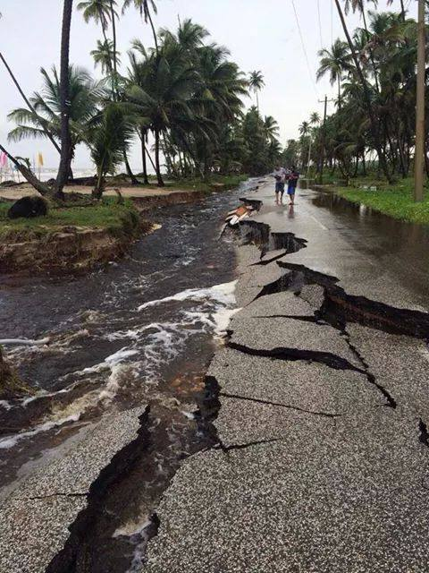
Coastal or Wave Erosion –
Islands in our region suffer a lot by the effects of coastal erosion. This is where the action of the waves in the sea constantly batter away at soil at the water’s edge. The force of the wind also contributes to the force of the waves. For farmers that have coconut trees planted close to the shore line it is not uncommon to one day see a tree that was once on land end up being in the sea, coconut plantations can be destroyed as a result. This occurs as the sea water removes the soil and its contents little by little. Large rocks and even buildings could end up being destroyed due to this form of erosion.

Slide 13
Wind Erosion
Many islands in the Caribbean experience strong tropical breezes. As a result you would find that wind damage can occur in areas where the land is exposed to strong breezes.
Wind can cause soil creep which is the gradual movement of loose soil particles toward the opposite direction from where it is blowing.
Saltation of soil particles occur when strong wind causes the soil particles to become airborne for a while and eventually fall to the ground forming heaps of soil. Soil particles can be carried many kilometers away e.g. Sahara dust. This can cause respiratory problems in humans and animals

Slide 14
Measures Used to Control Soil Erosion / Soil Conservation measures
Mulches –
A mulch is a material that is placed on bare areas of soil that are found between plants that are growing in the soil. Mulches help conserve soil water by reducing evaporation from the bed or plot.
The material used as a mulch could either be of organic origin or inorganic origin. Organic mulches are those which originate from living matter such as dead leaves or stems from plants, dried grass that does not contain weed seeds is used a lot for this purpose.
Inorganic mulches on the other hand originate from non living matter and may be chemically made in factories. One type of inorganic mulch that is used is light plastic sheeting similar to what is used for garbage bags. The inorganic mulch is used in a similar manner as you would use the dried grass mulch.

Slide 15
Cover Crops-
Cover crops which are also called vegetative covers, can similarly be used to reduce soil erosion. Rather than leaving a large area of soil bare which could lead to water and wind erosion, sometimes farmers may choose to have a cover crop growing in bare areas either between his or her established crop or in areas where the established crop is not growing.
Most farmers may choose to use leguminous crops as cover crops. Since legume crops add nitrogen to the soil and improves the soil fertility. Some legumes that they may use for this purpose are Centrosema plumieri, Centrosema pubescens, Calapogonium mucunoides and Pueraria phaseoloides
HOMEWORK – FIND PICTURES OF THESE PLANTS ON THE INTERNET USING GOOGLE IMAGES, DOWNLOAD AND PRINT THEM

Slide 16
Minimizing Tillage operations-
Excessive tillage or ploughing operations tend to loosen the soil and make it more susceptible to soil erosion by rain and wind. Farmers especially on hillsides should therefore minimize their tillage operations as loose soil could easily roll off the hillsides or be carried away in run off water. One way this can be done is by only tilling the soil of the hole where the roots of the plant will be placed rather than tilling a large area of land, as is usually done when establishing a raised bed for crops to be planted in.

Slide 17
Use of Barriers –
Another measure that is useful in controlling erosion is the use of barriers. Barriers can be used to control wind as well as water erosion.
For wind erosion, trees or certain crops are used as a barrier between the wind and the established crop so as to reduce the force of heavy winds. The trees or crops selected would usually be taller than the established crops e.g. some farmers may use forest trees such as the Carribean Pine for their barrier which blocks off the wind from affecting a shorter crop such as cassava. The trees or crops that are used as wind barriers are sometimes referred to as wind breakers. The establishment of such wind barriers would help to greatly reduce wind erosion.

Slide 19
Terracing-
Another measure that is used to limit soil erosion is the use of terraces in hilly regions. A terrace is formed when a section of a hill is levelled by man cutting into the hill so that it forms a flat region and this slows or prevents the rapid surface runoff of water that is usually responsible for removing loose soil. As a result of the flat nature of the terrace, it allows more water to be soaked up as the water is stopped from rolling downhill quickly and it reduces soil erosion as more soil is held on the terrace so less soil is carried downhill.
The hill is often formed into multiple terraces, along the contour giving it a step like appearance. The terraces are gently sloping and are separated from each other by banks. There are different types of terraces some examples are Bench terraces, Channel Terraces and Gardoni Terraces however in the Caribbean Bench Terraces are generally used which causes the hillside to have an appearance of benches or steps.
HOMEWORK – FIND PICTURES ON THE INTERNET OF THE DIFFERENT TYPES OF TERRACES AND SUBMIT THEM VIA EDMODO.

Slide 20
Bench Terraces

Slide 21
Strip Farming -
Strip farming which is also referred to as strip cropping is a method of farming used where crops are grown closely together in narrow strips and they may alternate with strips of closely planted grass or legume type crops. If the crop is short in height it can be alternated with a taller upright crop. The width of the strips is generally the same.
Strip farming helps to stop soil erosion by having the roots of crops hold onto the soil to prevent it from being washed away. Also because the grasses and legumes are planted closely together they help to hold back or trap soil particles that may pass through them in run off water.
Some forms of strip cropping are Contour strip cropping, Field strip cropping and Wind strip cropping. With contour strip cropping, crops are established along the contour lines of hillsides or mountains. The strips would run parallel to each other.

Slide 22
Contour Strip cropping

Slide 23
Proper Drainage Systems –
Having proper drainage systems in place on sloping land would also be essential to reducing the impact of run off water. Usually water as it goes down a hillside would take the pathway of least resistance. Depending on the force of the water it may even be able to push obstacles out of the way and carry them along with it.
Contour drains are constructed across the hill slope, along the contour to prevent the rapid flow of water downhill.

Slide 24
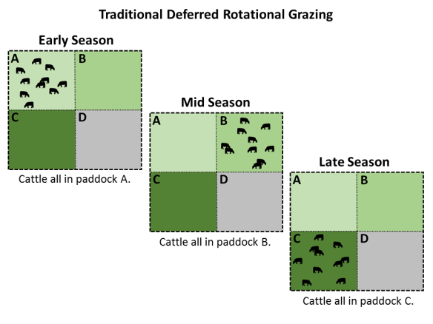
Rotational Grazing-
Rotational grazing can be used to prevent the problem of overgrazing of livestock that can lead to soil erosion. Here the field is divided into sections also known as paddocks and the animals are allowed to graze only in one section at a time. This gives the grass in the sections where the animal is not feeding, time to grow back and adequately cover the ground thereby reducing splash erosion.

Slide 25
Measures for conserving water
Generally some of the measures discussed under soil conservation actually help to slow down the speed of run-off water especially on hillsides and helps to conserve water as a result. For instance the use of grass barriers, terracing and contour strip cropping all help to reduce the speed of the flowing run off water. As the water slows down its speed this gives the water time to seep down into the soil and crops planted in that soil would be able to grow well as they would be able to receive the needed moisture.
Another way water can be conserved is by building ponds on flat portions of the land. On hills, flat portions of land could be provided through the use of bench terraces that the farmer may construct. In these ponds, run off water and rain can be collected and used for the watering of crops. Drains such as diversion ditches or contour drains can also lead to the ponds so that the run off water fills the ponds naturally.

Slide 26
In some cases farmers may construct Gabion Weirs. A Gabion Weir is a structure where rocks may be placed in the path of flowing water to divert the normal flow of water and even slow down the speed of moving water especially when they are constructed in a step like fashion as in the case of terraces. These weirs can also be used to form reservoirs where water can be collected.
The use of diversion ditches, contour drains and Gabion Weirs therefore contribute to water conservation in that they all help in the diversion of runoff water and the water that flows through them can be collected in containers such as tanks and barrels, ponds or reservoirs and used to irrigate the farmer’s crops.

Slide 27
Gabion weir

Slide 28
ANSWER THE FOLLOWING QUESTIONS

Slide 29
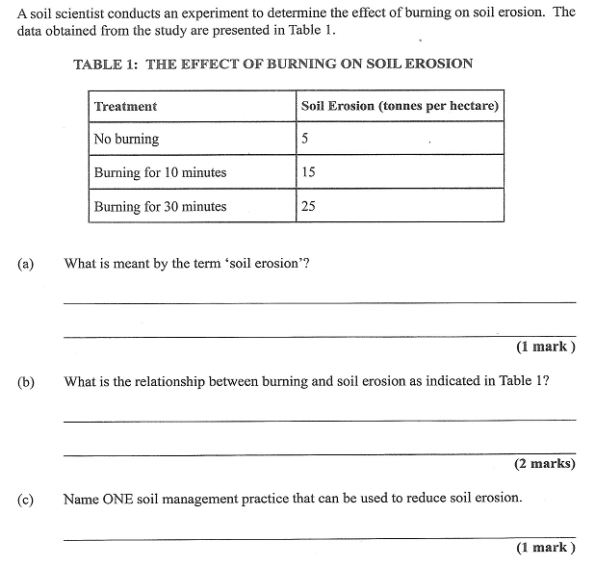

Slide 30
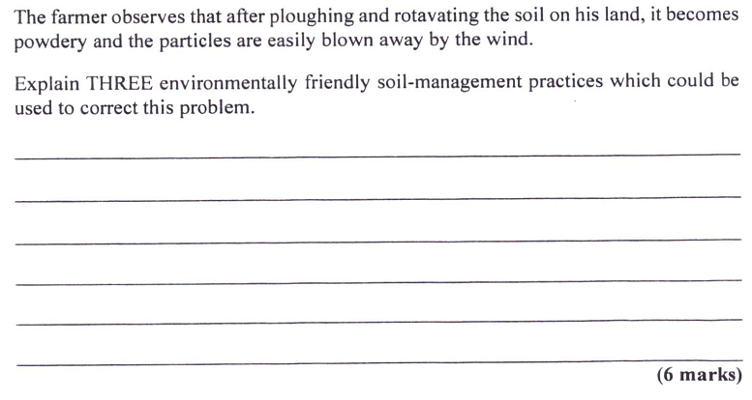

Slide 31
