Slide 1
External and Internal Structure of Monocots and Dicots
Structure of the Plant

Slide 2
THE PLANT

Slide 3
What are Monocotyledons and Dicotyledons?
Monocotyledons, also known as monocots, are one of two major groups of flowering plants (or angiosperms) that are traditionally recognized, the other being dicotyledons, or dicots. Monocot seedlings typically have one cotyledon (seed-leaf), in contrast to the two cotyledons typical of dicots.

Slide 4
Differences between Monocots and Dicots

Slide 6
THE ROOT SYSTEM
There are four main types of roots:
Tap roots – consists of a main root with lateral roots growing out of it e.g. tomato, mango
Fibrous roots – consists of a cluster of roots growing from the base of the stem e.g. corn
Adventitious roots – roots that grow from parts of the shoot system
Aerial roots – these grow above ground e.g. orchids

Slide 8
AERIAL ROOTS

Slide 9
External Structure of the root

Slide 10
INTERNAL STRUCTURE OF THE DICOT ROOT
THE MONOCOT ROOT IS SIMILAR EXCEPT THAT THE VASCULAR BUNDLES ARE SCATTERED AND NOT IN A SET ARRANGEMENT

Slide 11
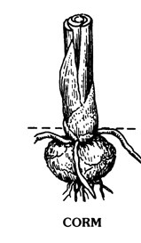
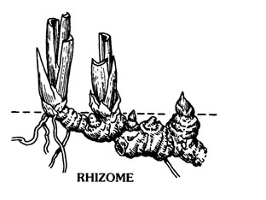
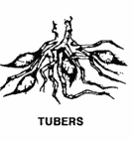
FUNCTIONS of the ROOT
The three main functions of the root are:
Anchorage of the plant in the soil
Absorption of water and mineral salts through a process called osmosis
Storage of plant food in specially modified roots e.g. corms, rhizomes, bulbs and tubers

Slide 12
THE SHOOT SYSTEM THE STEM
Stems can be herbaceous and woody. The herbaceous stems are green and fairly bendable. The woody stems as their name implies, are covered by bark. Most herbaceous plants are annuals or planted yearly. Monocot stems are non woody whereas dicot stems are woody

Slide 13
FUNCTIONS of the STEM
The stem is a part of the plant that holds up other structures such as the leaves and flowers and exposes them to the sun and to insects for pollination.
Stems also carry water and minerals up from the roots to the leaves to help with photosynthesis and take food back down to be stored and distributed to the plant as it has need.
Stems are valuable to man as a source of food and its wood is used for many products. The sap from many stems is used for resins and latexes.

Slide 14
TYPES of STEMS
There are different sorts of aerial stems or stems that are upright. They include tendrils, runners and thorns. Succulents are plants with bigger fleshy stems that help plants retain water in dry areas. Some stems are underground such as bulbs and tubers. There are also stems that cannot hold themselves up, but need to be supported e.g. vines, runners and twiners

Slide 15
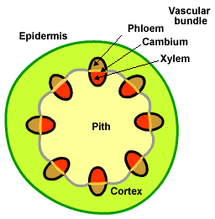
DIFFERENCES BETWEEN THE MONOCOT STEM AND THE DICOT STEM

Slide 16
THE LEAF
A typical leaf consists of :
Leaf blade or lamina
Petiole or leaf stalk
Midrib or main vein
Secondary veins
Apex or tip of the leaf

Slide 17
FUNCTIONS of the LEAF
There are three main functions of the leaf, these are;
A. Photosynthesis or manufacture of plant food
It is the primary function of green leaves by which plant food is made in the presence of sunlight and green pigment- chlorophyll present in the leaf. Water and carbon dioxide are essential for this
B. Interchange of gases
It takes place both for respiration and photosynthesis. There are numerous, minute openings present on the leaves, called stomata, through which gaseous exchange takes place between the atmosphere and the plant body.
C. Evaporation of water
Water absorbed by the root hairs of the plant is evaporated from the leaf surface during the day time. It generally takes place through the stomatal openings. The phenomenon is known as transpiration. This process allows the plant to absorb water and minerals from the soil and conduct the same to the top of the plant.

Slide 18
OTHER FUNCTIONS of the LEAF
D. Storage of food
Fleshy leaves of Indian aloe, Portulaca and fleshy scale leaves of onion store food materials and water for the future of the plants.
E. Vegetative propagation
Leaves of Bryophyllum and Begonia produce buds by means of which they give rise to new plants by vegetative propagation. In these cases when the leaf lamina touches the ground, the leaf margin at that point produces roots and form a bud that grows into a new plant.

Slide 19
TYPES of LEAVES
Leaves can be either;
simple – only one leaf blade
compound – more than one leaflet

Slide 20
INTERNAL STRUCTURE of the LEAF

Slide 21
Epidermis – Outer layer of tissues
Cuticle – Waxy protective outer layer of epidermis that prevents water loss on leaves, green stems, and fruits. The amount of cutin or wax increases with light intensity.
Leaf hairs – part of the epidermis
Palisade layer – A tightly packed layer of parenchyma tissues filled with chloroplasts for photosynthesis.
Chloroplasts –Chloroplasts contain chlorophyll, a green plant pigment that captures the energy in light and begins the transformation of that energy into sugars.
Vascular bundle – Xylem and phloem tissues, commonly known as leaf veins.
Spongy mesophyll – Layer of parenchyma tissues loosely arranged to facilitate movement of oxygen, carbon dioxide, and water vapor. It also may contain some chloroplasts.
Stomata – Natural openings in leaves and herbaceous stems that allow for gas exchange (water vapor, carbon dioxide, and oxygen).
Guard cells – Specialized kidney-shaped cells that open and close the stomata.

Slide 23
THE FLOWER
The flower is responsible for sexual reproduction of the plant

Slide 24
THE FRUIT
The fruit is that part of a plant which is in charge of protecting the seeds and guarantee their dispersal. It becomes as a result of the fertilization of the ovule. Some fruits, however, have another origin, deriving from the flower receptacle or some other parts of the flower. We have many kinds of fruits but the most typical fruit shows the following parts:
The pericarp is the external part of a fruit. It is all that surrounds the seed. It is divided into:
The exocarp is the outer covering. In an apple, for instance, it is what we know as the "skin".
The mesocarp is the middle covering. In a peach what we ordinarily call the "flesh".
The endocarp is the inner covering , in many cases the stiffened part normally covering the seed. In a plum , for example, what we commonly know as the "stone".

Slide 25
STRUCTURE of the FRUIT

Slide 26
TYPES of FRUIT
Fruits may be dry or fleshy
Three types of fruits exist --- simple, aggregate, & multiple
Simple fruits (apple) form from One pistil on a flower
Aggregate fruits (raspberry) form from several pistils on a flower
Multiple fruits (pineapple) form several flowers growing close together

Slide 27
SIT BACK AND LISTEN

Slide 28
THE SEED
The seed is enclosed inside the fruit and consists of the following parts
The radicle is the part of the embryo which emerges first. Once outside it develops into a main root, producing root hairs and secondary roots.
- The plumule is like a leaf in its early development.
- The hypocotyl is the space between the radicle and the plumule. It develops into a stem.
The endosperm is the food supply contained in the seed. This is sometimes included in the cotyledons, which either achieve the function of primary leaves or food storage, even both of them in some cases.
According to the number of cotyledons, we classify plants in two groups: monocotyledons or monocots and dicotyledons or dicots.
The seed coat or testa - is the outer layer of the seed.
The micropyle is a little pore on the seed coat , through which, apart from entering the sperm, the seed absorbs water to begin germination

Slide 29
THE DICOT SEED

Slide 30
THE MONOCOT SEED

Slide 31
CXC PAST PAPER QUESTIONS

Slide 33
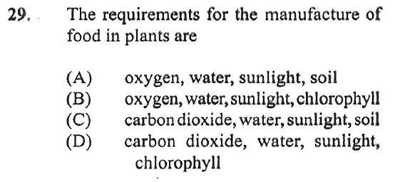

Slide 34
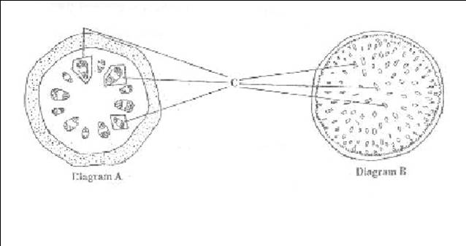
(a) Plants are divided into two broad groups. The labelled diagrams below show the cross-section of a plant from each group.
Name the two groups.
Diagram A …………………………………………………………………………
Diagram B ………………………………………………………………………….
Explain any TWO functions of the structure labelled C in the two diagrams with respect to a named tissue.
Tissue ………………………………………………………………………
Function ……………………………………………………………………
Tissue ………………………………………………………………………
Function ……………………………………………………………………

