Slide 1
Fire Extinguishers
CSEC TECHNICAL DRAWING
Gellineau, CPDD MoE 2020

Slide 2
OBJECTIVES
At the end of this lesson, you should be able to:
Describe a fire extinguisher and its operations
Identify types of fire extinguishers
Decsribe the process of using a fire extingusher
Select fire extinguishers for appropriate fires

Slide 3
FIRE EXTINGUISHERS
A fire extinguisher is an active fire protection device used to extinguish or control small fires, often in emergency situations
It is not intended for use on an out-of-control fire

Slide 4
CLASSIFICATION OF FIRE EXTINGUISHERS
There are 5 main types:
Water
Foam
Dry Powder
CO2
Wet chemical

Slide 5
NOTE
Review the lesson of types of fires as classification of fires is linked to types of fire extinguihers:
Or Click the link below for a quick review:
https://www.youtube.com/watch?v=xnZZruGjKBA

Slide 6
Water based Fire Extinguisher
Water fire extinguishers have a Class A rating and are suitable for fighting fires involving solid combustibles such as wood, paper and textiles.
This is the original fire extinguisher
NOTE:
Electrical equipment should be avoided when using a water extinguisher (unless water with additives are used) as water is a conductor.

Slide 7
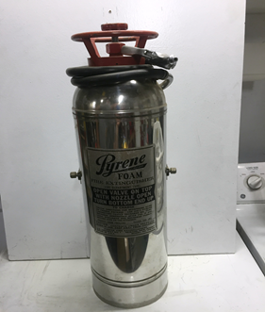
FOAM Based Fire Extinguisher
Foam fire extinguishers can be used on Class A and B fires.
They are most suited to extinguishing liquid fires such as petrol or diesel and are more versatile than water jet extinguishers because they can also be used on solids such as wood and paper

Slide 8
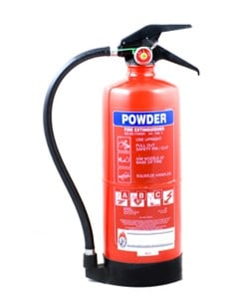
DRY POWDER FIRE EXTINGUISHER
Dry Powder extinguishers are for Class D or combustible metal fires, ONLY.
They extinguish the fire by separating the fuel from the oxygen element or by removing the heat element of the fire triangle.
They are similar to dry chemical.

Slide 9
CO₂ FIRE EXTINGUISHER
CO₂ extinguishers are predominantly used for electrical fire risks.
They are ideal for electrical fires, as CO2 is not a conductor and they do not leave behind any harmful residue
They are usually the main fire extinguisher provided in computer server rooms.
They can also put out Class B fires (flammable liquids, such as paint and petroleum).

Slide 10
WET CHEMICAL FIRE EXTINGUISHER
Wet chemical fire extinguishers are used on deep fat frier fires and fat fires (Class F), although some can also be used on A class fires (solids).
The wet chemical rapidly knocks the flames out, cools the burning oil and chemically reacts to form a soap-like solution, sealing the surface and preventing re-ignition.
This type of fire extinguisher contains a liquid extinguishing agent which is used to smother fires ignited from cooking oils and fats.

Slide 11
OPERATION OF A FIRE EXTINGUISHER
httpswww.youtube.com/watch?v=ktrv34zW://7-A
Click the link on the left
Look at the video explaining the operation of the fire extinguisher
Pay attention to ALL the facts as you will be tested at the end of this lesson.
Review if you did not catch all the details

Slide 12
Self Assessment
Instructions:
Read through the questions and write your responses as clearly and as briefly as you can
Take no more than 1 hour to complete the questions
When you have finished the paper, go to the answer sheet and check to see if your responses were correct.
Please review the material for ANY incorrect responses.

Slide 13
References
Photographs: wikimedia commons
https://www.youtube.com/user/nauticalive
https://www.youtube.com/channel/UCDwsNpdq8nR4a4mcxOEsigw

