Slide 1
FAMILY AND RESOURCE MANAGEMENT
THE FAMILY

Slide 2
Group level: Form Four/Form Five
INSTRUCTIONS
Read the information on the power point
Review what you have learned by completing the questions presented on the slides.
Use the answer key to assess your performance.

Slide 3
ROLES AND FUNCTIONS OF THE FAMILY

Slide 4
OBJECTIVES
At the end of the lesson, students should be able to:
Describe the roles of the family
Explain the different functions of the family
Differentiate between roles and functions of the family

Slide 5
ROLES of the FAMILY
Family roles are determined within the social setting of the family and are performed by individual family members.
Roles of a generalized nature are attributed to certain family members depending on circumstances and family situation. For example, father and mother as breadwinner, mother housekeeper, father counsellor and caring person.

Slide 6
ROLES of the FAMILY Cont’d
Family roles shape how we relate with each other in the family system.
These roles function to produce and preserve a balance in the family system.
Family roles have both positive and negative characteristics to them.
Understanding how well these roles work for the family is important and how they help or hurt family members in their effort to establish safe relationships.

Slide 7
ROLES of the FAMILY Cont’d
Parents play the most important roles within the family unit as:
Caregiver
Breadwinner
Nurturer
Disciplinarian
Role model
Spiritual guide

Slide 8
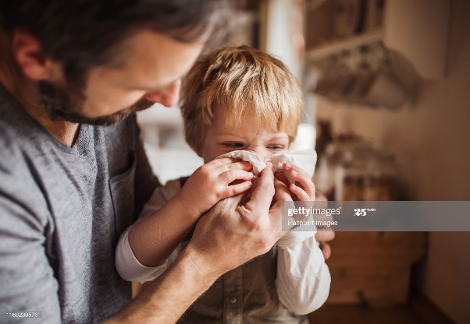
The CAREGIVER
Provide physical care, emotional support and encouragement to family members.
There is usually balance in taking care of his/her own needs while providing a positive influence on those around him/her.
https://media.gettyimages.com/photos/helping-a-senior-woman-out-of-the-car-picture-id952119556?s=2048x2048
https://media.gettyimages.com/photos/father-on-paternity-leave-looking-after-small-son-indoors-blowing-his-picture-id1168239576?s=2048x2048

Slide 9
The BREADWINNER
The person in the family who earns money to support other family members.
Some families may have one sole breadwinner, while others may have multiple.
https://media.gettyimages.com/photos/pediatrician-picture-id514836214?s=2048x2048
https://media.gettyimages.com/photos/male-teacher-standing-before-students-with-hands-raised-picture-id200193780-001?s=2048x2048
https://media.gettyimages.com/photos/organic-farmer-pride-of-his-crop-picture-id654568040?s=2048x2048=

Slide 10
The NURTURER
Provides emotional support, creates safety, is available to others, and can be a mediator.
He/she focuses on having and meeting emotional needs, usually in a balanced manner.
Mothers are by nature, nurturers, an example of this is breastfeeding.
https://media.gettyimages.com/photos/mother-and-son-planting-in-garden-picture-id594828619?s=2048x2048
https://www.gettyimages.com/detail/photo/mom-breast-feeding-her-baby-girl-and-fondling-the-royalty-free-image/669985716

Slide 11
The DISCIPLINARIAN
Believes in training or teaching family members to obey rules, or a code of behaviour.
Uses the appropriate punishment to correct disobedience.
In some families both parent work together in fulfilling this role.
https://www.gettyimages.com/detail/photo/tween-girl-hands-her-phone-over-to-her-mother-royalty-free-image/664785824
https://www.gettyimages.com/detail/photo/caucasian-parents-scolding-children-royalty-free-image/482143257

Slide 12
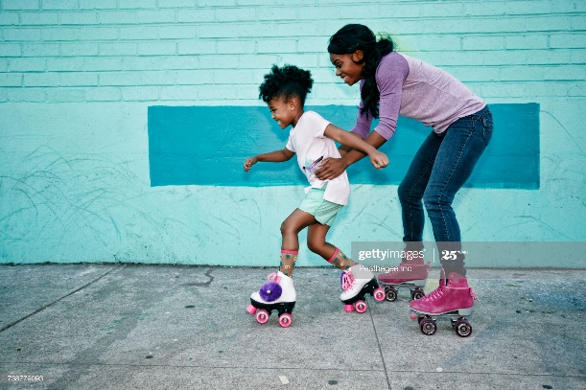
The ROLE MODEL
This person is a high achiever and carries the pride of the family
He/she is often a good leader and organizer, and is goal-oriented and self-disciplined.
Role models should have strong spiritual and moral values
https://www.gettyimages.com/detail/photo/he-gets-his-style-from-dad-royalty-free-image/854461746
https://media.gettyimages.com/photos/black-mother-holding-waist-of-daughter-wearing-roller-skates-picture-id738779093?s=2048x2048

Slide 13
SPIRITUAL GUIDE
Parents are expected to raise their children in both love and righteousness.
Spiritual guidance will provide children with a moral compass so they know right from wrong.
Parents need to teach children about having faith and hope.
https://www.gettyimages.com/detail/photo/show-appreciation-for-what-you-have-royalty-free-image/1041115524

Slide 14
FUNCTIONS of the FAMILY
Procreation and Reproduction
An important function of the family is to increase family size either bearing children or by adopting them.
Socialisation
This include education, religion, and preparation for a career, learning social relationships and management of leisure, and being a responsible citizen.

Slide 15
FUNCTIONS of the FAMILY Cont’d
Nurturing Growth of Personality
The family is responsible for the development of the organized pattern of behaviours and attitudes that make a distinctively functional individual.
Providing Basic Needs
Basic needs of food, shelter, clothing and health care. The young need emotional nurturing as well: they need love and a sense of security and belonging.

Slide 16
Providing Basic Needs Cont’d
Factors to meet the need of being physically well:
Eating healthy - proper nutrition
Regular exercise
Getting adequate sleep or rest
Being hydrated – drinking adequate amount of water
Adequate amount of fresh air
Practising safety awareness

Slide 17
Providing Basic Needs Cont’d
Factors to meet the need to be mentally well:
Appropriate nutrition for the brain
Mental exercises e.g. reading, doing puzzles etc.
Good family and other relationships
Physical activities
Adequate sleep or rest, vacation
Avoid of stressful situations
Taking care of yourself - regularly include in your life a little bit of love and attention

Slide 18
FUNCTIONS of the FAMILY Cont’d
Cultural Transmission
Culture:- beliefs,
- customs
- social heritage
- artistic heritage
Culture is passed on by the family from one generation to the next and should not conflict with the moral, and spiritual values in the home.

Slide 19
FUNCTIONS of the FAMILY Cont’d
Conferring Status
Status can either be ascribed or achieved.
Ascribed status
The status a person has by virtue of birth.
Includes race, ethnicity, gender, age, citizenship, religion and membership into the community.
The family helps to form these habits.
.

Slide 20
FUNCTIONS of the FAMILY Cont’d
Conferring Status
Achieved status
The status an individual acquires during the course of his /her lifetime.
Obtained from society and is often a result of hard work by the individual. Example, doctor, teacher, businessman/woman.
Education can alter our status, providing we work towards that goal.

Slide 21
FUNCTIONS of the FAMILY Cont’d
Regulation of Kinship Ties
The family enables the individual to identify his blood relations; thus we know our mother, father, brother, sister, and the sexual caution we must maintain with them.
The Family also enables individuals to identify acceptable behaviour towards persons in society to prevent infidelity, which leads to the disintegration of the family.

Slide 22
CONCLUSION
The family performs several essential functions for society.
It socializes children
It provides emotional and practical support for its members
It helps regulate sexual activity and sexual reproduction
It provides its members with a social identity

Slide 23
Review Questions
Answer All Questions
Describe the following roles which are performed by the family.
Breadwinner
…………………………………………………………………………………
…………………………………………………………………………………
(2 marks)
Caregiver
………………………………………………………………………………….
…………………………………………………………………………………
(2 marks)

Slide 24
2. State the difference between ascribed status and achieved status.
………………………………………………………………………………………………………………………………………………………………………………
(2 marks)

Slide 25
3. Complete the table by indicating the type of status. An example is done for you. (10 marks)
Status | Ascribed | Achieved
Dancer |  | *
Hairdresser
President
Teenager
Husband
Baby
Doctor
Sex – Male/female
DJ
Fire Fighter
Race

Slide 26
4. Identify three different factors that help to meet each of the following needs of the family:
(a) Mental well being
…………………………………………………………
…………………………………………………………
…………………………………………………………
(3 marks)
(b) Physical well being
………………………………………………………….
………………………………………………………….
…………………………………………………………..
(3 marks)

Slide 27
5.(a) Briefly discuss two challenges that a family is likely to experience if the father spends four months working overseas. (4 marks)
(b)Suggest one way in which the family could use available resources to overcome the challenge. (4 marks)
Total 30 marks

Slide 28
Answer Key
1.
Breadwinner is the person in the family who earns money to support other family members.
Caregiver is a person responsible for the physical care and emotional support of family members.
(2 marks for each correct response)
(= 4 marks)

Slide 29
2. The difference between Ascribed status and Achieved status is:
Ascribed status is the status a person has by virtue of birth whereas, Achieved status is the status an individual acquires during the course of his /her lifetime.
(2 marks)

Slide 30
3. (1 mark each = 10 marks)
Status | Ascribed | Achieved
Hairdresser |  | *
President |  | *
Teenager | *
Husband |  | *
Baby | *
Doctor |  | *
Sex – Male/female | *
DJ |  | *
Fire Fighter |  | *
Race | *

Slide 31
4. (a) Factors to meet the need of being physically well:
Eating healthy - proper nutrition
Regular exercise
Getting adequate sleep or rest
Being hydrated – drinking adequate amount of water
Taking in adequate amount of fresh air
Practising safety awareness
(3 marks for any three factors)

Slide 32
4. (b) Factors to meet the need to be mentally well:
Appropriate nutrition for the brain
Mental exercises e.g. reading, doing puzzles etc.
Good family and other relationships
Physical activities
Adequate sleep or rest, vacation
Avoid of stressful situations
Taking care of yourself - regularly include in your life a little bit of love and attention
(3 marks for any three factors)

Slide 33
5.
(a) Challenges (2 marks each) | (b) Ways to overcome (2 marks each)
1.The absence of the physical presence of the father to provide his wife and children with emotional support. | The family could use communication technology such as the internet to talk on a regular basis
2. His family may not feel as safe at home, especially at night. | The family could install security cameras, burglar bars or some other form of additional protection to help them feel safer.
3. Domestic activities which are normally assigned to the father may not be adequately taken care of during his period of absence | The family could pay someone to perform domestic tasks such as fixing the roof or other repairs to the home.
(Any 2 challenge & overcome 8 marks)
TOTAL 36 MARKS

Slide 34
REFERENCES
Stewart, Thelma M. (1994) Certificate Management of Homes and Families.
Dyer Rita & Maynard Norma (2004) Management.

