Slide 1
Let’s Journey with Poetry- You and Me! (Part 1)
For Students of StandardS Four AND FIVE
CURRICULUM PLANNING AND DEVELOPMENT DIVISION

Slide 2
For You!
Enjoyable rhymes and activities
No rush! No time limit
You can take 3 days, or a week. or one day!
You decide
Poetry for the SEA can be fun!

Slide 3
Have you ever eaten a poem?

Slide 4
How to Eat a Poem
Don't be polite. Bite in. Pick it up with your fingers and lick the juice that may run down your chin. It is ready and ripe now, whenever you are.
You do not need a knife or fork or spoon or plate or napkin or tablecloth.
For there is no core or stem or rind or pit or seed or skin to throw away.
by Eve Merriam

Slide 5
In these activities we will…
Have fun with some poems
Write poems for enjoyment
Explore poems so as to better understand them
Investigate the language of some poems
Examine poems suitable for the SEA ELA programme
Build understanding and appreciation of poetry

Slide 6
Which of these are poems? All of them!
Nursery Rhymes
Some songs
Some games
Lullabies

Slide 7
In your opinion, why do people write poems?
Write your thoughts here.
______________________________________________________________________________
______________________________________________________________________________
______________________________________________________________________________
______________________________________________________________________________

Slide 8
We write poems to…
Present an idea
Express how we feel
Reveal something humorous
Communicate a message
Make readers think!

Slide 9
Are you a poet? Write what comes to your mind.
I am a poet
I am not a poet
______________________________________
______________________________________
______________________________________
______________________________________
______________________________________
______________________________________
______________________________________
______________________________________

Slide 10
Anyone can write a few lines. It does not have to be perfect. What do you think of mine?
Our neighbour Mr Khan,
Thinks a cook should be a man.
But, cloudy soup he’s always making,
So we avoid him, for fear of dying.
MM-G, 2020

Slide 11
Look at the words at the end of each line.
Our neighbour Mr Khan,
Thinks a cook should be a man.
But, cloudy soup he’s always making,
So we avoid him, for fear of dying.
Lines 1 and 2 end with similar sounds
Lines 3 and 4 end with similar sounds

Slide 12
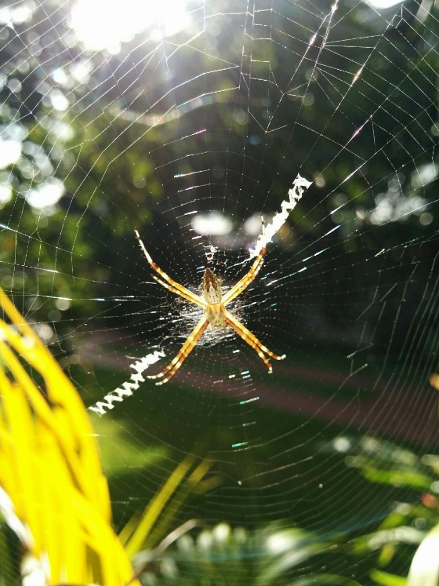
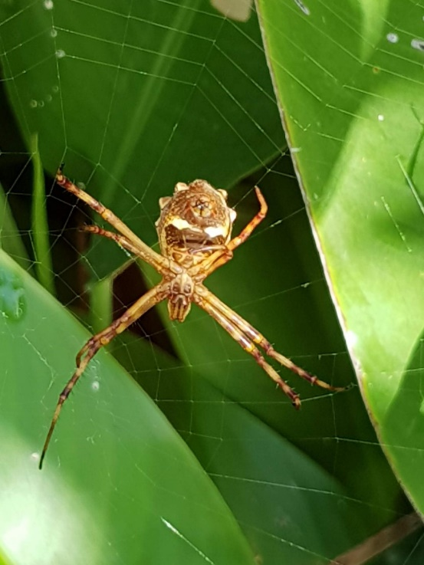
How about this popular Nursery Rhyme?
Incey Wincey Spider climbed up the water spout,
Down came the rain and washed the spider out,
Out came the sun and dried up all the rain,
And Incey Wincey Spider climbed up the spout again.

Slide 13
Let’s see what makes this rhyme enjoyable.
Incey Wincey Spider climbed up the water spout,
Down came the rain and washed the spider out,
Out came the sun and dried up all the rain,
And Incey Wincey Spider climbed up the spout again.
Rhyming words
Rhyming pairs
Attitude of Incey –
Did not stop trying!
Repetition of words
-climbed
-rain
-name of spider

Slide 14
How would you explain ‘rhyme’ to someone?
Rhyme is a repeat of similar sounds in words.
Boy rhymes with joy, ahoy, annoy, destroy and ___________
Girl rhymes with curl, pearl, twirl, corn-curl and _______________
Rhyme rhymes with climb, time, slime, sometime and _____________
And poem rhymes with gem, stem, them, anthem and ________________
Add your rhyming word at the end of each line above!

Slide 15
Match the words on the left to their correct rhymes.
Words | Rhyming Pairs
Play | Name & Came
Game | Bunch & Punch
Lunch | Glow & Radio
Video | Day & Tray

Slide 16
Write four lines following the pattern of Incey Wincey Spider.
Look carefully at the poem again.
Lines 1 and 2 should rhyme (have similar end sounds)
Lines 3 and 4 should rhyme

Slide 17
Try your 4-line rhyme now.
______________________________________________________________________________
______________________________________________________________________________
______________________________________________________________________________
______________________________________________________________________________

Slide 18
See, you did it! Lovely rhyme too!
Poems are to be enjoyed. Share yours with your mom or dad or granny or friend or pet.
You are on your way to polishing your poetry skills!

Slide 19
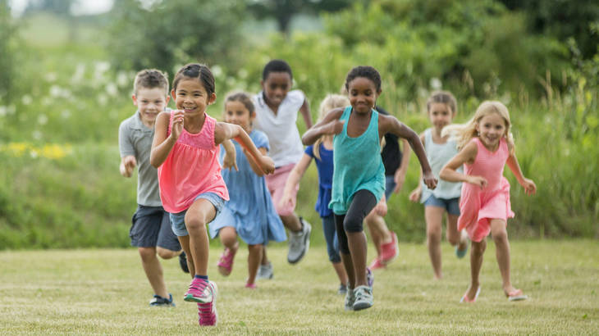
It’s break time! You have done so well, take as long as you wish! Be sure to come back tomorrow.
See you soon!

Slide 20
Welcome back!
Yesterday we looked at popular poems and you wrote your own lovely 4-line rhyme.
Let’s continue!

Slide 21
Important
Write and Read poems so you will better understand them!

Slide 22
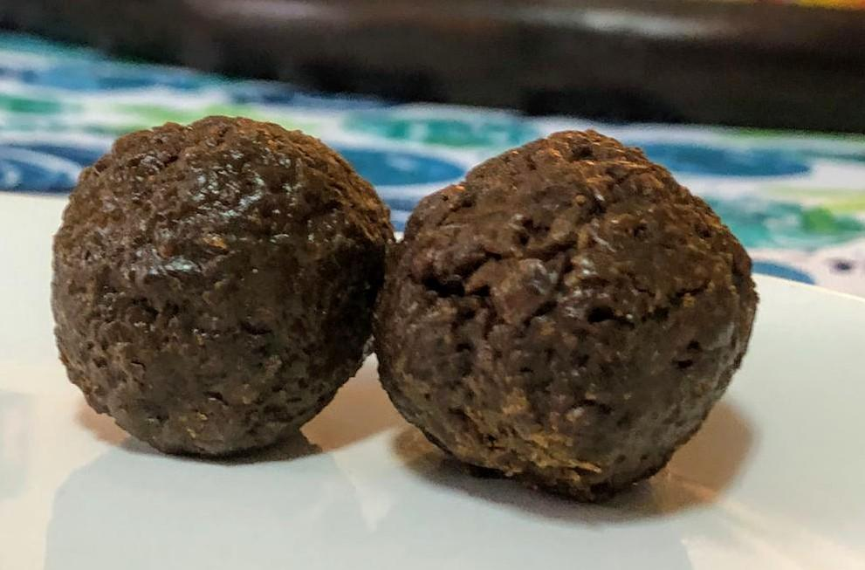
English Poems for the SEA
Easy Peasy! or Tough Toolum!

Slide 23
Is there such a thing as an SEA poem?
Yes!
No!
Think about it

Slide 24
No poet writes a poem for the SEA exam!
Poems are selected from books and from online for
you to explore and appreciate them
you to show that you understand what is written
It is an assessment of your Reading Comprehension skills!

Slide 25
For any SEA ELA poetry activity
You read a poem
Look for clues as to its main message
Figure out how you know it is the message
Write what you understand about the poem

Slide 26
What does a poem look like on the SEA ELA paper?
When a giant has a haircut it’s a massive enterprise due completely to the giant’s quite considerable size.
To begin an undertaking of such monumental scope first the barber needs a scaffold and a thousand yards of rope.
He’ll need leather gloves and work boots. He’ll need garbage cans and rakes, plus a parachute and safety net in case the giant shakes…
Poem by Kenn Nesbitt
.
Character
A giant
Vocabulary is important!
enterprise
considerable / undertaking
Sequencing!
To begin
first
plus
Character
A barber

Slide 27
He’ll ascend by helicopter to the giant’s lofty dome, with a pair of swords for scissors and a pitchfork for a comb.
Then for weeks and weeks he’ll labor; he will cleave and slice and hack. He will chop and saw and sever like a raving lumberjack.
Details
Helicopter
Cutting tools
Figurative language
Metaphor
Details
Actions Behaviours
Figurative language
Simile
Poem by Kenn Nesbitt

Slide 28
What else? I might have missed some…

Slide 29
If you said some of what’s above, you were on point! Good for you!
/
The mood
Senses -sight, taste, feeling, hearing
Meanings of words and phrases
Qualities of the characters

Slide 30
Time for some fun!
Remember it will help, if you were to Read and Write more poems.
A poem is like a person- the more you interact, the better you understand him or her. You might even find out a secret or two!

Slide 31
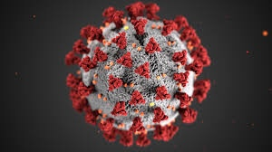
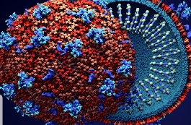
Here’s another rhyme I wrote for you!
That awful Covid19 virus
Tried to infect all of us.
But we resisted in many ways,
We used gloves, masks and sprays!
MM-G, 2020

Slide 32
Look at the words I used.
Word choice is important
Write the three words that tell you my dislike.
I chose words very carefully to show that I do not like that virus!
____________________________________________
____________________________________________
____________________________________________
____________________________________________

Slide 33
Did you get all of these?
infect
resisted
awful

Slide 34
To make the point, I found antonyms for the works in the left box. See how the meaning is affected.
Words are very important in poems.
Awful
Infect
Resisted
Awesome
Disinfect
Surrendered

Slide 35
Poets choose words carefully! The antonyms change the meaning of the poem.
This makes sense
This is nonsense
That awful Covid19 virus
Tried to infect all of us.
But we resisted in many ways,
We used gloves, masks and sprays!
That awesome Covid19 virus
Tried to disinfect all of us.
But we surrendered in many ways,
We used gloves, masks and sprays!
Examine the words to get at the meaning!

Slide 36
Poets choose their words carefully!
You must think about the words used by the poet, and try to answer this question.
Why did the poet use a particular word or phrase?
That awful Covid19 virus
That awesome Covid19 virus
Look for the clues, within the poem, that will help you.

Slide 37
Write two things you learned about poems today.
______________________________________________________________________________
______________________________________________________________________________
______________________________________________________________________________
______________________________________________________________________________

Slide 38
It’s break time again! Take as long as you wish!
See you next time.

Slide 39
This is a well-loved rhyme! Let’s both read it.
And then something went BUMP! how that bump made us jump! we looked! then we saw him step in on the mat! we looked! and we saw him! the cat in the hat! and he said to us, 'why do you sit there like that?' ‘I know it is wet and the sun is not sunny. but we can have lots of good fun that is funny!’
https://www.oatridge.co.uk/poems/d/dr-seuss-cat-in-the-hat.php

Slide 40
This poem is more than just funny. Why?
And then something went BUMP! how that bump made us jump! we looked! then we saw him step in on the mat! we looked! and we saw him! the cat in the hat! and he said to us, 'why do you sit there like that?' ‘I know it is wet and the sun is not sunny. but we can have lots of good fun that is funny!’
Find a word that indicates sound- onomatopoeia
Find the rhyming words
Find the words that are repeated
Find words that are spoken

Slide 41
‘The Cat in The Hat’ is carefully thought out.
And then something went BUMP! how that bump made us jump! we looked! then we saw him step in on the mat! we looked! and we saw him! the cat in the hat! and he said to us, 'why do you sit there like that?' ‘I know it is wet and the sun is not sunny. but we can have lots of good fun that is funny!’
sound- onomatopoeia
rhyming words- all are coloured
words that are repeated
words that are spoken
Appeal to senses: hearing (BUMP & spoken words)
sight (mat, cat, hat)

Slide 42
Those are the same things you look for in any poem.
Another poem is next. It’s a Limerick for you.
Read and enjoy!

Slide 43
Limericks are named after a place in Ireland
They are verses of 5 lines only
The 1st, 2nd and 5th lines rhyme
The 3rd and 4th lines are shorter and have a different rhyme from the other three lines
These verses are always deliberately humorous or silly.

Slide 44
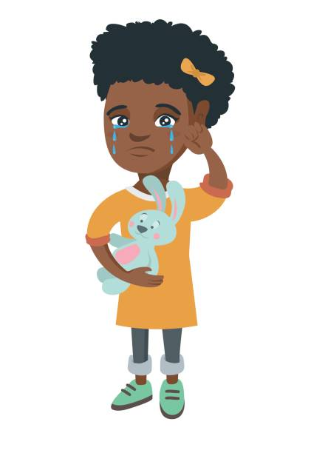
Here’s the funny 5-line Limerick I wrote for you.
There once was a child from Fyzabad,
Whose excellent grades made her sad.
For a whole week she tried
to shun learning, and cried!
That strange girl who could not be glad.
MM-G, 2020

Slide 45
Let’s look at its rhyming words and patterns.
There once was a child from Fyzabad,
Whose excellent grades made her sad.
For a whole week she tried
to shun learning, and cried!
That strange girl who could not be glad.
Rhyme
Lines 3 & 4
are shorter
Rhyme

Slide 46
Let’s now look at the words the poet used.
There once was a child from Fyzabad,
Whose excellent grades made her sad.
For a whole week she tried
to shun learning, and cried!
That strange girl who could not be glad.
Excellent indicates her performance is exceptional
Shun indicates her strong will to avoid learning – She wants bad grades!
Strange describes her unusual behaviour since most students want to do better!

Slide 47
Time for us to write our 5-line limericks. Remember, the more you write and read poems, the better you understand them!
__________________________________________________________________________________
__________________________________________________________________________________
__________________________________________________________________________________
__________________________________________________________________________________
__________________________________________________________________________________

Slide 48
You did very well. What do you think of mine?
An impish alligator named Wazim,
Kept pretending that he couldn’t swim.
He remained on the bank,
From the river he shrank,
Till Mama-Gator urged him in!
MM-G, 2020

Slide 49
Go and read your poem to someone at home. You can share mine too, if you like.

Slide 50
It’s a good time for a break! Take as long as you wish!
I will return when you do.

Slide 51
Welcome back!
Yesterday we looked at the contents of some more poems. Let’s continue our journey by examining figurative language!

Slide 52
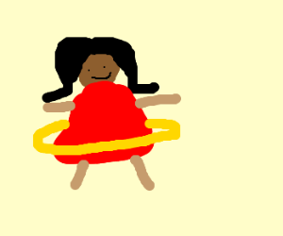
Do you remember this? It’s a song, a game and also a rhyme.
There's a brown girl in the ring Tra la la la la There's a brown girl in the ring Tra la la la la la Brown girl in the ring Tra la la la la She looks like a sugar and a plum Plum plum!

Slide 53
This is a simile. It is a comparison of two things.
She looks like a sugar and a plum Plum plum!
She is compared to sugar.
This hints that she is liked. The girl is sweet like sugar.
She is compared to a fruit- a delicious plum!

Slide 54
Remember, poems contain words that are carefully selected by poets.

Slide 55
Pay close attention to the language of poems.
Literal language
Figurative language
Descriptions of places, people, things
Use of adjectives
Use of adverbs
Use of words that appeal to your senses
Use of figures of speech
-Similes
-Metaphors
-Personification

Slide 56
Words in poems can be both!
Literal
(factual)
Figurative
(imaginative)

Slide 57
Look at these examples of figures of speech.
I moved reluctantly like an overfed goldfish.
Rajiv thinks he’s a prized goldfish in a glitzy aquarium.
The guppies were miserable because of the gluttonous goldfish.

Slide 58
Match each to its correct figure of speech.
I moved reluctantly like an overfed goldfish.
Rajiv thinks he’s a prized goldfish in an expensive aquarium.
The guppies were miserable because of the gluttonous goldfish.
Personification
Simile
Metaphor

Slide 59
Match each to its correct figure of speech.
I moved reluctantly like an overfed goldfish.
Rajiv thinks he’s a prized goldfish in an expensive aquarium.
The guppies were miserable because of the gluttonous goldfish.
Personification
Simile
Metaphor
If you got any correct you deserve a clap! These are not easy!

Slide 60
Personification- How can you detect it?
The guppies were miserable because of the gluttonous goldfish.
People feel misery or are miserable. Not fish
Greedy people are gluttons. Not fish!
Words! The vocabulary contains the clues!
Words and behaviours related to people, but used for animals or things, are the giveaway clues!

Slide 61
Metaphor- How can you detect it?
Rajiv thinks he’s a prized goldfish in a expensive aquarium.
Two things are compared- Boy and Goldfish
Metaphor- The attitude of Rajiv is compared to the attitude of a fish that is cherished!
The reader gets the impression that Rajiv’s attitude is not shared by the writer.
The words and the writer’s tone are the giveaway clues!

Slide 62
Prepare for questions on language use.
e.g. Give the meanings of the following expression as used in
the poem.
e.g. Why is ‘……………’ an appropriate description in the poem?
e.g. Identify the following figures of speech in the poem.

Slide 63
Personification can be challenging
Here is a poem that is full of personification.
Enjoy!

Slide 64
A Poem I Am
I am words that speak softly
-emotions and feelings.
I am thoughts made loudly
-ideas or inklings
I’m different from a story,
email or letter sent lovingly.
Sometimes I’m a rhyme
for a sing-song, happy time!
But, as your words,
I can become a powerful instrument
Or I can present your opinions in a poetic argument!
MM-G, 2020

Slide 65
To sum up- For any poem, read carefully to find what’s on the right.
Narrator & Characters
Rhyme & Rhythm
Mood & Atmosphere
Main Details or Events
Language Use (including figures of speech)

Slide 66
It’s time to wave goodbye!
I had fun working with you.
Hope you did too!
Best wishes!

