Slide 1
Subject Area: Logistics and Supply Chain Operations
Level: CAPE
Curriculum Topic: Types of Shipping Vessels Unit 2 Module 1 Objective 4
Key teaching points:
1. Describe the different types of shipping vessels

Slide 2
Types of Shipping vessels
Container Ships
Tankers
Passenger Ships
RORO Ships
Multipurpose and Schooners
Tugs and OSVs
Recreational

Slide 3
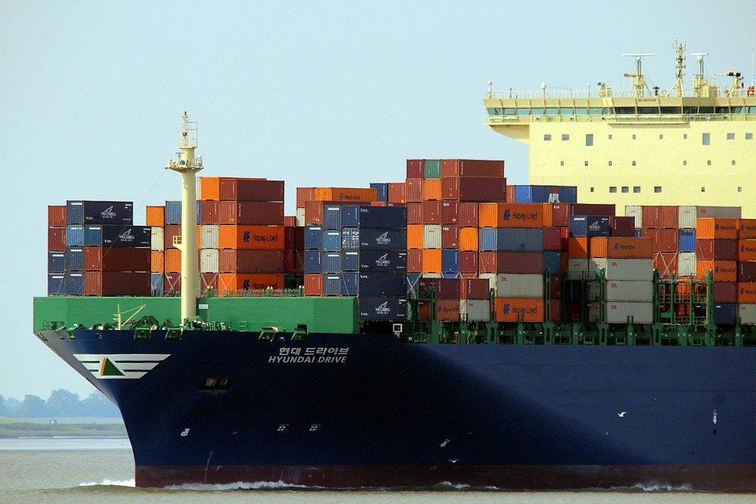
Container Ships
Container ships carry large containers. These standard size containers are filled with cargo.
This vessel is used to transport large quantities and the process is called containerisation.
Containers can be stacked upon each other for transport.
Some container ships can carry goods that require refrigeration as there are special containers for this.
Container ships are of different sizes depending on the route to be taken.

Slide 4
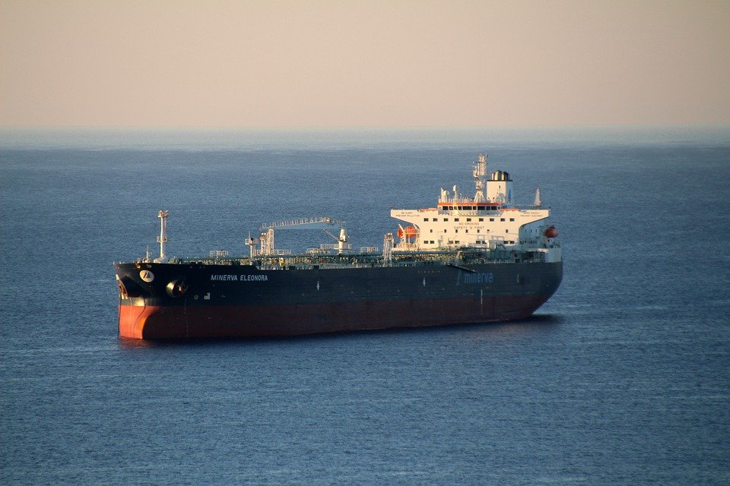
Tankers
Tankers are used specifically for cargo that is in liquid form like
Liquid natural gas (LNG)
Liquefied Petroleum Gas (LPG)
Chemicals
Crude Oil
Other liquids – wine, juice

Slide 5
Passenger ships
Cruise Ships – these carry vacationing passengers/tourists and can be luxurious to accommodate long routes.
Water taxis – These are used to transport passengers across short distances over water. For example the water taxi in Trinidad that transports persons from San Fernando to Port of Spain.
Ferry – These are used to transport passengers across slightly longer distances than the water taxi. For example the ferries that transport passengers between Trinidad and Tobago. The terms water taxi and ferry are sometimes used synonymously.

Slide 6
Roll-on Roll-off (RORO) ships
These ships are used to carry cargo that can be wheeled on and off the ship. Cargo can include vehicles of any type.

Slide 7
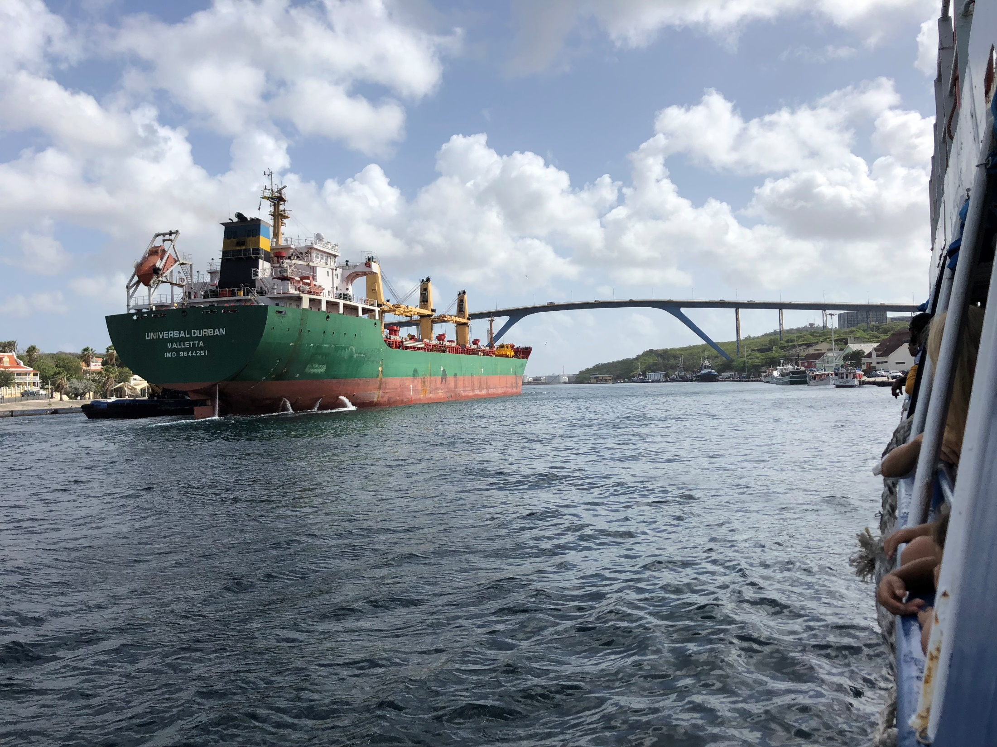
Multipurpose and Schooners
Multipurpose vessels can be used for
Carrying any kind of cargo
Laying pipes and cables in the sea
Off-shore drilling for oil or natural gas
Diving expeditions
Fishing
Research – seismic, oceanographic
Salvage
National defence
https://commons.wikimedia.org/wiki/File:Schooner_Pioneer.jpg
Schooners can be used for
Carrying some kinds of cargo
Recreation
Fishing

Slide 8
Tugs and Offshore supply vessels (OSV)
A tug assists a vessel in moving towards a particular direction by pushing or pulling.
An Offshore Supply Vessel (OSV) - In the drilling of oil or natural gas, special rigs or platforms are built out in the sea. These house special equipment and employees. The OSV carries equipment and supplies to these platforms.
Notice how the tug boat directs this multipurpose cargo ship through the Mira Flores Lock of the Panama Canal

Slide 9
recreational
Luxury yachts – Owners use these for private cruising.
Speed boats – These participate in races or are just for fun by owners. The Great Race in Trinidad and Tobago features many speed boats.

Slide 10
Activity
Design a poster identifying the different types of shipping vessels and their uses.
Place this poster on the wall of your room or store on your device for revision.

