Slide 1
PICTURE QUIZ
DANCE TERMS
Created by Barrackpore East Secondary School (2020)

Slide 2
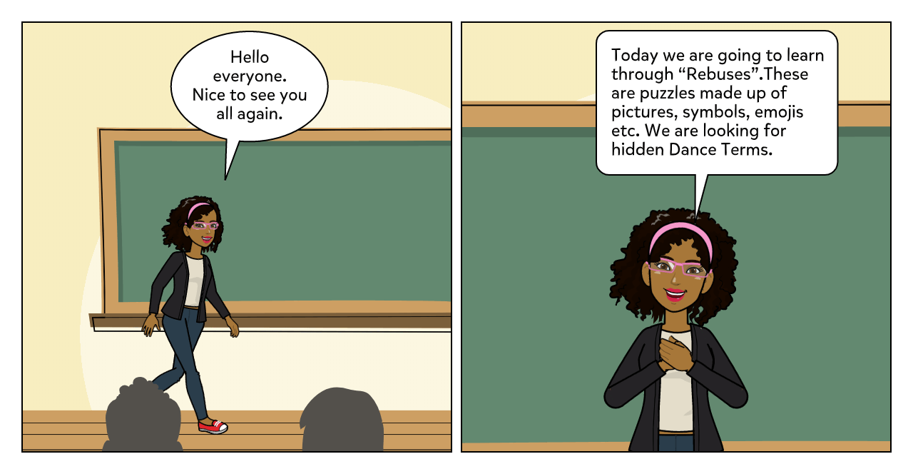
Craeted by Barrackpore East Secondary School 92020)

Slide 3
PICTURE QUIZ
Use the pictures to assist in finding Dance Terms.
1. | 2. A
3. & | 4.
Craeted by Barrackpore East Secondary School 92020)

Slide 4
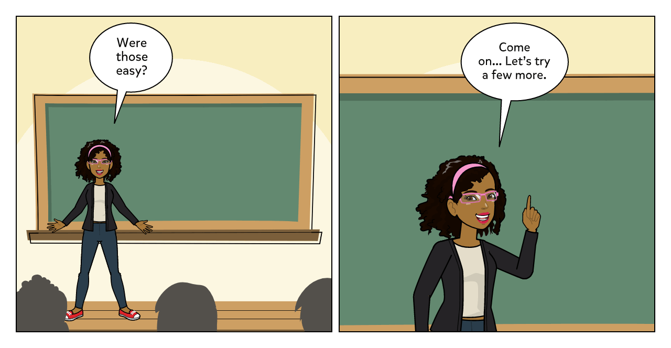
Craeted by Barrackpore East Secondary School 92020)

Slide 5
PICTURE QUIZ
Use the pictures to assist in finding Dance Terms.
5.. | 6.
7. | 8.
Created by Barrackpore East Secondary School 92020)

Slide 6
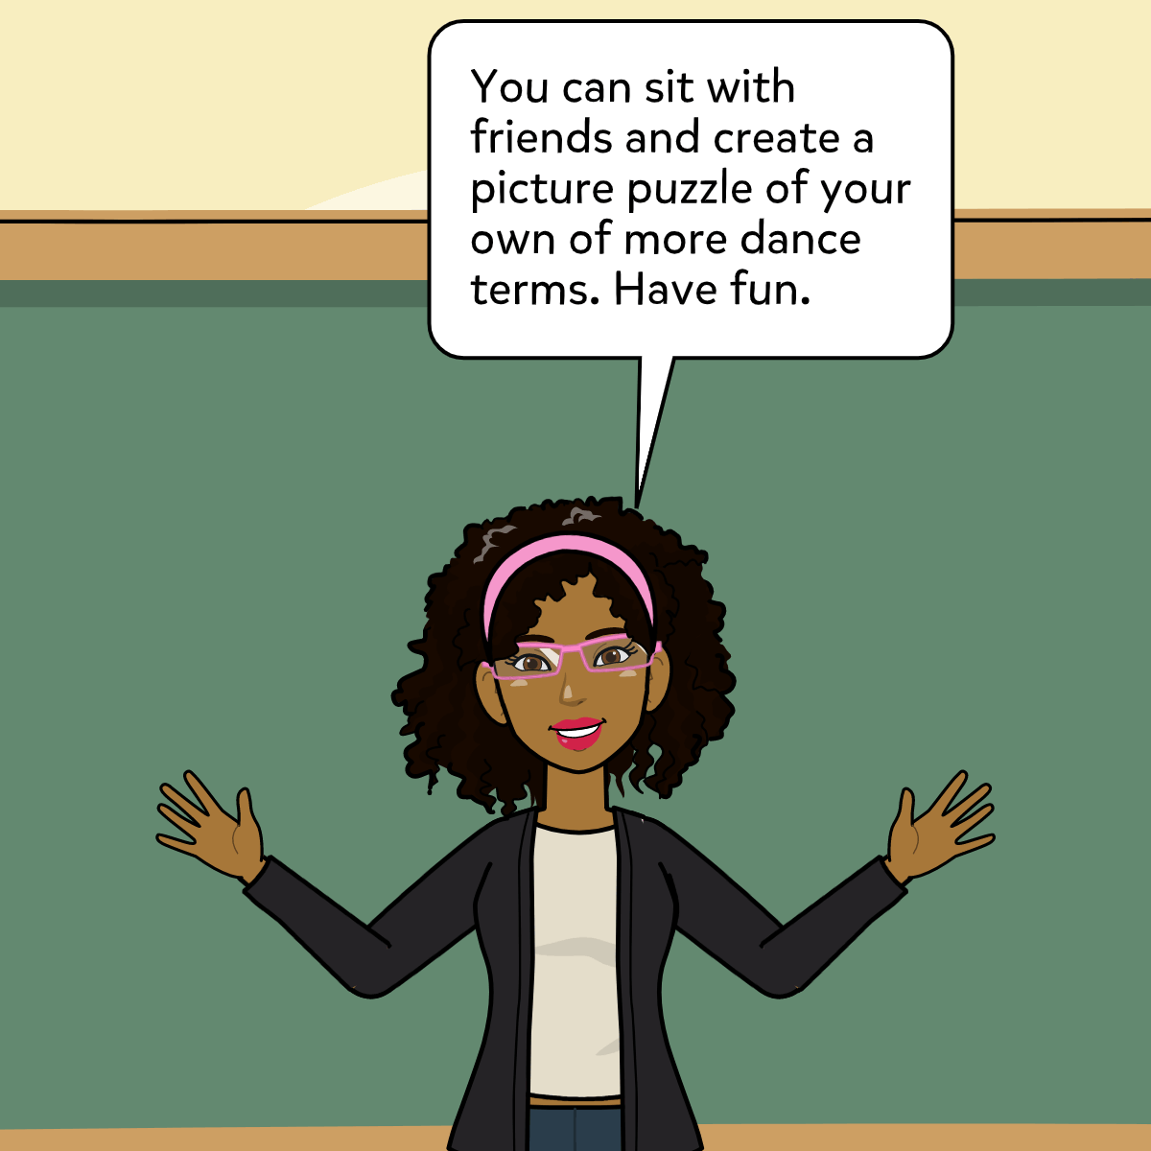
Created by Barrackpore East Secondary School (2020)

Slide 7
1. See Met Tree = Symmetry
2. A See Met Tree = Asymmetry
3. Call & Answer = Call and Response
4. Fingers Pointing = Directions
5. Hop Walk Run = Locomotor
6. Can No = Canon
7. Limb Bow = Limbo
8. Bell Ear = Bele
KEY
Created by Barrackpore East Secondary School (202o)

Slide 8
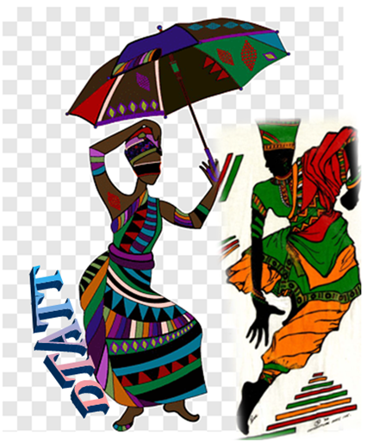
Compiled by:
Julia Le Gendre- Stewart
Barrackpore East Secondary
Dance Teachers’ Association of Trinidad and Tobago
(DTATT)

