Slide 1
ELECTRICAL AND ELECTRONIC TECHNOLOGY
INTRODUCTION TO INDUCTANCE IN D.c. CIRCUITS- Lesson 1

Slide 2
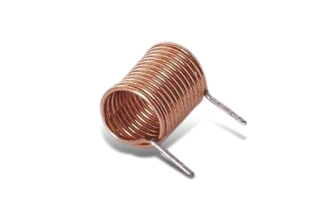
The Inductor Defined
An inductor is a coil that stores energy in the magnetic field when a current flows though it. The magnetic energy stored is converted back to electrical energy when a current is changed through it.
Fig 1: Inductor

Slide 3
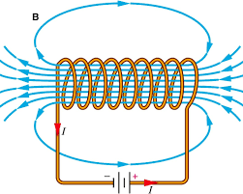
Physical method to strengthen the magnetic field of an Inductor
It is known that ,when a current flows through a straight conductor a magnetic field is produced around the conductor. To strengthen the magnetic field the conductor is normally coiled. When a steady D.C current flows through the coil a stationary magnetic field is produced as shown in Fig 2.
This is the basis of the simple Electromagnet.
FIG 2 : Magnetic field through an Inductor coil

Slide 4
QUESTION :
If we should coil or increase the turns of the Inductor in Fig 3, would its magnetic field get stronger or would it get weaker.
CLICK on button below for answer
Fig 3

Slide 5
Answer : If the Inductor turns are increased, the magnetic field would be stronger

Slide 6
We can create a moving magnetic field in the coil by opening and closing the switch. The magnetic field expands when the switch is turned on and collapses when turned off. Observe also the coil voltage polarity and the current delay. Click mouse to observe response when switch is closed
Creating a moving magnetic field

Slide 7
The coil voltage produced is called the induced voltage Induced voltage is removed when magnetic field is stationery
Creating a moving magnetic field

Slide 8
Click mouse to observe response when switch is opened
Creating a moving magnetic field

Slide 9
Induced voltage is removed when current completely falls to zero
Creating a moving magnetic field

Slide 10
Why does the current take time to build when the magnetic field expands and time to fall when the magnetic field collapses
More on the Inductive Effect in a circuit
Current Delay
CLICK THIS BUTTON FIRST TO GO TO NEXT SLIDE

Slide 11
When the switch is just opened, a voltage polarity is induced across the coil. The Induced voltage polarity opposes the current increasing to its full value. When the switch is opened the Induced voltage, opposes the current decreasing to zero value.
Effect of Induced Voltage in an Inductor (current delay)

Slide 12
When the magnetic field is stationary or when there is no current in the circuit, there is no induced Voltage across the coil
Effect of Induced Voltage in an Inductor

Slide 13
Which condition causes an induced voltage across a coil in a dc circuit (a) magnetic field is stationary (b) no magnetic field in coil (c) magnetic field expanding and collapsing when switch is just opened and just closed
QUESTION :
Press button for Anwser

Slide 14
ANWSER (C) magnetic field expanding and collapsing when switch is just opened and just closed

Slide 15
The stored energy from the magnetic field across the coil is converted to electrical energy when the switch is opened and when the switch is closed in a D.C. circuit. This momentary induced voltage derived across the coil, frequently reaches very high values at times.
STORED ENERGY IN THE MAGNETIC FIELD

Slide 16
The value of the Induced voltage also depends on how fast the field expands and how fast it collapses. The current that flows through the circuit is often delayed because of the induced voltage across the coil which opposes the applied battery voltage
STORED ENERGY IN THE MAGNETIC FIELD

Slide 17
When the switch is closed the induced voltage across the coil opposes the current rise to full value. When the coil is opened the induced voltage tries to prevent the current from falling to zero value.
STORED ENERGY IN THE MAGNETIC FIELD

Slide 18
USES OF INDUCTORS Inductors are used in the ignition system of cars to start the car with the momentary high voltage induced by the coil or inductor

Slide 19
USES OF INDUCTORS Inductors are also utilized in the operation of fluorescent lamps to start the gas filled lamps at low pressure. The 120Volts from the residential receptacle is not enough to start the lamp hence, the momentary induced voltage across the coil often reaches above 500 Volts to start the lamp. The coil used in a fluorescent lamp is called a ballast.

Slide 20
summary
An inductor is a coil that stores energy in the magnetic field when a current flows though it. The magnetic energy stored is converted back to electrical energy when a current is change through it.
The inductor produces an induced voltage when a current changes through it. This is because, when the current changes it causes a moving magnetic field, which in turn produces the Induced voltage.
The value of the induced voltage depends mainly on the rate of change of current in the circuit.

Slide 21
THANK YOU

