Slide 1
Local, Regional & International Institutions
Role of

Slide 2
Local Institutions
Both government and non government local institutions are essential for any agricultural economy. The quality of the support mechanisms put in place has an effect on the agricultural output
Each Ministry of Agriculture is divided into several sections that work together with other agencies to provide support for farmers. In Trinidad, our ministry is divided into 11 sections

Slide 3
Regional Institutions Caribbean Development Bank (CDB)
The CDB assists Caribbean nations in financing projects for its members . Its objective is to contribute to the economic growth and development of member countries a nd encourage economic cooperation.
Its main functions are:
Assist members in coordination of development programmes
Mobilise financial resources for regional development
Finance projects and programmes
Provide technical assistance
Stimulate and encourage the development of capital markets within the region

Slide 4
Regional Institutions Caribbean Agricultural & Research Development Institute (CARDI)
Conducts research and demonstrates appropriate technologies to farmers.
They provide technical assistance in areas such as”
Crop production, integrated pest management (IPM) and farming systems
Livestock and forages
Environmental and soil management
Technology services
Market research and statistical services
Business development and consultancy

Slide 5
Regional Institutions The University of the West Indies
The Faculty of Science and Agriculture offers a wide range of courses leading to qualifications from diplomas to post graduate degrees

Slide 6
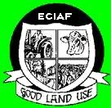
Regional Institutions The University of Trinidad & Tobago (UTT)
Through its Eastern Caribbean Institute of Agriculture & Forestry campus (UTT-ECIAF), they offer courses in agriculture and forestry as well as animal health and food processing. There are diploma or associate degree programmes available.

Slide 7
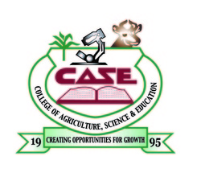
Regional Institutions College of Agriculture, Science and Education (CASE)
A multidisciplinary institution, is committed to providing education and training of the highest quality in agriculture, science and teacher education to men and women in Jamaica, and also in other Caribbean countries, through teaching, research and outreach.

Slide 8
Regional Institutions The Guyana School of Agriculture (GSA)
GSA provides training to certificate and diploma level in agriculture. The one year certificate course trains students to become forestry technicians. The two year diploma course leads to careers in agriculture such as agricultural science teachers, extension officers and animal health assistants

Slide 9
International Institutions Inter-American Institute for Cooperation on Agriculture (IICA)
This institution conducts agricultural research and graduate training in tropical agriculture. It promotes agricultural development and rural well-being.
IICA supports and encourages
Agro-energy and bio-fuels
Biotechnology and bio-safety
Rural communities
Trade and agribusiness
Trade negotiations
Organic agriculture
Agricultural health

Slide 10
International Institutions Food and Agriculture Organisation (FAO)
An organization of the United Nations leads international efforts to defeat hunger. It helps countries to modernize and improve agriculture, forestry and fishery practices and to ensure good nutrition for all

Slide 11
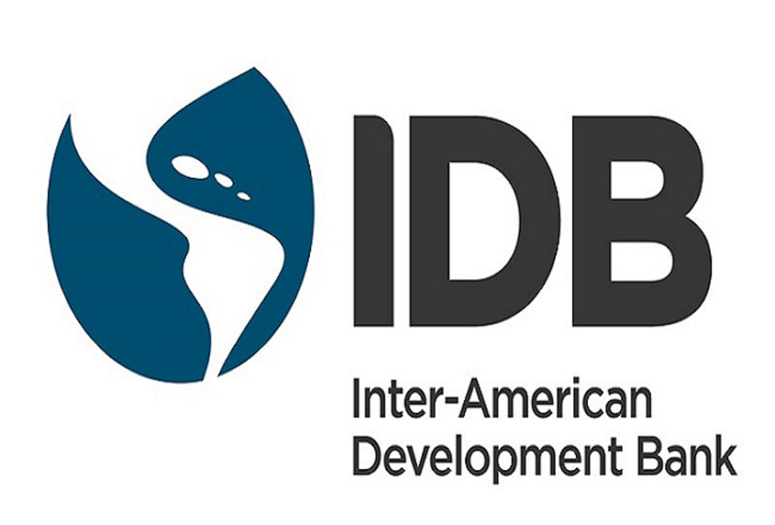
International Institutions Inter-American Development Bank (IDB)
This is an organization established to support Latin American and Caribbean economic and social development and regional integration. It is the largest multilateral source of funding and lends money mainly to governments and government agencies

Slide 12
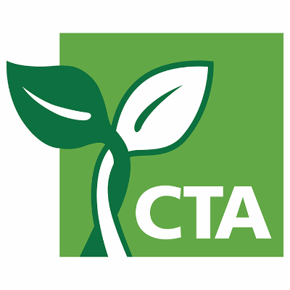
International Institutions Technical Centre for Agriculture and Rural Cooperation (CTA)
The CTA believes that investment in the right innovations in agriculture will help to catalyse development. Youth, digitalization and climate resilience are their priority intervention areas in their strategic plan.

