Slide 1
SCALES
Terence Baptiste

Slide 2
OBJECTIVE
WHAT
Prepare drawings to specific scales
-
SCALES
-
-

Slide 3
Definition
Def.
A scale is used to represent the relationship between a measurement on a model and the corresponding measurement on the actual object.
Without scales, maps and blueprints would be pretty useless.

Slide 4
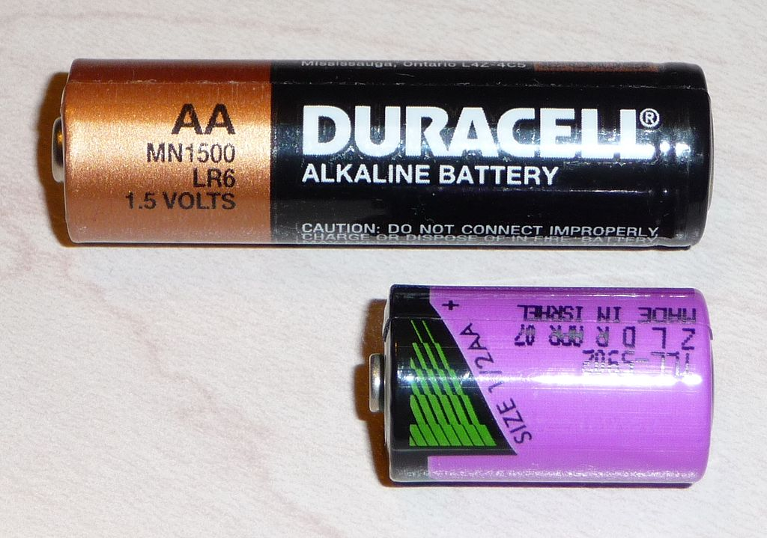
Note
Scale drawings are useful for planning and visualizing designs on paper.
Designs may be too large (a building) or too small (a watch part) to be drawn full-size and must be represented at a larger or smaller scale to be easily understood.
WHY
-
-
-
https://commons.wikimedia.org/wiki/Category:Images_with_AA_batteries_to_indicate_scale

Slide 5
Note
How
A scale is stated as a representative fraction (RF) or more frequently a ratio.
For example, a scale of 1:100 means that 1 unit of measurement on a drawing represents 100 units of the actual object being drawn

Slide 6
Calculate the scale
Exercise

Slide 7
Answer
Answer
6 cm on the object is represented by 3 cm on the drawing
12 cm on the object is represented by 6 cm on the drawing
Answer:
The answer is : 1 : 2
Meaning 1 unit of measurement on the drawing represents 2 units on the object

Slide 8
Instructions
How
Now get a sheet of paper and calculate the following missing values on slides 10 & 11

Slide 9
Calculate the RF
Actual Distance | Scaled Distance | RF
40 | 8
1500 | 15
1200 | 60
3600 | 72
1000 | 100
Calculate

Slide 10
Calculate the scaled Distance
-
Actual Distance | Scaled Distance | Ratio
3000 |  | 1:50
4500 |  | 1:20
50 |  | 5:1
100 |  | 2:1
5000 |  | 1:100
-
Calculate
-

Slide 11
Instructions
If you can, draw the scaled version of the door given in the next slide to a scale of 1 : 20.
Draw

Slide 12
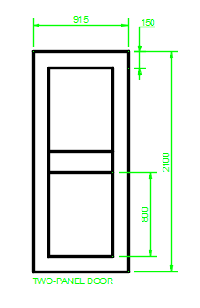
APPLICATION
-
Draw the elevation of the given door to a scale of 1:20 (915 x 2100) 15
-
-
DRAW

Slide 13
Answers
Check your answers to Slide 10:
1. 1 : 5
2. 1 : 100
3. 1 : 20
4. 1 : 50
5. 1 : 10
Slide 10

Slide 14
Answers
Check your answers to Slide 11:
1. 60
2. 225
3. 250
4. 200
5. 50
Slide 11

Slide 15
Lesson Completed
Congratulations!!
You can now:
- Define the term “scale”
Calculate the RF or ratio of a scale
Calculate the actual distances the scale would represent
Apply the scale to draw an object
Complete

Slide 16
Lesson Completed
References
Illustrations:
Study.com (Slide 1 & 6)
Complete

