Slide 1
FARM ORGANISATION & PLANNING
FARM RECORDS

Slide 2
REASONS FOR KEEPING RECORDS
Farm records are used to evaluate the performance of any farm or farm enterprise within a given period of time. Farm records will enable the farmer to know what each enterprise contributes to the overall progress of the farm.
Records are an aid to managerial control. With the help of records, a farmer can keep a close check on whether work on his farm is going according to his plans.
Farm records provide figures for farm planning and budgeting.
Farm records tell a farmer how much he is earning.
Farm records tell the farmer where he is gaining progressively or loosing.
Farm records enable the farmer to obtain loans from banks.
Farm records are required for taxation purposes

Slide 3
FARM RECORDS SHOULD:
Be easy to do and keep
Serve a definite purpose
Be simple, useful and effective
Be accurate and complete
Be kept consistently
Be easily accessible

Slide 4
TYPES OF RECORDS
Inventory – a check of farm assets such as machinery, tools, equipment, livestock etc.
Production – records farm production such as milk production, eggs laid, breeding.
Financial – profit and loss accounts, assets, liabilities and balance sheets.
Labour – records of personnel, tasks performed, hours worked, wages paid.

Slide 5
THE FARM INVENTORY
This is a record of the farm resources in terms of quantity and value.
It includes land, machinery, tools and equipment, buildings, livestock, field crops

Slide 6
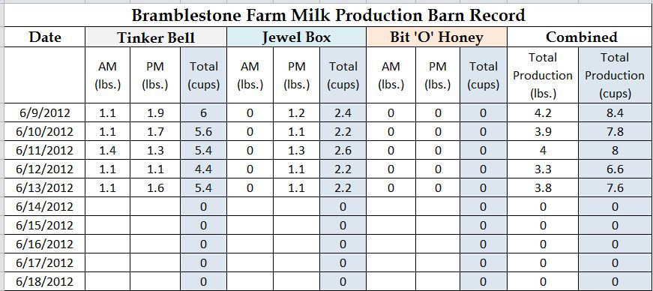
PRODUCTION RECORDS
These are used for crop and livestock enterprises to follow their progress and productivity
These records allow farmers to determine if inputs such as feed and fertilisers are being used efficiently e.g. egg production, breeding records of rabbits, yields of crops, the milk production of cows, etc.

Slide 7
LABOUR RECORDS
LABOUR RECORD
Farm Enterprise:
Acreage:
ACTIVITY | NUMBER OF WORKERS | NUMBER OF DAYS | WAGE per DAY | TOTAL
These are kept in the form of a wage or salary book.
Records indicate the number of persons hired, type of work, hours worked, gross wage, deductions (tax, insurance etc) and net wages
It gives an idea of the productivity of the worker

Slide 8
FINANCIAL RECORDS
These may take the form of income and expenditure records which the farmer will use to determine his profit or loss.
These records take into account, all transactions undertaken in the farm business
Other financial records include:
Income statement
Farm assets
Liabilities of the farm
The balance sheet

Slide 10
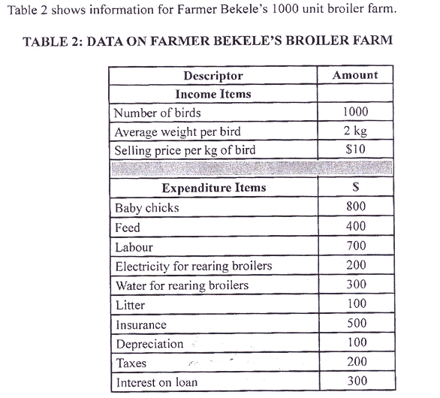
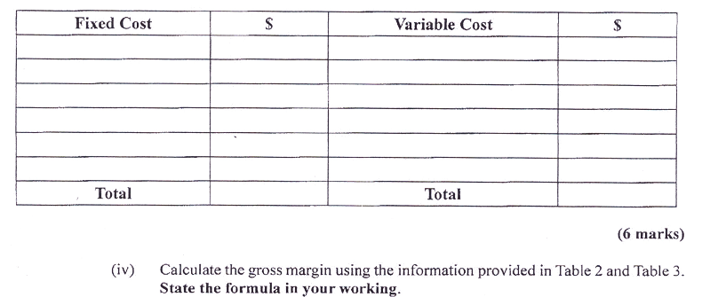

Slide 11
PARTIAL & COMPLETE BUDGETS
A complete budget/ total budget / whole farm budget is used when there is a major change in the resources and enterprises on the farm
A partial budget is prepared when there is a change in some aspect of the farm or starting a new enterprise.
Reasons for budgeting:
It helps the farmer to decide which enterprise to choose
It helps the farmer to compare the profitability of different enterprises
It makes it easier for the farmer to control the farm finances
It provides evidence to financial institutions when the farmer applies for a loan

Slide 13
THE RELATIONSHIP BETWEEN BUDGETING & DECISION MAKING
BUDGETING
DECISION MAKING
Is estimating the quantity of inputs, costs, outputs, income and profit, related to an agricultural enterprise
This is an essential process in farm planning
Is dependent on the data provided by budgeting
Good decision making results in farm profitability

Slide 14
STEPS TO DECISION MAKING
Identify Problem
Gather data
Analyse data
Formulate alternative solutions
Assess each solution
Select the best solution
Evaluate the chosen solution
Accept responsibility and results

Slide 15
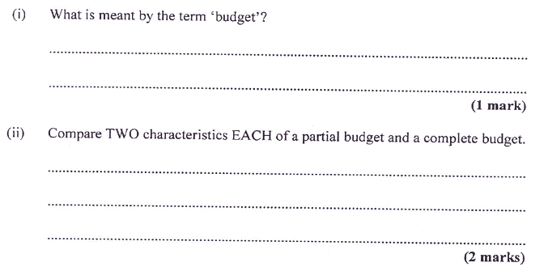
HOME WORK QUESTIONS

Slide 16
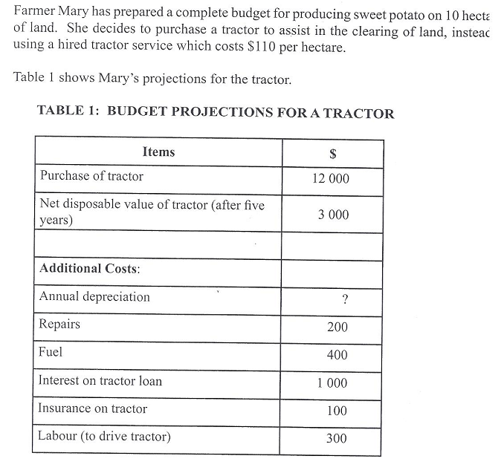
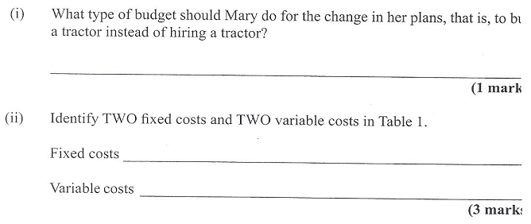

Slide 17
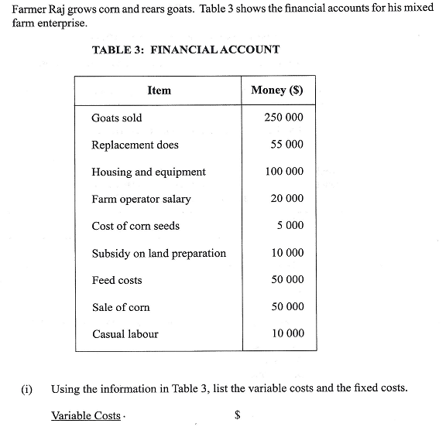
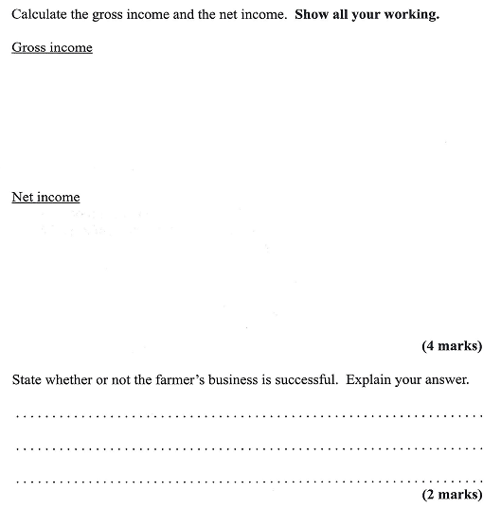

Slide 18
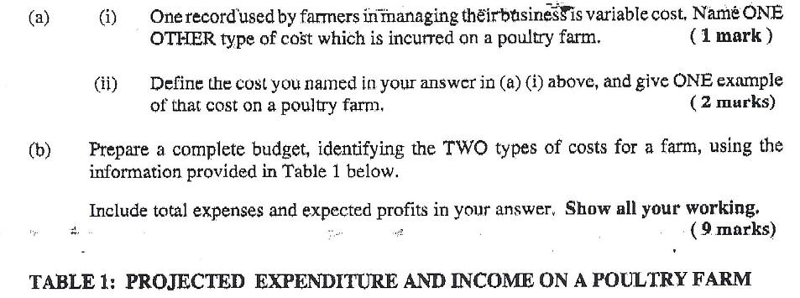
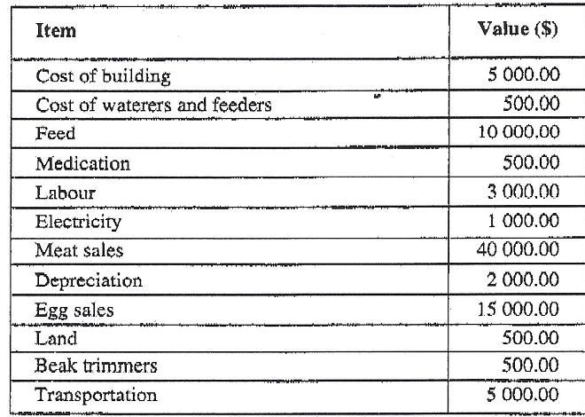

Slide 19
