Slide 1
THE PRODUCTION TEAM
THE DIRECTOR
Prepared by: Lavonne isaac-bhola
Theatre arts teacher III
secondary
Lesson for Form three students

Slide 2
WHO IS A DIRECTOR?
A Director is the person in charge; the one who gives directions to the actors and assumes the ultimate responsibility for the production.

Slide 3
Debra was asked to Direct a play for her community program.
Debra was wondering how she will get actors for her play. What does Debra have to do?

Slide 4
Should she:
Sit and hope that people from the community will volunteer?
Ask her family members to help her?
Take anyone who volunteers?
Conduct an audition?
Take people who love drama?
Can you guess?

Slide 5
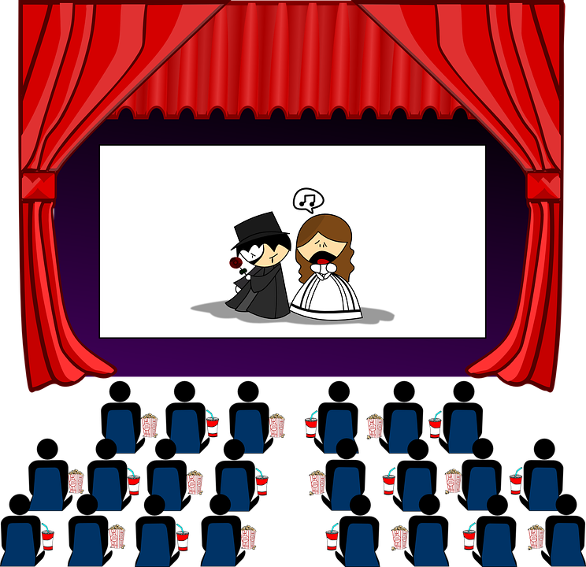
Debra should:
Conduct an Audition, that’s correct!
One of the Director’s role is to conduct an Audition

Slide 6
Debra needs to practice for the play. She must:
Ask everyone to study their lines at home?
Have a meeting with their parents?
Conduct rehearsals?
Have the actors come one by one to meet with her?
What do you think?

Slide 7
Debra should:
Conduct Rehearsals. Excellent!
Another role of the Director is to
Conduct Rehearsals.

Slide 8
Debra wants to make sure her actors’ performance is believable. What must she do?
Let them act with the script?
Help them with characterization?
Let them do what they think is best?
Debra should act the parts and let them follow what she does?
Which one would you choose?

Slide 9
Debra should:
Help them with characterization.
That’s correct

Slide 10
Debra must make sure that the actors and props are positioned in the right place.
What does Debra have to do?
The blocking for the show?
Read the script of the play?
Draw the stage?
Organize the stage?
What do you say?

Slide 11
Debra has to do:
The Blocking for the Show:
“Blocking is the organization of movement of props and actors on and off the stage”

Slide 12
Debra wants to add some Technical aspects to the play.
Should Debra do all the lighting, sound, costuming and set herself?
OR

Slide 13
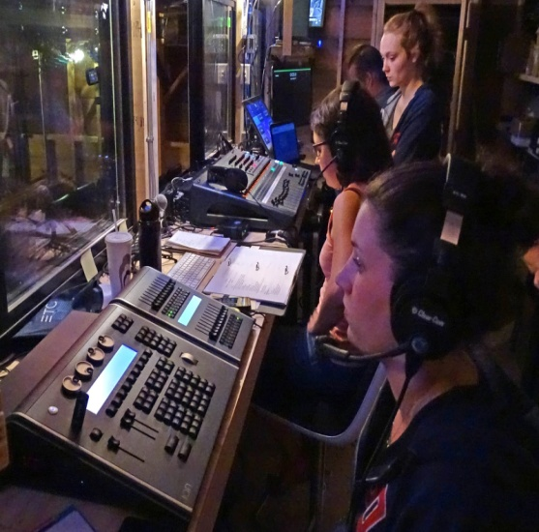
Debra should:
Collaborate or work with a Technical team.
The team includes:
Set Designer
Props person
Costume designer/make-up artist
Sound Technician
Lighting Technician

Slide 14
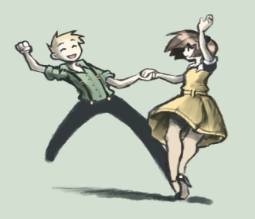
Debra wants to add some creativity to the play.
Which of the following can Debra add to the play?
Dance
Sound effects
Flashback or flashforward
Tableau
Lighting effects

Slide 15
Debra can add:
Answer: All of the Above
Debra can add Creativity to her play to make the play more interesting by including all of the above and more so that the play will be more realistic and the audience can better enjoy the show

Slide 16
Let’s Recap. Some Roles of the Director include:
Conducts auditions
Conducts rehearsals
Helps the actors with characterization
Blocking of the play’s moments
Collaborates with the technical team
Adds creativity to the play

Slide 17
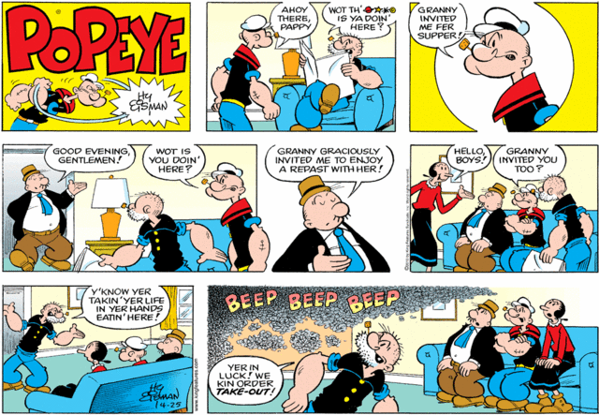
Debra was able to direct her show entitled: “Popeye”

Slide 18
RESEARCH ASSIGNMENT
Please research the three Directors listed below from Trinidad and Tobago. Write two paragraphs about the practitioner and some of the plays that they have directed and place in a folder.
1. Louis McWilliams
2. Rawle Gibbons
3. Zeno Obi Constance

