Slide 1
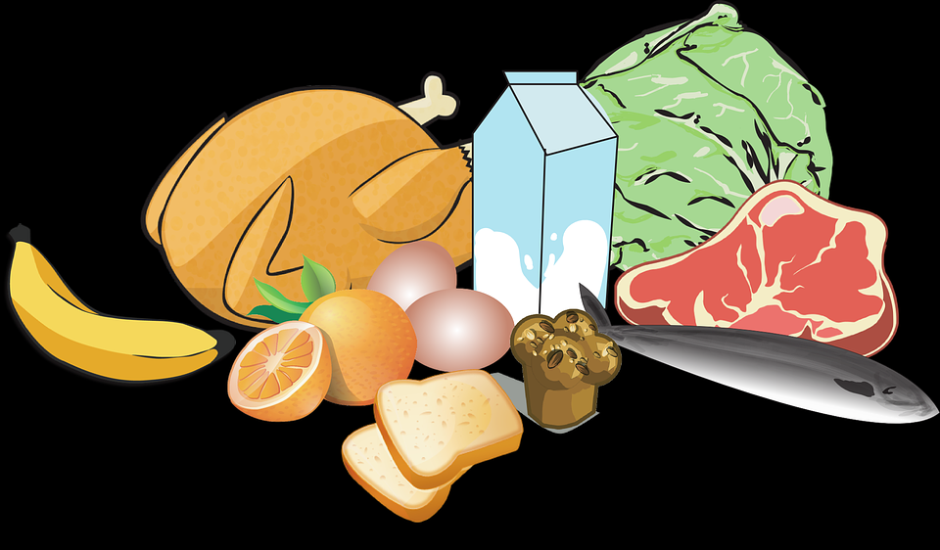
VITAMINS
Curriculum Planning & Development Division, Ministry of Education
FAT-SOLUBLE VITAMINS

Slide 2
CONTENT
OBJECTIVES
1.VITAMINS
2. VITAMIN A
3. VITAMIN D
4.VITAMIN E
5.VITAMIN K
6.SUMMARY
7.ASSIGNMENTS
8.REFERENCES

Slide 3
OBJECTIVES
At the end of this lesson, students should be able to:
Define the term “vitamin.”
Explain why vitamins are grouped into fat-soluble and water-soluble vitamins.
List the fat soluble vitamins.
State the functions of fat-soluble vitamins.
Name the sources of fat soluble vitamins.
Discuss the deficiency diseases related to each fat soluble vitamin.

Slide 4
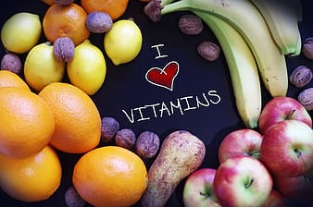
VITAMINS
Vitamins are chemical substances that are classed as micronutrients. They enable our bodies to function properly. Our bodies are unable to make most of the vitamins, so we get them from the foods that we eat. A diet that lacks any vitamins may lead to deficiency diseases.

Slide 5
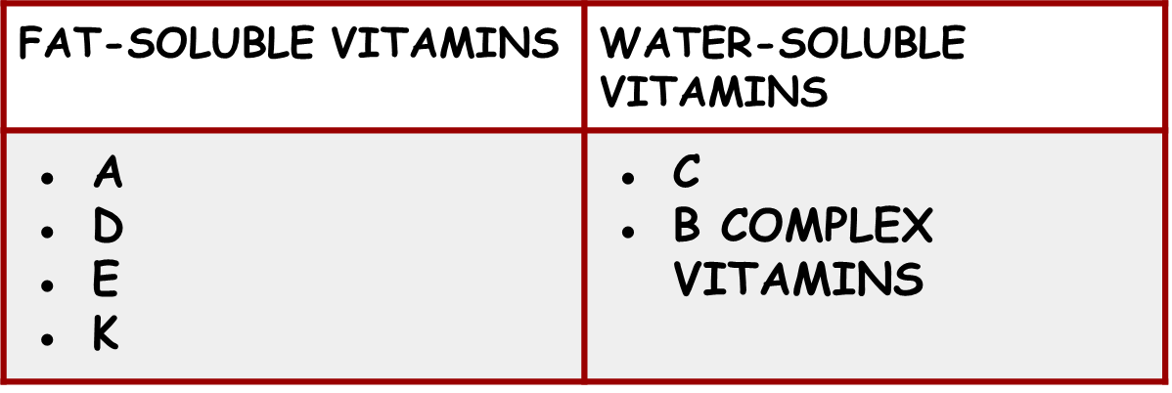
VITAMINS
Vitamins can be separated into 2 groups. This is based on their ability to dissolve in fat or water. The two groups are:

Slide 6
FAT – SOLUBLE VITAMINS

Slide 7
VITAMIN A (RETINOL)
FUNCTIONS
Needed to make visual purple, which helps us to see in dim light.
Needed to keep the mucous membranes moist and free from infection
Needed to maintain the health of our skin
Needed for normal growth of children (their bones and teeth)

Slide 8
VITAMIN A (RETINOL)
Requirements- Vitamin A can be stored in the fat, inside of the body. A daily supply is not needed.
Children need lots of vitamin A and persons who cannot absorb or digest fat well.

Slide 9
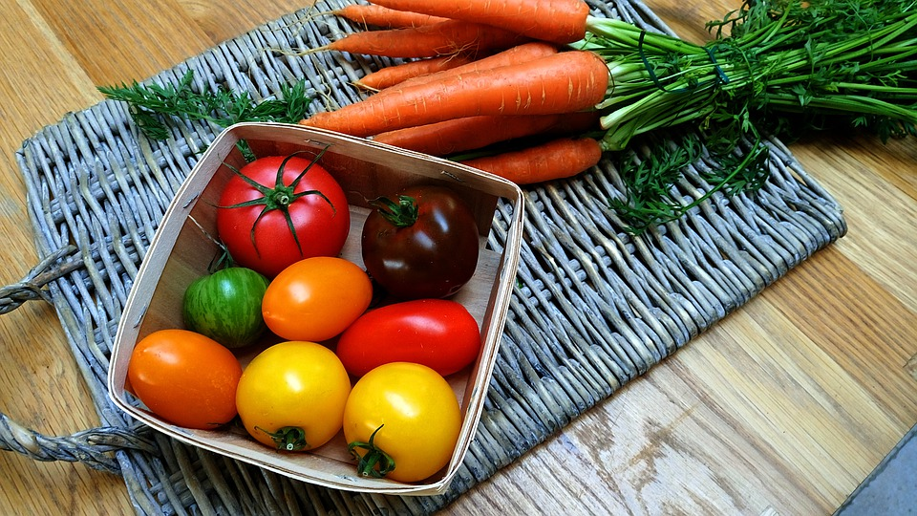
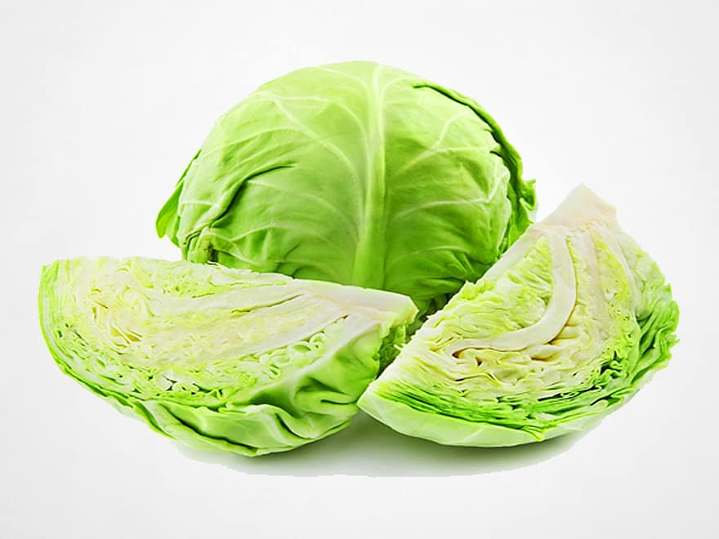
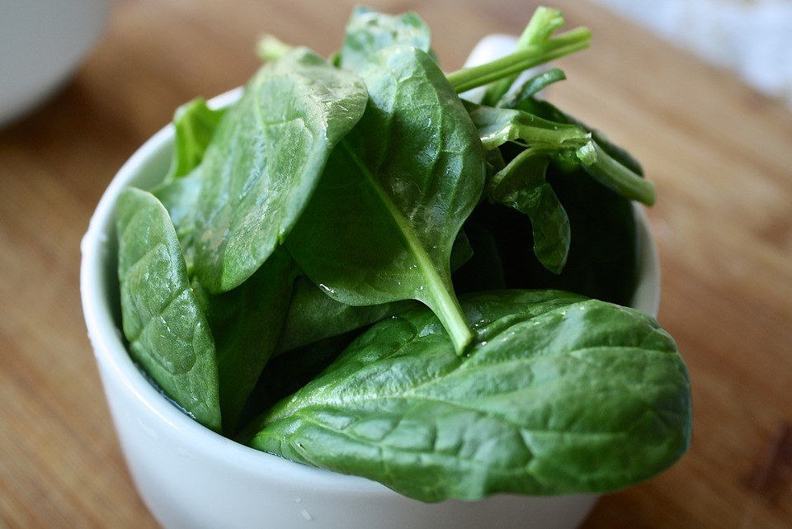
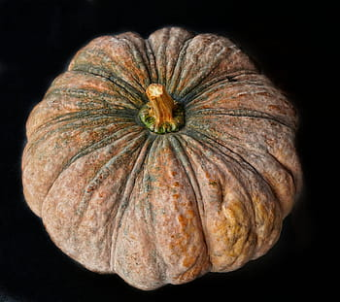
SOURCES OF VITAMIN A
EGGS
MILK
CHEESE
TOMATOES
CARROTS
CABBAGE
SPINACH
PUMPKIN

Slide 10
VITAMIN D (CHOLECALCIFEROL)
FUNCTIONS
Needed for the proper formation of bones and teeth
Helps to absorb calcium and phosphorous

Slide 11
VITAMIN D (CHOLECALCIFEROL)
Requirements- Vitamin D can be stored in the body because it is fat soluble. Most people produce enough vitamin D from being exposed to the sun.
An excess of vitamin D however can be toxic. Too much vitamin D can cause too much absorption of calcium, which can lead to calcification….hardening of the blood vessels, heart and lungs

Slide 12
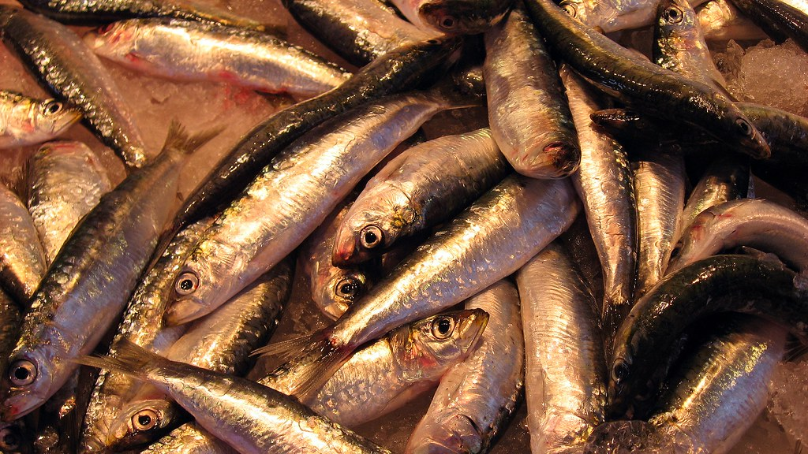
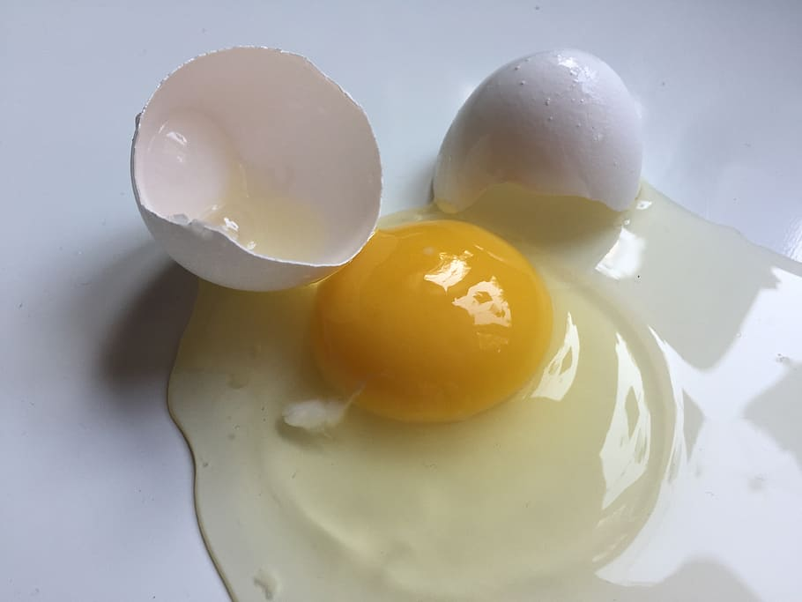
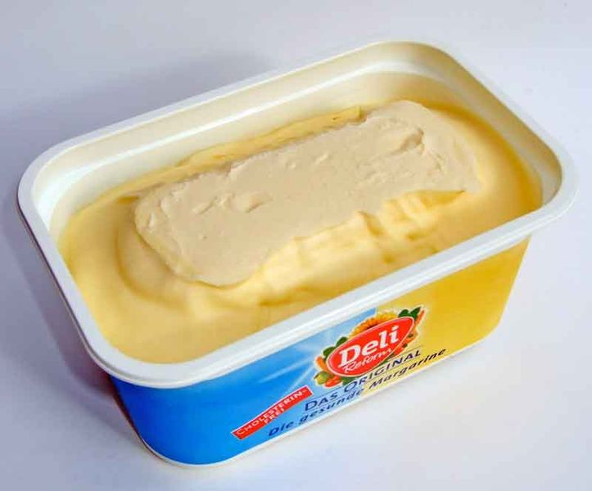
SOURCES OF VITAMIN D
DAIRY PRODUCTS
OILY FISH
EGG YOLK
MARGARINE

Slide 13
VITAMIN E (TOCOPHEROL)
FUNCTIONS
An antioxidant that protects cells from free radicals
Prevents oxidation of fatty acids
Protects against heart disease

Slide 14
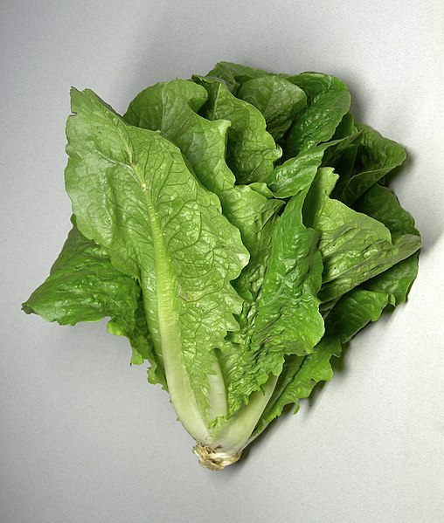
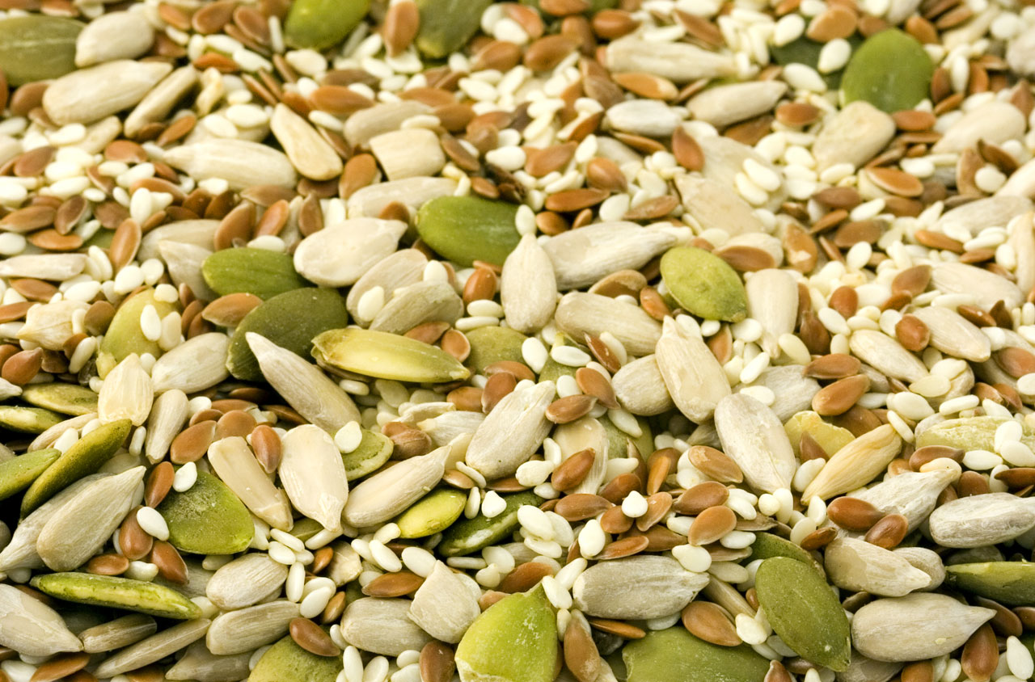
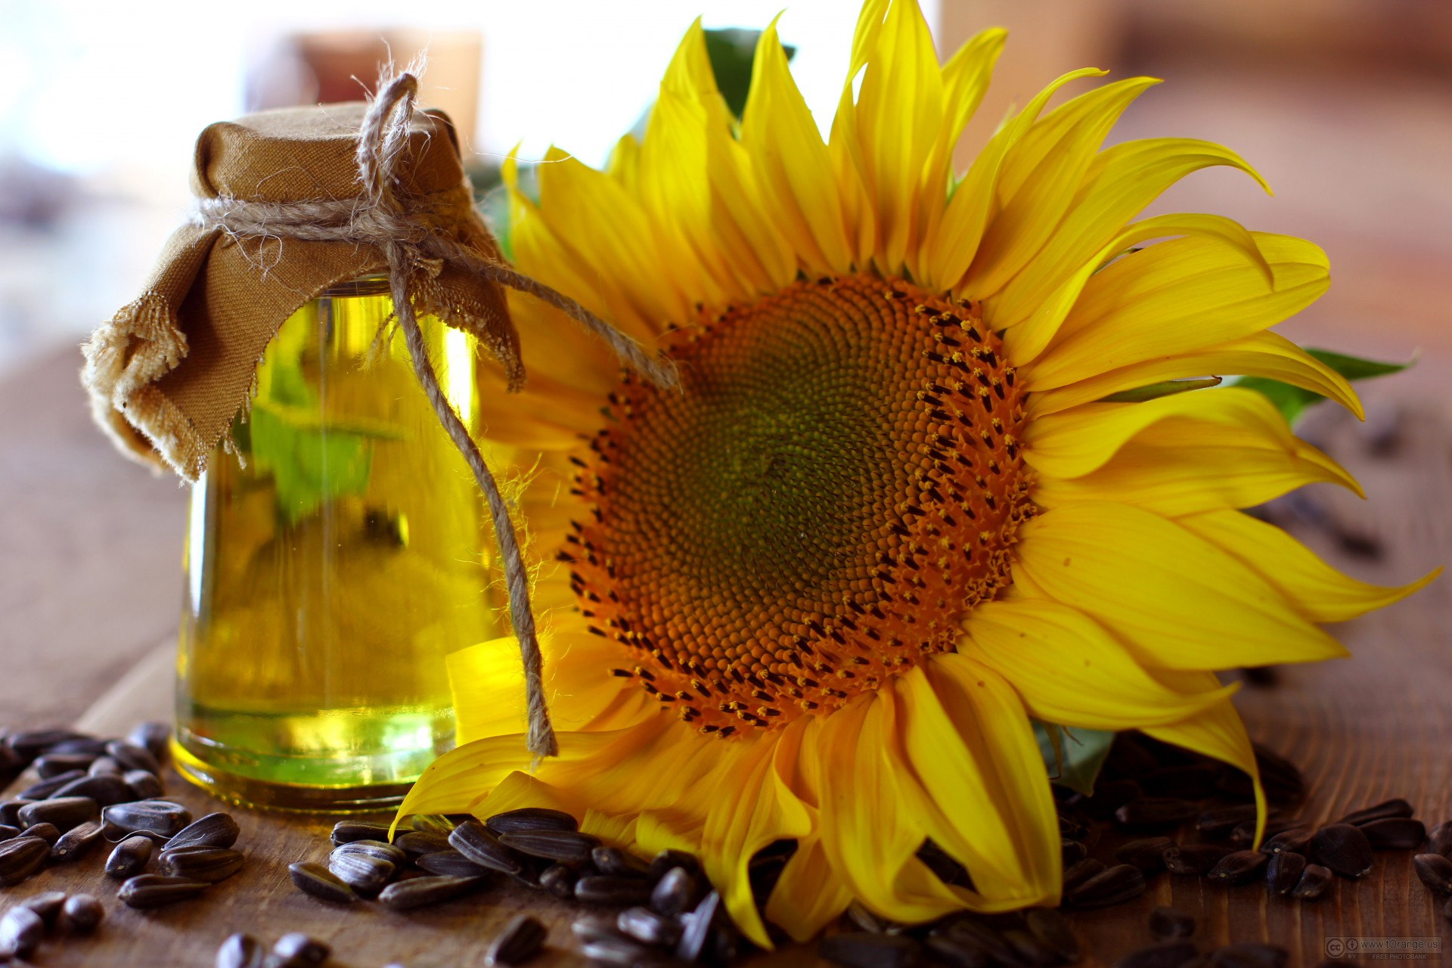
SOURCES OF VITAMIN E
PEANUTS
LETTUCE
SEEDS (E.G. SUNFLOWER, PUMPKIN)
SUNFLOWER OIL

Slide 15
VITAMIN K
FUNCTIONS
Helps with the making of coagulation substances so that a clot forms properly after an injury.
Helps with the making of bone proteins that binds to the minerals that help to form bones.

Slide 16
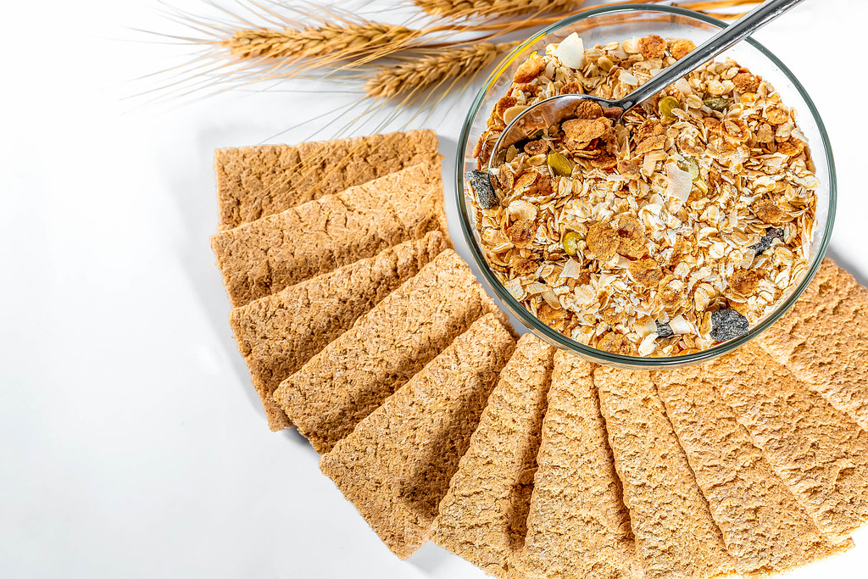
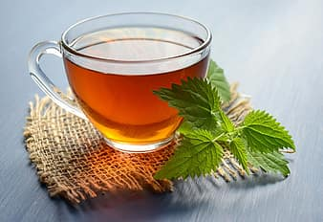
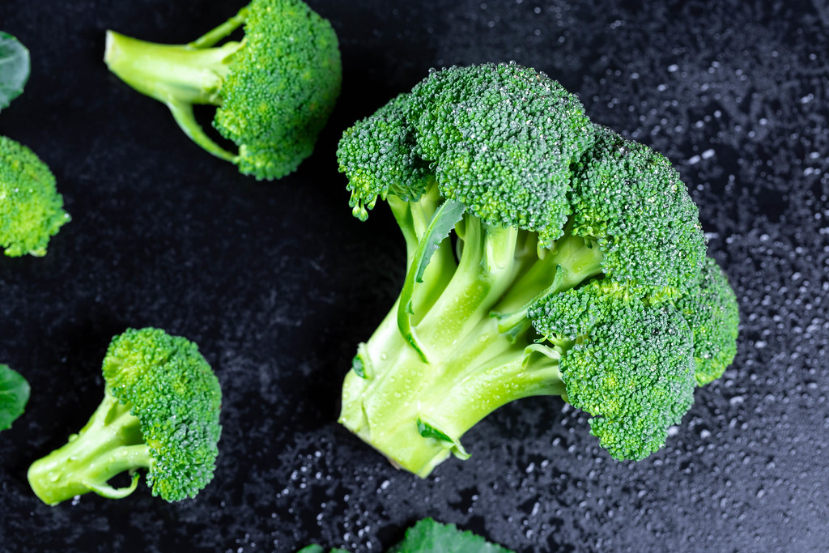
SOURCES OF VITAMIN K
GREEN LEAFY VEGETABLES
CEREALS
GREEN TEA
BROCCOLI

Slide 17
DEFICIENCY DISEASES

Slide 18
NIGHT BLINDNESS
VITAMIN-
Night blindness is caused by a lack of Vitamin A (Retinol)
SIGNS AND SYMPTOMS
Unable to see in the dark

Slide 19
SUMMARY
Vitamins are chemical substances that can be classed as micronutrients.
Vitamins can be divided into two groups based on whether they dissolve in fat or water.
The two groups of vitamins are fat-soluble and water-soluble vitamins.
Fat-soluble vitamins- A, D, E, and K vitamins.
Water-soluble vitamins - C and B Complex vitamins.

Slide 20
SUMMARY
Fat-Soluble vitamins - A, D, E and K
Perform different functions.
Can be found in various food sources
Have different requirements
A lack of any of these vitamins, can lead to deficiency diseases.

Slide 21
COMPLETE THE WORKSHEETS ATTACHED

Slide 22
REFERENCES
TEXTBOOK:
Anita Tull and Antonia Coward. (2009). Caribbean Food and Nutrition for CSEC. Oxford.

Slide 23
REFERENCES
IMAGES:
https://pixabay.com/illustrations/chicken-milk-dairy-food-559892/
https://www.pikrepo.com/search?q=vitamins
https://www.flickr.com/photos/160866001@N07/47448339861
https://pixabay.com/photos/vegetables-carrots-tomatoes-yellow-4851504/
https://www.pikist.com/free-photo-iplgr
https://pixabay.com/photos/spinach-healthy-green-dieting-1427360/
https://www.flickr.com/photos/30478819@N08/45680168564
https://www.flickr.com/photos/53255320@N07/6805917663
https://www.piqsels.com/en/public-domain-photo-zomqt
https://commons.wikimedia.org/wiki/File:Margarine_BMK.jpg
https://www.flickr.com/photos/30478819@N08/48840940686

Slide 24
REFERENCES
IMAGES:
https://commons.wikimedia.org/wiki/File:Romaine_lettuce.jpg
https://www.publicdomainpictures.net/en/view-image.php?image=295&picture=seeds
https://commons.wikimedia.org/wiki/File:Sunflower_oil_and_sunflower.jpg
https://www.pikrepo.com/fkjzx/green-leafy-vegetable-on-white-background
https://www.flickr.com/photos/30478819@N08/45439050672
https://www.pikist.com/free-photo-sshzd
https://www.flickr.com/photos/30478819@N08/32217897618

Slide 25
Acknowledgements
Lesson compiled by:
Ms. Venita Ramcharran, Rio Claro West Secondary

