Slide 1
ORTHOGRAPHIC PROJECTION
1st Angle Projection
SECTION 2B: SOLID GEOMETRY

Slide 2
OBJECTIVES
14. Drawing orthographic views
(b) Plans and Elevations

Slide 3
RECAP
Orthographic principles:
Multi view 2 dimensional drawings
Drawings viewed in relation to a horizontal and vertical plane
Utilizes two quadrants of the intersection of the vertical and horizontal plane
1st angle and 3rd angle projection are usually used for orthographic projection
Not as easy to visualize the whole product as a 3D drawing

Slide 4
RECAP
Click on the link below and review orthographic principles:
https://www.youtube.com/watch?v=ytwEDvX-l44&t=1s

Slide 5
1st ANGLE ORTHOGRAPHIC PROJECTION
In 1st angle projection system, the object is placed in the first quadrant between the observer and the plane of projection.
In this projection, the top view is drawn directly under the front view. And Left and right side views are drawn on the right and left side of the front view.

Slide 6
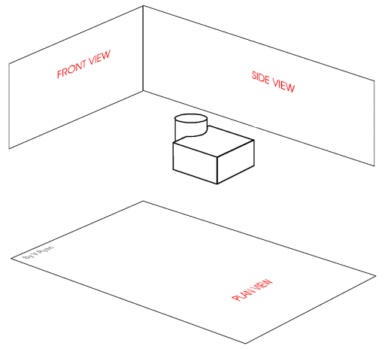
Ist Angle Projection

Slide 7
1st Angle Projection
The plan is viewed from above but projected on the horizontal plane
The front elevation is viewed directly in the front of the object but projected on the vertical plane directly above the plan.
The side elevation viewed from the left is projected on the right vertical plane and similarly the view from the right sides is projected on the left vertical plane.

Slide 8
1st Angle Projection
The symbol for orthographic projection are the front elevation and side view of a frustum
In the symbol for 1st angle projection, the front elevation is on the left and side elevation is viewed from the left but drawn on the right side of the front elevation as in the diagram.

Slide 9
1st Angle Projection: Freehand sketched views
Click on the link below to and look at the video which presents a sketched graphical explanation of obtaining orthographic views:
Take a note of the explanation
https://www.youtube.com/watch?v=Zptb2epQoEc

Slide 10
Activity
Sketch the 1st angle orthographic views for the four figures given in the diagram.
Use the face of the block with most details as the front elevation.
Sketch a front elevation; plan and right
bbbvffvgfvg end view.
Use mathematical graph paper and using each of the smallest blocks as 1 mm.

Slide 11
Solutions to Sketch Activity

Slide 12
Drawing 1st angle views using AutoCAD
Click on the link below, skip the advertisement and look at the video
Note the key points in producing 1st angle views of an object from isometric using the AutoCAD software
https://www.youtube.com/watch?v=CoOKGTY24yU
Now, go to your computer and software and draw the views of a cube of side 90mm in 1st angle orthographic projection.
How did you do? Did you get the views in the correct place?

Slide 13
Activity using AutoCAD
Using AutoCAD software and your computer, draw the orthographic 1st Angle views of the blocks in the adjacent diagram.
Use the face of the block with the most details as the front elevation.
Use a full size scale

Slide 14
References
Youtube videos
Orthographic Projection Slideshare Creative Commons

