Slide 1
Aquaculture
The cultivation of aquatic plants and animals under controlled conditions

Slide 2
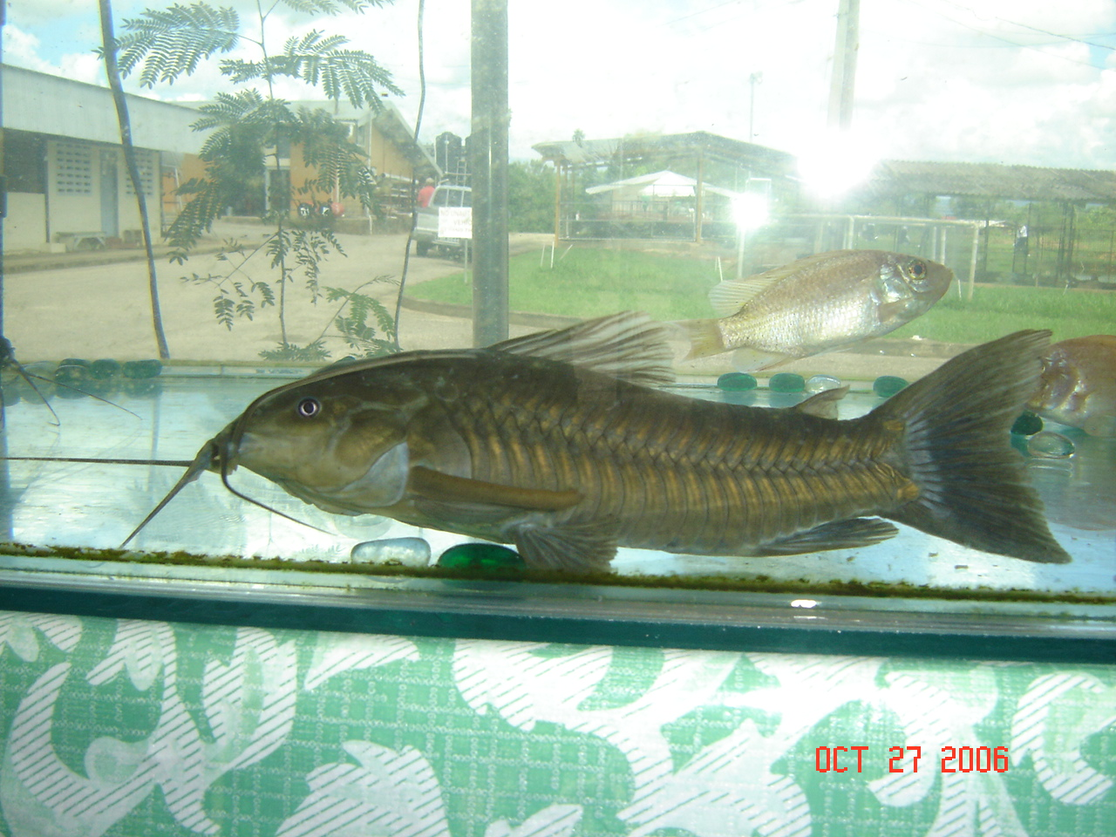
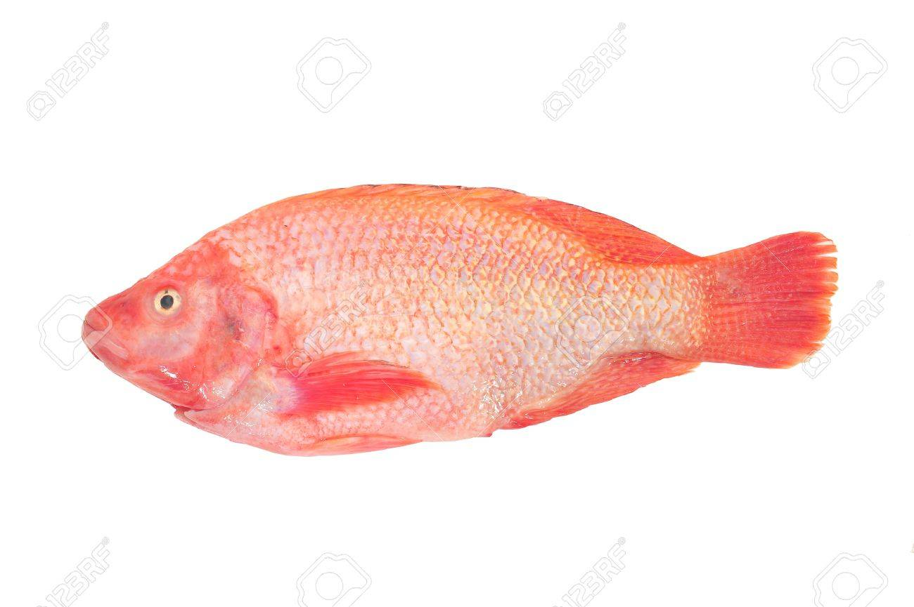
Species of Fish
Based on aquatic environment

Slide 5
Freshwater
Tilapia (Red & Silver)
Seawater
Brackish
Shrimp
Conch
Prawns
Oyster
Lobster
Turtle
Cascadura
Crayfish

Slide 6
Factors to consider when siting a fish farm
Topography
Source of Water
Soil Type
Not prone to flooding
Flat land
Controlled drainage
Graded ponds
Marginal lands
Reliable & adequate
Use of spring/ river/ rain
Non-polluted water
No untreated commercial water
A spillway to avoid overflow
Water must be clear not turbid
Water must be neutral to alkaline
Preferably clay
If loamy it must be compact
If sandy use a plastic liner
Free from leachable chemicals
Ponds should be 1.5 to 2 m deep

Slide 7
Management of a fish farm
Protection
Aeration
Fertllising
Fences and bird nets can be used to protect fish against predators such as caimans and birds
Ponds with a high stocking density of fish needs to be aerated to ensure a supply of oxygen in the water
Fertilisers can be added to the water to encourage the growth of algae which fish eat. In integrated farming systems animal pens can be built over the ponds so that pen manures fertilise the algae

Slide 8
Management of a fish farm cont’d
Weed control
Water quality
Feeding
While vegetation is encouraged to grow on the banks to prevent erosion, it should be kept low. Aquatic weeds should be controlled
Prevent the water from becoming muddy or mucky
Maintain a constant water level
Avoid overcrowding and over feeding
Feed at 3% bodyweight
Use sinking or floating pellets
Use a suitable fish food
Feed at the same spot everyday

Slide 9
Floating pellets

Slide 10
Hapa production of Fingerlings

Slide 11
Fingerlings

Slide 12
Fish pond management

Slide 13
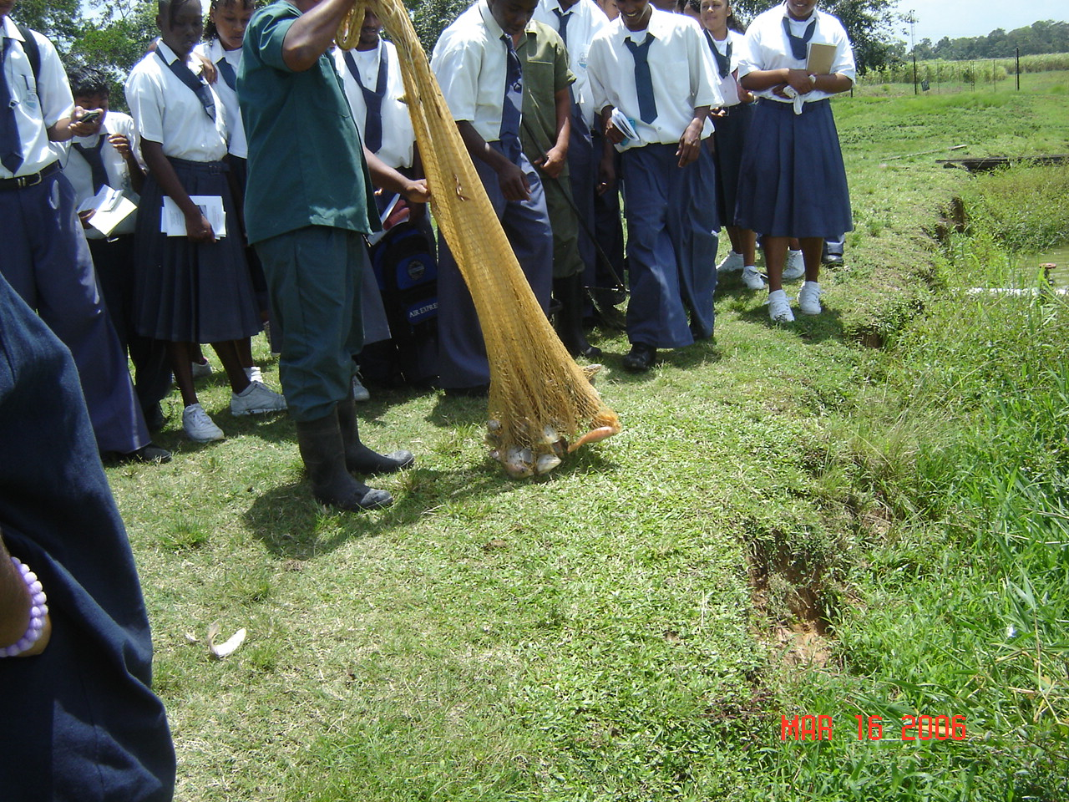
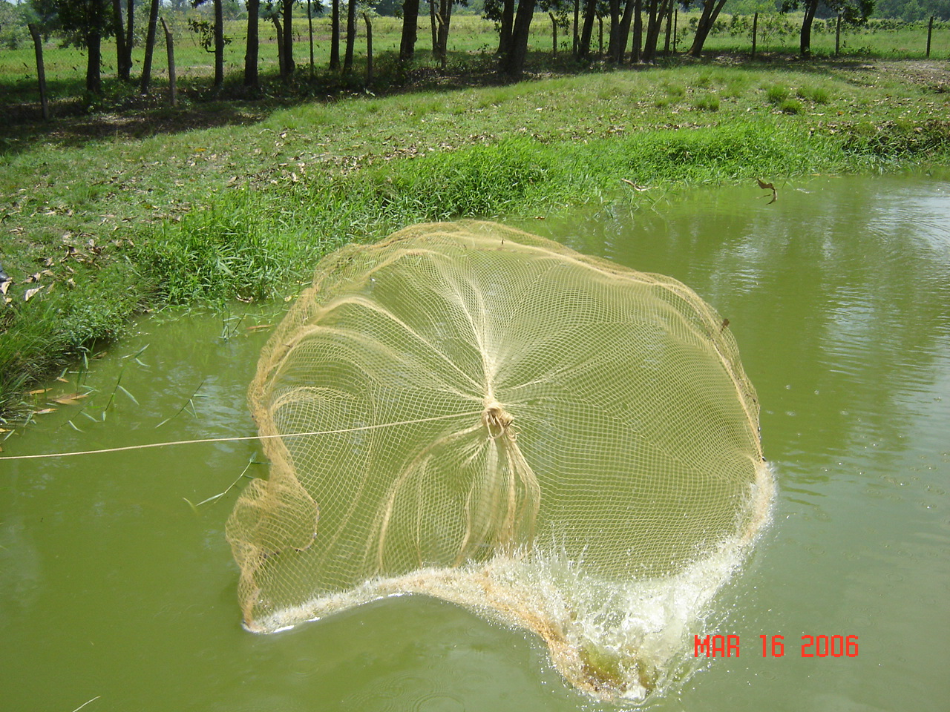
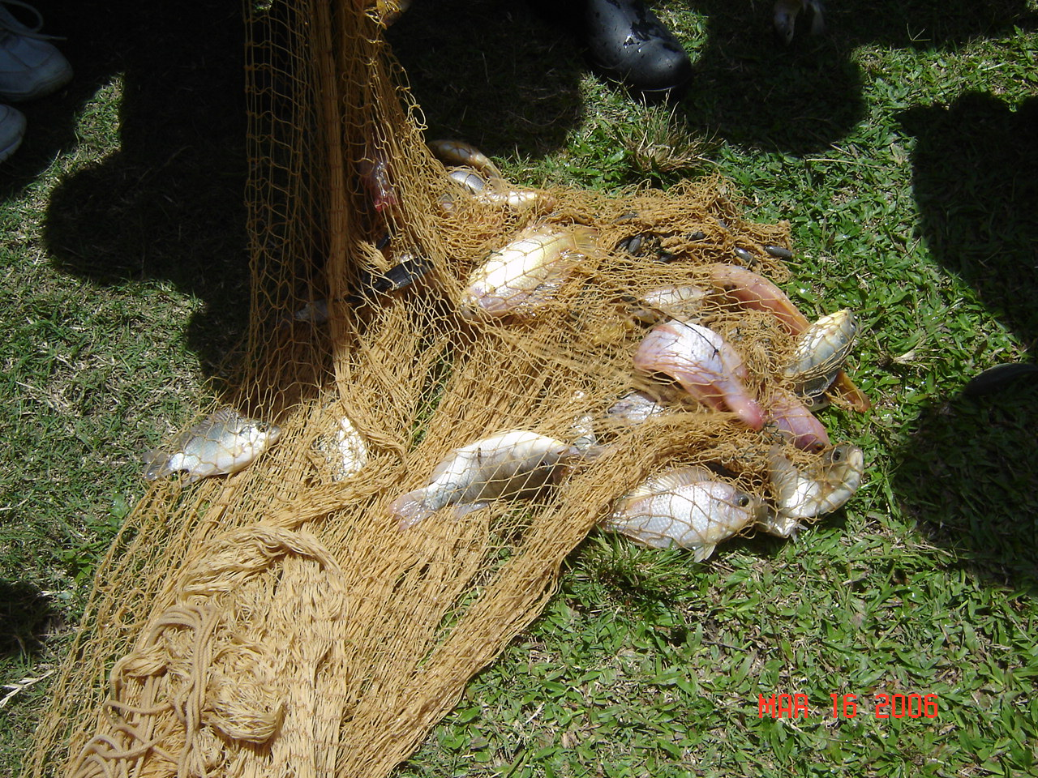
Harvesting
Harvesting takes place when fish have reached a market weight of 0.5 – 0.75 kg usually around five to six months.
There are several methods of harvesting:-
Use of drain pipes
Nets
Hooks
The pond should be constructed to allow easy harvesting

