Slide 1
How to draw linear graphs

Slide 2
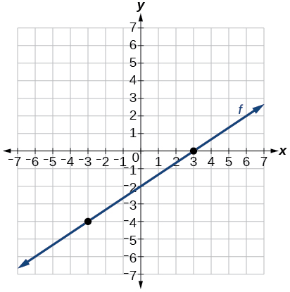
Graphs of linear functions
Output
A graph gives a picture of a function on the Cartesian Plain.
It shows the link between the numbers in the
input; the x values and output; the y values.
Input
A function or graph of the form y = ax + b is a linear function. Its graph is a straight line.

Slide 3
Graphs of linear functions
A graph gives the location of points by using co-ordinates then a line is drawn through them.
Output
The x value (or input) is always given first followed by the y value (or output).
A name of a linear function usually looks like this
y = mx + c
and sometimes like this
y = ax + b
Input

Slide 4
Coordinates.
y
Remember coordinates are pairs of numbers written in brackets that represent a particular location on the Cartesian Plain.
x
The coordinate (5, 3) tells us that the location is 5 units to the right and 3 units up.
A point can then be placed to show the location.

Slide 5
The Meaning of ‘c’ and ‘m’
The letters m and c in the linear function have special values. M represents the gradient or slope of the line. While c represents the y intercept. That is, the place where the line meets the y-axis.
If the gradient is positive, then the line will slope upwards.
If the gradient is negative, then the line will slope downwards.
The line will cross or meet the y-axis at the value of the intercept.

Slide 6
Graphs of linear functions
In the following examples, the names of the linear
graphs are :
Y = 2x + 1
Y = 2x – 5
Y = 4x
Y = 10 – x
here m = 2 and c = 1
here m = 2 and c = -5
here m = 4 and c = 0
here m = -1 and c = 10

Slide 7
Drawing graphs of linear functions.
y
y = 2x - 5
x
y = 2x + 1
10
9
x
xy
0
1
3
8
x
xy
0
1
3
-5
7
1
3
7
-3
1
6
5
x
4
3
2
1
x
x
-10
-9
-8
-7
-6
-5
-4
-3
-2
-1
0
1
2
3
4
5
6
7
8
9
10
-1
y = 4x
y = 10 - x
-2
-3
xy
-2
0
1
xy
3
0
2
-4
-5
-8
0
4
7
10
8
-6
x
-7
-8
-9
-10

Slide 8
y
y = 14 - x
10
y = -2x + 3
9
8
xy
0
1
3
xy
x
4
7
9
7
x
6
3
1
-3
10
7
5
5
4
x
3
x
2
1
x
x
-10
-9
-8
-7
-6
-5
-4
-3
-2
-1
0
1
2
3
4
5
6
7
8
9
10
-1
x
y = x + 7
-2
y = 2 – 2x
-3
xy
-4
-5
0
-2
xy
0
-5
1
2
2
7
5
-6
2
0
-2
-7
-8
-9
-10

Slide 9

Let’s draw the graph of the function y = 5x - 9 together:
y
1.First, calculate
2.Next, scale the axes.
y = 5x - 9
(3,6)
xy
1
2
3
$$y=5x−9$$
8
6
4
2
0
-2
-4
$$−4$$
$$5×1=5$$
$$−9=−4$$
(2,1)
x
$$5×2=10$$
$$1$$
$$−9=1$$
$$\text{6}$$
$$5×3=15$$
$−9=$6
1 2 3
(1,-4)
3. Plot the points.
4.Finally, draw and label the line.

