Slide 1
FAMILY AND RESOURCE MANAGEMENT
THE FAMILY

Slide 2
Group level: Form Four/Form Five
INSTRUCTIONS
Read the information on the power point
Review what you have learned by completing the questions presented on the slides.
Use the answer key to assess your performance.

Slide 3
FAMILY FORMS IN THE CARIBBEAN

Slide 4
OBJECTIVES
At the end of the lesson, students should be able to:
Define the term family
State the family forms in the Caribbean
Describe the family forms in the Caribbean
Explain positive and negative issues experienced by different families
Differentiate between categories of single parenting
Explain changes faced by redefined families

Slide 5
THE FAMILY
https://upload.wikimedia.org/wikipedia/commons/thumb/4/40/Family_jump.jpg/800px-Family_jump.jpg CC BY 2.0

Slide 6
Introduction
The Family is one of the most important structures in todays' society, it reflects the morals, values, attitude, behaviour and most importantly the spirituality of a nation.
Therefore the strength of a nation lies within the boundaries and confinement of our homes.

Slide 7
CONCEPT OF FAMILY
The term ‘family’ often refers to a group of two or more persons who may be related by marriage, birth, blood or adoption, who reside together in the same household and share the same resources and responsibilities.

Slide 8
Concept of Family Cont’d
Families may also be defined as a social arrangement based on marriage and the marriage contract, including recognition of the rights and duties of parenthood.

Slide 9
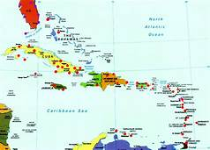
Major Family forms in the Caribbean
https://picryl.com/media/central-america-and-the-caribbean?zoom=true

Slide 10
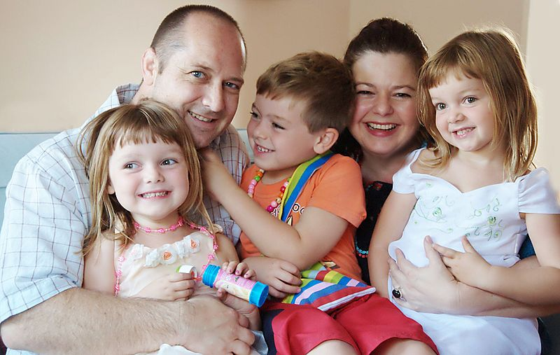
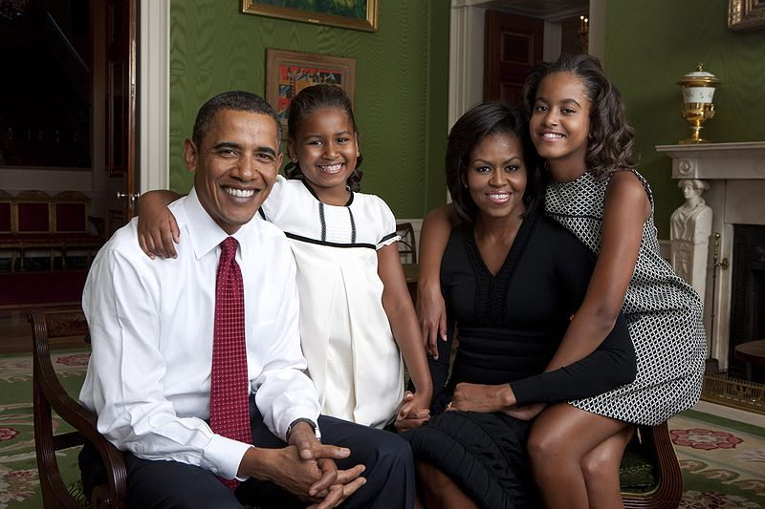
THE NUCLEAR FAMILY
The nuclear family comprises of both parents and their child/children.
https://upload.wikimedia.org/wikipedia/commons/thumb/5/5e/Happy_family_%281%29.jpg/800px-Happy_family_%281%29.jpg
CC By SA 2.0
https://commons.wikimedia.org/wiki/File:Obama_family_portrait_in_the_Green_Room.jpg Public Domain

Slide 11
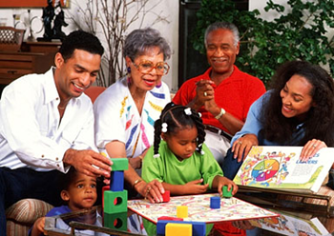
The Extended Family
A family which expands beyond the nuclear family to include grandparents and other relatives.
http://www.classifieds.guardian.co.tt/sites/default/files/event/family.play_.png

Slide 12
The Extended Family Cont’d
Positive impacts of the extended family:
More human resources to do household chores.
Older members like grandparents can assist in teaching younger members new skills.
Increased financial resources since working members will be able to contribute towards the household expenditure.
Older members could contribute towards socialization of the younger children and transfer of culture.
Increased emotional support

Slide 13
The Extended Family Cont’d
Negative impacts of the extended family:
There can be tension created among family members. Example grandparents may disagree with parents on child rearing practices.
Reduction in financial resources. Older persons may be unable to contribute financially due to health issues and therefore become dependent on the family income.
Lack of privacy for all to live comfortably.
Competition for resources such as television, washing machine, bathroom.

Slide 14
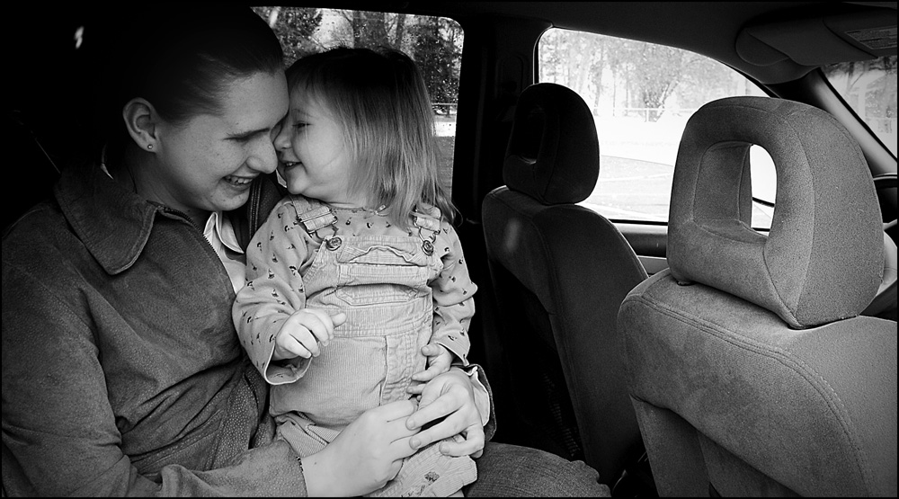
SINGLE PARENT
The single parent family comprises of mother or father and child/children living together.
https://upload.wikimedia.org/wikipedia/commons/d/d6/Doing_the_best_she_can.jpg CC By 2.0

Slide 15
TWO MAIN CATEGORIES OF SINGLE PARENTING
MATRIFOCAL
PATRIFOCAL
This is based on the MOTHER as the head of the family or household.
This is based on the FATHER as the head of the household.

Slide 16
The Single Parent Family Cont’d
A parent may become single for a variety of reasons:
Divorced
Widowed
Break-up
Unplanned pregnancy/unwilling father

Slide 17
The Single Parent Family Cont’d
Issues with single parenting
Financial burden, being the only breadwinner
May be hard to maintain discipline leading to behavioural problems with children.
Less time to spend with child/children due to long working hours to maintain the family.

Slide 18
SIBLING HOUSEHOLD
A sibling household consists of children living by themselves due to the death or abandonment of their parents.
The eldest child takes up the responsibility to care for their younger siblings.

Slide 19
Sibling Household Cont’d
Issues with sibling household should be avoided as much as possible.
Financial responsibility can become burdensome for the eldest child who is taking care of the younger ones.
The goals of the eldest child may have to be put on hold in order to assist siblings
May not have the patience/skill to deal with siblings when behaviour becomes difficult.
May be unable to fulfill all the roles and function of a family.

Slide 20
BLENDED / RECONSTITUTED
A family consisting of a couple, the children they have had together, and their children from previous relationships. OR
A blended family is defined as a family made of two parents and their children from previous marriages/unions. OR
A family composed of a couple and their children from previous marriages.

Slide 21
Blended/Reconstituted Cont’d
The blended family households can create issues and should be avoided for the benefit of the children.
The physical and emotional needs of children are different and they will adjust differently to the blended family.
Child may lose their uniqueness in being the only boy or girl in the family
Child may have difficulty accepting a new parent.
Changes in family tradition may be difficult for some children to accept.

Slide 22
Conclusion
Family is the fabric of a society, it should be built on a solid foundation.
Some family structures namely the single and blended family households can create issues and should be avoided for the benefit of the child/children.

Slide 23
Conclusion Cont’d
In the Caribbean, the number of cases of divorce, family violence and the general disintegration of family values and basic manners reflects poorly on our society.
It must remain at the forefront of our minds that unsavoury acts are committed by people and people originate in a family.
A family should be a place of comfort, care and love.

Slide 24
Review Questions
Answer All Questions
1. A group of people related to one another by blood, marriage or adoption.
Family
Relatives
Mom and dad
Siblings and parents
2. A married man and woman living with their biological or adopted children.
Parents
Nuclear family
Family unit
Blended family

Slide 25
3. The responsibility for older siblings in the event of death or abandonment of parent/s to fulfill family roles.
Sibling family
Extended
Blended/ reconstituted
Nuclear
4. Can a single parent family become nuclear through marriage?
YES
NO

Slide 26
5. A family where one parent is not biologically related to the child/children is called.
Nuclear
Blended/combined/reconstituted
Extended
Single parent
6. Which of the following best describes the Caribbean Family?
Father, mother and child living together
A group of people living in a shelter
Elderly people living in a home
Siblings sharing an apartment

Slide 27
7. Your grandmother moved in with you and your parents, what type of family are you now living in?
Nuclear
Extended
Reconstituted
Single parent
8. Which of the following can change a nuclear family to a single parent family?
Marriage
Birth of child
Divorce
Adoption

Slide 28
Items 9 - 13 refer to the following scenario.
Mr. and Mrs. Henntel have been married for six years and have a three year old daughter. They are now sharing a home with Mr. Henntel's retired parents and have agreed that Mrs Henntel will continue to work in the medical field. Mr Henntel assists with the preparation of meals, so that his wife will be able to devote more time in the care of their daughter.

Slide 29
9. Which of the following types of family is described in the scenario?
Nuclear
Blended
Extended
Single-parent
10. How will Mr. and Mrs. Henntel benefit from this new type of family arrangement?
Financial stability
Limited space
Sound discipline
Growth and foster respect for the elderly
i
i,iii,iv
ii, iv
ii,i

Slide 30
11. In early 2019, Mr. Henntel's mother needed an emergency surgery procedure. Therefore both his parents opted to migrate. The family will now be identified as
extended
single
blended/combined
nuclear
12. In light of COVI-19. An unfortunate mishap occurred. Mr. Henntel's wife contracted COVID-19 and died. In filling out the social welfare application form, he is now required to list his family as:
sibling
reconstituted
single
nuclear

Slide 31
Refer to scenario on slide 27
13.Explain two positive impacts and one negative impact of this new family type.
Positive Impacts
…………………………………………………….....................................
……………………………………………………………………………….
……………………………………………………………………………….
……………………………………………………………………………….
……………………………………………………………………………….
Negative Impact
……………………………………………………………………………….
……………………………………………………………………………….
……………………………………………………………………………….
(6 marks)

Slide 32
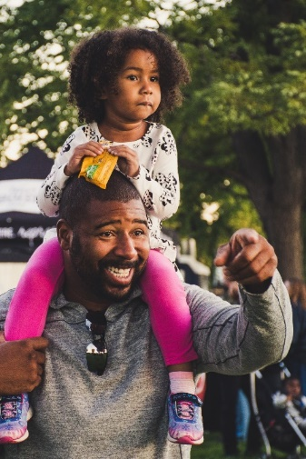
14. Name and describe the type of single parenting shown in the image below.
Name …………………………………………………………………………………………….
Description …………………………………………………………………………………….
…………………………………………………………………………..……………………………
(2 marks)

Slide 33
15. State the difference between the ‘extended family’ and the ‘blended family’.
………………………………………………………………………………………………………………………………………………………………………………………………………………………………………………………………………………………………………………………………………….
(2 marks)
Total 22 marks

Slide 34
Answer Key
1. a
2. b
3. a
4. a
5. b
6. a
7. b
8. c
9. c
10. 9
11. d
12. c
1 mark each = TOTAL 12 marks

Slide 35
13.Positive Impacts of grandparents living with family:
Assist in doing household chores.
Contribute to financial resources
Assist in socialization of the child and transfer of culture.
(2 marks for any two response)
(=4 marks)

Slide 36
Negative Impact of grandparent living with the family:
Tension created on child rearing practices.
Reduction in financial resources - dependent on the family income.
Lack of privacy for all to live comfortably.
Competition for resources such as television, bathroom.
(2 marks for any response)

Slide 37
14. Patrifocal family : The father is the head of the household.
(1 mark each for name and description)
(= 2 marks)
15.
Extended family: A type of family in which relatives (such as grandparents, aunts, uncles and cousins) in addition to parents and children live in a single household.
A blended family is defined as a family made of two parents and their children from previous marriages/unions.
(1 mark for each definition = 2 marks)
Total 22 marks

Slide 38
REFERENCES
Stewart, Thelma M. (1994) Certificate Management of Homes and Families.
Dyer Rita & Maynard Norma (2004) Management.
Father with child: https://pxhere.com/en/photo/1533673
CC0 Public Domain Free for personal and commercial use

