Slide 1
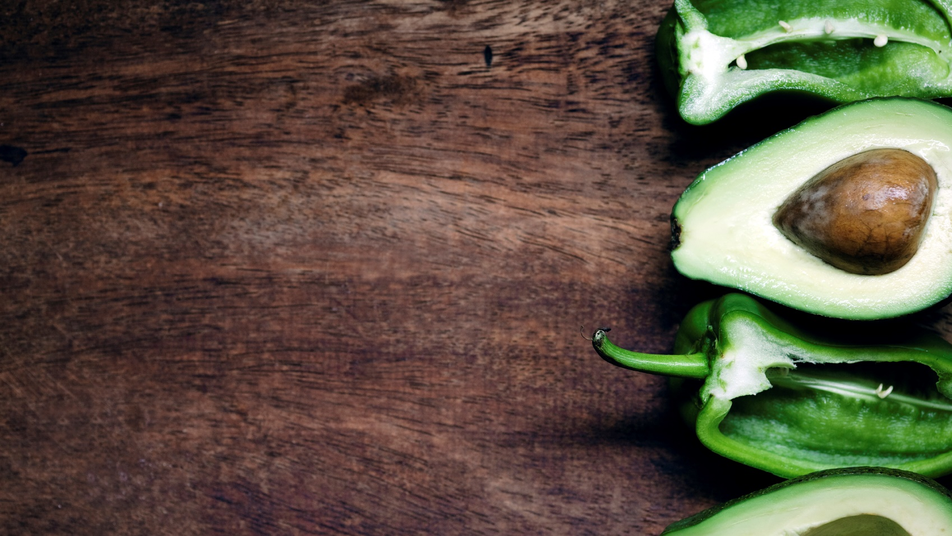
HARVESTING & POST PRODUCTION
MANAGEMENT

Slide 2
The farmer uses a plant’s maturity to decide the exact moment or stage to pick a crop. The stage at which the crop is harvested is important to the quality of the product. Good quality is ensured by harvesting at the correct stage of maturity. Fruits picked at the wrong stage may not ripen properly and crops harvested too late will have shorter shelf-life.
Maturity is decided by observations such as:
Physical methods e.g. size, shape, colour and texture
Chemical methods e.g. measuring the amount of sugar or acidity in produce
Physiological methods e.g. respiration rate and ethylene production

Slide 3
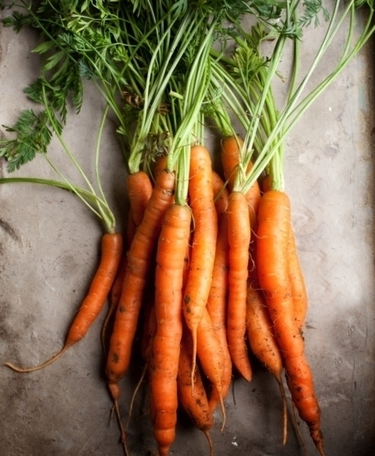
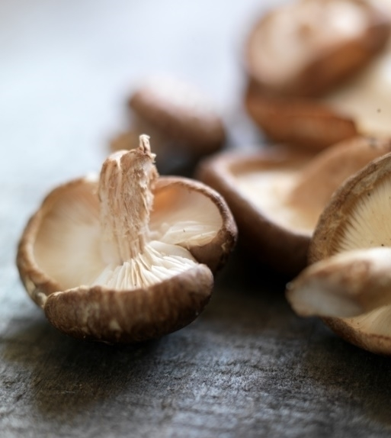
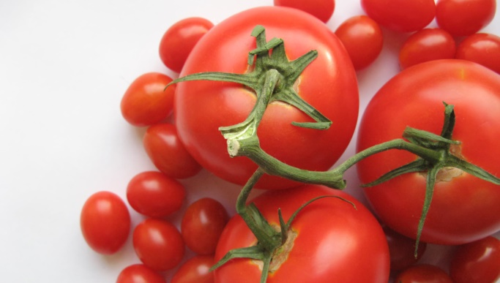
MATURITY INDICES
Physiological
Horticultural
Harvest

Slide 4
PHYSIOLOGICAL | HORTICULTURAL | HARVEST
The stage when maximum growth and maturation is achieved | Any stage of development where the crop is ready for use e.g. green mango for kuchela v.s. ripe mango | A combination of physiological and horticultural. Fruits/vegetables are at their peak condition
Farmers need to apply a combination of different maturity indices to ensure that there is a high quality of produce along the value chain

Slide 5
Activity: IDENTIFY WHEN THE FOLLOWING CROPS ARE READY TO BE HARVESTED
CUCUMBER |  | LETTUCE
TOMATO |  | CABBAGE
BEAN |  | OCHRO
SWEET PEPPER |  | YAM
CASSAVA |  | SWEET POTATO

Slide 6
IDENTIFY WHEN THE FOLLOWING CROPS ARE READY TO BE HARVESTED
CUCUMBER | Immature/ color change | LETTUCE | Solidity of head
TOMATO | Mature green / color change | CABBAGE | Solidity of head
BEAN | Snap stage | OCHRO | Snap stage
SWEET PEPPER | Mature green | YAM | After yellowing begins
CASSAVA | Mature (6-11 months) | SWEET POTATO | 4 months after planting

Slide 8
Cause of produce spoilage
Metabolic/biological changes due to; Respiration, Ethylene production, Growth, Compositional changes
Transpiration: loss of moisture resulting in shriveling, wilting, softening or limpness
Physical injury: stimulates ethylene production and moisture loss
Pathological production: spoilage due to bacteria and fungi
Physiological breakdown; chilling injury, heat injury, disorders

Slide 9
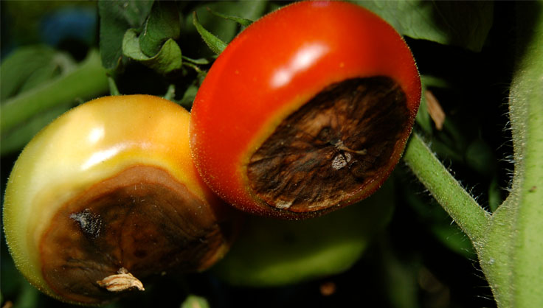
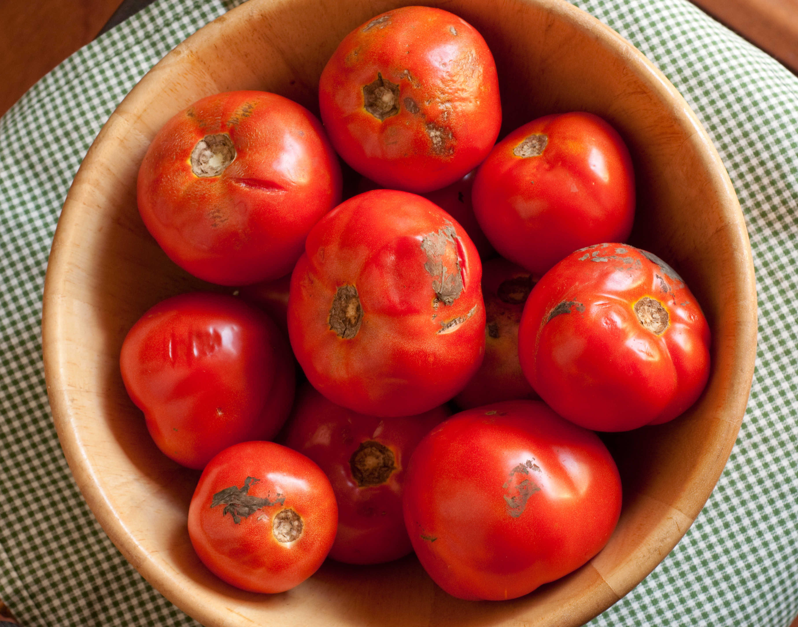
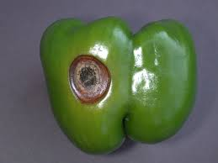
activity
PRODUCE | POST HARVEST DAMAGE | EFFECT OF DAMAGE TO PRODUCT
 | BLOSSOM END ROT
 |  | BRUISING, LOSS OF QUALITY, POOR SALE VALUE
 | ANTHRACNOSE

Slide 10
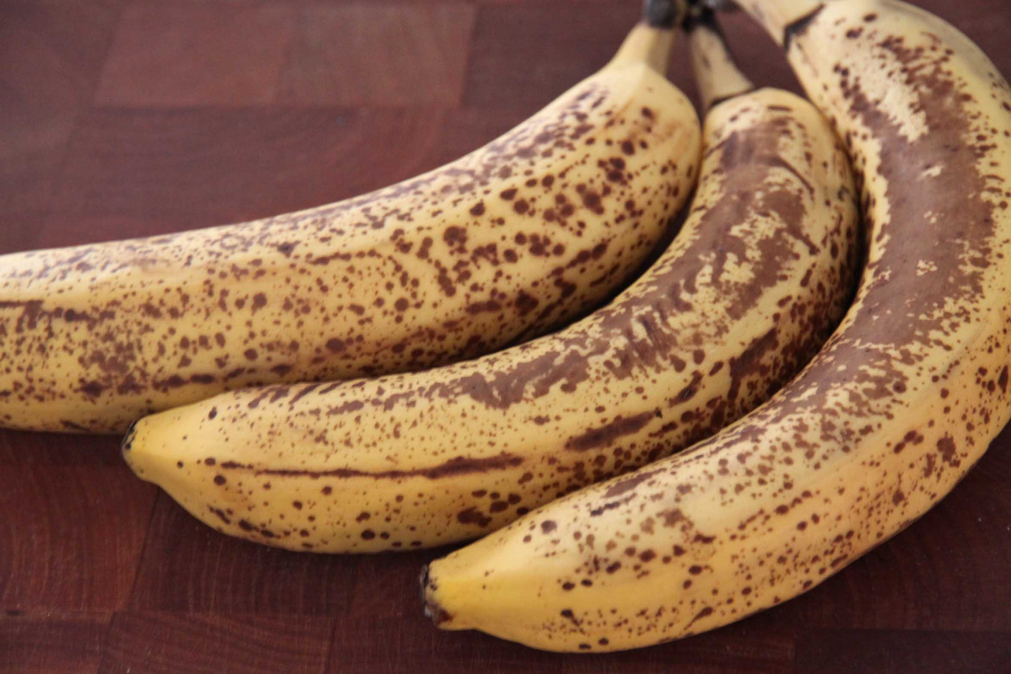
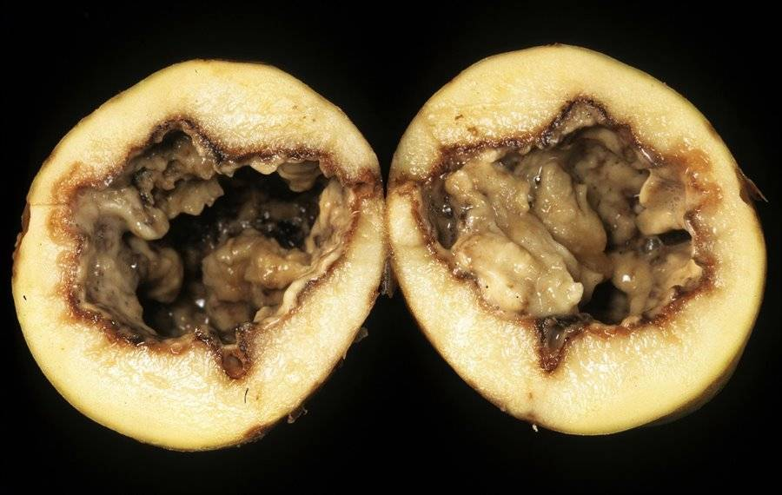
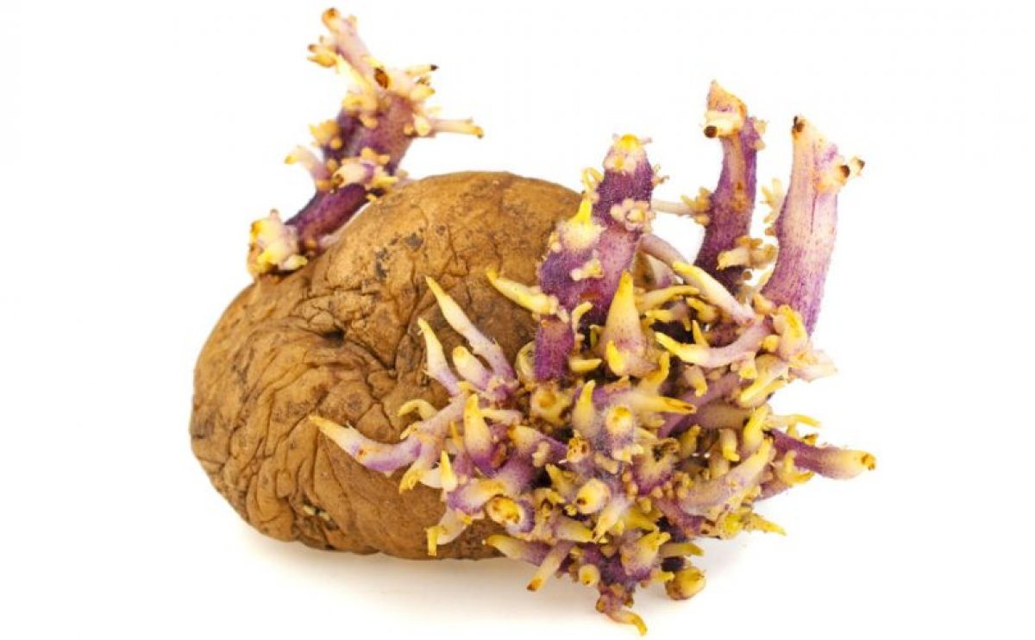
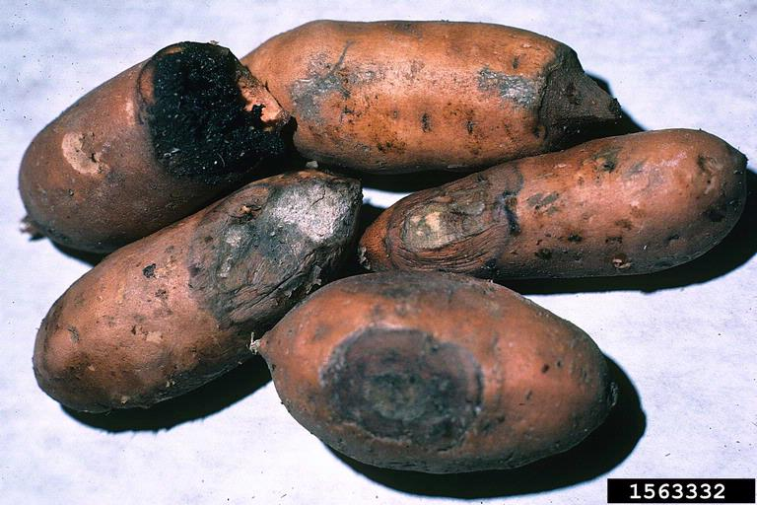
PRODUCE | POST HARVEST DAMAGE | EFFECT OF DAMAGE TO PRODUCT
 | BACTERIAL SOFT ROT
 | FUSARIUM ROOT ROT

Slide 11
HARVESTING PROCEDURES
LEAFY VEGETABLES – uproot and then cut the roots off OR cut the base of the stem
FRUIT VEGETABLES – hand picked when mature green with the calyx on
ROOT CROPS – uprooting or digging minimizing damage to roots
CORN – picked green or dry by hand or mechanical harvester
RICE – cut by hand or by mechanical harvester
HELICONIA – remove entire stalk, free from damage and have good foliage
ANTHURIUM – cut from the plant at ¾ maturity
GINGER LILY – cut at ground level
ORCHIDS – the whole spike is cut being careful not to damage

Slide 12
Harvesting procedures cont’d
Harvest during cool hours
Shade harvested produce
Use clean, vented field containers and DO NOT overpack
Use harvesting aids e.g. picking poles, knives, nets
Avoid delay between harvest and transport from field
Harvest at correct stage of maturity

Slide 13
POST HARVEST TREATMENT
This is the application of various methods and techniques that delay the process of senescence(aging) and maintain the highest quality in the harvested product. This is the stage after harvest and includes cooling, cleaning, grading and packaging
Aims of POST HARVEST TREATMENT
Preservation of integrity of the product – avoiding damage
Maintenance of quality of product – size, shape, taste, odour, nutrients
Prevention of post harvest diseases
Prevention of weight loss due to drying or respiration
Prolongation of shelf life by treatment or processing
Reduce crop loss after harvest

Slide 14
Post harvest management includes
Transport from the field | Move quickly from field to packing house Pack in suitable containers Use a suitable vehicle e.g. refrigerated Avoid over exposure to sunlight
Humidity management | Humidity influences water loss Cooler humidity slows down chemical changes in produce
Sanitation | Worker sanitation e.g. washing of hands, use of hairnets, wearing appropriate clean protective clothing e.g. gloves, aprons and coveralls
Minimising of damage | Minimise damage to produce to avoid spoilage (what kind of damage can occur to the produce?)
Sorting | Remove bruised or damaged produce that my shorten shelf life
Storage | Preserve freshness of product

Slide 15
Post harvest treatment includes
CURING - this is done to root tubers if they are being stored for long periods. It involves the application of high temperatures and high relative humidity to heal skins damaged by harvesting. The produce is piled in a partially shaded area and covered with an insulating material e.g. straw and left for 4 days.
ARTIFICIAL WAXING – wax is applied to replace natural wax lost during washing of fruits and vegetables
RIPENING – for uniform and controlled ripening ethylene is applied to the produce.

Slide 16
Food preservation
This is the process of treating and handling food to stop or greatly slow down spoilage to prevent food borne illness and to maintain nutritional value, texture and flavor.
This is done to:
Slow down the activity of disease causing bacteria
Kill the bacteria altogether
Preservation includes processes such as; heating, oxidation, dehydration, toxic inhibition e.g. smoking, freezing

Slide 17
Common methods of preservation are
DRYING | Dried meat Dried fruits e.g. peach, raisins, apricots Dried cereals e.g. rice and wheat
SMOKING | Smoked fish Smoked meat
FREEZING
VACUUM PACKAGING | Stores food in a vacuum environment in an airtight bag or bottle
SALTING | Salted meat Mushrooms in brine
SUGAR | Fruit preserves in syrups or candied
PICKLING | Food is preserved by placing it in a substance that inhibits or kills bacteria e.g. brine, vinegar, vegetable oil or ethanol

Slide 18
Common methods of preservation are
JELLYING | Food is cooked in a material that makes a gel e.g. gelatin
JUGGING | Meat is stewed in a covered earthen jug n brine/gravy/red wine/ animal blood
IRRADIATION | Also called ‘cold pasteurization’ the food is exposed to ionizing radiation
FRESHERIZED PROCESS | Using an ultra-high pressure technique
CANNING & BOTTLING | Cooking and sealing foods in sterile cans or jars and boiling the container to kill bacteria
BIOLOGICAL PROCESSES
MODIFIED ATMOSPHERE
Assignment – visit a supermarket or browse the internet for pictures of preserved food, print and stick them into your notebooks

Slide 19
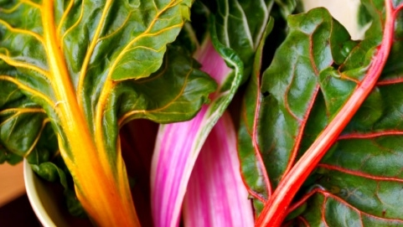
Our fresh produce promise
Local
Fresh
delicious

Slide 20
Thank you

