Slide 1
Punctuation and Capitalisation Overview
Curriculum Planning and Development Division
2020

Slide 2
Objectives
By the end of these lessons you will:
Appreciate the use of punctuation marks/capital letters in sentences and understand their purpose in communicating messages accurately.
Use punctuation marks/ capital letters appropriately and accurately in sentences.

Slide 3
Punctuation- End Marks
This Photo by Unknown Author is licensed under CC BY-SA

Slide 4
Full stops
The full stop is also called a period.
It is used at the end of a complete (declarative) sentence.
Because of the traffic on the highway
The principal arrived late because of traffic on the highway.
Not a complete sentence
Complete sentence

Slide 5
Full stops are also used in abbreviations
Mr. | Dr. | a.m. | p.m.
Examples:
Mr. David is a caring and excellent teacher in my school.
Our family goes to Dr. Harry’s office for regular check-ups.
At school, we take a fun break at 10.00 a.m. daily.
After school, we do our homework then go outside to play until 5.45 p.m.

Slide 6
Question Marks
Question marks are used at the end of interrogative sentences (sentences that ask questions).
Examples:
Do you have any coins?
Will you be having chocolate cake for dessert?
How many children will be going on the field trip?

Slide 7
Exclamation Marks
Used to show strong feelings such as surprise, anger or joy.
Some examples are:
“Settle down!” shouted the coach to the football team.
“Ouch!” groaned the injured athlete.
“Don’t touch!” warned the mother to the toddler.
“Wait!” exclaimed the man as the bus started driving away.

Slide 8
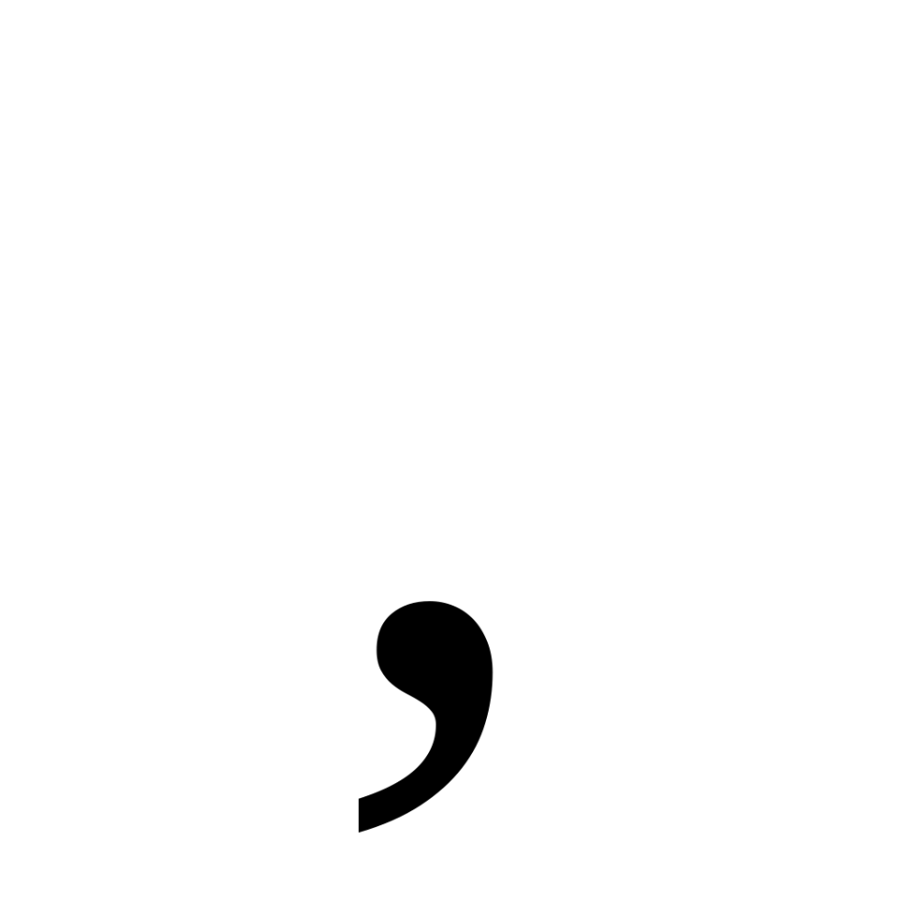
Punctuation pause marks

Slide 9
Some uses of commas
Items in a series
E.g. Here are the carrots, cucumbers, pears and apples.
Nouns of direct address
E.g. Class, take out your books.
Nouns in apposition
E.g. My aunt, an experienced teacher, gives free lessons on Saturdays.

Slide 10
Commas save lives!
Place a comma in the following sentence and save grandpa’s life.
Let’s eat grandpa!
Let’s eat, Grandpa!
Rule: Use commas for nouns of direct address.

Slide 11
Commas save lives!
Place a comma in the following sentence and save the dogs and children.
“I like cooking dogs and children.”
“I like cooking, dogs and children.”
Rule: Use commas to separate items in a series.

Slide 12
Commas save lives!
‘Learn how to cut marinate and cook friends!’
‘Learn how to cut, marinate and cook, friends!’
Rule: Use commas for nouns of direct address.
Rule: Use commas to separate items in a series.

Slide 13
The Colon
Introduces examples, explanations or details after an independent clause.
Remember this structure-
:
Independent clause
example, explanation, detail.

Slide 14
Example 1
Rapid urbanization has led to multiple problems: air pollution, congestion and a shortage of affordable housing for families.
The clause before the colon mentions that there are multiple problems due to urbanization.
The clause after the colon explains what the multiple problems are.

Slide 15
Example 2:
I can promise you one thing: I will be here for you if you need me.
The clause before the colon expresses a promise.
The clause after the colon explains what the promise is.

Slide 16
Some things to remember
Replace the colon with ‘that is’
If the meaning of the sentence is clear, then the use of the colon is correct.
When using the colon in a list
If the phrase ‘the following’ can be used, then the use of the colon is correct.
Remember that the colon comes at the end of an independent clause.

Slide 17
Apostrophes in contractions
Used in contractions to replace a missing letter.
Example:
He does not enjoy eating ripe paw paw.
He doesn’t enjoy eating ripe paw paw.
The verb, “doesn’t” expands to “does not” and the apostrophe replaces the “o” in the word, “not”.

Slide 18
Other punctuation marks
This Photo by Unknown Author is licensed under CC BY-NC-ND
This Photo by Unknown Author is licensed under CC BY-SA

Slide 19
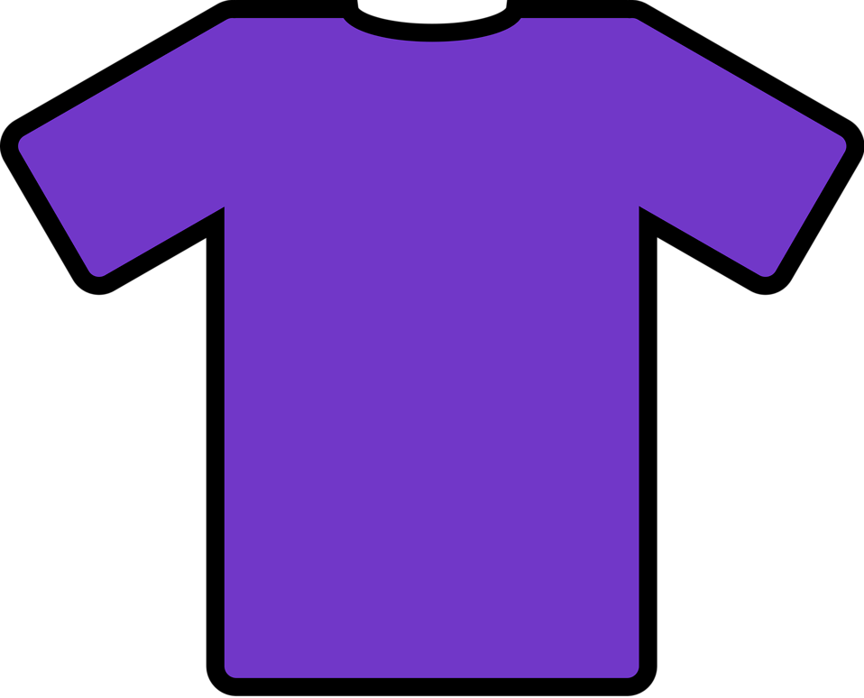
Apostrophes are used to show possession.
Jason’s blue shirt is his favourite item of clothing.
The ’s indicates that the shirt belongs to Jason.

Slide 20
Quotation Marks in direct speech
Quotation marks show the actual words of a speaker.
Did you bring your lunch?
Of course I did!
“Did you bring your lunch?”
“Of course I did!”

Slide 21
Quotation Marks in direct speech
Show the actual words of a speaker.
If the words of the speaker are within the sentence, the open quotation starts after the comma and ends after the final punctuation mark.
Example: Valmiki asked, “Did you go to school today?”
Notice how the direct speech begins with a capital letter.

Slide 22
Quotation Marks in direct speech
If the actual words of the speaker begin the sentence, then the sentence starts with the open quotation marks:
Example: “My teacher has a shiny, new, blue truck!” shouted my friend, Sherry.

Slide 23
Quotation Marks are used in titles of movies and books.
Examples:
‘Avengers: End game’ broke numerous box office records.
The ‘Chronicles of Narnia’ series is popular among young readers.

Slide 24
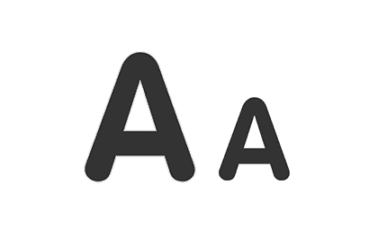
Capitalisation Rules
This Photo by Unknown Author is licensed under CC BY-ND

Slide 25
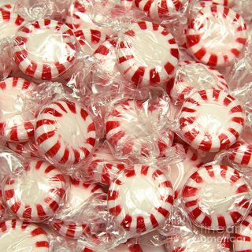
Use MINTS to remember when to capitalise
This Photo by Unknown Author is licensed under CC BY-SA

Slide 26
MINTS Capitalisation
To begin months of the year (days of the week and holidays too!)
Examples:
Rain fell heavily last November.
Republic Day is celebrated on September 24th in Trinidad and Tobago.
Practice will take place this Saturday at 9 a.m.

Slide 27
MINTS Capitalisation
Personal pronoun, “I” (even if it is in the middle of a sentence!)
Example:
I enjoy hiking to Maracas during my vacation.
Everyday Shanti and I sit together in class.

Slide 28
MINTS Capitalisation
Names of specific people and places.
Examples
Harry is currently residing in the United States.
Teddy, our dog, likes to chew on old slippers.
Can you take me to Frederick Street?

Slide 29
MINTS Capitalisation
Titles of books, television shows and movies
Examples:
Chantelle enjoyed reading ‘Matilda’ for the second time.
‘Scooby Doo’ is my son’s favourite cartoon.
‘Black Panther 2’ is scheduled for release in 2022.

Slide 30
MINTS Capitalisation
Start of sentences
My father is an accomplished musician.
Every morning, Randall drinks a cup of coffee and reads the news online.
Tomorrow I plan to go to the gym.

Slide 31
Proper punctuation and capitalisation make your writing easier to read!

