Slide 1
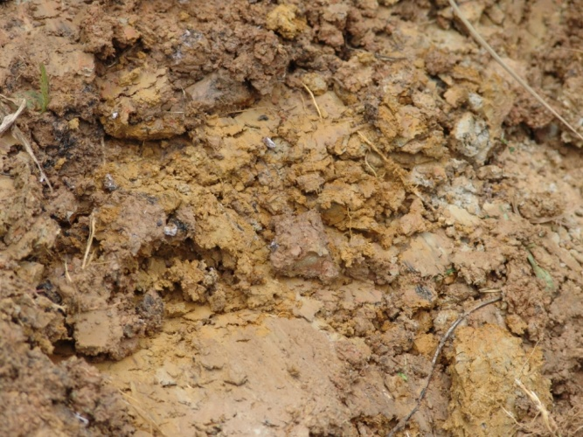
Soil Physical Properties

Slide 2
What are soil properties?
Soil contains components (constituents) which influences the soil to behave in a certain way called:
Soil Property
Soil Properties can be grouped as
Physical Properties
Chemical Properties

Slide 3
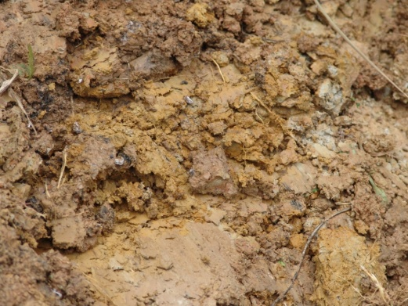
Soil Physical Properties
Size of particles and how they cling together
Important properties are :
Structure & Texture

Slide 4
Soil Physical Properties
Texture
Structure
Colour
Cohesion
Porosity
Permeability and retentively
Swelling and shrinkage
Surface crusting
Puddles

Slide 5
1. Soil Texture
Proportions or amount of different soil particles
Soil particles are:
sand
silt
clay
Particles are used to measure the coarseness or fineness of soil
Soils can be described as sandy, gravelly, clayey
Based on the workability of the soil, it can also be referred to as
Light (sands and sandy loams),
Medium (loams)
Heavy (clay loams and clays)

Slide 6
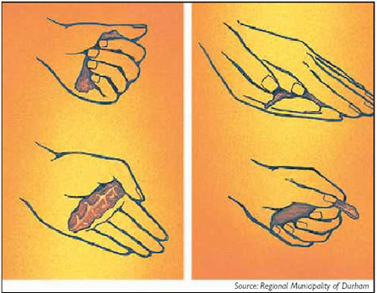
Soil Texture
We determine texture by:
Feel
Moulding
Particle size (sedimentation or sieve method)

Slide 7
SBA Practical

Slide 8
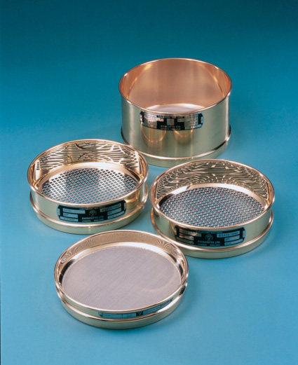
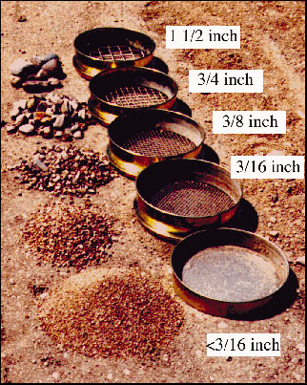
Particles of soil by size
Gravel and Stones
> 2 mm in diameter
Sand
2.0 to 0.02 mm
Silt
0.02 to 0.002 mm
Clay
< 0.002 mm

Slide 9
Importance of Soil Texture
Determines agricultural usage of soil
Many other physical properties based on texture (aeration, water content)
Coarse textured soils unable to retain much water and nutrients
Fine textured soils can retain water and nutrients

Slide 10
2. Soil Structure
Depends on how the individual soil particles are packed (arranged)
Arrangement usually consists of five shapes
Forms into shapes by cementing agents
Creates voids or gaps which allow
(i) roots to penetrate and
(ii) circulation of air & water

Slide 11
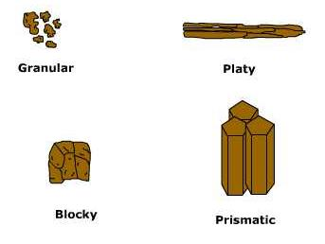
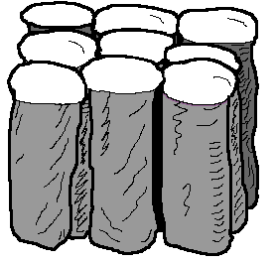
Soil Structure - Shapes
Columnar

Slide 12
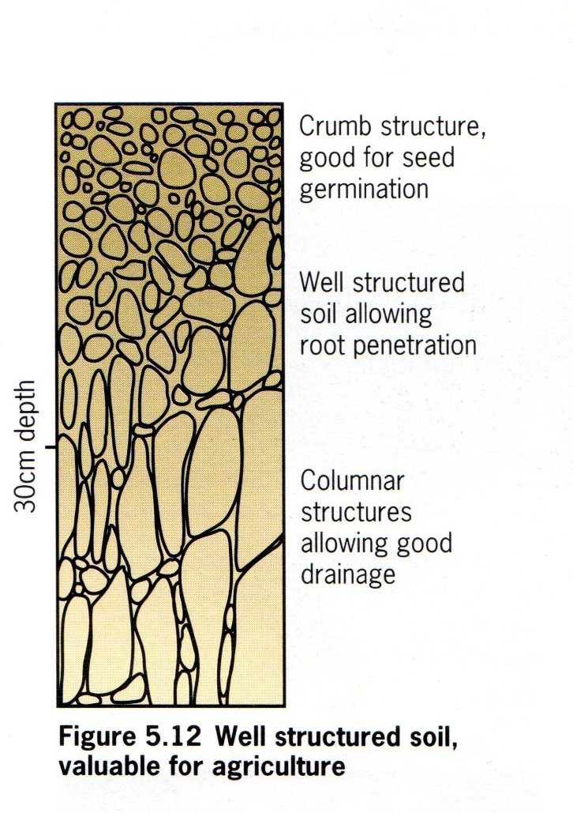
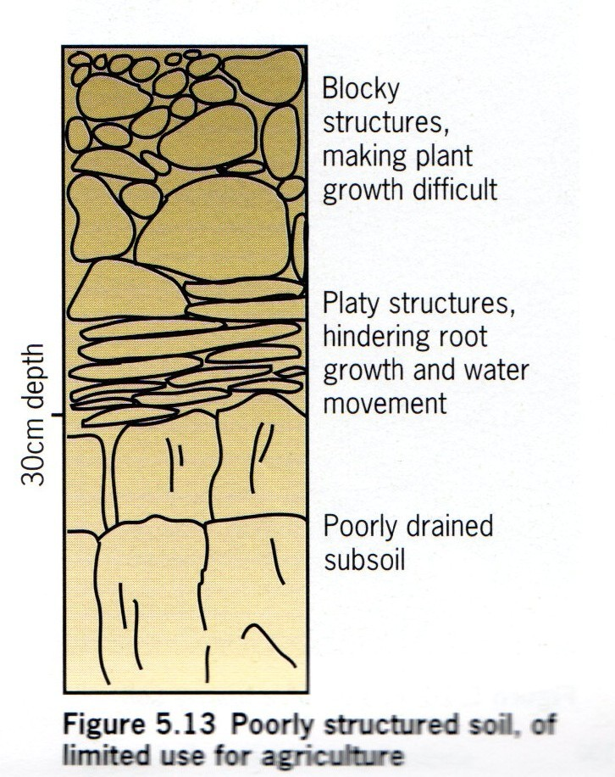
Soil Structure - Examples

Slide 13
Importance of Soil Structure
Helps in suitable bed preparation
Helps in soil erosion control
Helps in emergence of plants since land preparation improves soil structure
Allows maximum aeration and water holding for plant growth

Slide 14
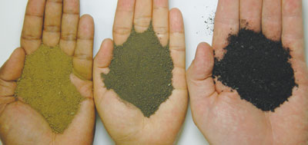
3. Colour
indicates physical and chemical properties
is due to humus content and chemical nature
grey suggest swampy soils
dark brown/ black means soil high in humus
yellow, brown/ red means iron oxides present
red means good aeration, less water

Slide 15
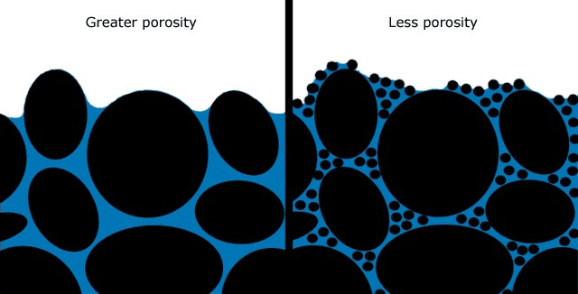
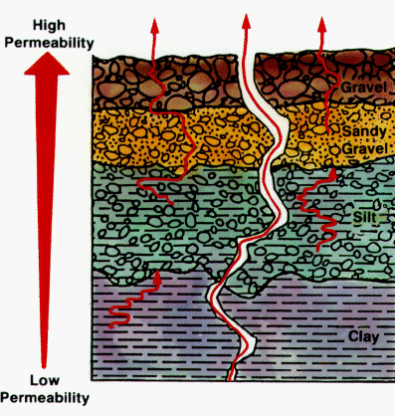
Soil Physical Properties (cont’d)
4. Cohesion
is the ability of soil to stick together
5. Porosity
is allowing air and water to pass through soil
6. Permeability and retention
is soil allowing water to pass through
capacity of soil to hold water called
Water-holding capacity

Slide 17
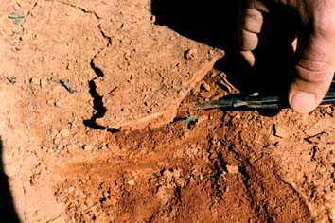
Soil Physical Properties (cont’d)
7. Swelling and shrinkage
deals with soil moisture level and occurs mainly in clay soils
8. Surface crusting
is when a crust appears on soil surface after a heavy shower or rain
9. Puddles
formed during land preparation in wet soil conditions due to breaking soil structure
Surface crusting

Slide 18
Physical Properties of Soil - Summary
Deals with size of soil particles and how they cling together
Soil Structure and Texture and most important properties
Other properties include colour, porosity, permeability, swelling and shrinkage

