Slide 1
Slaughtering Procedures
In Farm Animals
Notes:
NOTE: To replace a picture, just select and delete it. Then use the Insert Picture icon to replace it with one of your own!

Slide 2
Preparing for Slaughter
When slaughtering animals the following should be considered
Preparing the animals for slaughter
Restraint devices
Religious or ritual slaughter (Halal/ Kosher)
Bleeding
At slaughter time animals should be healthy and physiologically healthy
The animals should be adequately rested especially if they have travelled long distances
Animals should be allowed water during holding
Sick or injured animals are identified and quarantined
Animals should never be beaten or mistreated
Animals should be properly restrained before slaughter

Slide 3
Slaughtering Broilers
Observe the following

Slide 4
Broilers are slaughtered around 8 weeks of age
They should weigh between 1.8 – 2 kg
Birds are fasted 6 to 8 hours prior to slaughter but allowed free access to water
The jugular vein of the bird is cut with a sharp knife and allowed to bleed out
The bird is scalded and plucked to remove the feathers. A plucking machine is used for large numbers of birds
On large farms/ processing plants the birds are shackled to a moving assembly line where they are stunned then bled using an electric knife
The carcass is dressed by removing all internal organs, the head, neck and feet
A cut is made all around the vent to remove the intestines and organs
A hand is inserted into the cavity to loosen the organs and then pulled out through the opening
The heart is removed and washed along with the gizzard and liver
The gall bladder is removed from the liver and the gizzard is opened and its lining removed
The heart, liver. Gizzard and neck are referred to as ‘giblets’ and are sold with the bird
The birds are packed into polythene bags and sold fresh or frozen
The offal is collected and discarded

Slide 5
Slaughtering chicken
Killing, scalding, plucking

Slide 6
Slaughtering chicken
Gutting, Bagging

Slide 7
Slaughtering Cattle

Slide 8
Cattle Slaughter
Holding, Stunning, Shackling

Slide 9
Cattle Slaughter
Bleeding, Skinning, Gutting

Slide 10
Slaughtering Cattle
Inspection of Offal, Sawing carcass in half, Washing carcass

Slide 11
Slaughtering of Cattle
Trimming and stamping by Health Inspector, Chilling, Meat cuts

Slide 12
Slaughtering of Rabbits
Stunning and bleeding, Skinning, Gutting

Slide 13
Slaughtering of Rabbits
Getting Live weight, dressed carcass weight and weight of offal

Slide 14
Slaughtering of Rabbits
Dressed carcasses, Cuts of Rabbit

Slide 15
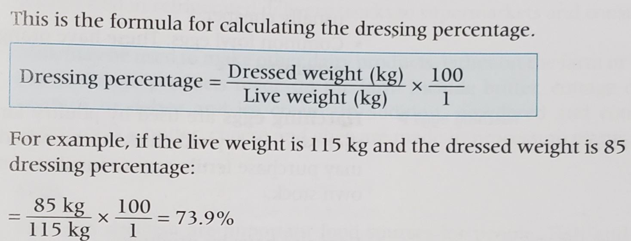
Dressing Percentage
Dressing percentage refers to the percentage of the live weight that is obtained as edible meat after slaughter.
The dressing percentage varies depending on the class of farm animal
LIVE WEIGHT is the weight of an animal before slaughter
DRESSED WEIGHT is the weight of the animal after slaughter and the offal (non edible parts) is removed

Slide 16
Dressing percentage of major farm animals

Slide 17
Animal products and By-products
ANIMAL PRODUCT | TYPES | BY-PRODUCT
EGGS | Farm or Table eggs Common fowl eggs Hatching eggs | Dried eggs (whole, yolk, white) Eggshell
MILK | Pasteurised whole milk Powdered milk Condensed Milk Evaporated milk | Butter, cheese, ghee, yoghurt, cottage cheese
FISH | Raw (sushi), baked, curried, stew, fried, grilled, steamed, salted, smoked | Fishmeal Bonemeal Ground oyster shells
OFFAL | Tripe Black pudding Tongue Trotters Kidneys Liver | Leather from skins Bonemeal Fertiliser Lard and soap from animal fat

Slide 18
Animal products and By-products
ANIMAL PRODUCT | TYPES | BY-PRODUCT
MEAT | Poultry Goat (chevon) Sheep (mutton, lamb) Pig (pork, bacon) Cattle (beef) Rabbit | Sausage Ham Bacon Salami Steak Minced meat

