Slide 1
FARM MECHANISATION
Subtitle

Slide 2
What is a machine?
A machine may be defined as any equipment or apparatus specially designed for a particular purpose and used for the transmission of force, power or motion to produce a desirable effect.
It is a device that gives a mechanical advantage to facilitate the doing of work.
There are six simple machines – the lever, the pulley, the screw, the wedge, the wheel and axle and the inclined plane

Slide 3
WHAT IS A FORCE?
1) Force is a push or pull
2) Force is the capacity to do work or cause physical change
3 ) A force is that which changes or tends to change the state of rest or motion of a body.
Forced is measured in Newtons

Slide 4
WHAT IS WORK?
Work can be defined as transfer of energy.
Work is done on an object when you transfer energy to that object. If one object transfers (gives) energy to a second object, then the first object does work on the second object.

Slide 5
ENERGY & POWER
WHAT IS ENERGY?
WHAT IS POWER?
Energy can be defined as the capacity for doing work
Energy is measured in Joules
Two types of energy are:
Potential energy – stored energy
Kinetic energy – energy in movement
Power is the rate of doing work. It is the amount of energy consumed per unit time
It is measured in WATTS

Slide 7
SOME COMON FARM MACHINES
The combine harvester
The milking machine
The knapsack sprayer
Planting machinery such as:
The broadcaster
The seed drill
The seed planter

Slide 8
THE COMBINE HARVESTER
SUGAR CANE HARVESTER
RICE HARVESTER

Slide 9
THE MILKING MACHINE
THE BUCKET MILKER
THE MIKING PARLOUR

Slide 10
CARE of THE MILKING MACHINE
Observe strict sanitation before and after milking
Check teat cups and pulsator regularly
Check for leaks and cracks in hoses
Do not operate the pulsator too fast or too slow
Clean vacuum line 2 or 3 times a year
Do not machine milk animals that are suffering from udder diseases

Slide 11
THE KNAPSACK SPRAYER
KNAPSACK SPRAYER
PNEUMATIC KNAPSACK SPRAYER

Slide 12
CARE & MAINTENANCE of THE SPRAYER
Release residual air pressure after spraying
Rinse sprayer after use and wash with detergent
Lubricate moving parts with oil or grease
Remove and clean strainers
Change worn packing
Rinse the nozzle with water to clear it.

Slide 13
PLANTERS
BROADCASTER
SEED DRILL

Slide 14
PLANTERS
SEED PLANTER
RICE TRANSPLANTER

Slide 15
THE TRACTOR
The most versatile source of power on the farm

Slide 16
TYPES of TRACTORS
THE WHEEL TRACTOR
THE CRAWLER OR TRACK TRACTOR

Slide 17
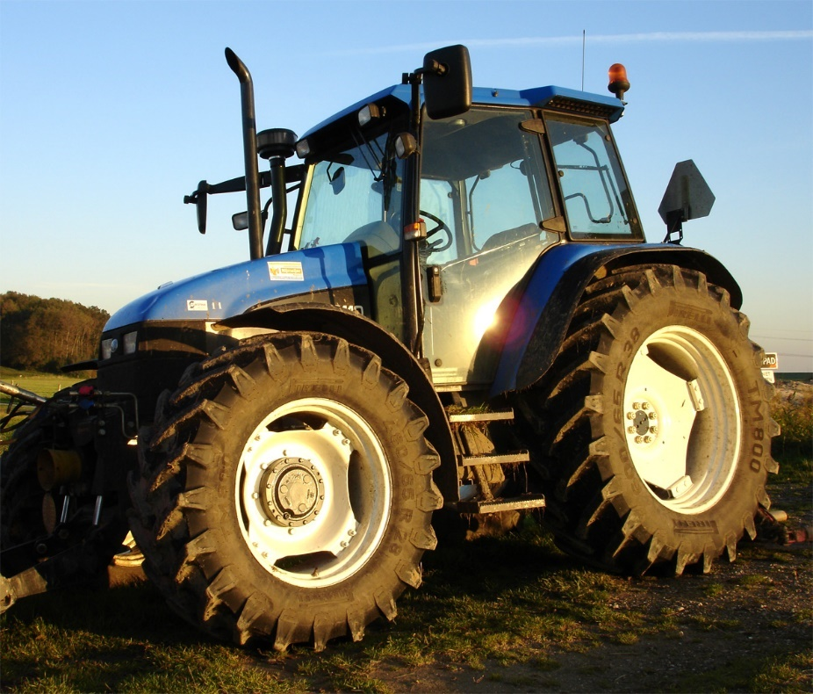
TYPES OF WHEEL TRACTORS
There are three types:
Hand guided, two wheeled tractor
Four wheel , two wheel driven
Four wheel, four wheel driven

Slide 18
TRACTOR ATTACHMENTS
Mouldboard plough
Disc plough
Chisel plough
Rotovator
Harrow
Brushcutter
Trailer
Fertiliser spreader
Manure spreader
Crop sprayer
Subsoiler

Slide 19
MOULDBOARD PLOUGH
DISC PLOUGH

Slide 20
CHISEL PLOUGH
ROTOVATOR

Slide 21
HARROW
BRUSH CUTTER

Slide 22
TRAILER
FERTILISER SPREADER

Slide 23
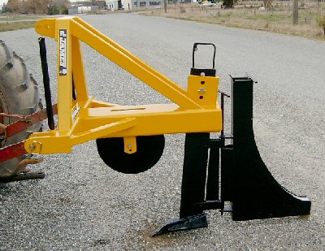
MANURE SPREADER
CROP SPRAYER
SUBSOILER

Slide 24
Let’s look at some Modern Agricultural Equipment

Slide 26
ADVANTAGES AND DISADVANTAGES OF MECHANIZATION
ADVANTAGE
DISADVANTAGE
Difficult jobs are done with ease
Makes some jobs possible that are otherwise difficult to undertake
Reduces economic pressure to resort to bad agricultural practices
Makes cultivation of large areas possible
It is cost effective
Uneconomical for peasant farmers who own small parcels of land
Little advantage to subsistence farmers
Most small farmers cannot afford to purchase machinery
May lead to unemployment

Slide 27
CARE & MAINTENANCE of FARM TOOLS
Wash tools after use e.g. fork, hoe, rake, cutlass. Other tools may be wiped clean
Dry tools after washing
Sharp blades need to be sharpened and kept sharp using a file or grindstone
Repair any broken handles or parts
Paint handles of tools to prolong their life
Oil or g rease metal blades or prongs of forks to prevent rusting. Lubricate moving parts
Store tools neatly in a special area using a tool rack or cupboards.

Slide 28
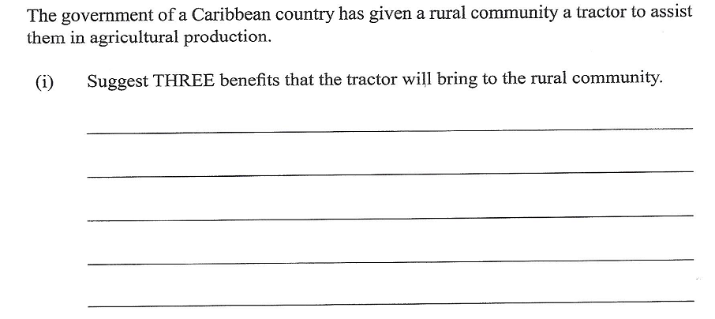
PAST PAPER QUESTIONS

Slide 29
