Slide 2
3D DRAWING: Lesson 2 -ISOMETRIC
CPDD, MoE
CPDD, MoE

Slide 3
OBJECTIVES
At the end of this lesson, you should be able to:
State the characteristics of an isometric drawing
Explain the process of sketching in Isometric
Sketch simple components in Isometric

Slide 4
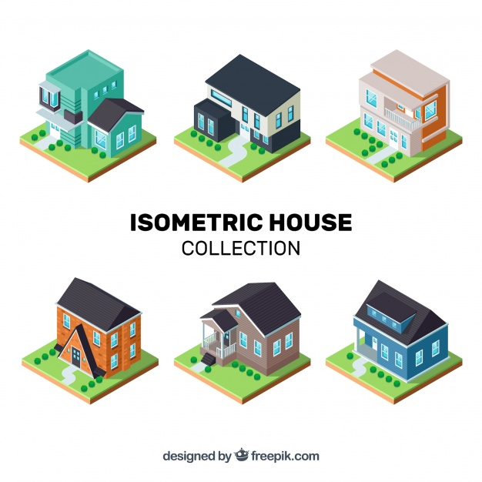

Slide 5
You should take this time to review the lesson on 3D drawing.

Slide 6
ISOMETRIC DRAWING
Isometric drawing is a method of presenting designs/ideas in 3 dimensions
It is otherwise referred to as a type of pictorial drawing

Slide 7
ISOMETRIC DRAWING
Isometric drawing represents products in a format that allows the non-technical person/client to better see the features of the object in a realistic manner.
It shows how the object can be constructed.
It also allows for flaws to be easily identified.

Slide 8
ISOMETRIC DRAWING
Isometric:
Iso = same
Metric = measure
This refers to the:
All angles are the same
Angles of the receding axes = 30°
Measurements on ALL axes are the given measurements of the component.

Slide 9
ISOMETRIC DRAWING
Note that:
All the receding lines are 30° to the horizontal.
The vertical lines are true 90° lines to the horizontal
Measurements are true measurements of the component unless a scaled view is requested.
Lines drawn parallel to the isometric axis are called isometric lines

Slide 10
ISOMETRIC DRAWING
Lines not parallel to the isometric axis are called non-isometric lines

Slide 11
REPRODUCING ISOMETRIC DRAWING: Isometric lines
Isometric drawing can be done using freehand sketching or fully constructed.
We will start with freehand sketching
Click on the link below
https://youtu.be/uWYl51QJ0Zw
Stop when you do not follow the process and go over the material a second time

Slide 12
PRACTICE ACTIVITY
Stop looking at the presentation
Take 60 minutes (15 minutes per block)
Using the method shown in the video, practice sketching in isometric, the given blocks in the slide below.

Slide 13
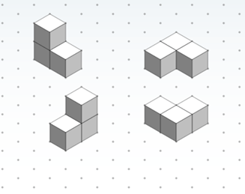
PRACTICE ACTIVITY: 60 Minutes

